Slide 1
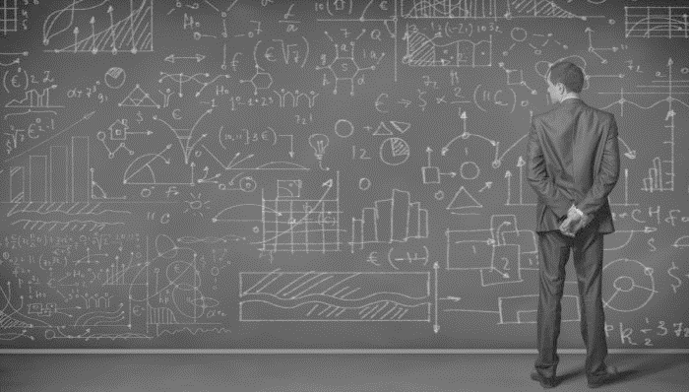
DATA SCIENCE
Clustering

Slide 2
Unsupervised Learning
Clustering – K-Means/Hierarchical
Association Rules

Slide 3
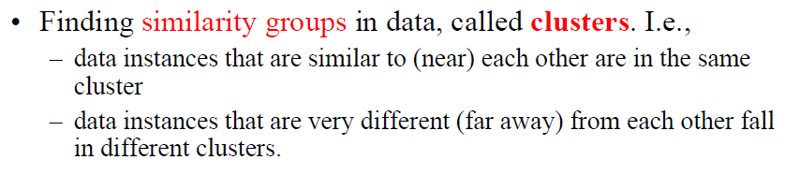
Clustering

Slide 4
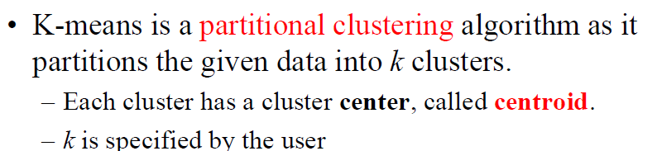
K-Means Clustering

Slide 5
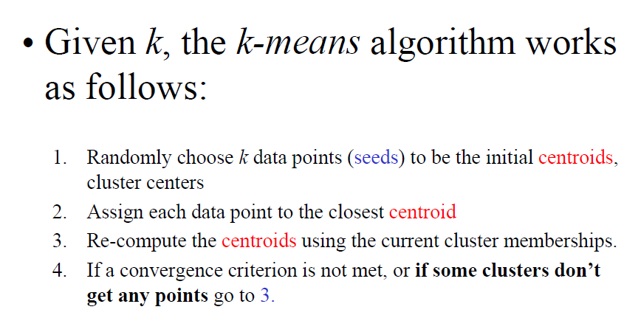
K-Means Clustering

Slide 6
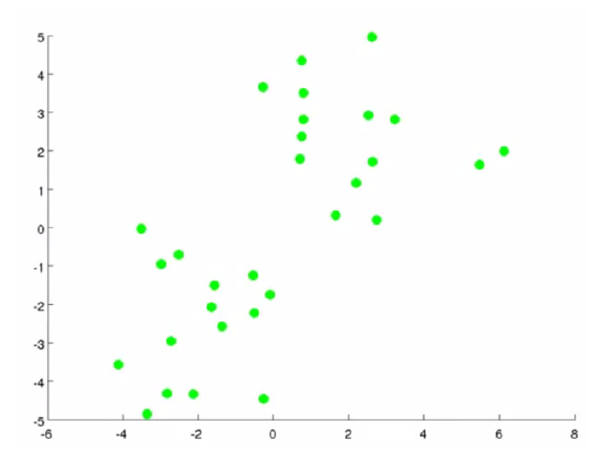

Slide 7
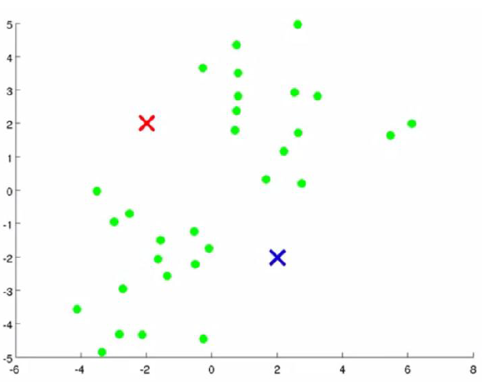

Slide 8
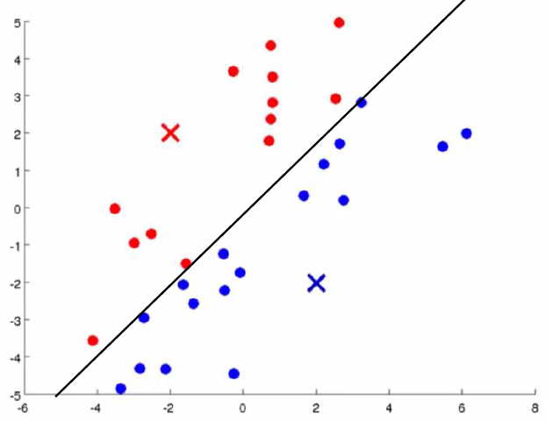

Slide 9
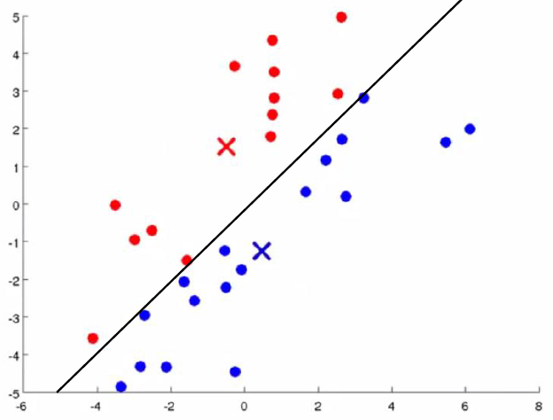

Slide 10
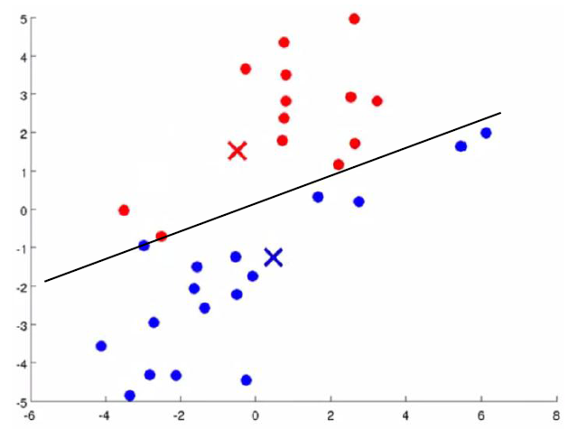

Slide 11
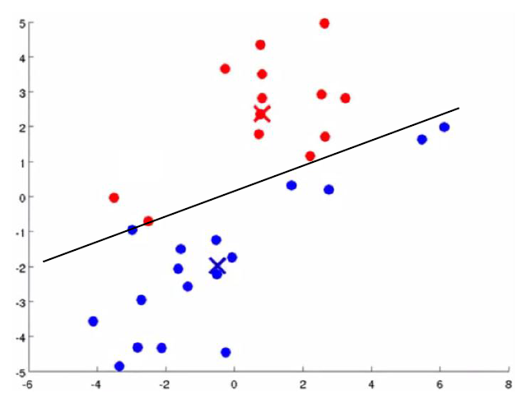

Slide 12
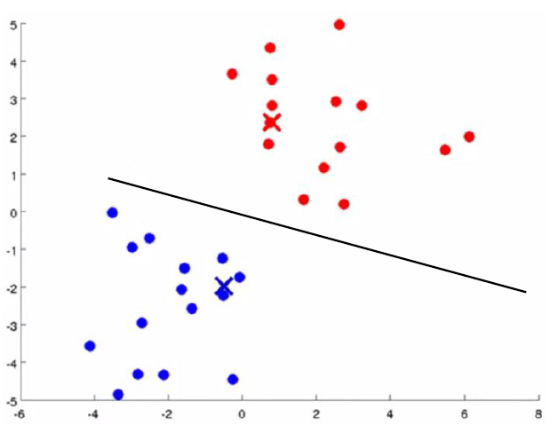

Slide 13
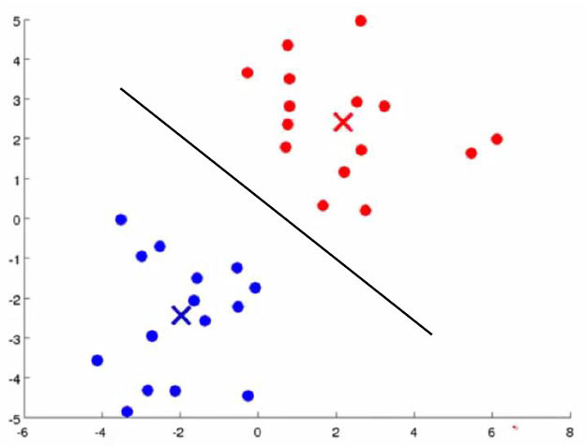

Slide 14
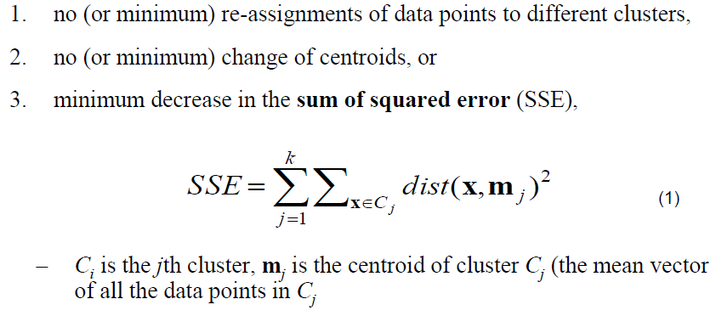
Stopping Criterion

Slide 15
K-Means Clustering
Maximise Inter-Cluster Distance
Minimise Intra-Cluster Distance

Slide 16
Hierarchical(Agglomerative) Clustering

Slide 17
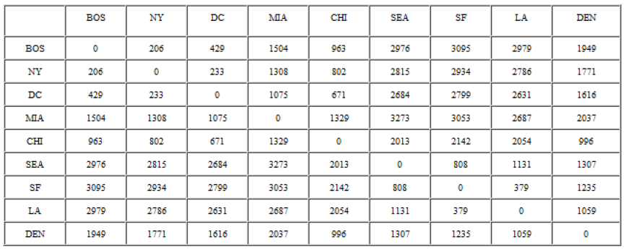
Hierarchical Clustering

Slide 18
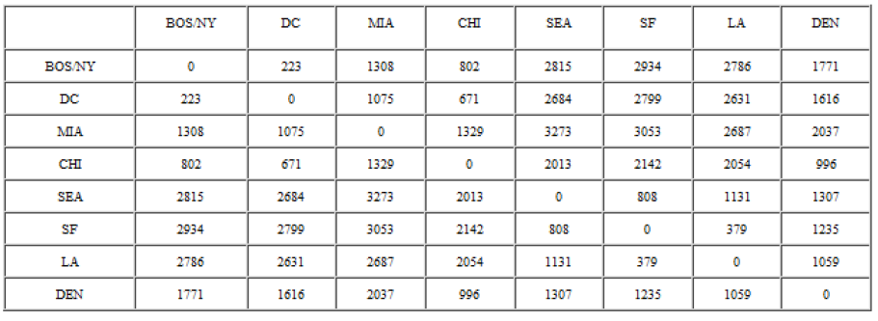
Hierarchical Clustering

Slide 19
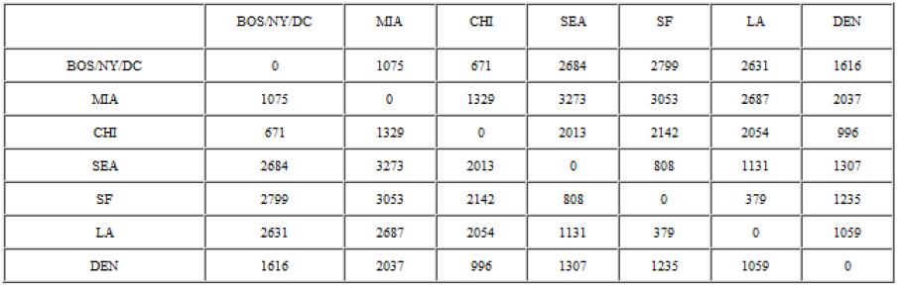
Hierarchical Clustering

Slide 20
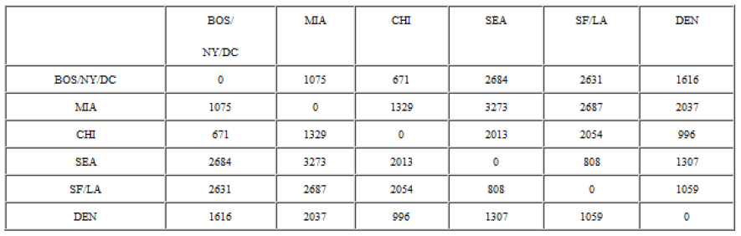
Hierarchical Clustering

Slide 21
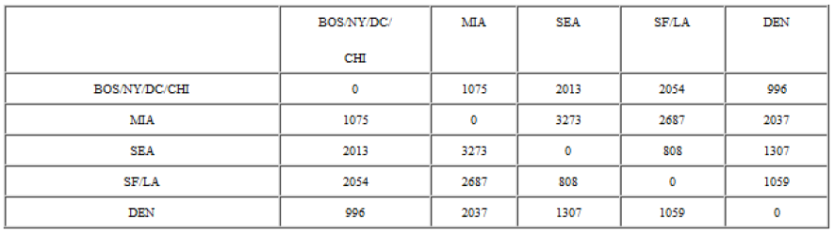
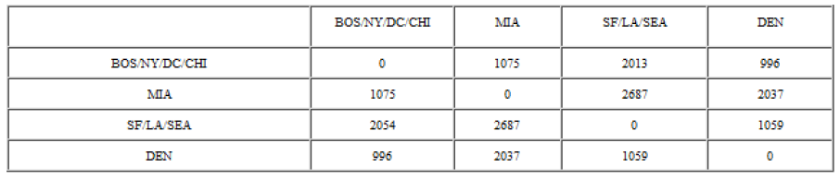

Slide 22
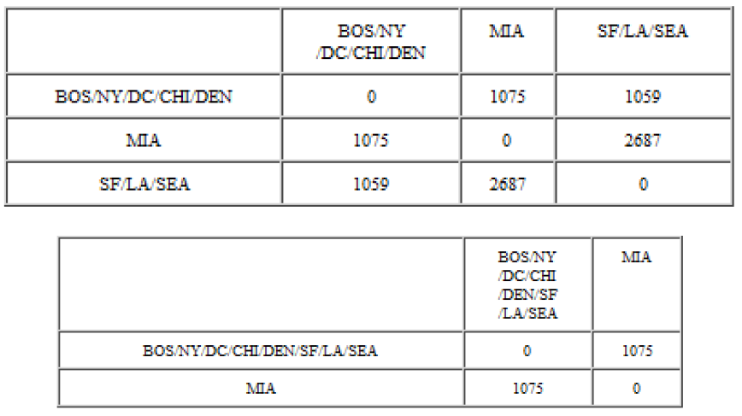

Slide 23
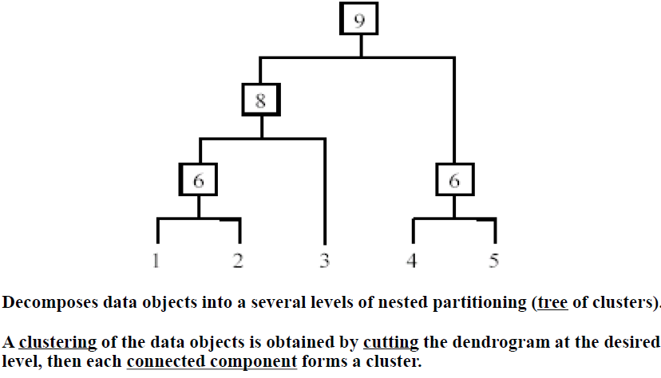
Hierarchical Clustering

Slide 24
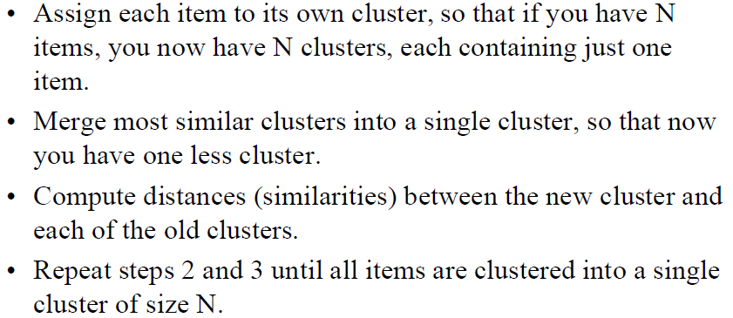
Hierarchical Clustering

Slide 25


Slide 26

Let’s

