Slide 1
Human Computer Interaction
UE17CS424
NEEDFINDING
Team:DHEERAJ REDDY PES1201700830
DR SAI PRANEETH PES1201701094
NAVEEN G PES1201701439
SYED ALI HUSSAIN PES1201802391

Slide 2





DESIGN PROCESS
Discover
Define
Thinking
Design
Develope

Slide 3
WORK FLOW
Fitness Club
Home
About Us
Classes
Schedules
Contact
Timetable
Address
Send Message
Get Started
Learn More
Trainer’s
Yoga
Email
Become a member
Working Hours
Trainer’s Profile
Aerobic
Trainer’s Details
Phone no
Cross Fit

Slide 4
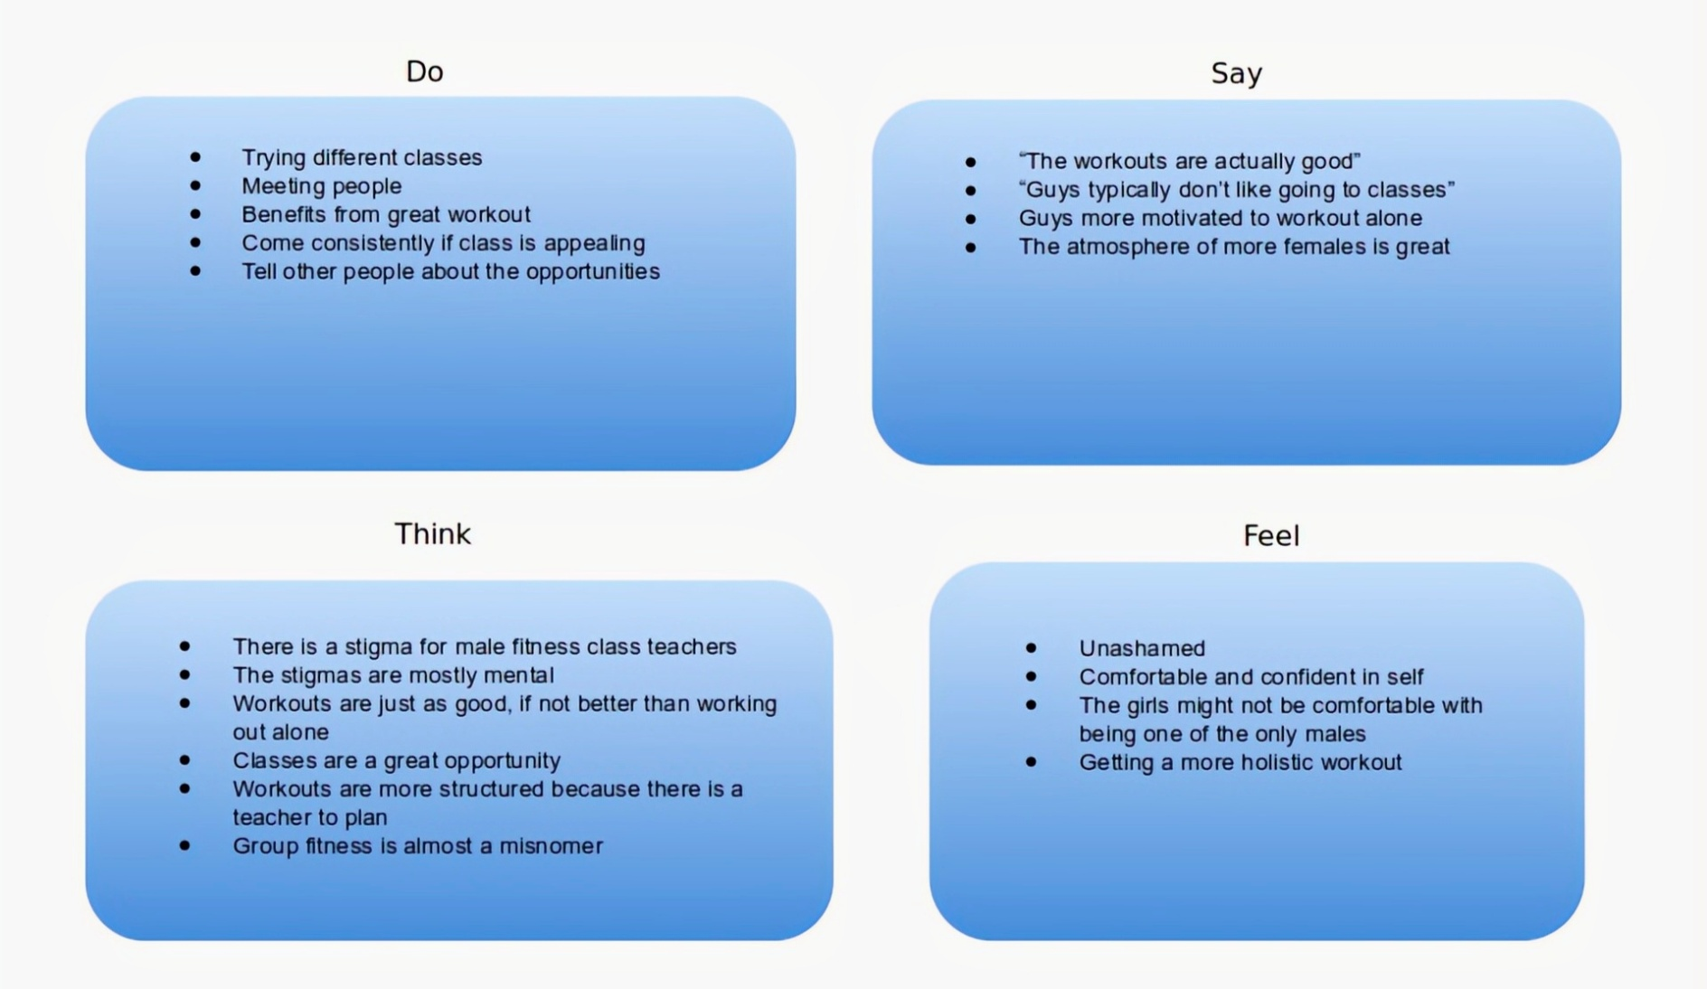
EMPATHY MAP

