Slide 1
Caviar
Discover the world of luxury
Naveen
Chand
Khaja
Taheer
John
Subhranil

Slide 2
Introduction
Caviar is an international brand of luxurious smartphones and accessories, handcrafted by high quality materials.
Caviar was and remains the first among equals, creating actual meanings, piercing novelties and non-standard technical solutions in strictly limited editions.

Slide 3
Abstract
The project is based on the luxurious e-commerce website inspired from caviar.global. Our website is offered with seamless web interaction experience like navigate to various menus, reCaptcha, payment gateway API from razorpay and provision of login through OTP and these are the unique features that has been integrated in our website. Our website is offered with secured login and registration along with validation, So that duplicate accounts are not allowed and to make security of the customers our top priority.

Slide 4
Technologies and languages
Front End
HTML
CSS
Typescript
Angular
Bootstrap
Javascript
Back End
Java
Springboot
Typescript
Angular
Bootstrap
MySQL

Slide 5
Tools
Visual Studio Code
Eclipse IDE
MySQL CLI
Google firebase console

Slide 6
Challenges
First, We faced challenges with proper interaction of springboot and angular. We overcome this by putting cross origin annotation before every function in springboot controller.
Second, we faced one bug which is letting us to perform login and registration even without verifying captcha. We overcome this but making the captcha a part of the form group and inputed some validation condition in html.
At last, for the OTP, the operation is working good. But we decided to make it even more secure by letting the users provide mobile number in registration and by the time the user tries to login with OTP, unless the number is registered in database, the user cannot use this feature.

Slide 7
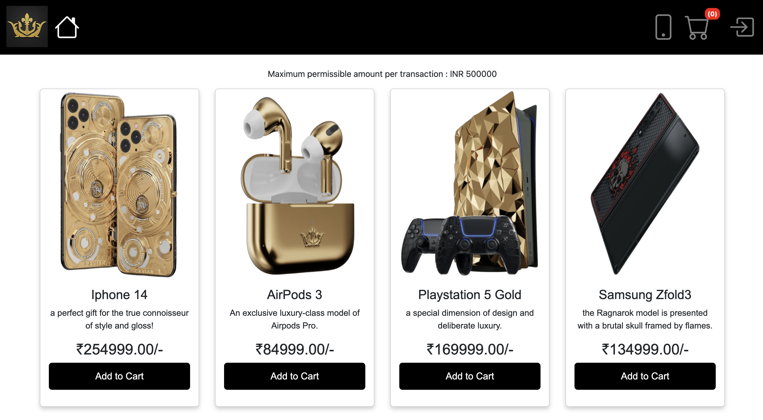
Screenshots

Slide 8
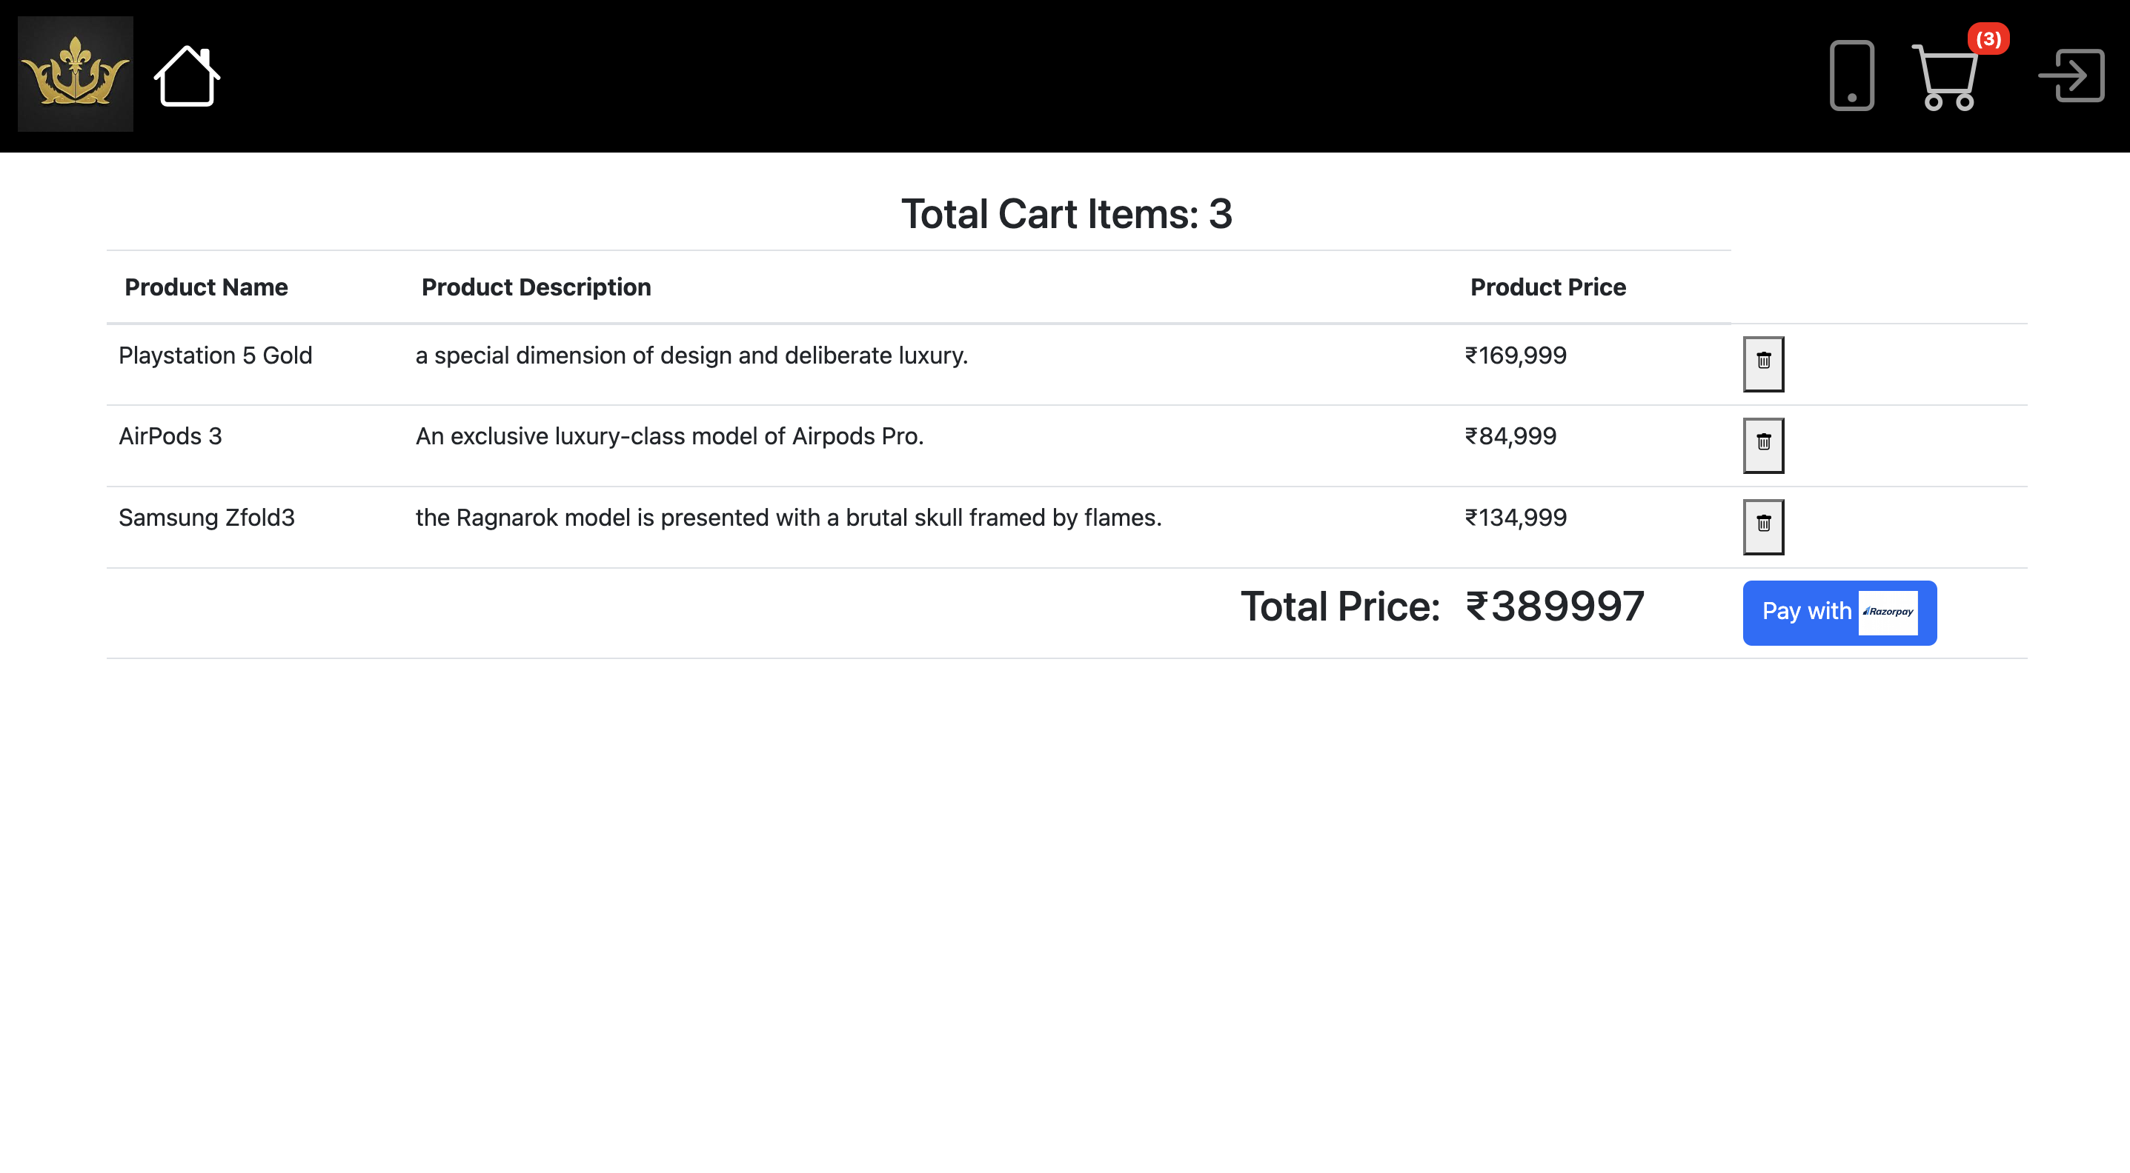
Screenshots

Slide 9
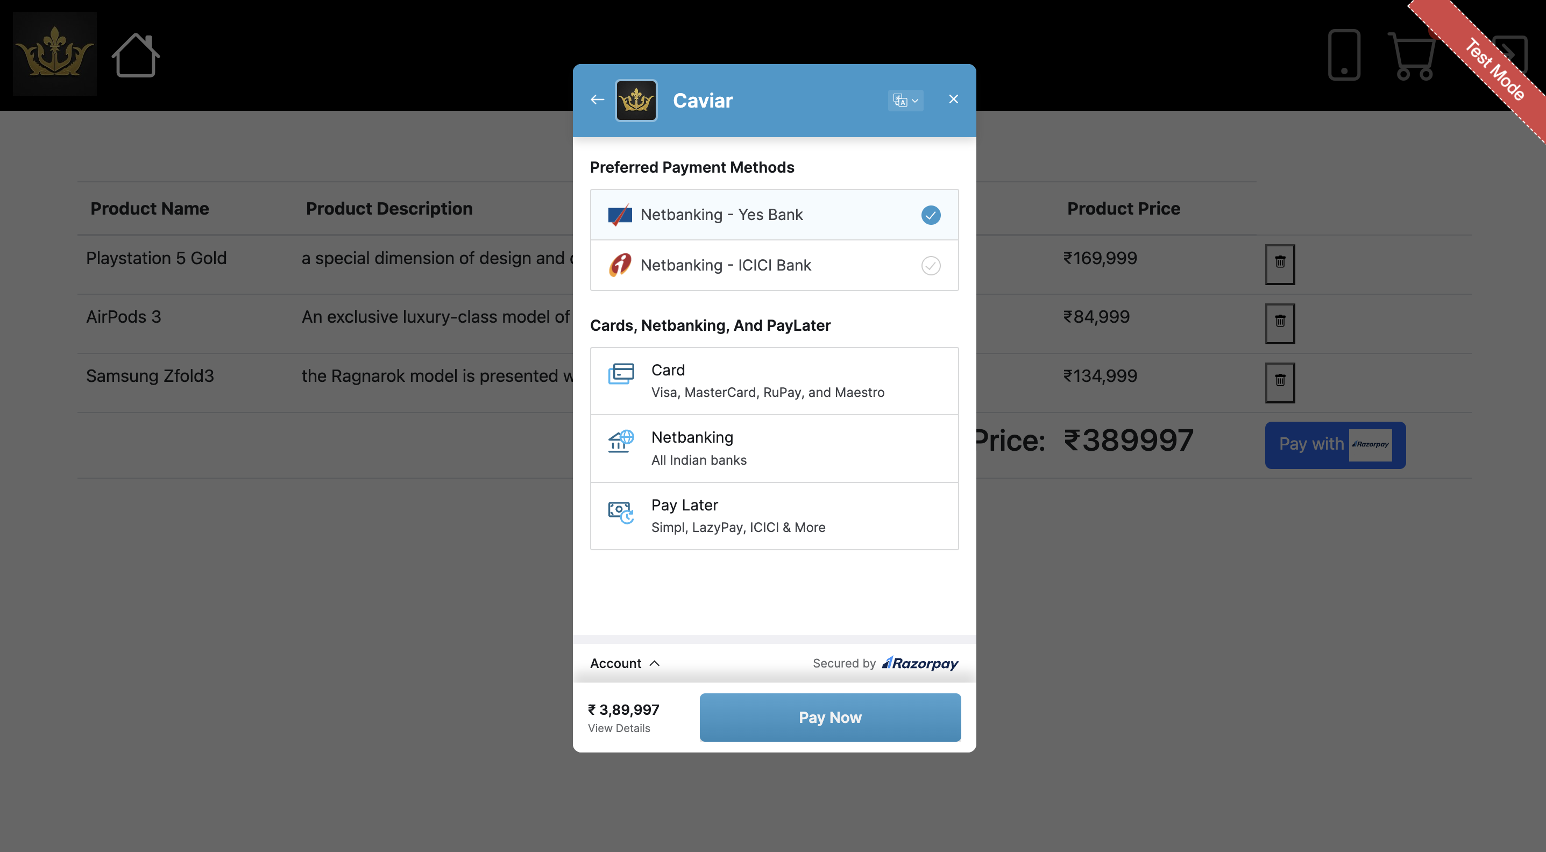
Screenshots

Slide 10
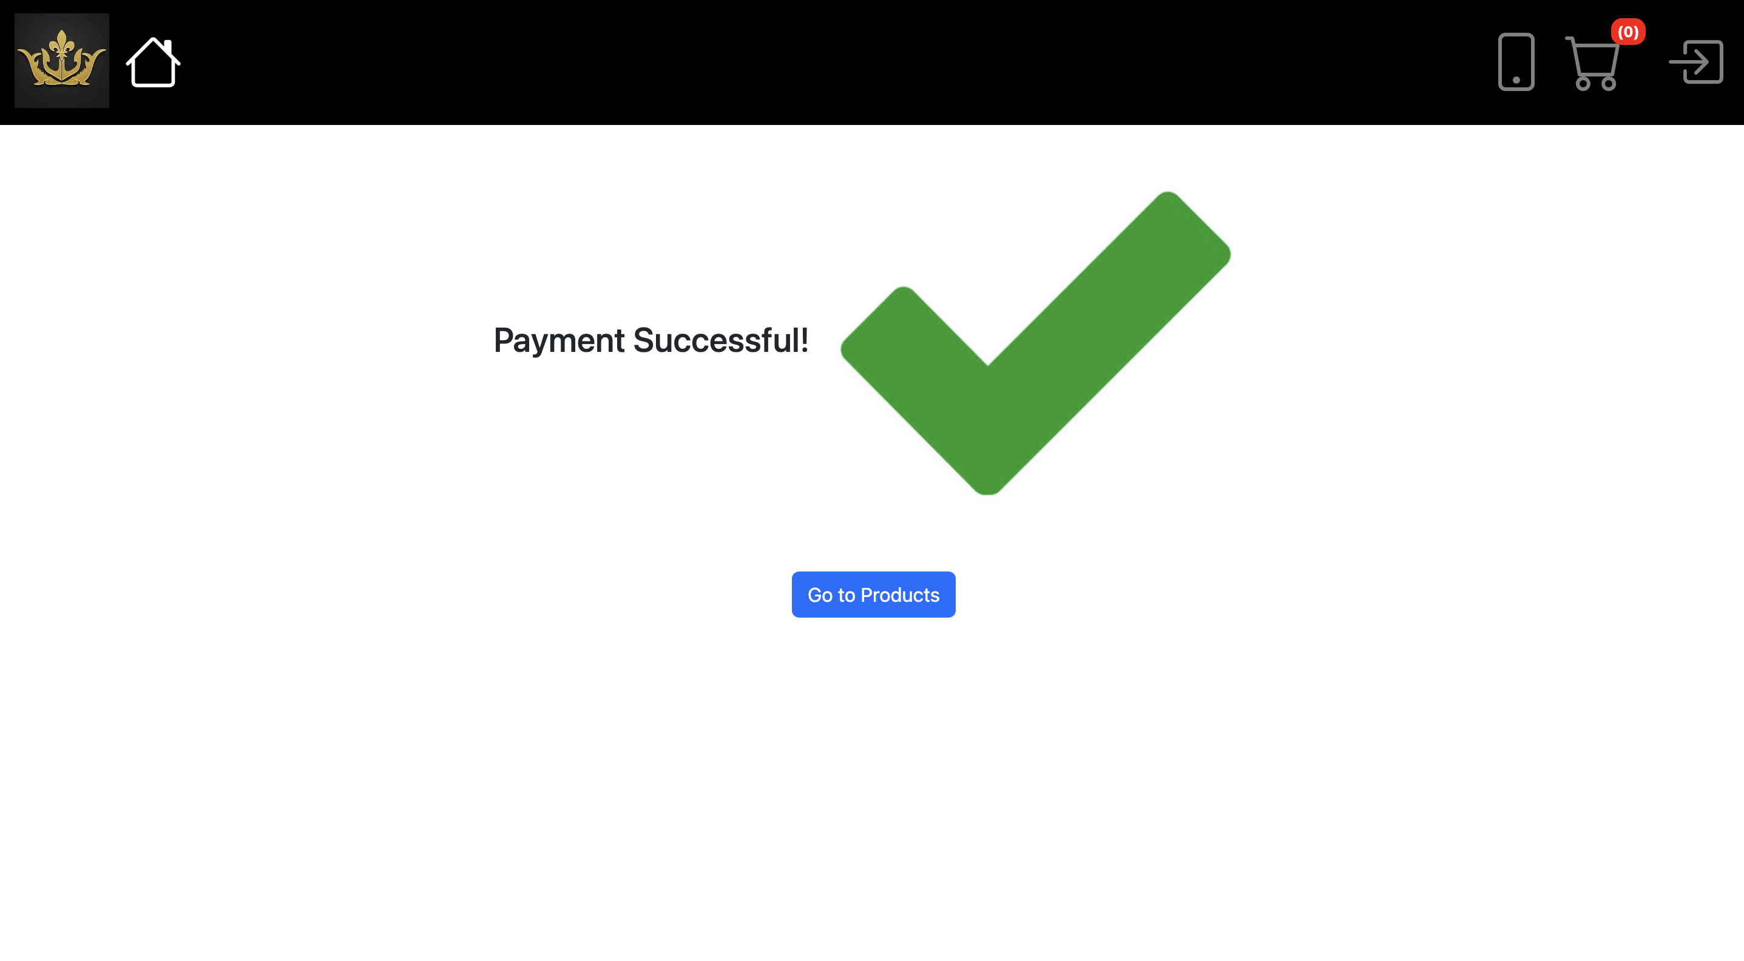
Screenshots

Slide 11
Github link
https://github.com/naveen777744/caviar.git

Slide 12
Project Demo

Slide 13
Questions?

Slide 14
Thank You

