Slide 1
DIABETES PREDICTION USING ML
TEAM :
O.NAVEEN ( R170467 )
M.NAGA VENKATA BHAVYA VANI ( R170081)

Slide 2
TABLE OF CONTENTS
Abstract
Problem Statement
Introduction
Data Sources
Literature Survey
Proposed Model
Implementation
Technologies
Result
Conclusion
Future Scope
References

Slide 3
ABSTRACT
Diabetes mellitus is the most common disease worldwide and keeps increasing everyday due to changing lifestyles, unhealthy food habits and over weight problems.There were studies handled in predicting diabetes mellitus through physical and chemical tests, are available for diagnosing diabetes. In the proposed system, an efficient way of detecting diabetes is proposed through machine learning. Under machine learning, we used the classification algorithm Support Vector machine (SVM) algorithm.The experiment results shows that the prediction of diabetes done at high accuracy.

Slide 4
Problem Statement
Diabetes is a most common disease caused by a group of metabolic disorders. It is also known as Diabetic mellitus. It affects the
organs of the human body. It can be controlled by predicting this disease earlier. If diabetics patient is untreated for a long time, it
may lead to increase blood sugar. Now a days, Healthcare industries generating large volume of data. Machine Learning algorithms
and statistics are used to predict the disease with the help of current and past data. Machine learning techniques helps the doctors
to predict early stage for diabetics. Diabetics patient medical record and different types of algorithms are added in dataset for
experimental analysis. we use logistic regression, random forest, decision tree classifier and gradient boosting to predict whether a
patient has diabetes based on diagnostic measurements. Performance and accuracy of the applied algorithms is discussed and
compared.

Slide 5
INTRODUCTION
Population of India isnow more than 100 million so the actual number of diabet-ics in India is 40 million. Diabetes is major cause of death in the world. Early prediction of disease like diabetes can be controlled and save the human life.To accomplish this, this work explores prediction of diabetes by taking various attributes related to diabetes disease. For this purpose we use the Pima Indian Diabetes Dataset, we apply various Machine Learning classification and ensemble Techniques to predict diabetes. Machine Learning Is a method that is used to train computers or machines explicitly. Various Machine Learning Techniques provide efficient result to collect Knowledge by building various classification and ensemble models from collected dataset. Such collected data can be useful to predict diabetes. Various techniques of Machine Learning can capable to do prediction, however it’s tough to choose best technique. Thus for this purpose we apply popular classification andensemble methods ondataset for prediction.

Slide 6
Data Sources
The data sources that were collected and used for the purpose of Diabetes Prediction Usind ML are:
1. Diabetes Prediction diabetes.csv : This dataset is the Diagonistic Parameters of of various aspects like No.of Preganancies,Glucose, Blood Pressure, Skin Thickness,Insulin etc.

Slide 7
Literature Survey
SUPPORT VECTOR MACHINE
Support Vector Machine or SVM is one of the most popular Supervised Learning algorithms,
which is used for Classification as well as Regression problems. However, primarily, it is used
for Classification problems in Machine Learning.The goal of the SVM algorithm is to create the best line or decision boundary that can segregate n-dimensional space into classes so that we can easily put the new data point in the correct category in the future. This best decision boundary is called a hyperplane. SVM chooses the extreme points/vectors that help in creating the hyperplane. These extreme cases are called as support vectors, and hence algorithm is termed as Support Vector Machine.

Slide 8
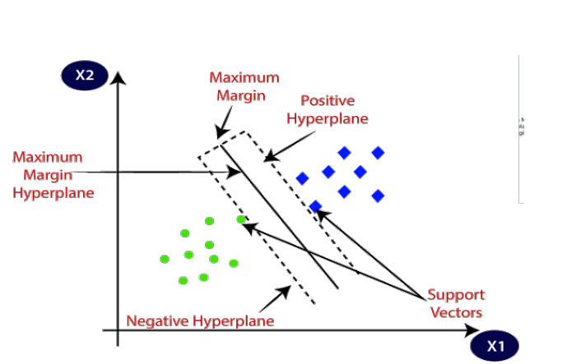
Consider the below diagram in which there are two different categories that are classified using a
decision boundary or hyperplane:

Slide 9
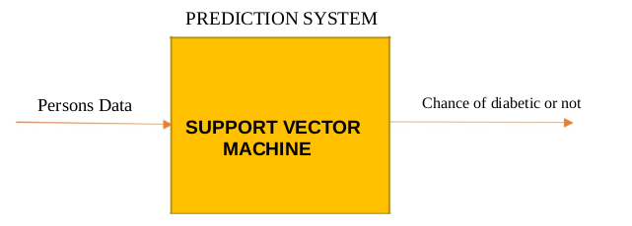
IMPLEMENTATION
PROPOSED SYSTEM :
→ So in this model we have proposed daibetes predection using ml which predicts the percentage of chance of getting a person is diabetic or not.
Working Model:

Slide 10
This proposed system is built in following systems:
1.Data Collection
2.Date Preprocessing
3.Model Building
4.Saving the Model using Pickle
5.Creating a webapp using Streamlit.

Slide 11
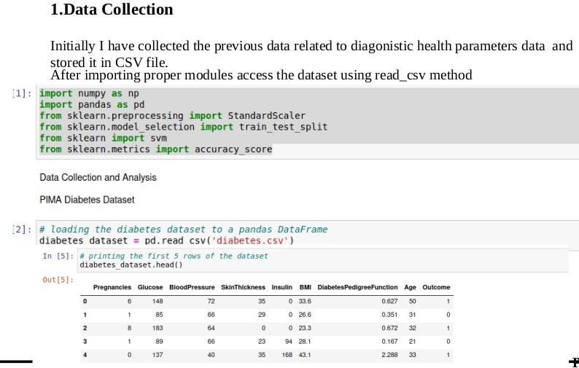
IMPLEMENTATION

Slide 12
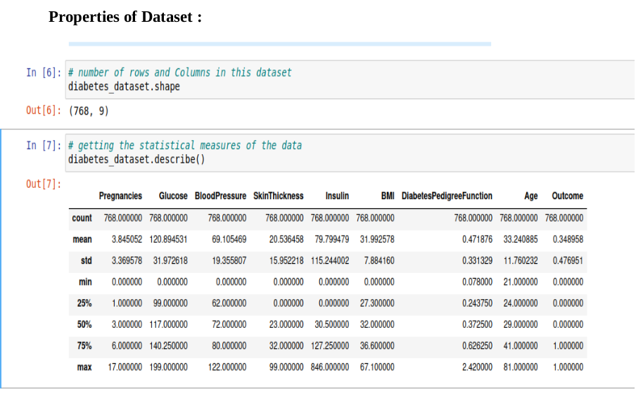

Slide 13
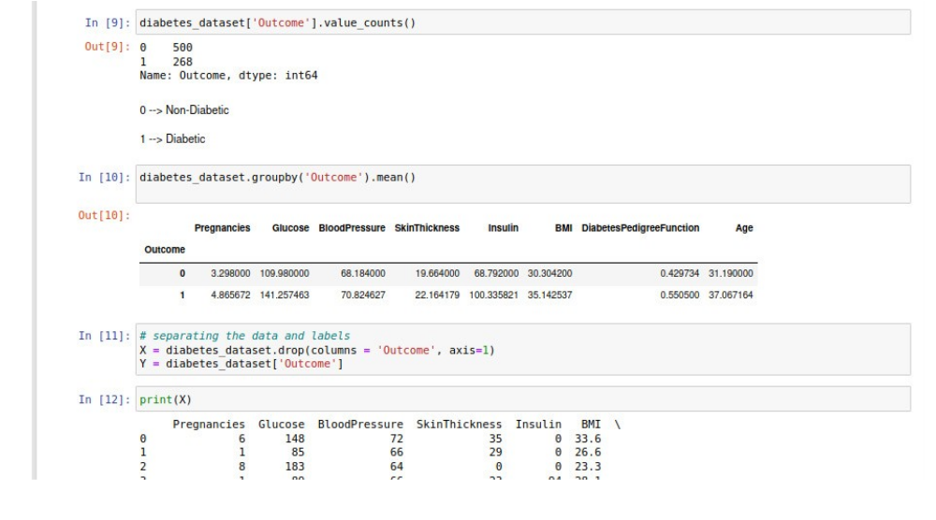
Data Preprocessing

Slide 14
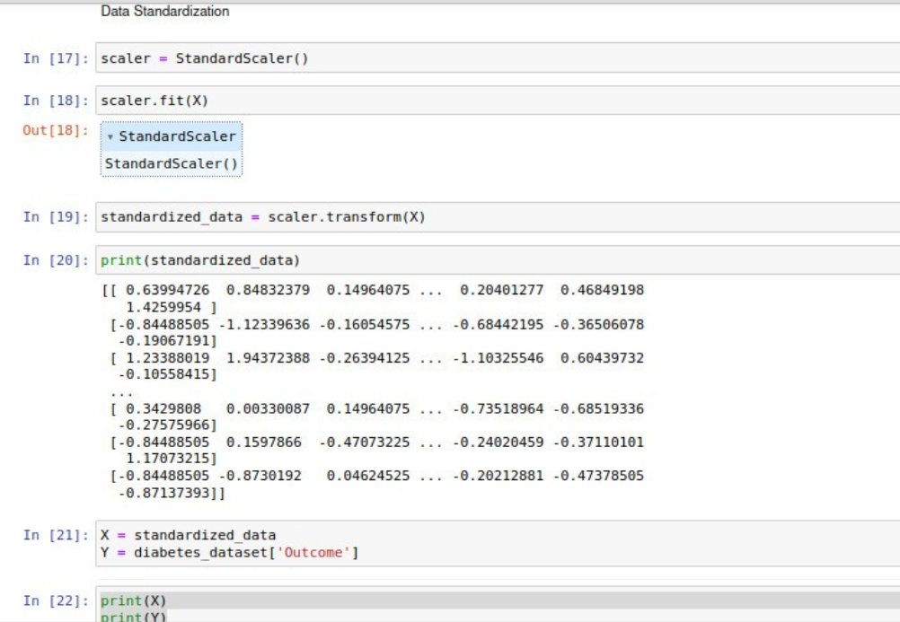

Slide 15
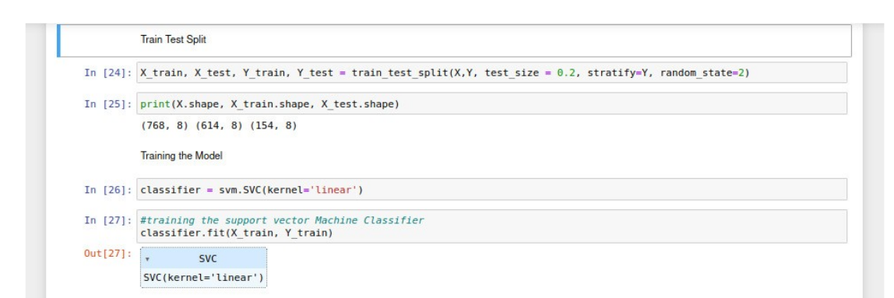
Model Building
Now train the test data using train data by fitting into support vector machine model

Slide 16
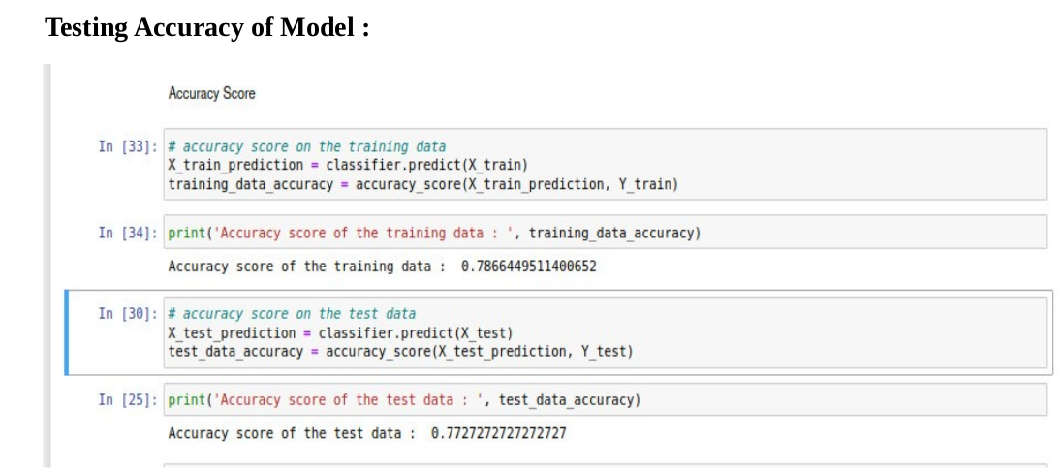

Slide 17
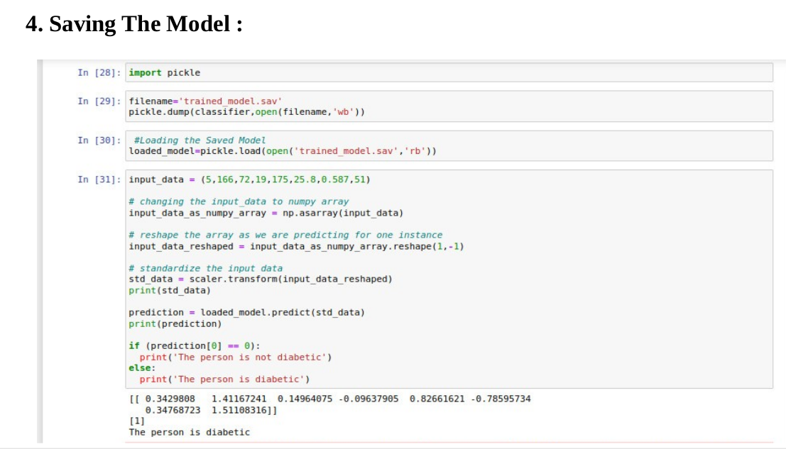

Slide 18
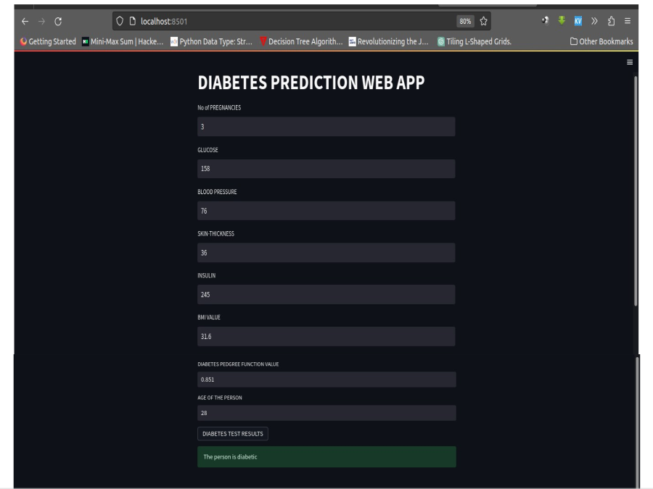
RESULT

Slide 19
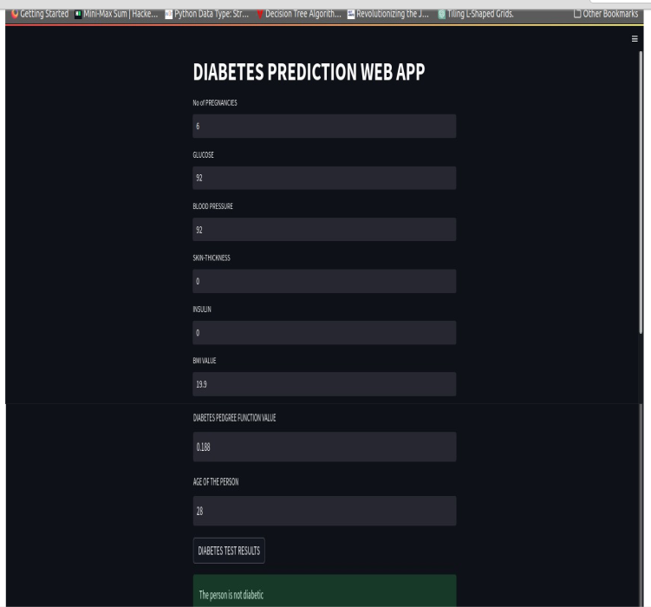

Slide 20
CONCLUSION
In this project we used support vector machine algorithm to provide chance of getting a person is Diabetic or not.Here we used the person’s diagonistic health parameters data to train the model and testing.Whenever person or health researcher enter their details,the model gives the prediction based on similar previous data.So that person will know their chance of having a Diabetic disease or not.

Slide 21
FUTURE SCOPE
In Future, the designer system with the used machine learning classifications algorithm can be used to predict or diagnose of the diabetes analysis including some other machine learing algorithms.
We will also try to improve the interface more interactive i.e, queries section, help section etc.

Slide 22
REFERENCES
[1] GeeksForGeeks : https://www.geeksforgeeks.org/ml-linear-regression/
[2] Scikit Learn :
https://scikitlearn.org/stable/modules/generated/sklearn.model_selection.train_test_split.html
[3] Javatpoint : https://scikitlearn.org/stable/modules/generated/sklearn.model_selection.train_test_split.html
[4] ResearchGate : https://www.researchgate.net/publication/348433004/
[5]Youtube

Slide 23
𝒯𝒽𝒶𝓃𝓀 𝒴ℴ𝓊

