Slide 1

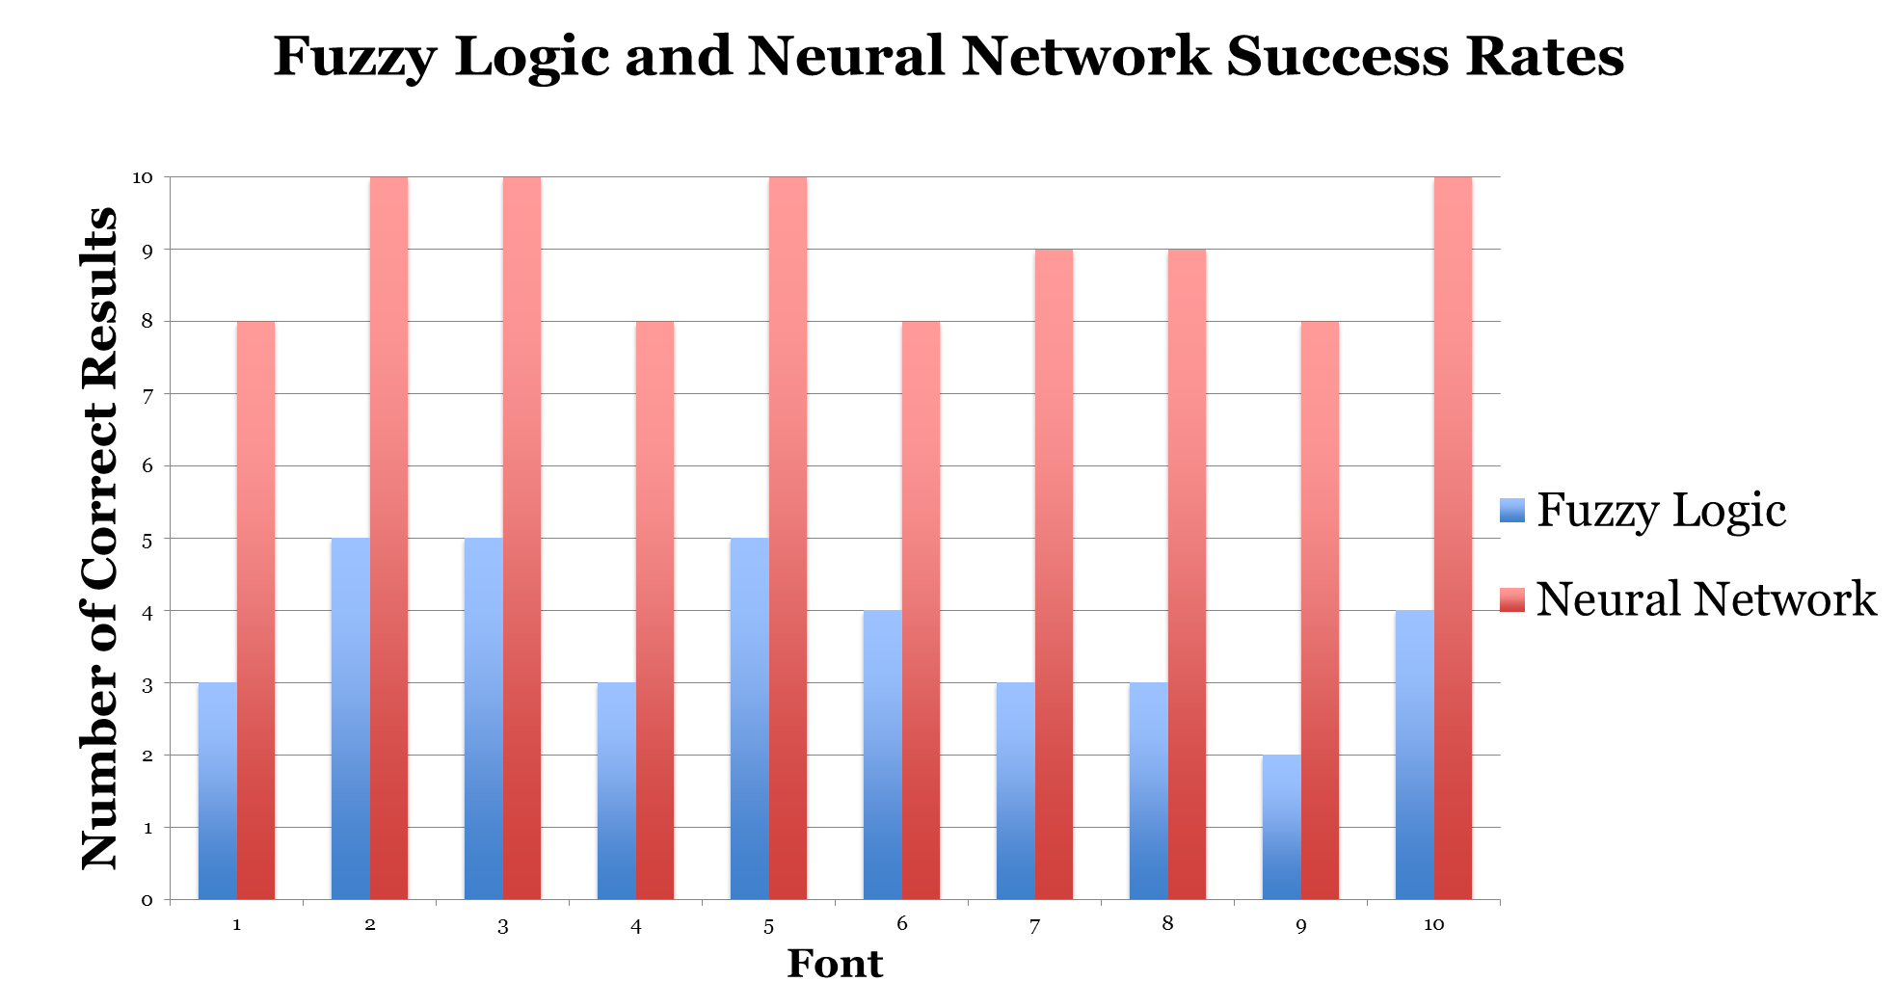
Winter 2015 – ECE457B Computational Intelligence
ECE Dept, University of Waterloo
Instructor: Fakhri Karray
Numerical Character Recognition
Group #4: Mark Berger, Sahar Haider, Naveen Narayanan, Gordon Zhou
Abstract and Overview:
Extracting information from images is a common problem, for example: scanning passports, identifying license plates, cashing cheques, filling out forms etc.
Use Optical Character Recognition (OCR) to extract characters from images using automated computer algorithms
Recognize Arabic numerals from 0 – 9 by separating individual digits
Problem Formulation:
Tools, Algorithms:
Experiments, Analysis:
Aiming to solve the problem of identifying different fonts; both serif and sans-serif variants
Character recognition main stages:
  1) Character segmentation
  2) Character recognition
Factors that need to be accounted for in character segmentation include:
  Size of text
  Image noise
Python 2.7
OpenCV, an open source computer vision library
  Turning images into gray scale
  Gaussian blurring to reduce the noise
  Otsu’s method to binarize the image into black and white using local thresholds
Experiment Setup
Image file with several different fonts including both serif and sans-serif fonts
Gaussian
Otsu
Evaluation Metrics
Blur
Binarize
Number recognition accuracy using Fuzzy Logic and ANN
SciPy and NumPy, packages for scientific computing
  Used for manipulating multi-dimensional arrays
Algorithms
  Fuzzy Logic
  Generalized bell membership function to fuzzify input parameters
  Use different fuzzy rules, for example pixel density, symmetry, to de-fuzzify the fuzzified input
  Artificial Neural Network
  Back propagation algorithm to train data
Analysis
 | Fuzzy Logic | ANN
Trained Fonts Success Rate | 78.90% | 100%
Random Fonts Success Rate | 36.47% | 94.11%
Proposed Solution:
Two alternatives using computational intelligence
  Fuzzy Logic
  Artificial Neural Networks
Fuzzify pixels, apply patterning rules:
  Left-right symmetry
  Top-bottom symmetry
  Pixel density
  Pixel width
  Number of pixels in the center of the image
Artificial Neural Network
  Train the ANN using a number of different fonts and characters
  Multi-Layer Perceptron with Back Propagation Learning algorithm
Conclusion:

