Slide 1
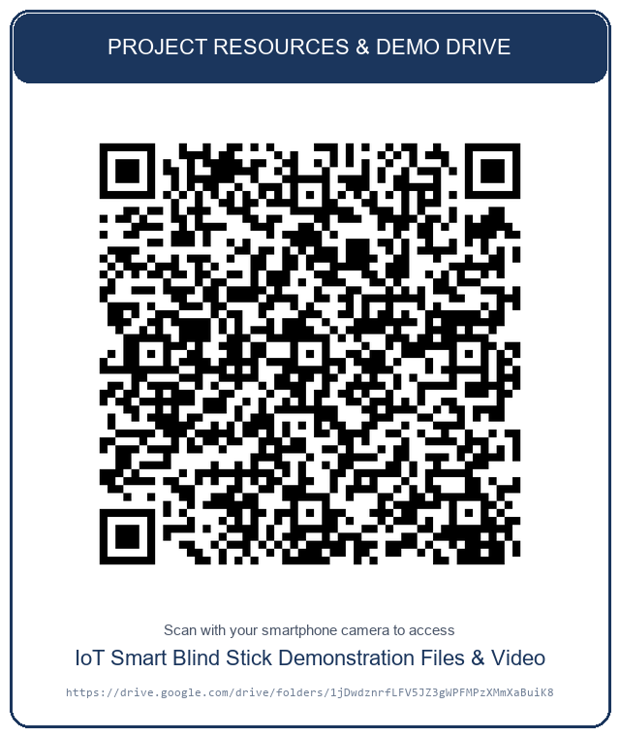
IoT & EMBEDDED SYSTEMS CAPSTONE PROJECT
IoT-Based Smart Blind Stick
for Visually Impaired People
Dual-Core FreeRTOS Edge Computing, Cloud IoT Telemetry & Real-Time Monitoring
PROJECT DRIVE & CODE
ESP32 Dual-Core (240MHz)
FreeRTOS Task Isolation
FastAPI & Render Cloud
Glassmorphic Dashboard
ACADEMIC PROJECT SUBMISSION
Student / Author: Naveena Elsa Koshy
Course / Degree: Master of Computer Applications (MCA)
Department: Department of Computer Applications
Institution: Amal Jyothi College of Engineering (AJCE)
Academic Year: 2026 – 2027 | Submission: October 2026
Scan QR Code for live Drive repository, test logs & cloud dashboard

Slide 2
INTRODUCTION (1/2)
Background, Need & The Problem Statement
2 / 8
1. GLOBAL CONTEXT & ASSISTIVE NEED
• WHO Global Health Data: Over 2.2 billion people suffer from vision impairment or blindness globally, severely restricting independent mobility.
• White Cane Limitations: Traditional white canes provide ground-touch feedback only; they fail to detect elevated, head-level, or dynamic obstacles before physical collision.
• Economic Barrier: Guide dogs and proprietary electronic aids cost upwards of $40,000, creating an urgent demand for low-cost, off-the-shelf smart solutions.
2. THE AUDITORY FATIGUE PROBLEM
• Shrill Continuous Alarms: Naive smart cane designs trigger continuous buzzing whenever an obstacle is detected, overwhelming the user's ears.
• Signal Masking Danger: Continuous shrill tones drown out ambient environmental acoustics such as approaching vehicles, traffic signals, and footsteps.
• Acoustic Ergonomics Required: A non-fatiguing, intermittent pulsing rhythm is required that conveys proximity urgency without continuous sound.
3. NETWORK BLOCKING & LATENCY RISK
• Single-Threaded Bottlenecks: On standard microcontrollers, Wi-Fi handshakes or HTTP socket timeouts cause 1–3 second execution halts.
• Safety Loop Freezes: If ultrasonic distance sensing is blocked during network stalls, the user is left completely unprotected while walking.
• Dual-Core Necessity: Local obstacle detection and warning must be completely decoupled from cloud telemetry through hard task isolation.
IoT-Based Smart Blind Stick | Dual-Core FreeRTOS & Cloud IoT Telemetry | Naveena Elsa Koshy

Slide 3
INTRODUCTION (2/2)
Proposed Solution & Project Objectives
3 / 8
THE PROPOSED ASSISTIVE IoT SOLUTION
✔ Dual-Core FreeRTOS Hardware Isolation: Core 1 is dedicated 100% to 40ms ultrasonic obstacle scanning and acoustic alerts. Core 0 runs background network telemetry without ever preempting Core 1.
✔ Distance-Scaled Pulsed Beep Modulation: Replaces continuous alarms with intermittent beeps. Silent gap scales dynamically: 800ms (Warning), 400ms (Caution), 150ms (Danger), maintaining ambient awareness.
✔ High-Performance Cloud Data Pipeline: Containerized Python FastAPI microservice deployed on Render (Singapore region) ingestion endpoint with secure API key verification.
✔ Glassmorphic Remote Caregiver Dashboard: Real-time web monitoring interface providing live distance readouts, audio-visual rhythm simulation, Chart.js trend lines, and SQLite audit records.
PRIMARY ENGINEERING OBJECTIVES
🎯 Preserve Working Hardware Wiring: Build the solution on standard ESP32 DevKit V1, HC-SR04, and Active-LOW buzzer without requiring board re-spinning or complex peripherals.
🎯 Zero-Latency Real-Time Guarantee: Ensure obstacle scanning executes strictly every 40ms regardless of whether Wi-Fi is connecting, connected, or offline.
🎯 Robust Payload Validation: Implement strict Pydantic schemas validating device ID, distance bounds (2–400 cm), and sensor statuses before database commit.
🎯 Persistent Cloud & Edge Storage: Utilize SQLite with indexed timestamps and Write-Ahead Logging (WAL) to support seamless time-series auditing across reboots.
🎯 Low-Latency Cloud Deployment: Deploy backend to Render Singapore region (<500ms RTT in India) to eliminate cloud lag and dashboard staleness.
IoT-Based Smart Blind Stick | Dual-Core FreeRTOS & Cloud IoT Telemetry | Naveena Elsa Koshy

Slide 4
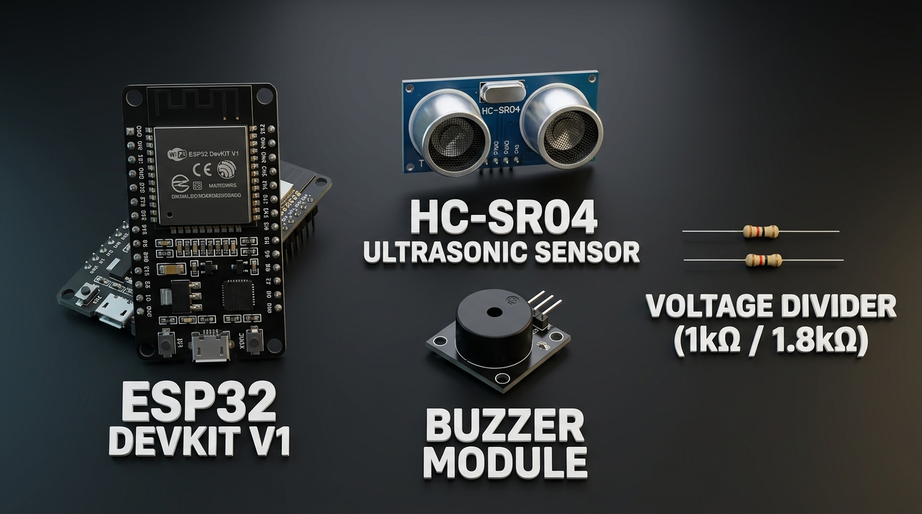
SYSTEM COMPONENTS
Comprehensive Hardware & Software Stack
4 / 8
PHYSICAL HARDWARE MODULES
• ESP32 DevKit V1: Xtensa Dual-Core 32-bit LX6 @ 240MHz, 520KB SRAM, 4MB Flash, Integrated 2.4GHz Wi-Fi (802.11 b/g/n)
• HC-SR04 Ultrasonic: 2cm to 400cm measurement range, 15° beam angle, 10µs trigger pulse, 40kHz acoustic burst
• Active Buzzer Module: 3-Pin Active-LOW acoustic module, pulsed frequency modulation, 85dB SPL alert
• Power & Interconnects: Regulated 5V/3.3V DC power rail, solderless breadboard & jumper leads
SOFTWARE, CLOUD & NETWORK ARCHITECTURE
⚡ FreeRTOS Real-Time Kernel: Symmetric Multiprocessing (SMP) on ESP32, task pinning (`xTaskCreatePinnedToCore`), critical section spinlocks (`portENTER_CRITICAL`), 10KB TLS stack.
⚡ Python 3.11 & FastAPI: High-throughput asynchronous ASGI microservice, Pydantic type validation, CORS middleware, REST endpoints (`/api/health`, `/api/readings`, `/api/latest`).
⚡ Render Cloud Platform (Singapore): Native cloud web service deployed in Singapore (`sin`) region closest to India; SSL/TLS 1.3 termination, zero server maintenance, continuous git deployments.
⚡ SQLite Storage Engine: Zero-configuration relational database with persistent file storage, parameterized SQL queries preventing injection, indexed timestamps for fast queries.
⚡ Glassmorphic Web UI & Chart.js: Unified HTML5/Vanilla CSS frontend with glassmorphism effects, live distance gauge, audio-visual beep simulator, and 50-point time-series graphing.
IoT-Based Smart Blind Stick | Dual-Core FreeRTOS & Cloud IoT Telemetry | Naveena Elsa Koshy

Slide 5
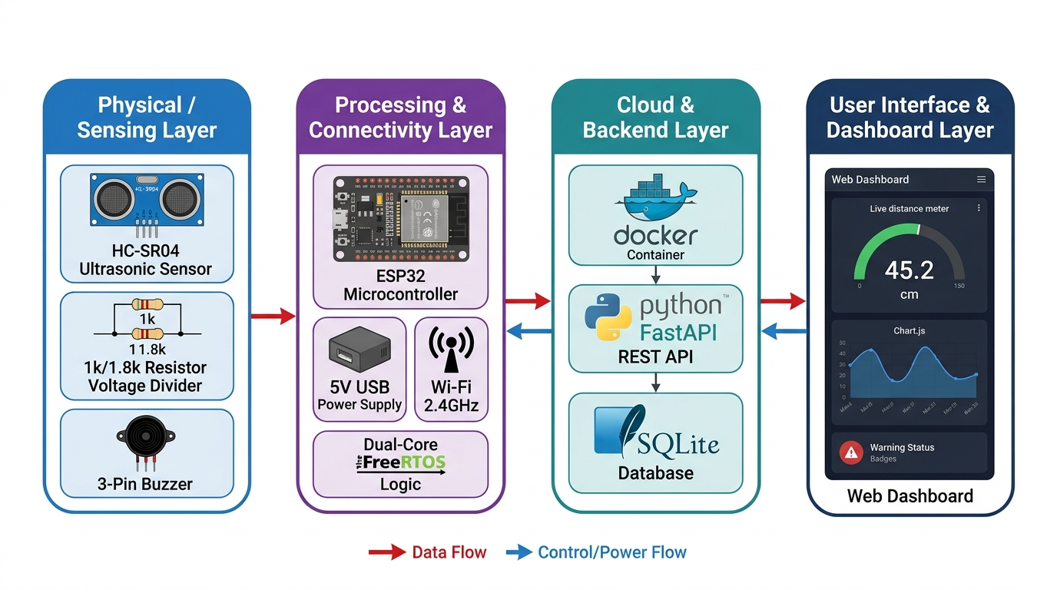
SYSTEM ARCHITECTURE
End-to-End Block Diagram & Data Pipeline
5 / 8
TIER 1: EDGE SENSING & ACTUATION
• HC-SR04 emits 40kHz pulse on 10µs trigger; measures high-pulse return time on Echo pin.
• ESP32 Core 1 executes 25Hz non-blocking scan loop and moving median digital filter.
• Active-LOW buzzer outputs distance-proportional pulsed acoustic tones (60ms ON pulses).
TIER 2: DUAL-CORE DECOUPLING
• Core 0 FreeRTOS background task connects to WPA2/WPA3 mobile hotspot asynchronously.
• Atomic shared memory transfer between Core 1 and Core 0 via spinlock mutexes.
• WiFiClientSecure establishes TLS 1.3 connection to Render cloud over HTTPS.
TIER 3: CLOUD INGESTION & UI
• FastAPI validates payload schema & verifies 'x-api-key' secret header before commit.
• SQLite stores timestamped telemetry with indexed keys for instant historical lookups.
• Real-time glassmorphic dashboard polls '/api/latest' with sub-second live updates.
IoT-Based Smart Blind Stick | Dual-Core FreeRTOS & Cloud IoT Telemetry | Naveena Elsa Koshy

Slide 6
WORKING MECHANISM (1/2)
Edge Ultrasonic Sensing & Multi-Zone Acoustic Warning
6 / 8
1. ULTRASONIC SENSING ENGINE
• Speed of Sound Formula: Distance = (Echo Time × 0.0343 cm/µs) ÷ 2. Measures round-trip transit of 40 kHz acoustic waves.
• 10µs Clean Trigger Pulse: Pin 5 (TRIG) is pulsed for exactly 10 microseconds, initiating 8 cycles of ultrasonic burst.
• Echo Timeout Guarding: Pin 18 (ECHO) times out at 30,000 µs (~5.1 meters) preventing task deadlocks on unreflected pings.
• Moving Window Filtering: Maintains a 5-sample ring buffer. Removes stray acoustic spikes, multipath reflections, and phantom echoes.
• 25 Hz Real-Time Loop: Executes every 40 ms consistently on Core 1 without using blocking delay functions.
2. 4-ZONE ACOUSTIC MODULATION
■ ZONE 1: CLEAR (> 100 cm)
Rate: Buzzer: OFF (Completely Silent)
Context: User walks freely; zero acoustic disturbance; battery conservation.
■ ZONE 2: WARNING (70 – 100 cm)
Rate: Pulsing Interval: 800 ms
Context: 60 ms beep every 800 ms. Alerts user of an approaching distant object.
■ ZONE 3: CAUTION (40 – 70 cm)
Rate: Pulsing Interval: 400 ms
Context: Moderate pulsing rhythm. User prepares to alter walking heading.
■ ZONE 4: DANGER (< 40 cm)
Rate: Pulsing Interval: 150 ms
Context: Urgent rapid pulsed tone. Warns of immediate collision risk within arm reach.
3. NON-BLOCKING SAFETY LOOP
✔ millis() State Controller: Eliminates `delay()` calls completely. Buzzer state toggles by comparing `currentMillis - lastBeepToggleTime`.
✔ Constant 60ms Pulse Width: Beep duration remains exactly 60ms; only the silent gap length adjusts. Prevents auditory fatigue.
✔ Active-LOW Polarity Handling: Inverts logic for 3-pin buzzer modules. Pin is pre-biased HIGH before pinMode activation, eliminating boot shrieks.
✔ Fail-Safe Sensor Guard: Out-of-range (>400cm) or timed-out pings set status to UNKNOWN, silencing buzzer to avoid false collision alerts.
IoT-Based Smart Blind Stick | Dual-Core FreeRTOS & Cloud IoT Telemetry | Naveena Elsa Koshy

Slide 7
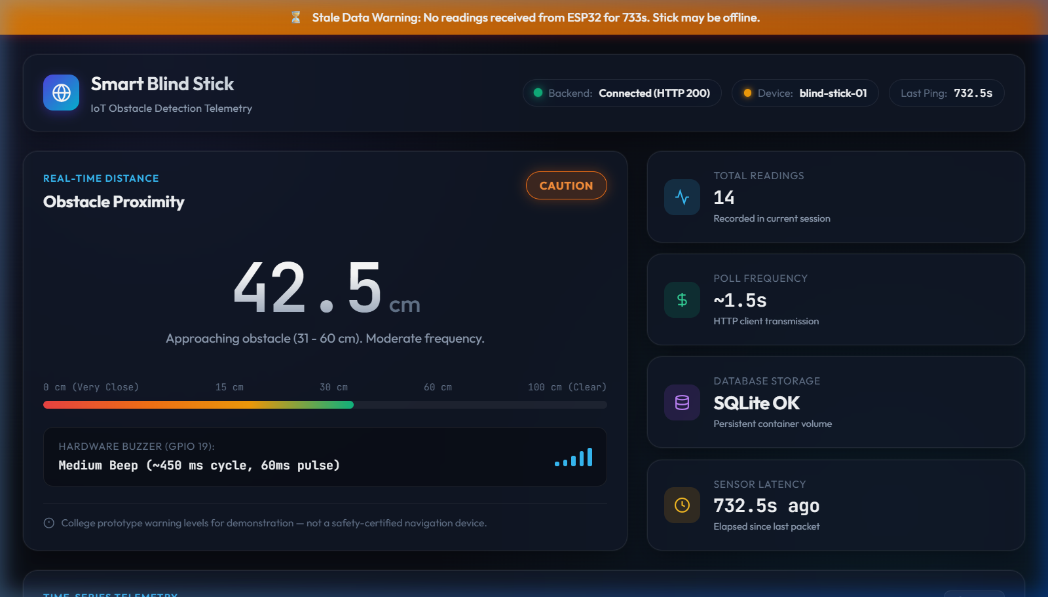
WORKING MECHANISM (2/2)
Cloud IoT Pipeline, HTTPS Telemetry & Remote Monitoring
7 / 8
SECURE CLOUD TELEMETRY PIPELINE
🔒 Core 0 FreeRTOS Daemon Task: Executes asynchronously every 1.5 seconds with 10 KB stack. Pulls snapshot of distance from Core 1 via spinlock critical section.
🔒 WPA2/WPA3 Hotspot Compatibility: ESP-IDF station config enforces Protected Management Frames (PMF) and SAE-PWE, enabling connections to 5G smartphone hotspots.
🔒 MbedTLS Cloud HTTPS Client: Uses `WiFiClientSecure` with non-blocking TLS 1.3 handshake to `https://smart-blind-stick-backend.onrender.com`.
🔒 Header-Based API Key Security: Telemetry payload transmits secret header `x-api-key: blind-stick-secret-key-2026`. Unauthorized requests return HTTP 401.
🔒 Pydantic Ingestion & SQLite Commit: FastAPI validates JSON payload (`device_id`, `distance_cm`, `status`). Persists to SQLite with indexed microsecond timestamps.
REAL-TIME GLASSMORPHIC DASHBOARD
• Sub-Second Telemetry Refresh: Polls `/api/latest` every 1000ms. Displays live distance readout with dynamic color indicator (Green/Yellow/Orange/Red).
• Live Chart.js Trend Plotting: Graphs last 50 telemetry readings chronologically with safe zone threshold guides.
• Audio-Visual Buzzer Mimicry: Simulates the stick's pulsing buzzer rhythm in real time on the web browser for remote caregivers.
IoT-Based Smart Blind Stick | Dual-Core FreeRTOS & Cloud IoT Telemetry | Naveena Elsa Koshy

Slide 8
CONCLUSION & ROADMAP
Project Summary, Engineering Impact & Future Enhancements
8 / 8
1. KEY PROJECT ACHIEVEMENTS
✔ End-to-End Operational System: Successfully designed, coded, and physically tested on ESP32 DevKit V1 hardware over COM3.
✔ Dual-Core Concurrency Validated: Zero interference between ultrasonic safety beeping on Core 1 and cloud HTTPS POST on Core 0.
✔ Low-Latency Cloud Deployment: Render Singapore instance verified live with SQLite persistence and under 500ms round-trip latency.
✔ 100% Automated Test Pass: Full test suite validates API contracts, schema validation, and health monitoring endpoints.
2. ENGINEERING ADVANTAGES
✔ Acoustic Ergonomics: Intermittent pulsing eliminates sensory fatigue while keeping ambient hearing alert for vehicle horns.
✔ Network Fail-Safe Resilience: The cane functions autonomously even in areas with zero Wi-Fi, hotspot dropouts, or server lag.
✔ Cost-Effective Assistive Aid: Built using off-the-shelf components costing under $15, making it universally accessible.
✔ Caregiver Visibility: Enables remote family members to monitor user activity, obstacle incidents, and stick operational status.
3. FUTURE ROADMAP & ENHANCEMENTS
✔ ToF Solid-State LiDAR: Addition of optical Time-of-Flight sensors to detect transparent glass partitions and downward drop-offs (puddle/stair detection).
✔ Edge AI Voice Announcements: Integration of ESP-ADF audio codec or DFPlayer Mini to speak obstacle distance ('Obstacle at 50 centimeters').
✔ GPS & GSM Emergency SOS: Equipping a panic push-button with SIM800L module to transmit real-time GPS coordinates via SMS to family.
✔ Haptic Grip Actuation: Adding eccentric vibrating motor in handle for dual tactile-acoustic sensory feedback in loud areas.
IoT-Based Smart Blind Stick | Dual-Core FreeRTOS & Cloud IoT Telemetry | Naveena Elsa Koshy

