Slide 1


Slide 2
What is tinder?
Tinder is an online dating app that matches couples based on their physical attraction to one another.
It alerts you to other Tinder users who fall within a specified age range and gender and are within a certain distance of your location, and it lets you know whether you have any mutual friends.
You decide whether or not you like the look of a person: if you do, great; if you don't, they'll never know.
If you're both interested then Tinder's messaging function offers you a private chat thread in which to talk and get to know each other better.
Tinder is available in over 40 languages in 196 countries.

Slide 3
revenue
Total revenue jumped 28.5% to $379 million in the fourth quarter ended Dec 31. Net loss was at $9.02 million, compared with a profit of $73.8 million a year earlier.
24% of Tinder users are paying for online dating services.
JMP Securities predicts Tinder to be worth $1.6bn, with $121m coming from subscriptions alone.
At QUARTER ENDING 06/30/18 estimated Revenue is 413 million USD.
At QUARTER ENDING 03/31/18 , Revenue is 407 million USD.

Slide 4
Functions And Processes
Tinder plus: $9.99/month for the users under the age of 30 years and $19.99/month for users over the age of 30 years.
Features of Tinder Plus + See how many people have liked you, directly from the grid auto-match, dismiss, or click into the person’s profile.
Tinder Gold: $14.99/ month for the users under the age of 30 years and $24.99/month for users over the age of 30 years
Rewind, unlimited right swipes, 5 Super likes a day, Ad-free, Hide distance, Hide age, Control whom you see, Passport, Boost
Boost :- A new feature which makes users profile the top profile ($1.99 to $3.99 per boost).
The Passport feature will accommodate the company’s expansion outside of the dating sphere and beyond romantic interactions.
Tinder Social: which you can access by tapping the icon of a group of people at the top of the screen. This mode sees you join up with a few friends to form a group, and then you can swipe through other groups to find people you'd like to match with.

Slide 5
Important KPI’s and Metrics
Number of downloads (or upgrades)
Number of times sessions opened in a week/month/quarter/etc. (activity)
New user vs. old user (acquisition)
User retention rate
App downloads versus App usage
matching algorithms-survey based and facial recognition based
Filter
Gamification-Swiping left and right
Crashes and Exceptions

Slide 6
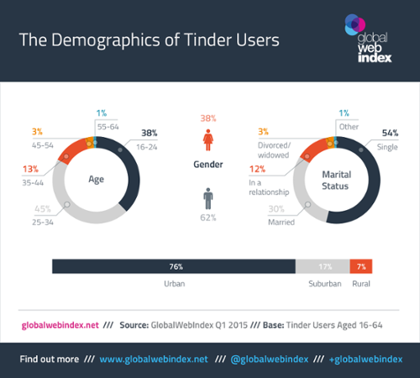
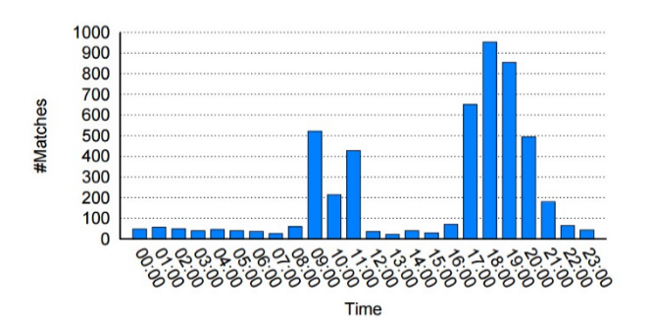
Demographics of Match Arrival Time Tinder users Distribution

Slide 7
Analysis
Tinder’s performance has been quite impressive, in just three years it has become a global cultural phenomenon, operating in 196 countries with an estimated 24 million users.
It is able to process 1.4 billion swipes per day, and has accumulated over 9 billion matches. The user experience remains high quality with an app rating of 4.5/5.
The user base continues to growth at a rapid rate, and there are an estimated 500,000 paid subscribers which leads investors to value Tinder at over $1.3 billion (some as high as 3$ billion).
Tinder is using software from a startup called Interana.
Interana is everywhere inside Tinder, troubleshooting network connectivity issues and measuring the effectiveness of social media partnerships, among other things.
Anything would have been better than the status quo at Tinder, which had been using legacy analytics software that was completely overwhelmed by the company’s meteoric growth.
Tinder uses canvas business model for its operations and market growth.

