Slide 1


Slide 2
Overview
UBER→ “super” in Greek
Founded in 2009 by Travis Kalanick & Garrett Camp
Active in 57 countries and 300+ cities
Started operations in India in August 2013
Presently, it operates in 23 cities in India with 2,50,000 drivers

Slide 3
WHAT IS UBER?
Uber Technologies is a peer-to-peer ridesharing, taxi cab, food delivery, and transportation network company.
Its platforms can be accessed via its websites and mobile apps.
• Clear Pricing
• Wait Time
• Cashless & Convenient
• Feedback Matters
• Fare Splitting

Slide 4
INITIATIVES:
• UberPool (60-70%) less than Go
• UberAuto-₹25 for rides upto 4kms
• UberGo- ₹7/km
• UberPremier- ₹ 19.5/km
• UberXL-₹8/km
• Extra- Assist
• UberEats
•UberHealth

Slide 5
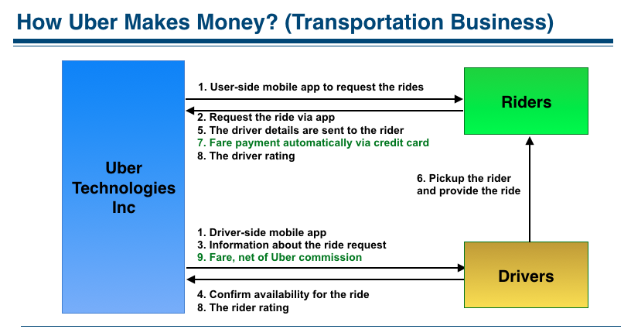

Slide 6
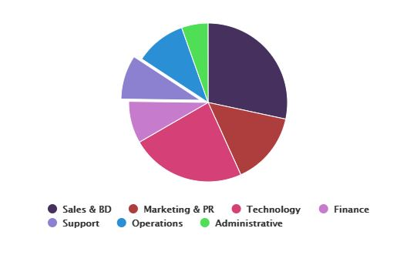
Functions
Employee breakup(in %)
Sales & BD- 26.6%
Marketing & PR- 13.9%
Technology- 21.9%
Finance- 8%
Support- 8.4%
Operations- 9.7%
Administrative- 5.1%

Slide 7
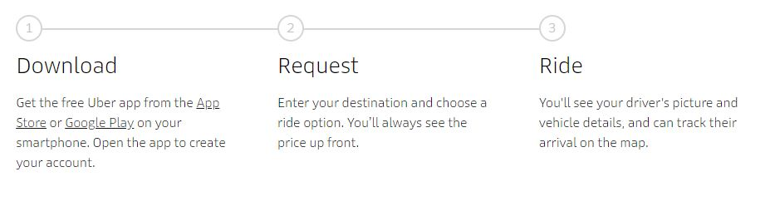
Process

Slide 8
UberEats
Working:
Customers-Restaurants
Revenue model- $50 billion(market value)
-> Customer convenience/ Delivery fee
-> Courier partner fee
-> Restaurant partner revenue share(30%) commission
-> Restaurant marketing fee

Slide 9
Metrics
Uninstall Rate
App Openings(Eyeballs)
Completed Trips
Idle Time
Peak Time
Wait Time
Driver Supply
Uber is clocking more than 10 million rides a week in India

Slide 10
Financials
Uber India Technology
52.3% increase in net profit to
Rs 3.2 lakh
Revenue from operations increased 133% to Rs 1.04 crore
Total expenses rose 142.5% to Rs 97 lakh
Uber India Systems
Revenue from operations grew 9.6% to Rs 410.7 crore in FY17
Rise in its net profit at Rs 19 crore
Expenses increased 10% to Rs 380.6 crore
Rs 95.5 crore was attributed to employee benefit expenses

Slide 11
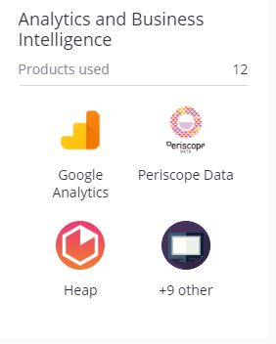
Analytic Software: UBER
Supply Optimization
Visualizing Data Analytics

