Slide 1
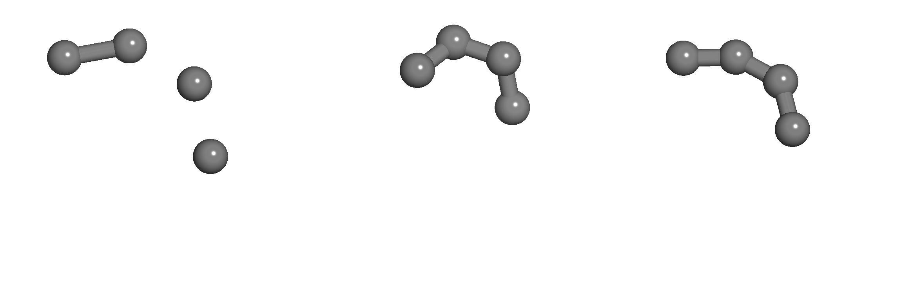
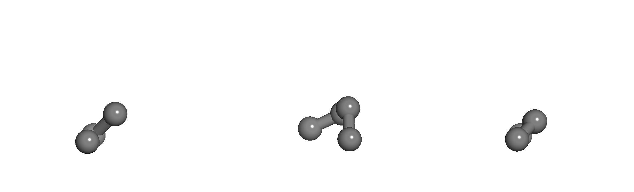
Top view
Initial Structure
Optimized Structure (Avogadro)
Globally Optimized Structure (Julia)
Side view

