Slide 1

IBM UNIVERSITY ENGAGEMENT
Project Submission
Exploring the Power of Agentic AI with IBM Granite and watsonx Orchestrate
Project Title: Interview Trainer Agent | Problem Statement No. 22
Domain: Education & Career Development (HR Technology)
Student Name | Photo | Email ID | Mobile Number (WhatsApp)
Naveena Sandhi |  | naveenaasandhi@gmail.com | 9063218875
Technology used: IBM watsonx Orchestrate · IBM Cloud Lite · RAG (Retrieval-Augmented Generation)

Slide 2

Problem Statement No. 22 — Interview Trainer Agent
The Challenge
An Interview Trainer Agent, powered by RAG (Retrieval-Augmented Generation), prepares users for job interviews by generating tailored question sets and preparation strategies based on their profile name, experience level, and job role.
It retrieves role-specific interview questions, industry expectations, behavioral scenarios, and HR guidelines from recruitment portals, professional networks, and company interview databases.
Users can input their resume or job title, and the agent provides targeted questions, model answers, and improvement tips.
It supports both technical and soft-skill assessment, ensuring a comprehensive interview prep experience.
This AI-driven assistant builds user confidence, sharpens responses, and increases success rates in competitive hiring environments.
2

Slide 3





Proposed Solution
The Interview Trainer Agent is built on IBM watsonx Orchestrate as a RAG-powered conversational agent that delivers personalized, role-specific interview coaching in real time.
Resume-Grounded Knowledge
Conversational Interface
ReAct Reasoning Style
Multi-Channel Delivery
The candidate's resume is uploaded as a knowledge source, so every question set is grounded in their real projects, skills, and academic background.
A chat-based agent greets the user with quick-start prompts — mock interviews, prep strategies, and behavioral questions — for a guided experience.
Configured with the ReAct agent style so the model can plan, retrieve, and refine its response before delivering tailored guidance.
Deployable across Teams, WhatsApp, Slack, Facebook Messenger, SMS, and voice/phone channels for accessible, anywhere practice.
3

Slide 4

Technology Used
IBM watsonx Orchestrate
IBM Cloud Lite Services
Low-code platform used to build, configure, and deploy the Interview Trainer Agent (built and hosted on IBM Cloud).
Provides the underlying trial infrastructure to build, test, and run the agent in a live environment.
Foundation Model — GPT-OSS 120B
RAG (Retrieval-Augmented Generation)
Powers the agent's reasoning and personalization; watsonx Orchestrate also supports IBM Granite models for the same workflow.
Grounds every response in the candidate's uploaded resume for accurate, personalized question generation.
Agent Behavior & Guidelines Engine
Multi-Channel Connectors
Custom instructions define the agent's persona, experience-level context, and interview-prep methodology.
Teams, WhatsApp (Twilio), Slack, Facebook Messenger, SMS, and phone/voice channels for flexible access.
4

Slide 5

watsonx Orchestrate Components Used
Profile
Agent description, welcome message, and quick-start prompts (mock interview, prep strategy, behavioral questions).
Knowledge
Resume uploaded as a knowledge source ("Resume — by IBMid") so answers stay grounded in the candidate's real background.
Behavior
Custom instructions define the agent's role as an Interview Trainer Agent and its RAG-based prep strategy; Agent Style set to ReAct.
Toolset
Extendable with organizational tools so the agent can take further action beyond conversation.
Channels
Home page, Embedded agent, Teams, WhatsApp with Twilio, Facebook Messenger, Slack, Phone (Genesys/SIP), and SMS.
Deployment
Agent tested in Debug mode via "Talk to agent" and deployed live from Manage Agents.
5

Slide 6
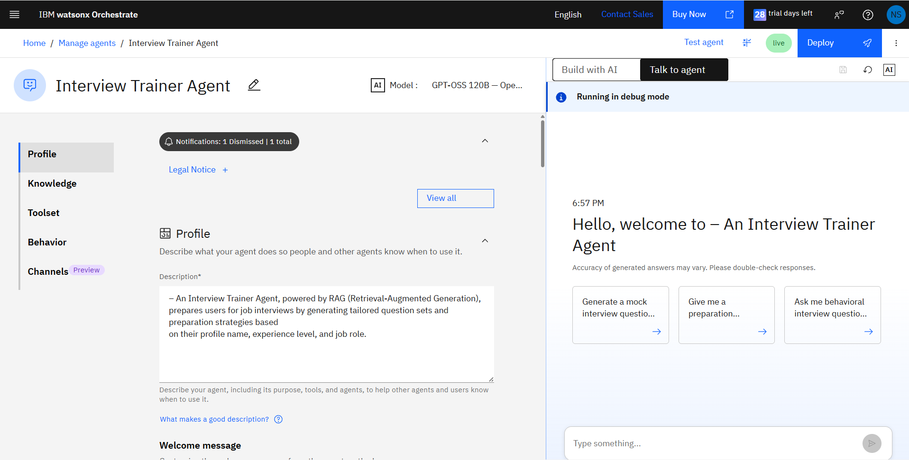
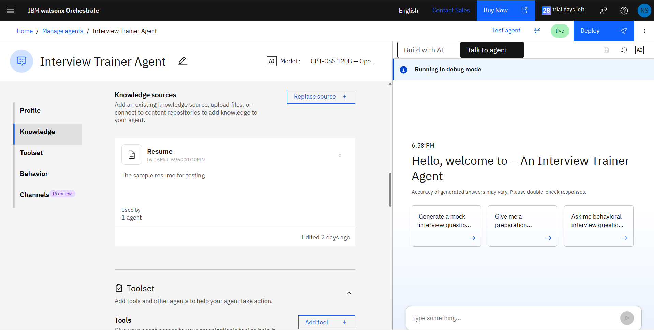
Agent Build — Profile & Knowledge Source
IBM watsonx Orchestrate: Interview Trainer Agent configuration
Left: Agent profile describing purpose — generating tailored interview question sets based on name, experience level, and job role.
Right: Candidate resume added as a knowledge source, enabling RAG-based, resume-grounded responses.
6

Slide 7
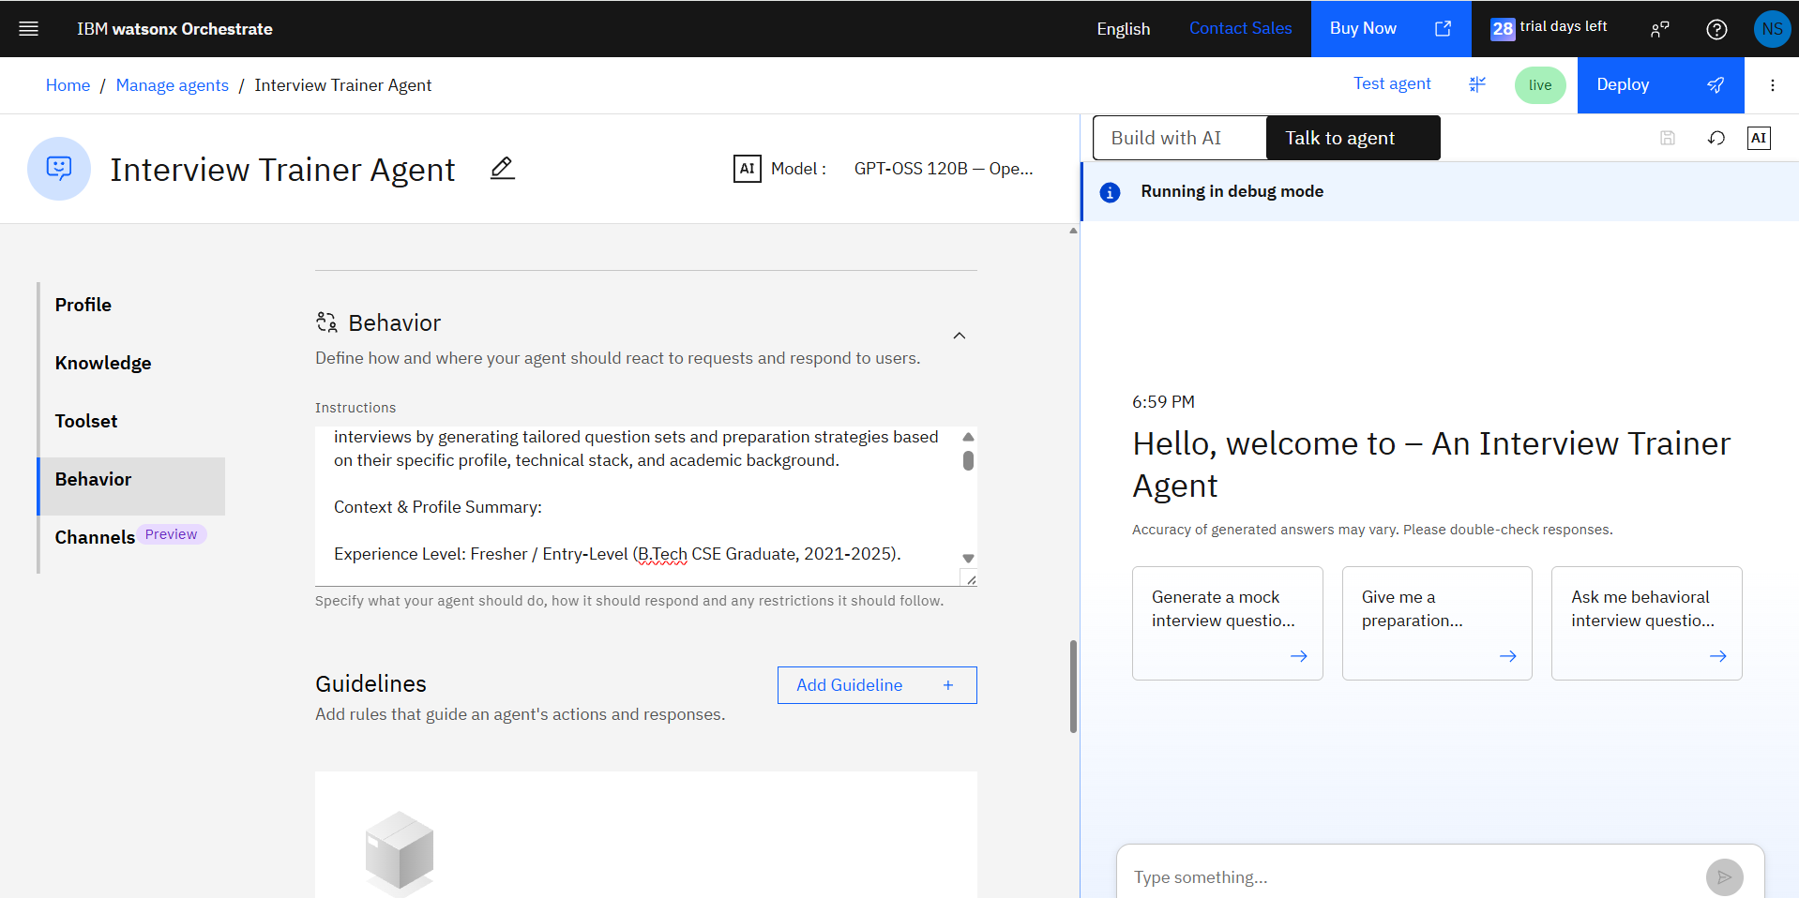
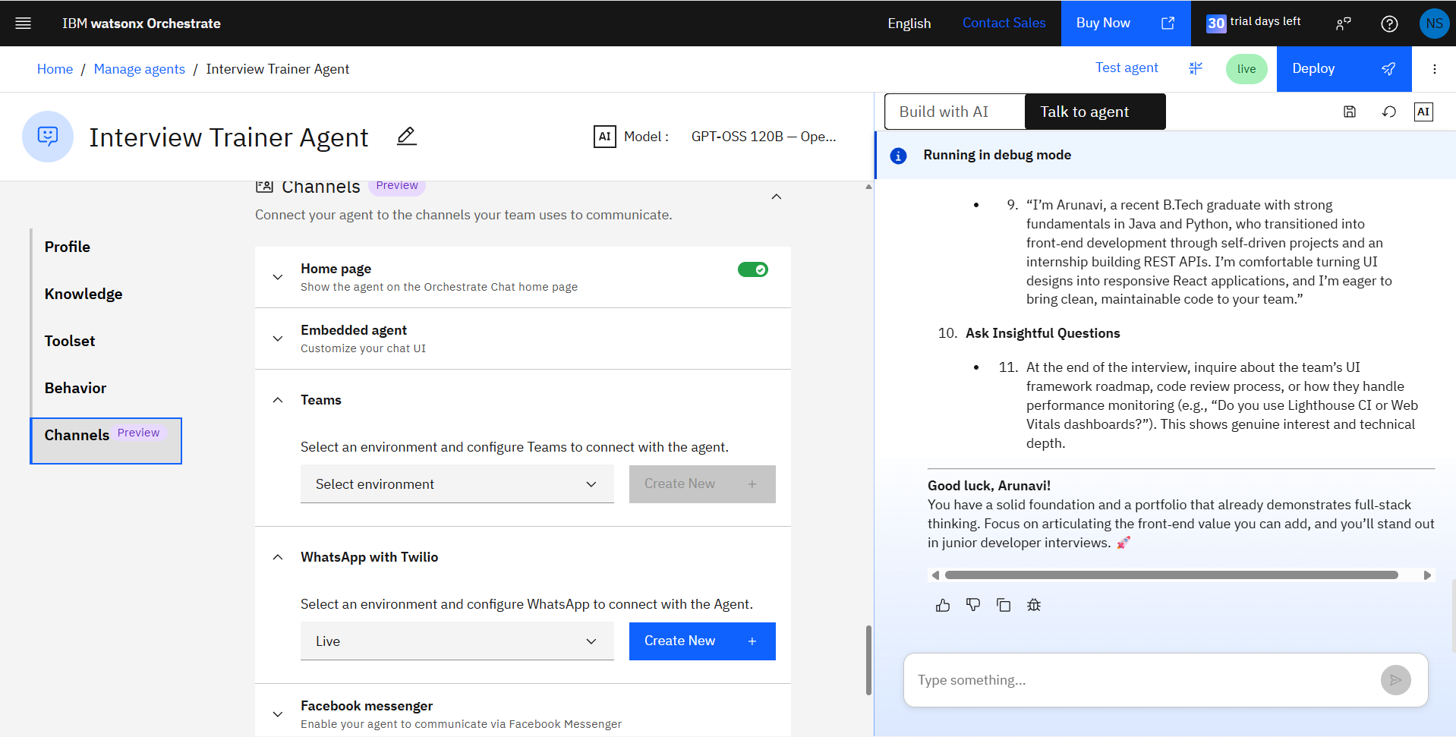
Agent Build — Behavior & Multi-Channel Deployment
IBM watsonx Orchestrate: Interview Trainer Agent configuration
Left: Behavior instructions defining the agent's context, profile summary, and interview-prep strategy.
Right: Channels enabled for Teams and WhatsApp with Twilio, alongside Facebook Messenger, Slack, phone, and SMS.
7

Slide 8
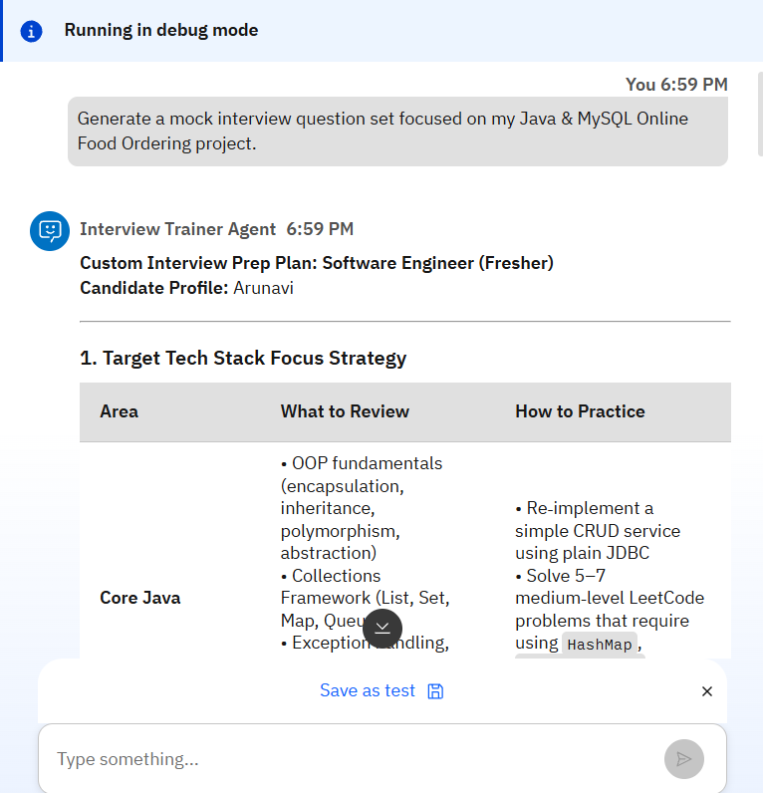
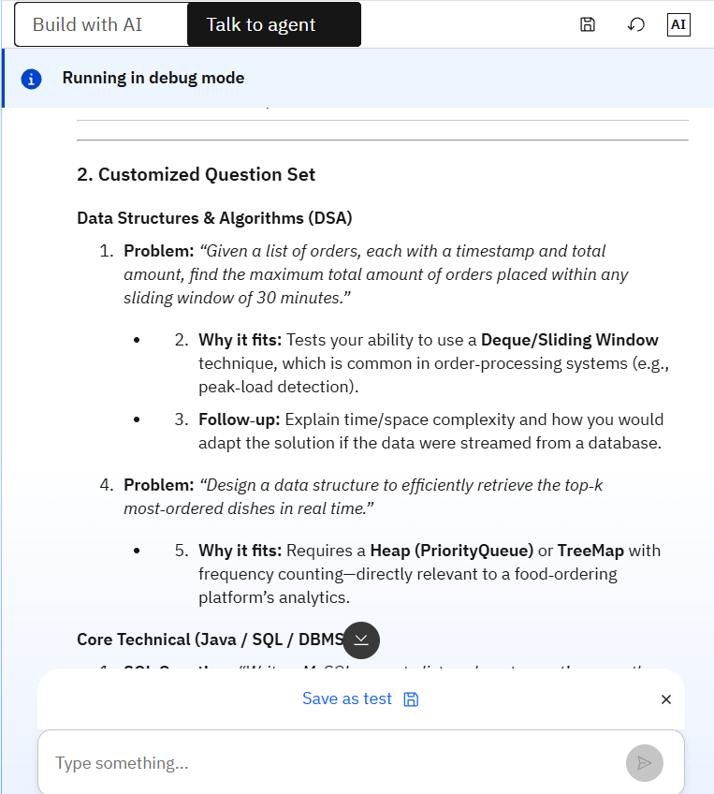
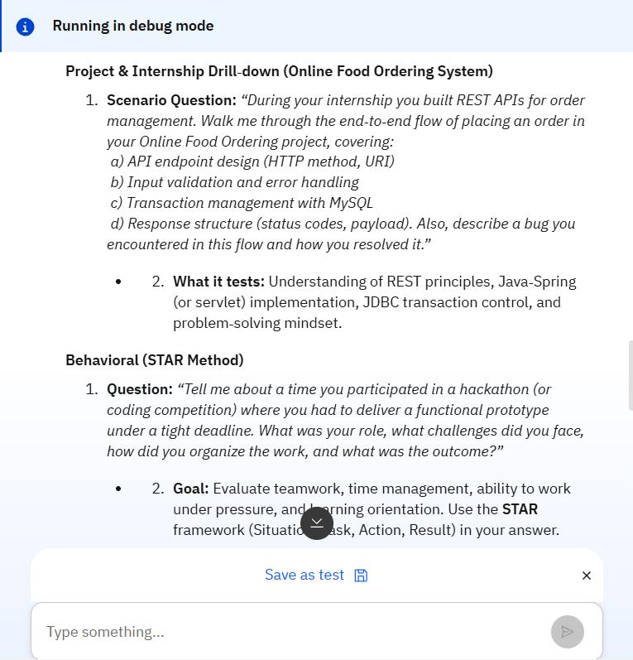
Live Demo — Personalized Interview Prep Output
Test conversation run in watsonx Orchestrate debug mode
Prompt: "Generate a mock interview question set focused on my Java & MySQL Online Food Ordering project." The agent returns a candidate-specific prep plan — tech-stack focus areas, a customized DSA/technical question set, a project & internship drill-down, and STAR-method behavioral questions.
8

Slide 9
Role of Agentic AI in the Solution
Acts as an autonomous interview coach rather than a static Q&A chatbot — planning, retrieving, and reasoning before responding.
Uses the ReAct agent style to think, act, observe, and refine its approach until a complete, tailored prep plan is delivered.
Grounds every recommendation in the candidate's resume via RAG, bringing genuine context awareness to each session.
Adapts across technical, project-based, and behavioral (STAR) question types within a single continuous conversation.
Is reachable across multiple channels — chat, Teams, WhatsApp, Slack, SMS, and voice — making practice available anywhere.
9

Slide 10


Novelty and Uniqueness
Resume-Grounded RAG
Full-Spectrum Coverage
Question sets are generated from the candidate's actual resume, not generic templates — every question maps to a real project or skill.
A single agent spans technical, project-drill-down, and behavioral (STAR) preparation in one conversation.
Low-Code, Enterprise-Ready
Omni-Channel Access
Built entirely on IBM watsonx Orchestrate — no custom backend required, with governance and scalability built in.
Deployable to Teams, WhatsApp, Slack, Messenger, SMS, and voice, meeting candidates on the channel they already use.
10

Slide 11

GitHub Repository
Repository format: public GitHub repository with README enabled.
https://github.com/naveenasandhi/Interview-Trainer-Agent/tree/main
Repository must include:
app.json — exported watsonx Orchestrate agent configuration
Interview_Trainer_Agent_Problem_Statement.pdf — problem statement document
Interview_Trainer_Agent_Presentation.pptx — this project presentation
Any additional supporting files (screenshots, sample resume, README)
11

Slide 12

Future Scope
1
Voice-Enabled Mock Interviews
Activate watsonx Orchestrate's voice modality so candidates can rehearse spoken answers and receive tone/pacing feedback, closer to a real interview panel.
2
Recruiter & Job-Description Matching
Let the agent ingest a target job description alongside the resume to highlight gaps and tailor question sets to that specific role.
3
Performance Analytics Dashboard
Track a candidate's practice history, frequently missed question types, and improvement over multiple sessions.
4
Deeper Toolset Integration
Connect calendar and ATS tools so the agent can schedule mock sessions and pull live job postings automatically.
12

Slide 13

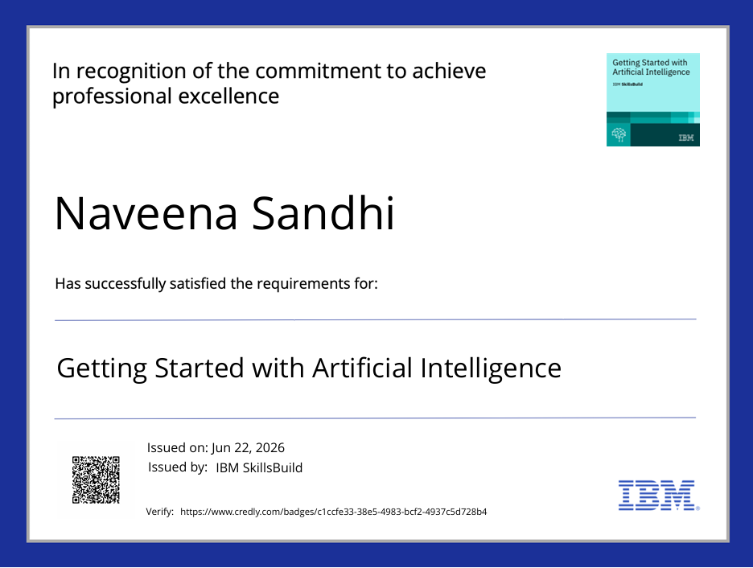
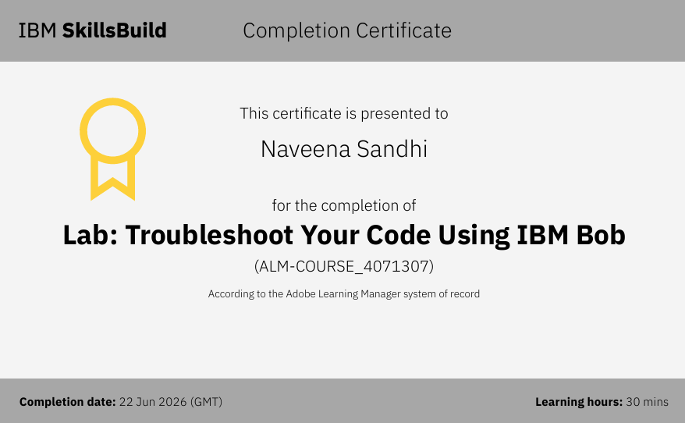
Certificates Earned
Credly Certificate
IBM BOB Certificate
13

Slide 14
Thank You!
Thank you for your time and interest.
Naveena Sandhi · Interview Trainer Agent · Problem Statement No. 22

