Slide 1
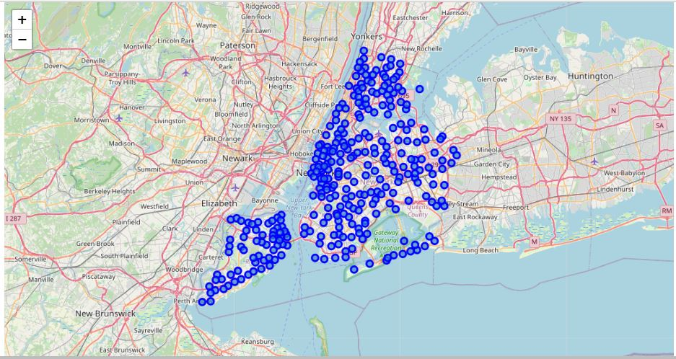
Presentation-NewYork

Slide 2
Results
From this venues data we filtered and used only the restaurant data for Brooklyn & Manhattan clustering and Bronx, Queens and Staten Island clustering. As we focussed only on restaurants business.

Slide 3
Discussion
-There is scope to increase Farmers markets in Bronx, Queens and Staten Island.
-There is scope to explore cuisines of various countries in Bronx, Queens and Staten Island.
-In Manhattan and Brooklyn restaurants of cuisines of many countries are available. So if risk can be taken with great menu on board. It also shows people love eating cuisines of various countries

Slide 4
Conclusion
This analysis is performed on limited data. This may be right or may be wrong. But if good amount of data is available there is scope to come up with better results. If there are lot of restaurants probably there is lot of demand. Brooklyn and Manhattan has high concentration of restaurant business. Very competitive market. Bronx, Queens and Staten Island also has good number of restaurants but not as many as required. So this can be explored

