Slide 1
ESO202A: Mechanics of Solids
Sumit Basu
Department of Mechanical Engineering
sbasu@iitk.ac.in
Ph: +91 (0) 512 679 7506
Room no NL211A
URL: http://home.iitk.ac.in/~sbasu

Slide 2

What is this about?
What happens to solid objects when they are subject to forces?
They translate when only forces are applied.
They may rotate when the applied forces have moments about some point.

Slide 3
Rigid bodies are idealised solids that do not change shape when subjected to forces. They just translate or rotate or do both simultaneously.
Real bodies also “deform” when subjected to forces.

Slide 4
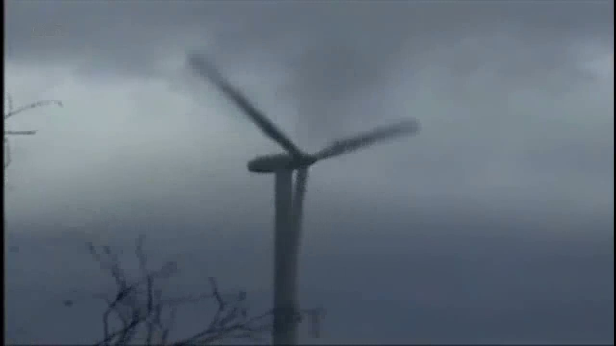
Deformation can lead to failures

Slide 5
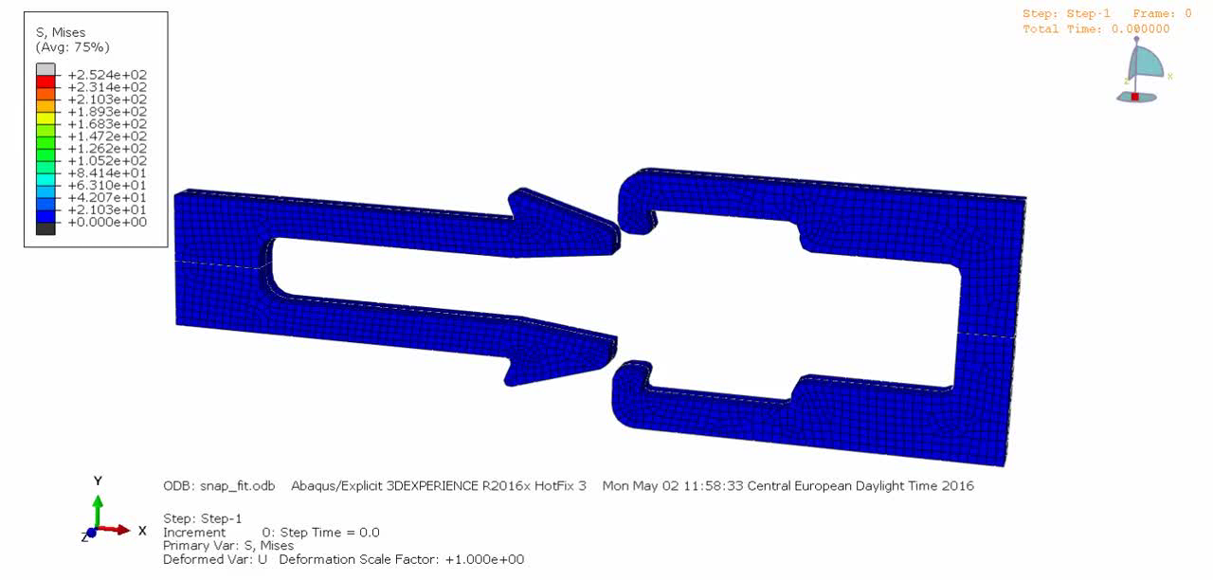
Deformation can be useful

Slide 6
Text books
Boresi and Schmidt, Advanced Mechanics of Materials, Sixth Edition, John Wiley and Sons, 2003
Crandall, Dahl, Lardner and Sivakumar, An Introduction to the Mechanics of Solids (in SI units), McGraw Hill Education Pvt Ltd, 3rd edition, 2017.

Slide 7
Course notes
Course notes will be regularly uploaded on http://www.usebackpack.com
Joining code is 6aa92c
You may have to create an account in backpack (using your iitk/gmail id) if you want to access the notes, solutions, assignment sheets and announcements. Strongly recommended.

Slide 8
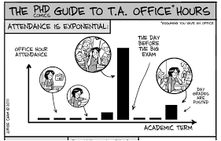
Teaching assistants and office hours
Available on every Saturday, 10 am – 11:30 am in NL211.
Arpit Srivastava, arpitks@iitk.ac.in
Mayank Chouksey, mayankc@iitk.ac.in
Ashwani Sengar, ashwani@iitk.ac.in
Ishu Agarwal, ishu@iitk.ac.in
Rohit Gupta, rohitd@iitk.ac.in
My office hours: 11 am-12 noon, Fridays
Ask your tutor for their office hours
Home assignments should be submitted to the TA of your tutorial section.

Slide 9
evaluation
15%
Two quizzes, each of 40 min duration
Quiz 1 on 4th Feb 2019
Quiz 2 on 1st April 2019
10%
10 Home Assignments
25%
Mid semester examination
35%
End semester examination

Slide 10
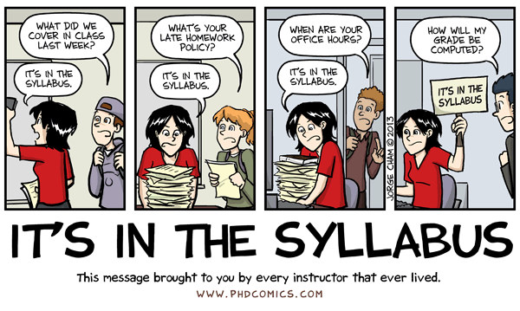
attendance
7.5% for the class + 7.5% for the tutorials

Slide 11

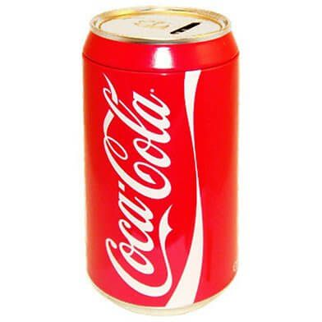
Why should I care to learn this stuff?
Why are aerated beverages sold in cans and non-aerated ones in paper based packages?

Slide 12
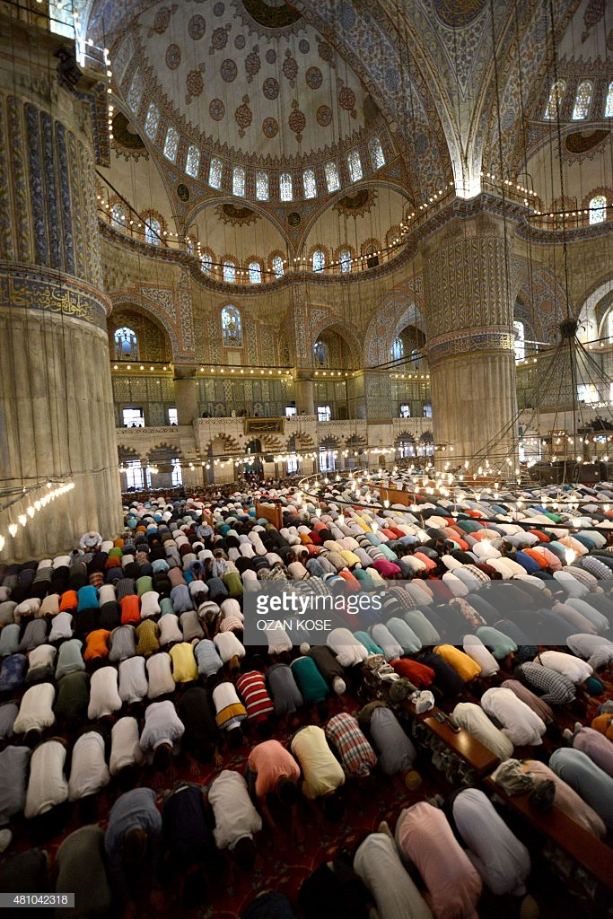
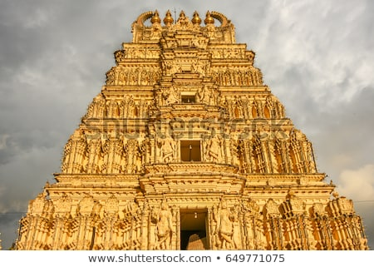
Why do some places of congregation have small entrances and sanctums while others can accommodate large numbers of people?

Slide 13
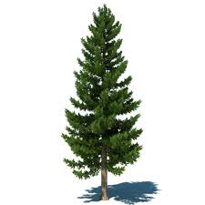
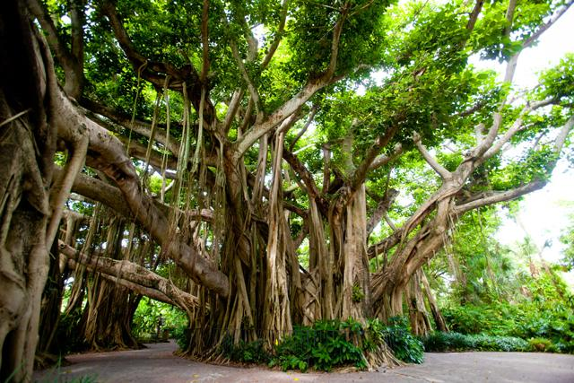
Why do large deciduous trees have big trunks while tall alpine trees have slender trunks?

Slide 14
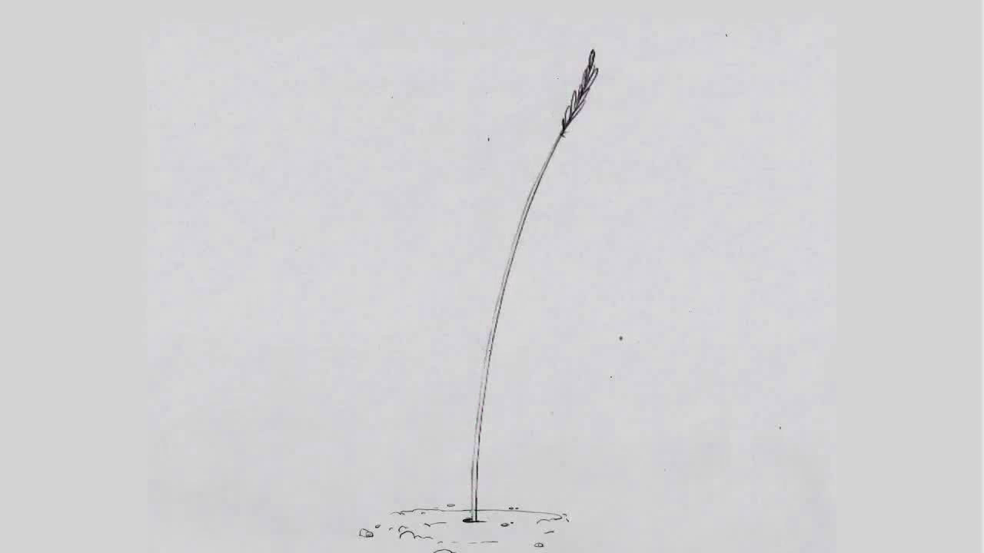
Why is the grass tapered from bottom to top?

Slide 15
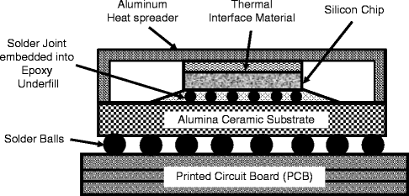
Why is heating a problem in computer chips?

Slide 16
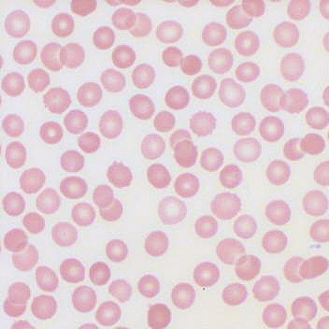
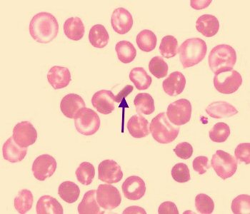
Can mechanics of solids help in understanding sickle cell disease?

Slide 17
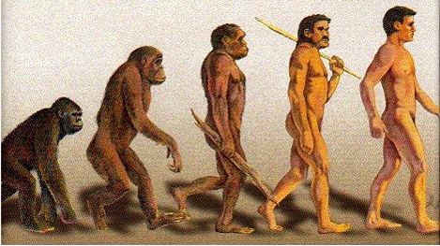
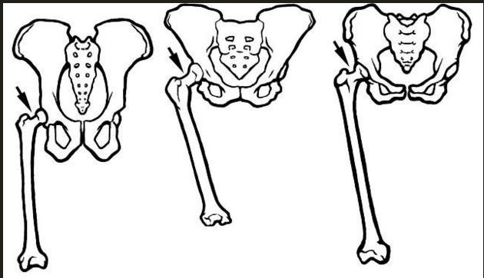
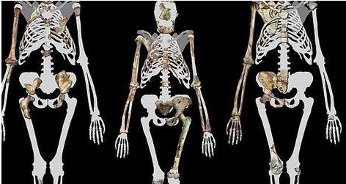
3.7 million years ago
Why does the design of the femural bone change with evolution of upright walking?
Australopithecus sediba
1.9 million years ago, South Africa
Femur bones of a chimpanzee, early human and modern human
Lucy, australopithecus
3.2 million years ago, Ethiopia

