Slide 1
Hospital Resource Allocation under Uncertain Patient Demand Using Stochastic Optimization
B.Tech Stochastic Decision Making - Mini Project
[Your Name] | [Roll No.] | [Department] | Guide: [Faculty Name]
All data are illustrative academic assumptions, not real hospital data.

Slide 2
Motivation and problem statement
• Hospitals must fix beds and staff before knowing how many patients will arrive
• Too little capacity: patients go unserved
• Too much capacity: costly resources sit idle
• Planning on the average hides busy and quiet days
Problem
Choose bed capacity B and staff capacity S in advance to maximise the expected net value: patient-care benefit minus resource cost, when demand is uncertain.
Illustrative academic assumptions - not real hospital data - not for clinical use
2

Slide 3
Stochastic decision making
• Deterministic model: assumes one demand number - ignores risk
• Stochastic model: demand is random, described by scenarios with probabilities
• Decide first, observe demand later; judge a decision by its expected outcome E[V] = Σ pᵢ Vᵢ
• Also examine the spread of outcomes: Monte Carlo simulation
• Check robustness: sensitivity analysis
Illustrative academic assumptions - not real hospital data - not for clinical use
3

Slide 4
Demand scenarios (illustrative)
Scenario | Probability | General | Emergency
Low demand | 0.20 | 40 | 8
Normal demand | 0.50 | 60 | 12
High demand | 0.30 | 85 | 20
Parameter | Value
Benefit / general | ₹1,000
Benefit / emergency | ₹2,500
Cost / bed unit | ₹250
Cost / staff unit | ₹180
Limits (B, S) | 0 to 100
Expected demand: 63.5 general + 13.6 emergency = 77.1 patients
Benefits are hypothetical rupee-equivalent scores, not valuations of patient health or lives.
Illustrative academic assumptions - not real hospital data - not for clinical use
4

Slide 5
Mathematical model
• Decision variables: B (beds), S (staff units), integers with 0 ≤ B ≤ 100, 0 ≤ S ≤ 100
• Effective capacity: C = min(B, S)
• Emergency first: eᵢ = min(Eᵢ, C), then general: gᵢ = min(Gᵢ, C − eᵢ)
• Scenario value: V = eᵢ·2500 + gᵢ·1000 − 250·B − 180·S
Objective
maximise E[V(B,S)] = Σ pᵢ · V(B,S,Dᵢ) subject to Σ pᵢ = 1, pᵢ ≥ 0
Illustrative academic assumptions - not real hospital data - not for clinical use
5

Slide 6
Optimization algorithm: exact enumeration
Validate inputs
Enumerate all (B, S)
Compute E[V] for each
Pick the maximum
Break down by scenario
• 10,201 feasible allocations evaluated - the answer is computed, never hard-coded
• Ties broken by lower cost; a loop-based version cross-checks the vectorised optimizer in the tests
• Since C = min(B, S), the optimum balances beds and staff (B = S)
• Hand check: a capacity unit costs ₹430; it earns ≥ ₹800 expected up to unit 72, only ₹300 after
Illustrative academic assumptions - not real hospital data - not for clinical use
6

Slide 7
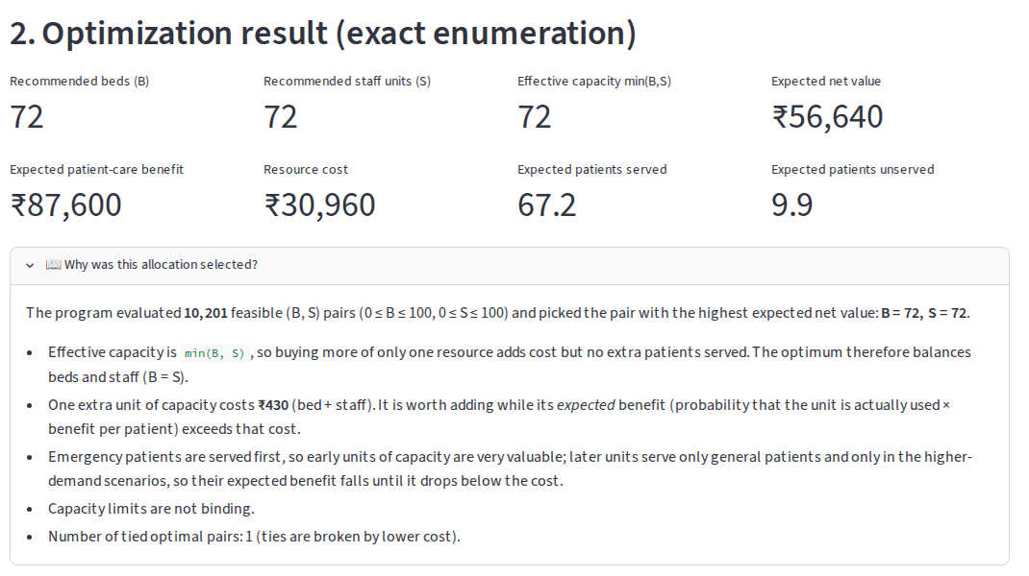
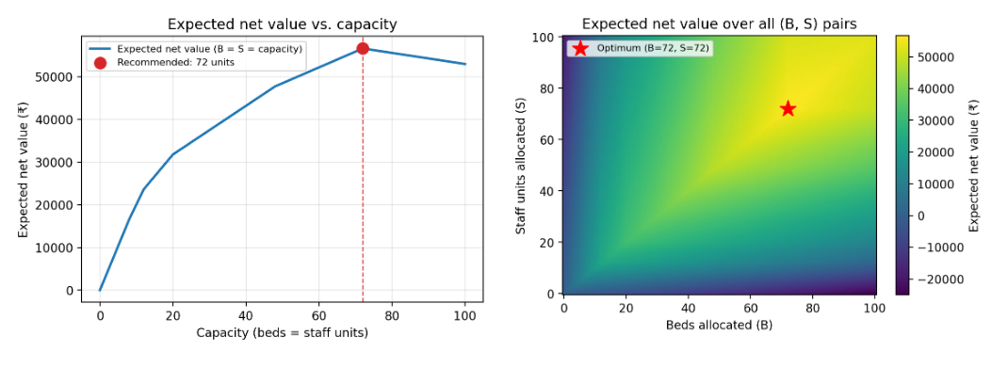
Dashboard (real screenshots of the running app)
Left: optimization results panel. Right: expected-value charts. Captured from the running Streamlit app with default inputs.
Illustrative academic assumptions - not real hospital data - not for clinical use
7

Slide 8
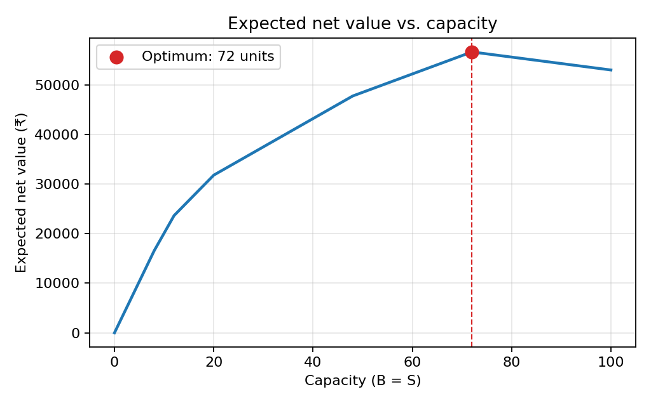
Results
Quantity | Result
Recommended B / S | 72 / 72
Expected benefit | ₹87,600
Resource cost | ₹30,960
Expected net value | ₹56,640
Expected served / unserved | 67.2 / 9.9
Scenario | Service rate | Unserved
Low demand | 100.0% | 0
Normal demand | 100.0% | 0
High demand | 68.6% | 33
Expected net value peaks at 72 units. High demand leaves 33 general patients unserved; all emergency patients are served.
Illustrative academic assumptions - not real hospital data - not for clinical use
8

Slide 9
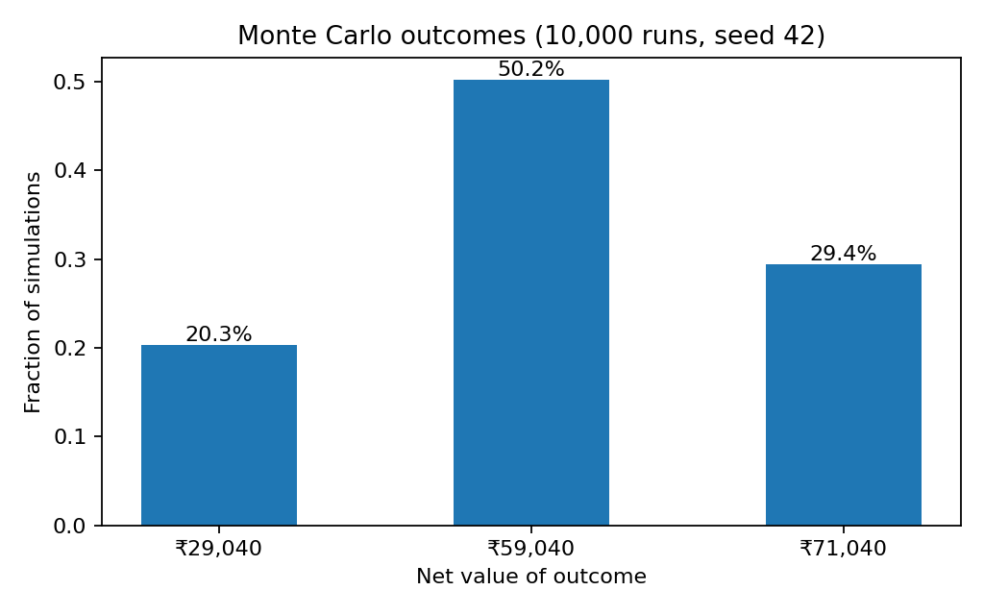
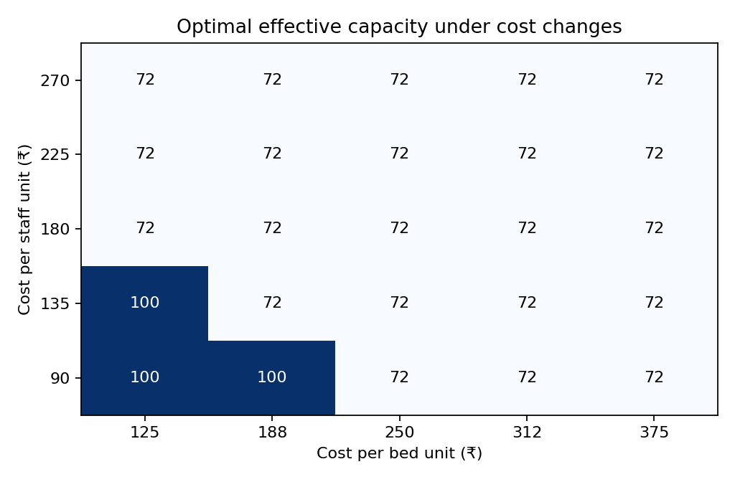
Monte Carlo risk and sensitivity analysis
10,000 runs, seed 42: mean ₹56,468, std ₹14,793, 5th pct ₹29,040, 95th pct ₹71,040. Enumeration picks the optimum; Monte Carlo shows variability.
Cost ±50%, re-optimised for each pair: capacity stays 72 over a wide range and jumps to the 100-unit limit when costs are low.
Illustrative academic assumptions - not real hospital data - not for clinical use
9

Slide 10
Limitations and conclusion
Limitations
Conclusion
• Only three scenarios, one period
• No queues, stays or staff types
• Hypothetical benefits and constant costs
• Not validated on real data; not for clinical use
• Stochastic model gives B = S = 72, expected net value ₹56,640
• Expected value alone hides risk: Monte Carlo shows the spread
• Decision is stable over a cost range, then changes in steps
• 41 automated tests; future work: richer demand, multi-period, risk-averse objectives
Illustrative academic assumptions - not real hospital data - not for clinical use
10

