Slide 1









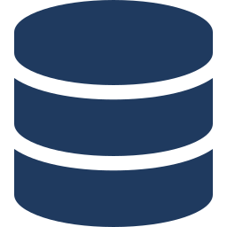
CONSUMED
AI Factory
OREO
Markets domain control layer turns model outputs into validated, auditable outcomes
Domain-owned
OREO standard
LLM / VLM inference
Processing packages
Domain validators
Evidence & provenance
Routing & gating
Result envelope
Correction loop
OCR / IDP
AI Gateway & guardrails
Schemas, profiles & prompts per use case
BIC, IBAN, ISIN, ISO 4217 + ref data
Verbatim source citation per field
Straight-through, review or exception
Contract for RATAN, SSI+ & FLOWZERO
Corrections → evals → package promotion
Data landing zone
Notes:
OREO consumes AI Factory capabilities wherever suitable and adds the Markets domain control layer that turns probabilistic model outputs into validated, auditable business outcomes.
Domain-owned (filled icon): processing packages, domain validators, routing & gating, correction loop.
OREO standard (outlined icon): evidence & provenance, result envelope contract.

Slide 2
CONSUMED
OREO
Markets domain control layer turns model outputs into validated, auditable outcomes
Domain-owned
OREO standard
AI Factory
Processing packages
Domain validators
Evidence & provenance
Routing & gating
Result envelope
Correction loop
Central AI platform
Schemas, profiles & prompts per use case
BIC, IBAN, ISIN, ISO 4217 + ref data
Verbatim source citation per field
Straight-through, review or exception
Contract for RATAN, SSI+ & FLOWZERO
Corrections → evals → package promotion
Notes:
OREO consumes AI Factory capabilities wherever suitable and adds the Markets domain control layer that turns probabilistic model outputs into validated, auditable business outcomes.
Domain-owned (filled icon): processing packages, domain validators, routing & gating, correction loop.
OREO standard (outlined icon): evidence & provenance, result envelope contract.

