Slide 1
AEGIS
The modern audit platform built for
Urban Cooperative Banks
RBI Risk Based Internal Audit (RBIA) Aligned • Multi-Language • 17 Roles • Cloud SaaS
Nexly Advisory | aegis.nexlyadvisory.com | naveenchhikara@hotmail.com | February 2026

Slide 2
THE CHALLENGE
UCB internal audit is stuck in the past
Paper & Excel Workflows
Internal audit runs on paper files, spreadsheets, and email follow-ups. No centralized tracking, no real-time status.
Rising RBI Expectations
RBIA framework, increasing inspection rigour — regulatory demands grow every year while tools stay the same.
Wrong Tools Available
Generic audit software is built for large commercial banks — too complex, too expensive, English-only, and needs an IT department.
Result: Missed findings • Delayed compliance • Poor inspection outcomes • Regulatory risk

Slide 3
THE SOLUTION
AEGIS: purpose-built for UCBs
One platform for the entire internal audit lifecycle — from risk assessment to board reporting — with the RBI RBIA framework built in, not bolted on.
Complete Audit Lifecycle
RBI RBIA Framework Built In
Risk assessment → planning → field execution → findings → compliance tracking → board reporting. Replace 6 spreadsheets with 1 platform.
19-parameter risk assessment model. 568 examination items pre-loaded. RBI compliance monitoring and reporting.
Multi-Language & Multi-Role
Cloud-Hosted SaaS
Available in Hindi, Marathi, Gujarati, English. 17 roles from CEO to field auditor. Every user sees what they need.
No servers to buy. No IT team required. We handle setup, training, and support. Hosted in India (AWS Mumbai).

Slide 4
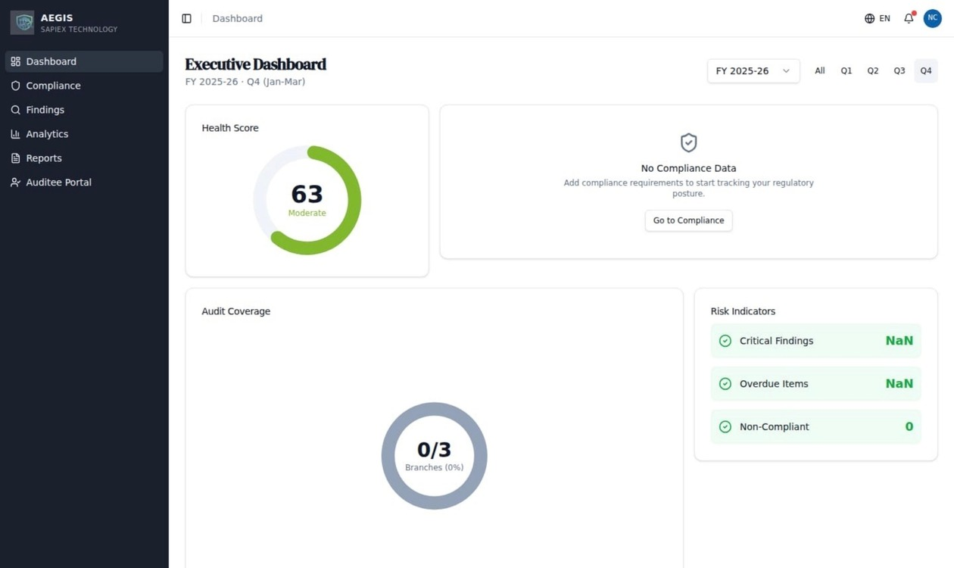
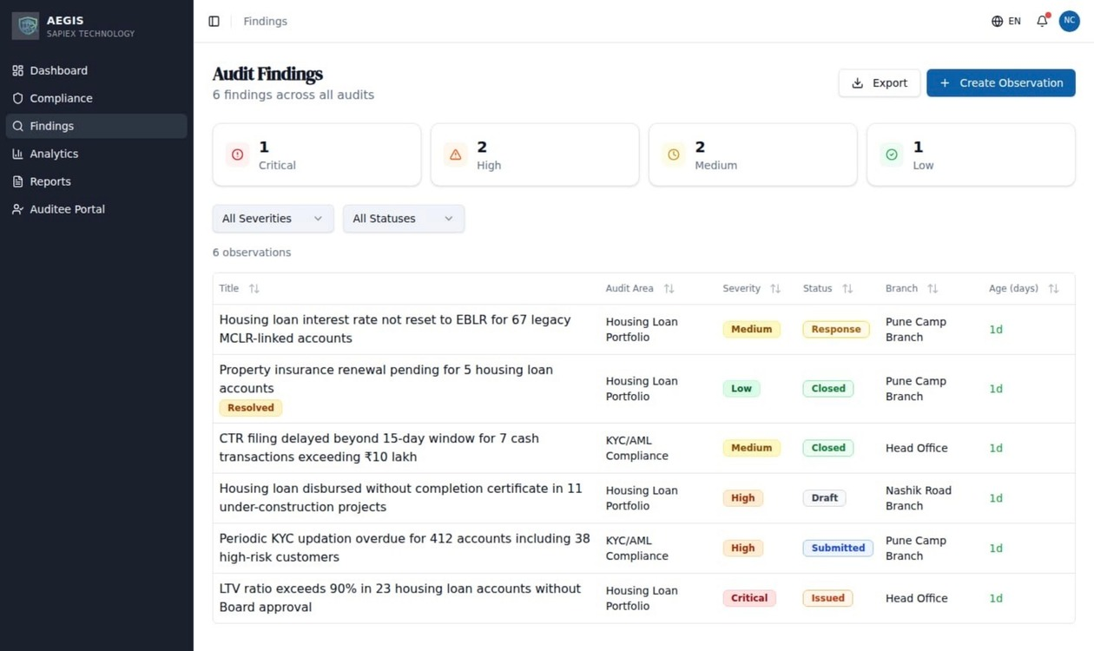
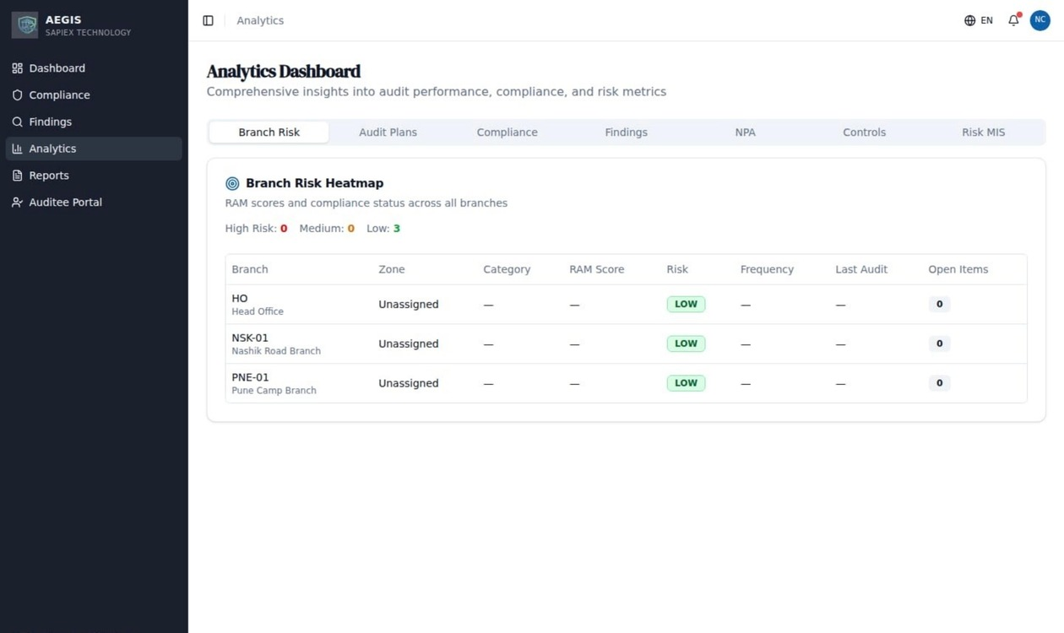
PLATFORM PREVIEW
See it in action — live and deployed
Executive Dashboard
Health Score & Audit Coverage
Audit Findings
Observation Lifecycle & Tracking
Analytics & Risk Heatmap
Branch Risk Visualization
Cloud-native • Multi-tenant • 4 Languages • 17 Role-based Views • Live at aegis.nexlyadvisory.com

Slide 5
BY THE NUMBERS
Platform at a glance
104
18
568
17
Audit
Requirements
Functional
Modules
Examination
Items
User
Roles
4
19
39
1
Languages (EN/HI/MR/GU)
Risk Parameters per Branch
Examination Areas
Platform, Zero Spreadsheets
Every requirement mapped to RBI's Risk-Based Internal Audit framework

Slide 6
WHAT'S INCLUDED
18 integrated modules
Risk Assessment Model (RAM) — 19-parameter branch scoring
Investment & Housekeeping Monitoring
Annual Audit Planning — risk-ranked, auto-generated
Regulatory Calendar — RBI deadlines pre-loaded
Field Audit Execution — structured section checklists
Risk Register — organizational risk tracking
Observation Management — severity, tracking, escalation
Control Library — mapped to risks
Compliance Lifecycle — Branch → Controlling/Reviewing Officer → ACB
Work Program Management — test execution
Board Governance Dashboard — health score, KPIs
QA Assessment — IIA standards
Report Generation — one-click PDF and Excel
Audit Trail — complete action logging
Concurrent Audit Module — parallel audit tracking
Analytics Dashboard — risk heatmaps, trends
IS Audit — 122-item cyber security checklist
Admin — users, branches, zones, templates

Slide 7
WHO USES AEGIS
17 roles, each with a dedicated view
CEO / Managing Director
Bank-wide health score, audit coverage, risk summary, compliance indicators
Head of Internal Audit (HIA)
Audit planning, team management, progress tracking, report generation
Chief Compliance Officer (CCO)
Compliance status, regulatory deadlines, escalation monitoring
Auditor / Lead Auditor
Field checklists, examination items, observation recording, evidence upload
Branch Head / Auditee
Findings assigned to branch, response submission, deadline tracking
Board Observer / ACB Member
Consolidated audit reports, governance metrics, risk trends
Controlling / Reviewing Officer
Zone-level compliance review, finding verification, escalation
Also includes: IS Auditor, Risk Head, System Admin, Concurrent Auditor, Zonal Auditor, Field Auditor — 17 roles total.

Slide 8
WHY AEGIS
Built different — built for you
Capability | Excel / Manual | Generic Audit Software | AEGIS
RBI RBIA Framework | Manual | Partial | Built In
568 Examination Items | No | No | Pre-loaded
Multi-Language (HI/MR/GU) | No | No | Yes — 4 languages
17 UCB-Specific Roles | No | Generic roles | CEO to Auditor
Compliance Lifecycle | Email follow-ups | Basic tracking | 4-stage workflow
Board Dashboard | Quarterly reports | Basic reports | Real-time health score
Setup & IT Required | None but no control | Servers + IT team | Zero — we handle it
Cost for UCB | Free but risky | ₹10-30L/year | ₹3-4L/year

Slide 9
GET STARTED
Start with a free sandbox pilot
We set up a demo environment with your bank's branch structure. Explore the full platform for 4 weeks with zero commitment. If it works for your team, we move to a real-data pilot.
STAGE 1
STAGE 2
STAGE 3
Sandbox Pilot
Real-Data Pilot
Subscription
Free
₹50K deposit
₹3–4L/year
Week 1–4
Week 5–16
Month 5+
→
→
Demo environment with your branches
Connect your actual audit data
Unlimited users and audits
Full platform access for key users
Full team onboarding
Ongoing support and updates
Guided onboarding and training
Complete one real audit cycle
Data hosted in India (Mumbai)
Zero commitment — explore freely
Deposit credited to subscription
Annual subscription, cancel anytime
Indicative pricing, subject to final packaging and bank size.

Slide 10
Ready to transform your
audit process?
Let's set up your free sandbox pilot — no commitment, no cost.
Live Platform
aegis.nexlyadvisory.com
Email
naveenchhikara@hotmail.com
Company
Nexly Advisory
AEGIS • The modern audit platform built for Urban Cooperative Banks

