Slide 1
AEGIS
The modern audit platform built for Urban Cooperative Banks
4-Week Strategic Roadmap
104 requirements shipped → Pilot launch ahead
Nexly Advisory | February 2026

Slide 2
Where We Are Today
Full platform shipped — 104 audit requirements across 18 functional modules
104
18
568
17
Audit
Requirements
Functional
Modules
Examination
Items
User Roles
(CEO to Auditor)
✓ Designed for RBI RBIA framework
✓ One-click PDF + Excel reports
✓ 19-parameter risk assessment model
✓ Role-specific dashboards
✓ Section-based audit execution
✓ Multi-language (EN/HI/MR/GU)
✓ 4-stage compliance lifecycle
✓ Cloud-hosted, production-ready

Slide 3
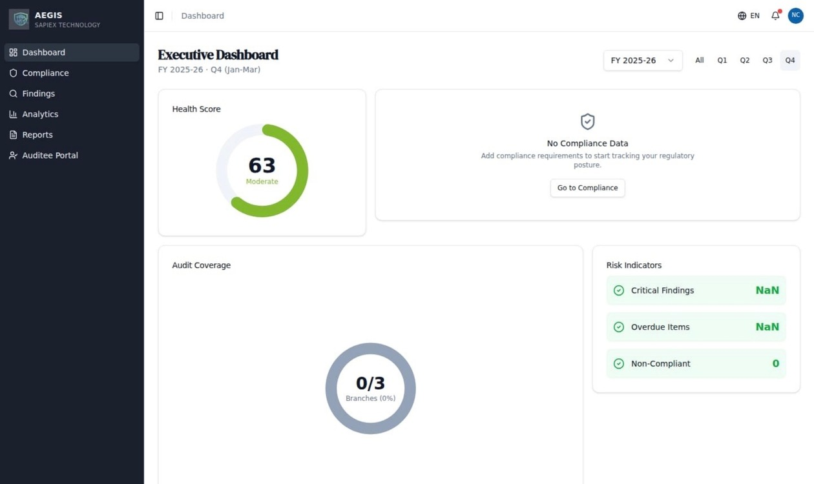
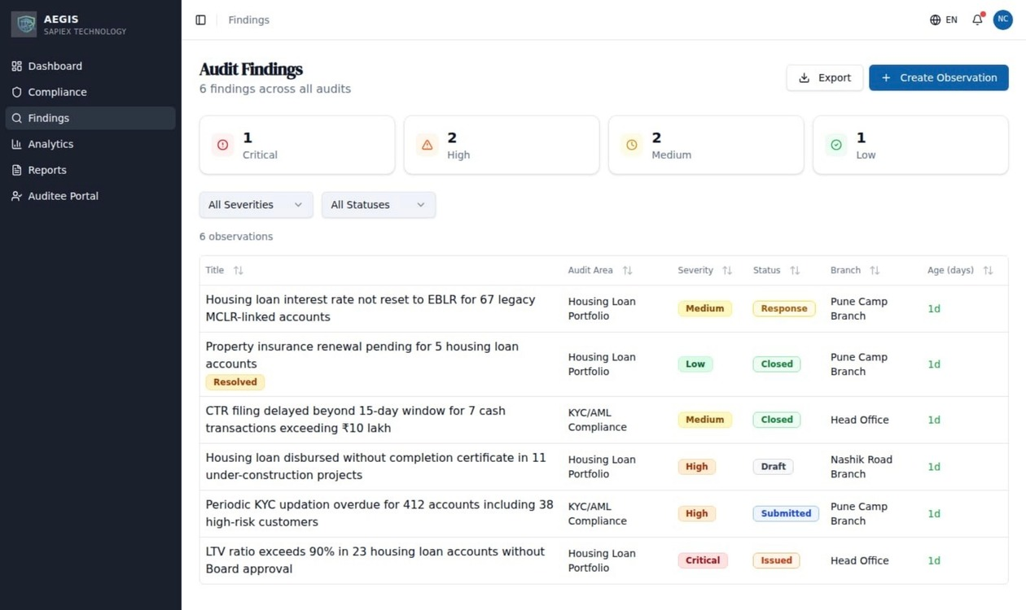
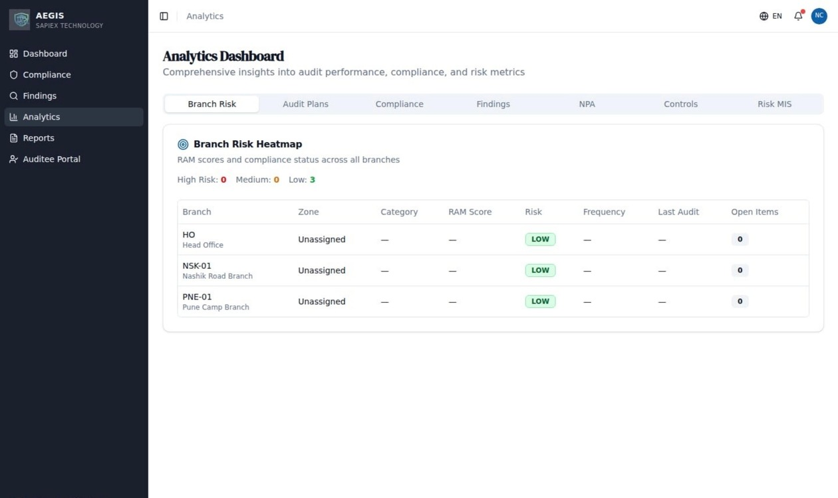
Platform Preview
Live screenshots from the AEGIS platform — production-deployed at aegis.nexlyadvisory.com
Executive Dashboard
Audit Findings
Analytics & Risk Heatmap
Health score, audit coverage, risk indicators
Observations with severity, status, branch tracking
Branch-level RAM scores and compliance status
Cloud-native • Multi-tenant • 4 Languages • 17 Role-based views

Slide 4
Pilot Readiness Plan
18 enhancements across 5 phases to prepare for UCB pilot launch
Phase 4 — Regulatory
6 gaps
Role enforcement, escalation routing, RBI pack
Phase 6 — Specialized
5 gaps
IS checklist completion, vendor risk, CBS params
Phase 3 — GRC
4 gaps
Work program exec, board view, QA standards
Phase 2 — Reporting
2 gaps
Report tracking model, calendar drag-drop
Phase 1 — Core
1 gap
Zone management UI
Pre-Pilot Configuration Checklist
▸ Email delivery — upgrade to production sending for pilot users
▸ Demonstration data — populate all screens with realistic sample data
▸ Dashboard accuracy — verify all KPI calculations display correctly
▸ Deployment automation — include all database components in release pipeline
▸ Navigation completeness — add landing pages for all sections

Slide 5
4-Week Roadmap
Now / Next / Later — prioritized by pilot readiness impact
NOW
Week 1-2
NEXT
Week 3
LATER
Week 4
› Populate demonstration data
› Role-based access enforcement
› IIA self-assessment setup
› Fix dashboard calculations
› Audit test recording
› RBI inspection readiness pack
› Automate dashboard deployment
› IS checklist completion
› Vendor risk assessments
› Add section landing pages
› Board consolidated view
› CBS audit parameters
› Enable email notifications
› Auto-escalation routing
› Cyber security checklist
› Zone-based audit workflow
› Audit calendar enhancements
› Report lifecycle tracking
Prioritization: Operational blockers first → pilot-critical gaps → nice-to-have completeness

Slide 6
Week 1–2: Foundation & Pilot Blockers
Goal: A demo-ready platform where every page works with real data and no errors
Task | Impact | Effort | Status
Populate platform with complete demonstration data | All pages show realistic data instead of empty screens | 2-4h | Not Started
Correct all dashboard KPI calculations | Dashboard shows accurate numbers across all widgets | 2-3h | Not Started
Automate deployment of all dashboard components | Deployments work end-to-end without manual steps | 1-2h | Not Started
Add section landing pages for audit and admin | Smooth navigation across all platform sections | 1-2h | Not Started
Enable email notifications for pilot users | Assignment alerts and reminders reach pilot users | 1-2h | Not Started
Zone-based audit workflow and branch grouping | ZAC workflow operational, branch→zone grouping | 4-6h | Not Started
Audit report lifecycle tracking with download history | Full audit trail of report generation and access | 3-4h | Not Started
7
Total Tasks
16–24h
Est. Effort
P0
P0 — Blocking

Slide 7
Week 3: Roles & Workflows
Goal: All 17 roles have correct scoped access; key audit workflows are end-to-end functional
Task | Impact | Effort
IS Auditor: restrict access to IT audit modules | IS auditors see only IS-related modules | 3-4h
Risk Head: dedicated risk management dashboards | Risk Head role has dedicated risk views | 2-3h
System Admin: separate admin controls | Admin role distinct from audit permissions | 3-4h
Audit test recording: capture results inline | Auditors can record test results inline | 4-6h
Board-level consolidated issue summary | Board sees cross-source issue summary | 3-4h
Auto-escalation: critical findings to Head Office | Critical findings auto-route to HO/IAD | 4-6h
Also review: CCO and Board Observer role access — may need expansion similar to the CEO role update.
6
Tasks
19–27h
Est. Effort
P1
P1 — High Priority

Slide 8
Week 4: Regulatory Completeness
Goal: Close remaining gaps for 100% RBI compliance coverage
Task | Impact | Effort
Quality assurance: IIA self-assessment questionnaires | Quality assessment can be conducted | 3-4h
One-click RBI inspection readiness pack | Inspection readiness in 1 click | 4-6h
Vendor risk assessments: fix update workflow | Vendor assessments updateable | 1-2h
CBS audit workflow: complete parameter coverage | CBS audit workflow functional | 2-3h
Cyber security checklist: full 122-question coverage | Full 122-question coverage | 2-3h
Audit calendar: drag-drop with recurring events | Better calendar UX for audit planning | 4-6h
Risk acceptance: formal auditable sign-off | Risk acceptance formally auditable | 2-3h
Board review calendar with RBI regulatory dates | Pre-populated regulatory calendar | 1-2h
Investment monitoring: automated deposit cap tracking | Automated cap monitoring | 2-3h
IS audit checklists: end-to-end completion | IS audits end-to-end | 2-3h
10
Tasks
24–37h
Est. Effort
P2
P2 — Completeness

Slide 9
Pilot Strategy
From sandbox demo to paying customer in 3 stages
Pilot A
Pilot B
Paid
Sandbox
Real Data
Subscription
Week 5-8
Free
Week 9-16
₹50K deposit
Month 5+
₹3-4L/year
› Demo tenant with full data
→
› Real tenant onboarding
→
› Full platform access
› Hands-on walkthrough sessions
› Bank data migration support
› Email notifications active
› Feedback collection & iteration
› SLA monitoring & escalation
› Dedicated support channel
Indicative pricing, subject to final packaging and bank size.

Slide 10
Risks & Dependencies
Identified risks with impact assessment and mitigation plans
Risk | Impact | Mitigation
Email delivery service approval delay | High | Apply immediately; fallback to alternative provider if >2 weeks
Team capacity for 4-week timeline | High | AI-assisted development; ruthless prioritization of pilot-critical items
SSL certificate renewal (May 2026) | Medium | Auto-renewal configured; verification scheduled
Demonstration data needs refresh | Medium | Refresh before any demo; automate in deployment pipeline
Expanding automated test coverage | Medium | Automated end-to-end testing for the complete audit workflow
CBS integration deferred to post-pilot | Low (now) | Manual data entry sufficient for pilot; CBS API integration post-pilot
Key dependency: Pilot A requires all Week 1-2 items complete + at least 1 target UCB identified. Begin UCB outreach in Week 2 to align with Week 5 pilot start.

Slide 11
Success Metrics
How we know the platform is ready for Pilot A
0
0
Incomplete screens
Calculation errors
Every workflow screen populated with actionable data from Day 1
All dashboards and analytics display verified figures
18→0
100%
Open enhancements
Audit lifecycle coverage
All 104 audit requirements verified and functional
Login → plan audit → execute → record findings → generate report
AEGIS — Target: Pilot-Ready by Q1 2026

