Slide 1

Multidimensional Poverty Dynamics: Methodology And Results for 34 Countries
Sabina Alkire, José Manuel Roche and Ana Vaz AEA, January, 2017
Session: Poverty, Shared Prosperity, and Vulnerability

Slide 2
Motivation
This paper set out a systemic account of multidimensional poverty dynamic using the Alkire- Foster Adjusted Headcount Ratio and its consistent sub-indices.
It also scrutinizes three approaches to assessing the pro-poorness of multidimensional poverty reduction.
These technics were then applied to the analysis of changes in multidimensional poverty based on the Global MPI and related destitution measure.

Slide 3
What is the MPI?
The MPI is an internationally comparable index of acute poverty for 100+ developing countries.
It was launched in 2010 in the Human Development Report, and updated in 2011, 2013 and 2014.
The MPI methodology is being adapted for national poverty measures – using better indicators for that policy context.

Slide 4
Data: DHS surveys
Coverage – poverty dynamics in this paper:
34 countries
338 sub-national regions + disaggregation for ethnic groups for Benin, Kenya and Ghana
Roughly 2.5 billion people (2010); on aggregate like Haiti.
Comparisons across time are as strict as data permit.
Survey years and intervals vary (2 to 12 years – 30 periods are 4 to 7 years, and for 20 countries most recent data are 2010-12).
29 countries have all 10 indicators; 5 have 9 indicators
Significant updates are in progress.
4

Slide 5
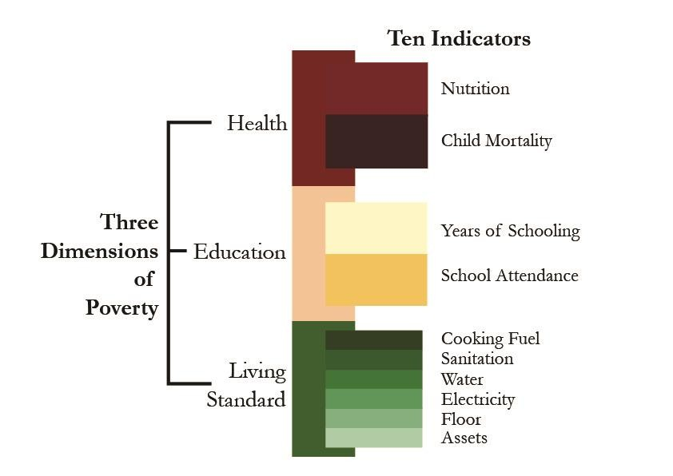
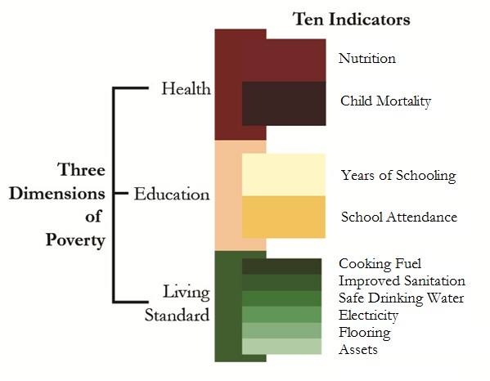
Dimensions, Weights, Indicators

Slide 6
Dimensions Indicators, Weights, Cutoffs
Dimension (Weight)
Indicator (Weight)
Deprivation Cut-off
Health (1/3)
Any adult or child in the household with nutritional information is undernourished¹
Any child has died in the household²
Nutrition (1/6)
Child mortality (1/6)
Education (1/3)
Years of schooling (1/6)
No household member has completed five years of schooling
Any school-aged child in the household is not attending school up to class 8³
Child school attendance (1/6)
Access to electricity (1/18)
The household has no electricity
The household´s sanitation facility is not improved or it is shared with other households
Access to improved sanitation (1/18)
The household does not have access to safe drinking water or safe water is more than 30 minutes walk round trip
Standard of Living (1/3)
Access to safe drinking water (1/18)
Type of flooring material (1/18)
The household has a dirt, sand or dung floor
Type of cooking fuel (1/18)
The household cooks with dung, wood or charcoal.
The household does not own more than one of: radio, TV, telephone, bike, motorbike or refrigerator, and does not own a car or truck
Asset ownership (1/18)

Slide 7
Methodology
Follows the global MPI, but with the comparable variables
Uses the AF methodology with nested weights; k=33.33%
MPI_{T} are rigorously comparable
Methodology: Chapter 9 of AFSSRB OUP 2015
Standard errors, sig levels, data tables available online
Implements the destitution measure presented next
A linked paper focuses on measured growth elasticities
7

Slide 8
Paper Structure
Overview
Methodological Detour: Theoretical decompositions
Closer View: Leaving No One Behind:
Changes by Incidence and Intensity
Changes by ethnic groups & subnational regions
Changes by deprivation (indicator)
Reduction of the subset of the poor who are Destitute
8

Slide 9

















34 countries: National Level initial year: H, A
75%
Niger
70%
Ethiopia
Average Intensity of Poverty (A)
65%
Cameroon
Nigeria
India
Mozambique
60%
Madagascar
Pakistan
Haiti
Uganda
55%
Rwanda
50%
Ghana
Nepal
Indonesia
Zambia
Tanzania
45%
Colombia
Kenya Cambodia
Bangladesh
40%
Bolivia
Lesotho
Peru
Dominican
Republic
0% 10%
The size of the bubbles is a proportional
representation of the total number of MPI poor in each country
35%
30%
20% 30% 40% 50% 60% 70% 80% 90% 100%
Percentage of People Considered Poor (H)

Slide 10
Overview
30 countries (98% of covered population) have significant* reductions in MPI by α = 0.05; 29 countries by α = 0.01.
Guyana and Peru only at α = 0.10
Jordan and Senegal: no significant reductions
Madagascar: significant increase in MPI (α = 0.01)
* significance refers to full period of comparison, not annualized changes

Slide 11
MPI_{T} over time
Niger 2006-2012
Ethiopia 2000-2005
Ethiopia 2005-2011
Mozambique 2003-2011
Benin 2001-2006
Rwanda 2005-2010
Senegal 2005-2010/11
Uganda 2006-2011
Zambia 2001/2-2007
Malawi 2004-2010
Madagascar 2004-2008/9
Tanzania 2008-2010
Nigeria 2003-2008
Bangladesh 2004-2007
Nepal 2006-2011
Haiti 2006-2012
Ghana 2003-2008
Bangladesh 2007-2011
India 1998/9-2005/6
Cambodia 2005-2010
Cameroon 2004-2011
Kenya 2003-2008/9
Pakistan 2007-2012/13
Lesotho 2004-2009
Namibia 2000-2007
Zimbabwe 2006-2010/11
Bolivia 2003-2008
Gabon 2000-2012
Indonesia 2007-2012
Peru 2005-2008
Peru 2008-2012
Guyana 2005-2009
Dominican Rep. 2002-2007
Colombia 2005-2010
Egypt 2005-2008
Jordan 2007-2009
Armenia 2005-2010
.000
.100 .200
MPI in Year 1
.300 .400
MPI in Year 2
.500
.600
.700
.800

Slide 12
Annualized Changes
Annualized Absolute Rate of Change: is the difference in levels across two periods divided by the difference in the two time periods.
𝑀 𝑋
2 − 𝑀₀ 𝑋_{𝑡}1
∆𝑀 =
0
𝑡
0
𝑡² − 𝑡¹
Relative Rate of Change: is the compound rate of reduction per year between the initial and the final
periods.
1
𝑡²−𝑡¹
𝑀₀ 𝑋_{𝑡}2
𝛿𝑀₀ =
− 1 × 100
𝑀₀ 𝑋_{𝑡}1

Slide 13
Madagascar 2004-2008/9 Armenia 2005-2010
Jordan 2007-2009
Guyana 2005-2009
Colombia 2005-2010 Senegal 2005-2010/11 Egypt 2005-2008
Dominican Rep. 2002-2007 Pakistan 2007-2012/13 Namibia 2000-2007
Indonesia 2007-2012
Peru 2008-2012
Peru 2005-2008
Cameroon 2004-2011
Gabon 2000-2012
India 1998/9-2005/6 Zimbabwe 2006-2010/11 Malawi 2004-2010 Kenya 2003-2008/9 Lesotho 2004-2009
Nigeria 2003-2008 Zambia 2001/2-2007 Benin 2001-2006
Niger 2006-2012
Ethiopia 2005-2011
Haiti 2006-2012
Mozambique 2003-2011
Ethiopia 2000-2005
Bangladesh 2007-2011
Uganda 2006-2011
Bolivia 2003-2008
Cambodia 2005-2010
Tanzania 2008-2010
Bangladesh 2004-2007
Ghana 2003-2008
Rwanda 2005-2010
Nepal 2006-2011
-.030
-.025
-.020
-.015 -.010 -.005 .000
Annualized Absolute Change in MPI
.005
.010
.015

Slide 14





Note: robustness tests online (e.g. for k)
Nepal 2006-2011
Rwanda 2005-2010
.05
.05
0
0
-.05
-.05
-.1
-.1
-.15
-.15
-.2
-.2
0
.1
.2
.3
.4 .5 .6
Poverty cutoff (k)
.7 .8
Upper Limit
.9
1
0
.1
.2
.3
.4 .5 .6
Poverty cutoff (k)
.7 .8
Upper Limit
.9
1
Lower Limit Change in MPI
Lower Limit Change in MPI
Ghana 2003-2008
Cambodia 2005-2010
.05
.05
0
0
-.05
-.05
-.1
-.1
-.15
-.15
0
.1
.2
.3
.4 .5 .6
Poverty cutoff (k)
.7
.8
.9
1
0
.1
.2
.3
.4 .5 .6
Poverty cutoff (k)
.7 .8
Upper Limit
.9
1
Lower Limit

Slide 15
MPI (H) and $1.25/day Income poverty (H)
Matching years available for 7 countries (Armenia, Colombia, Dominican Republic, Egypt, Ethiopia, Malawi: in 4 of these rate of $1.25/day reduction exceeds MPI reduction)
Linear interpolation or extrapolation used for $1.25/day for 18 countries
Total of 22 comparisons that reduced MPI (H) significantly.
Initial levels of MPI (H) exceeded income poverty (H) in 19 of 25 countries.
Reduction patterns are not identical, so require further study.

Slide 16
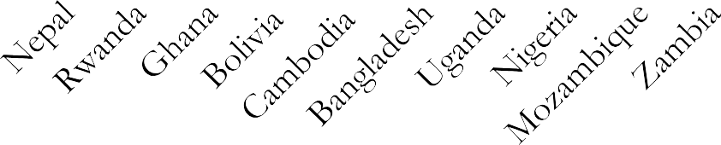
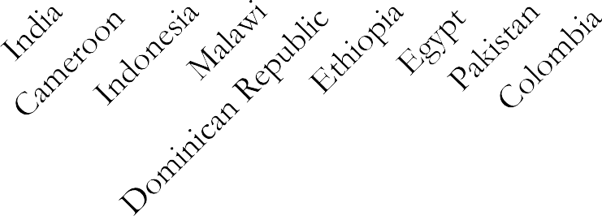
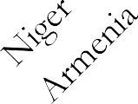
MPI (H) and $1.25/day Income poverty (H)
2
1
0
-1
-2
-3
-4
-5
-6
-7
-8
MPI Incidence
$1.25 Incidence

Slide 17
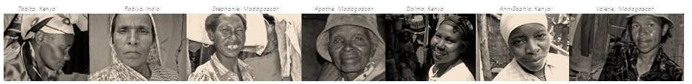
Methodological Interlude:
Dynamic Subgroups Analysis using repeated Cross-Sectional data

Slide 18
Dynamic Subgroups – Repeated Cross-Section Data
It is impossible to decompose ∆𝑀₀ with the empirical precision as when using panel data
However we do care about the extent to which the poorest of the poor reduced the intensity of their poverty or exited poverty.
Consider 2 groups:
Movers: those who changed status across periods (∆𝐻)
Stayers: ongoing poor plus the proportion of previously poor people who were replaced by ‘new poor’ (𝐻 𝑋_{𝑡}2 )

Slide 19
Change in 𝑴_{𝟎}
If poverty reduced and the group of people who entered poverty is empirically small (assumptions)
Change in 𝑀₀ can be decomposed as follows:
∆𝑀₀ = ∆𝐻 × 𝐴^{𝐸} + 𝐻 𝑋_{𝑡}2 × ∆𝐴^{𝑂}
Movers Effect
Stayers Effect
How to obtain 𝑨^{𝑬} and 𝑨^{𝑶} ?

Slide 20
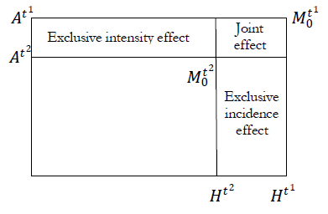
Apablaza and Yalonetzky
Assumptions:
𝐴^{𝐸} is assumed to be the average intensity in period 2.
∆𝐴^{𝑂} is assumed to equal the simple difference in intensities
of the poor across the two periods

Slide 21
Apablaza and Yalonetzky
2 2
2
1
𝑡 𝑡
𝑡
𝑡
∆𝑀 = 𝐴 ∆𝐻 + 𝐻 ∆𝐴 + 𝐻
− 𝐻 𝐴^{𝑡2} − 𝐴^{𝑡1}
0
Effect from
entry and exit
Effect among
ongoing poor
Interaction
effect

Slide 22
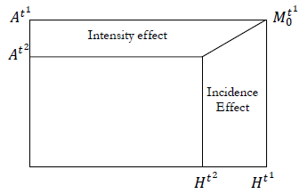
Roche – Shapley Decomposition
Assumptions:
- 𝐴^{𝐸} is assumed to be the average intensity for the two periods.
- The percentage of ongoing poor is assumed to be the average incidence for the two periods

Slide 23
Roche – Shapley Decomposition
𝐴^{𝑡2} + 𝐴^{𝑡1}
𝐻^{𝑡2} + 𝐻^{𝑡1}
∆𝑀₀ =
∆𝐻 +
∆𝐴
2
2
Incidence effect
Intensity effect

Slide 24
Upper and Lower Estimates - empirical
Estimate lower and upper bound estimates for 𝐴^{𝐸} , ∆𝐴^{𝑂}
If less poor people moved out of poverty
Identify the ∆𝐻 × 𝑛 poor persons having the lowest intensity
Use the average of those scores for 𝐴^{𝐸} then solve for 𝐴^{𝑂}
If poorest people moved out of poverty
Identify the ∆𝐻 × 𝑛 poor persons having the highest intensity
Use the average of those scores for 𝐴^{𝐸} then solve for 𝐴^{𝑂}

Slide 25
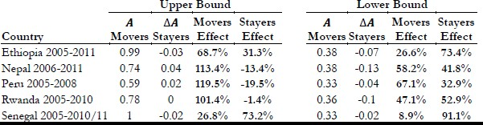
Example
The upper and lower bounds are wide apart and vary across countries.
The real contributions could vary within this range.
Can we guess which effect had the biggest contribution? Not necessarily (Ethiopia, Rwanda)

Slide 26
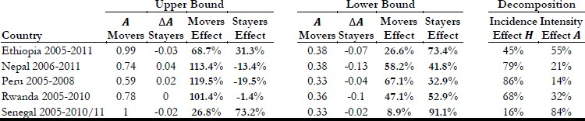
Example: Shapley
Shapley decomposition lies between the upper and lower bounds.
Shapley decomposition has the appeal of appearing to provide point estimates.
But the underlying assumptions are strong and not validated.
It may be better to be ‘vaguely right than precisely wrong’.

Slide 27
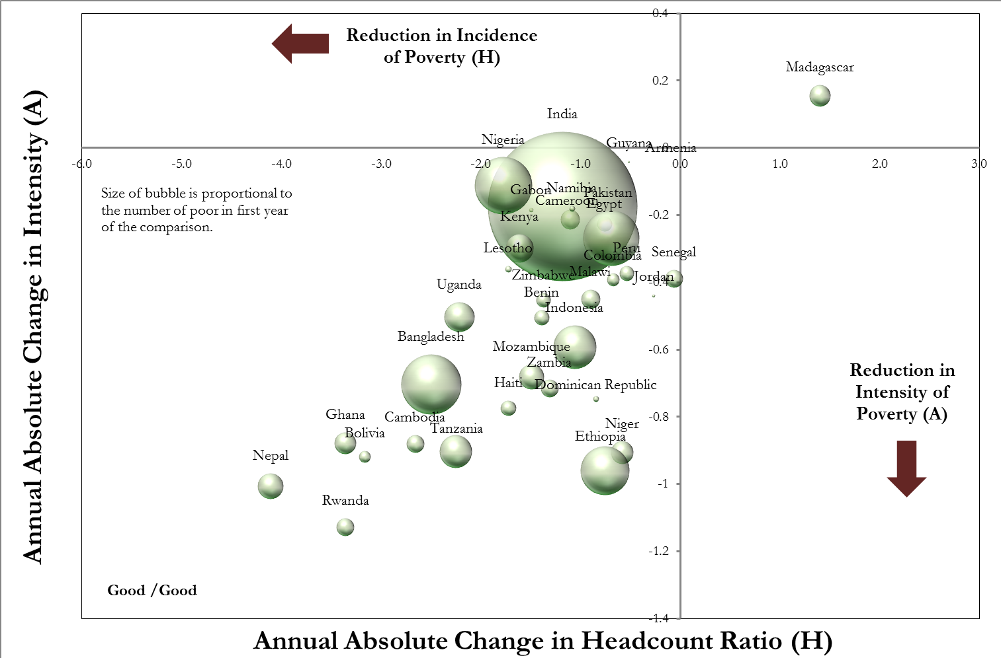
Reductions in Headcount ratio H and Intensity A
28

Slide 28
34 countries: National Level initial year: H, A
75%
Niger
70%
Ethiopia
Average Intensity of Poverty (A)
65%
Cameroon
Nigeria
India
Mozambique
60%
Madagascar
Pakistan
Haiti
Uganda
55%
Rwanda
50%
Ghana
Nepal
Indonesia
Zambia
Tanzania
45%
Colombia
Kenya Cambodia
Bangladesh
40%
Bolivia
Lesotho
Peru
Dominican
Republic
0% 10%
The size of the bubbles is a proportional
representation of the total number of MPI poor in each country
35%
30%
20% 30% 40% 50% 60% 70% 80% 90% 100%
Percentage of People Considered Poor (H)

Slide 29









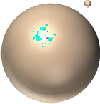



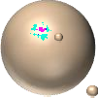








































34 National and 338 Sub-National Levels, initial year
75%
Niger
Ethiopia
70%
Average Intensity of Poverty (A)
65%
Cameroon
Nigeria
India
Mozambique
60%
Madagascar
Pakistan
Haiti
Uganda
55%
Rwanda
50%
Ghana
Nepal
Indonesia
Zambia
Tanzania
45%
Colombia
Kenya Cambodia
Bangladesh
40%
Bolivia
Lesotho
Peru
Dominican
Republic
0% 10%
The size of the bubbles is a proportional
representation of the total number of MPI poor in each country
35%
30%
20% 30% 40% 50% 60% 70% 80% 90% 100%
Percentage of People Considered Poor (H)

Slide 30
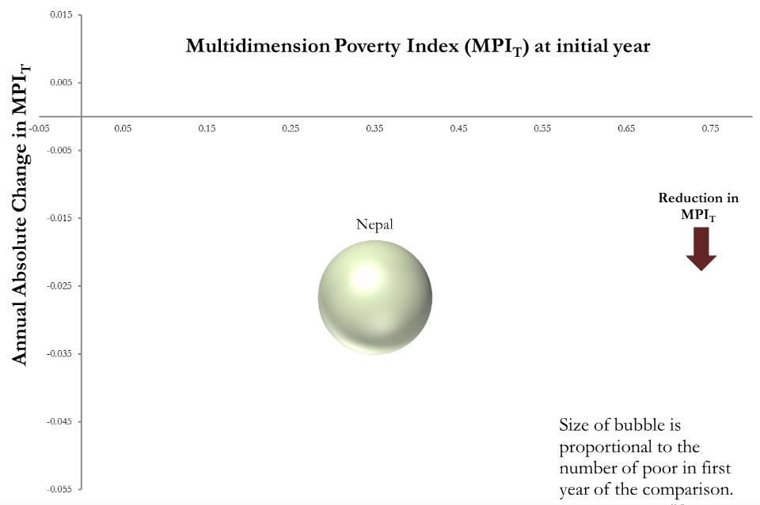
Subgroup Decompositions

Slide 31
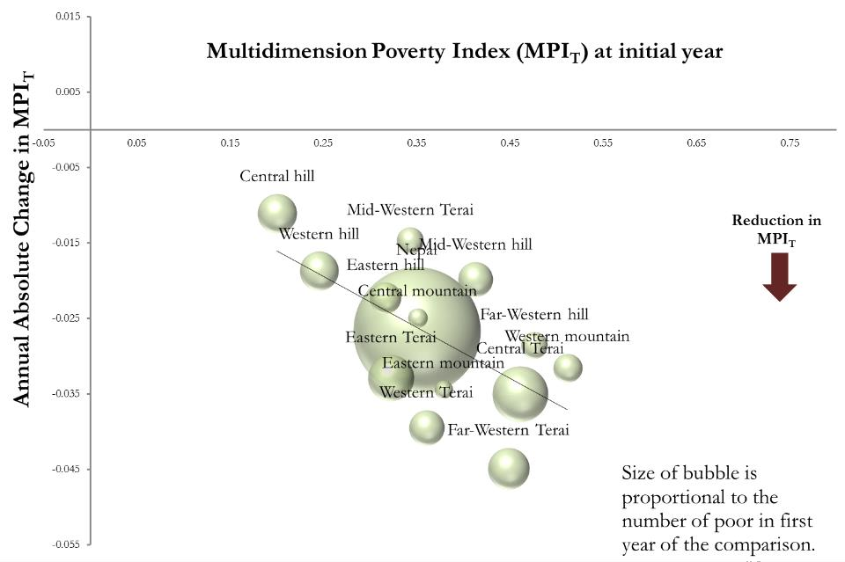
Subgroup Decompositions

Slide 32
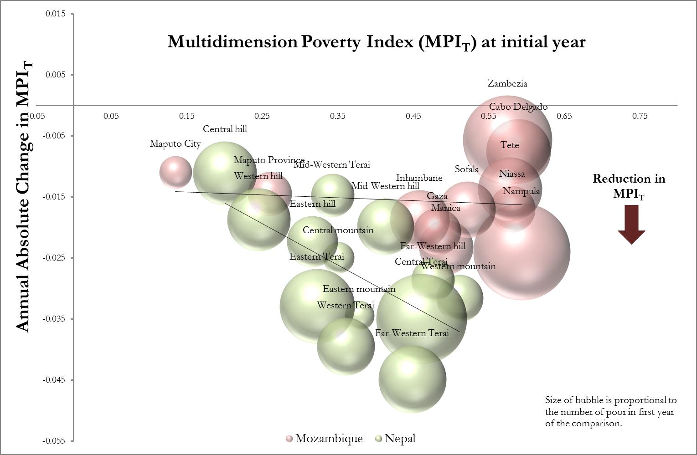
Poverty reduction in regions of Mozambique and Nepal

Slide 33
























Indonesia MPI Reduction 2007-12 by subnational regions
0.010
West Papua
Annual Absolute Change in % MPI
0.005
Papua
_{North S}C_{ul}e_{a}n_{w}t_{e}ra_{si}l Kalimantan
Central Sulawesi
West Sulawesi
Jambi
West Nusa Tenggara
0.000
0.00 Jakarta
East Kalimantan
S₀o_{.1}u₀ th East Sulawesi
0.05
National
0.15
North Maluku
0.20
Reduction in MPI
0.25
Bangka-Belitung
Yogyakarta Special
Aceh
Gorontalo
Bali
South Kalimantan
Region
Riau
0.005
Central Java
West Java
Lampung
Kepulauan Bangka-
Belitung
North Sumatra
East Java
West Kalimantan
0.010
South Sumatra
Bengkulu
East Nusa Tenggara
Maluku
South Sulawesi
West Sumatra
Banten
0.015
Multidimensional Poverty Index (MPI) at initial year
0.020
34

Slide 34
Disaggregation by subnational regions: Summary results
A total of 208 regions, representing 78% of our sample, showed statistically significant reduction in MPI.
Eight countries: Bangladesh 2007-11, Bolivia, Gabon, Ghana, Malawi, Mozambique, Niger and Rwanda – had significant reductions in each subnational region.
In nine countries the poorest region had the fastest reduction (Bangladesh 2007-11, Bolivia, Colombia, Egypt, Kenya, Malawi, Mozambique, Namibia, Niger)
Subnational disparities increased in Ethiopia (2000-5), Indonesia, Jordan, Mozambique, Niger, Nigeria, Pakistan, Tanzania and Zambia.
35

Slide 35








Disaggregating by ethnic group - Benin
0.010
Multidimension Poverty Index (MPI_{T}) at initial year
Size of bubble is proportional to
the number of poor in first year of
0.005
Dendi
Peulh
the comparison.
0.000
0.00
Annual Absolute Change in MPI_{T}
0.10
0.20
0.30
0.40
0.50
0.60
0.70
0.80
Bétamaribe
-0.005
Yoruba
Bariba
Fon
Reduction in
MPI
-0.010
Adja
Yoa and Lopka
-0.015
-0.020
.
-0.025
-0.030
-0.035

Slide 36
Disaggregating by ethnic group - Benin
0.010
Multidimension Poverty Index (MPI_{T}) at initial year
Size of bubble is proportional to
the number of poor in first year of
0.005
Dendi
Peulh
the comparison.
0.000
0.00
Annual Absolute Change in MPI_{T}
0.10
0.20
0.30
0.40
0.50
0.60
0.70
0.80
Bétamaribe
-0.005
Yoruba
Bariba
Fon
Reduction in
MPI
-0.010
Adja
Yoa and Lopka
-0.015
-0.020
.
-0.025
-0.030
-0.035

Slide 37




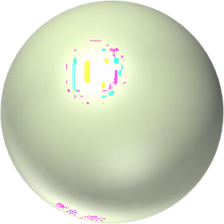
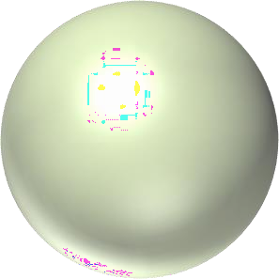


Disaggregating by ethnic group - Kenya
0.010
Multidimension Poverty Index (MPI_{T}) at initial year
Meru
0.005
Size of bubble is proportional to the number of poor in first year of the comparison.
0.000
Kamba
Mijikenda/Swahili
0.00
Annual Absolute Change in MPI_{T}
0.10
Kikuyu
0.20
Luhy⁰a^{.30}
0.40
0.50
0.60
0.70
0.80
-0.005
Luo Kisii
Kalenjin
Reduction in MPI
-0.010
-0.015
-0.020
Somali
-0.025
-0.030
-0.035

Slide 38

Disaggregating by ethnic group - Kenya
0.010
Multidimension Poverty Index (MPI_{T}) at initial year
Meru
0.005
Size of bubble is proportional to the number of poor in first year of the comparison.
0.000
Kamba
Mijikenda/Swahili
0.00
Annual Absolute Change in MPI_{T}
0.10
Kikuyu
0.20
Luhy⁰a^{.30}
0.40
0.50
0.60
0.70
0.8
-0.005
Luo Kisii
Kalenjin
Reduction in MPI
-0.010
-0.015
-0.020
Somali
-0.025
-0.030
-0.035

Slide 39
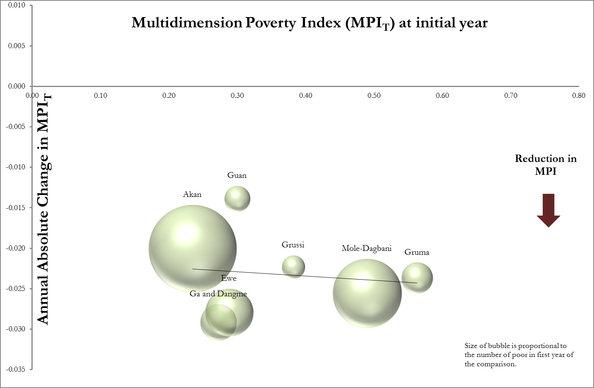
Disaggregating by ethnic group - Ghana
40

Slide 40
Dimensional Changes
The (annualized) absolute rate of change in 𝑀₀ can be expressed as the weighted 𝑤_{𝑗} average of the (annualized)
absolute rates of change in censored headcount ratios h_{j}.
𝑑
∆ 𝑀₀ = 𝑤_{𝑗}∆ ℎ_{𝑗} 𝑘
𝑗=1
When different indicators have different weights, the effects of their changes on the change in 𝑀₀ reflect these weights.

Slide 41
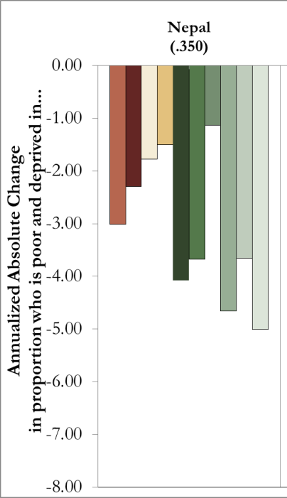

Change in censored headcount ratios
If a deprivation is reduced
If a person deprived in that indicator becomes non-poor
42

Slide 42
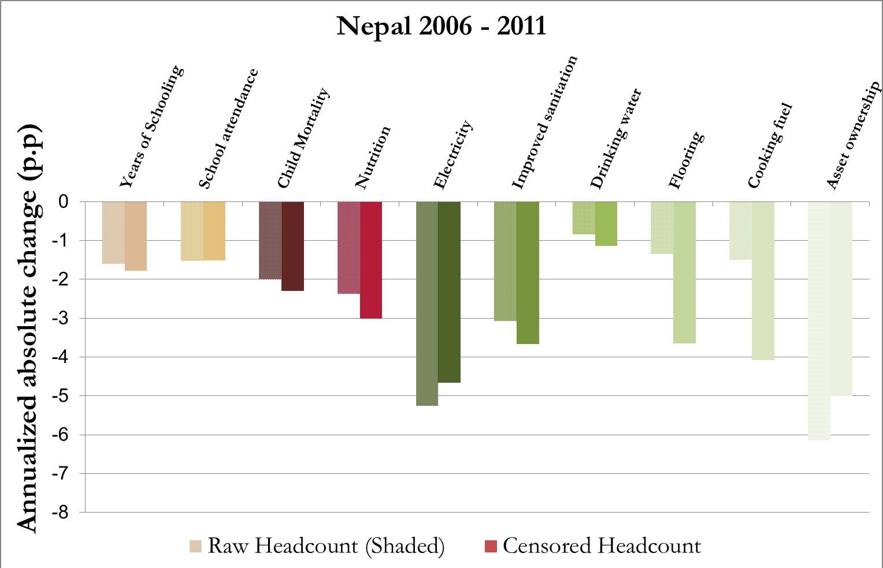
Changed in Censored and Uncensored h_{j}

Slide 43
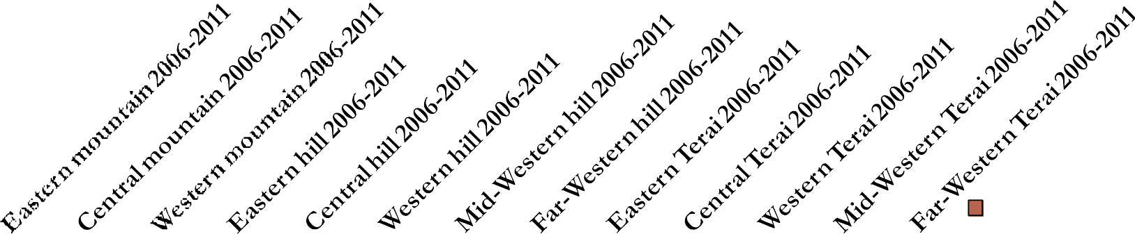
Indicator Changes by region (Nepal)
Annualized Absolute Change
in proportion who is poor and deprived in...
Nutrition
0.03
Child Mortality Years of
0.01
Schooling
-0.01
Attendance
Cooking Fuel Sanitation
-0.03
-0.05
Water
-0.07
Electricity
Floor
-0.09
Assets
-0.11

Slide 44
Changes in censored headcount ratios
Rwanda (.330)
Ghana (.202)
Tanzania (.335)
Uganda (.343)
0
-0.01
Nutrition
Child Mortality Years of Schooling Attendance
-0.02
-0.03
-0.04
Electricity
-0.05
Sanitation
Water
-0.06
Floor
-0.07
Cooking Fuel
-0.08

Slide 45
Changes in Indicators: Summary results
Ten countries had significant reductions in each indicator (censored headcount ratios): Bolivia, Cambodia, Colombia, the Dominican Republic, Gabon, India, Indonesia, Mozambique, Nepal, and Rwanda.
Each of the 10 component indicators had the fastest
reduction in some region.
Overall, the fastest absolute reduction on average was access to sanitation.
46

Slide 46
Destitute: A Subset of the Poor
We implement destitution measures across each of these 34 countries and study their dynamics
Indicators:
Weights:
Poverty cutoff:
Deprivation cutoffs:
Same as MPI Same as MPI Same as MPI Deeper
All destitute people are also MPI poor.
Alkire, Conconi and Seth 2014
47

Slide 47
Deprivation cutoffs: Destitute
Indicator | Destitution Cutoff
Schooling 1/6 | No one has completed more than one year of schooling
Attendance 1/6 | All primary school aged children are out of school
Nutrition 1/6 | Someone is severely malnourished at home
Mortality 1/6 | Household has lost two or more children
Electricity 1/18 | The household has no electricity (No change)
Sanitation 1/18 | No facility available so practice open defecation
Water 1/18 | No Safe water or a 45 minute walk
Floor 1/18 | The household has a dirt, sand, or dung floor (No change)
Fuel 1/18 | Cooks with Wood or Dung
Assets 1/18 | Owns No Assets – Radio, television, mobile phone, bicycle etc.
Any person who is deprived in 1/3 of these weighted indicators is Destitute.
48

Slide 48
Overview
Over half of all MPI poor people are destitute.
28 countries reduced destitution (0.05); 29 reduced H^{D}
Largest reductions in: Ethiopia, Niger, Ghana, Bolivia, Rwanda, Tanzania, Nepal, Haiti, Bangladesh (2004-7) and Zambia.
These are LDCs or LICS except Ghana & Bangladesh
49

Slide 49
Overview
In most countries, destitution is being reduced faster than MPI in relative terms; in 4 countries this is also true in absolute terms.
Nine countries reduced all destitution indicators significantly: Cambodia, Dominican Republic, Ethiopia (2000-5), Haiti, India, Indonesia, Mozambique, Niger and Rwanda (0.05).
27 countries had significant reductions of destitution in rural
areas, and 20 countries in urban areas.
50

Slide 50
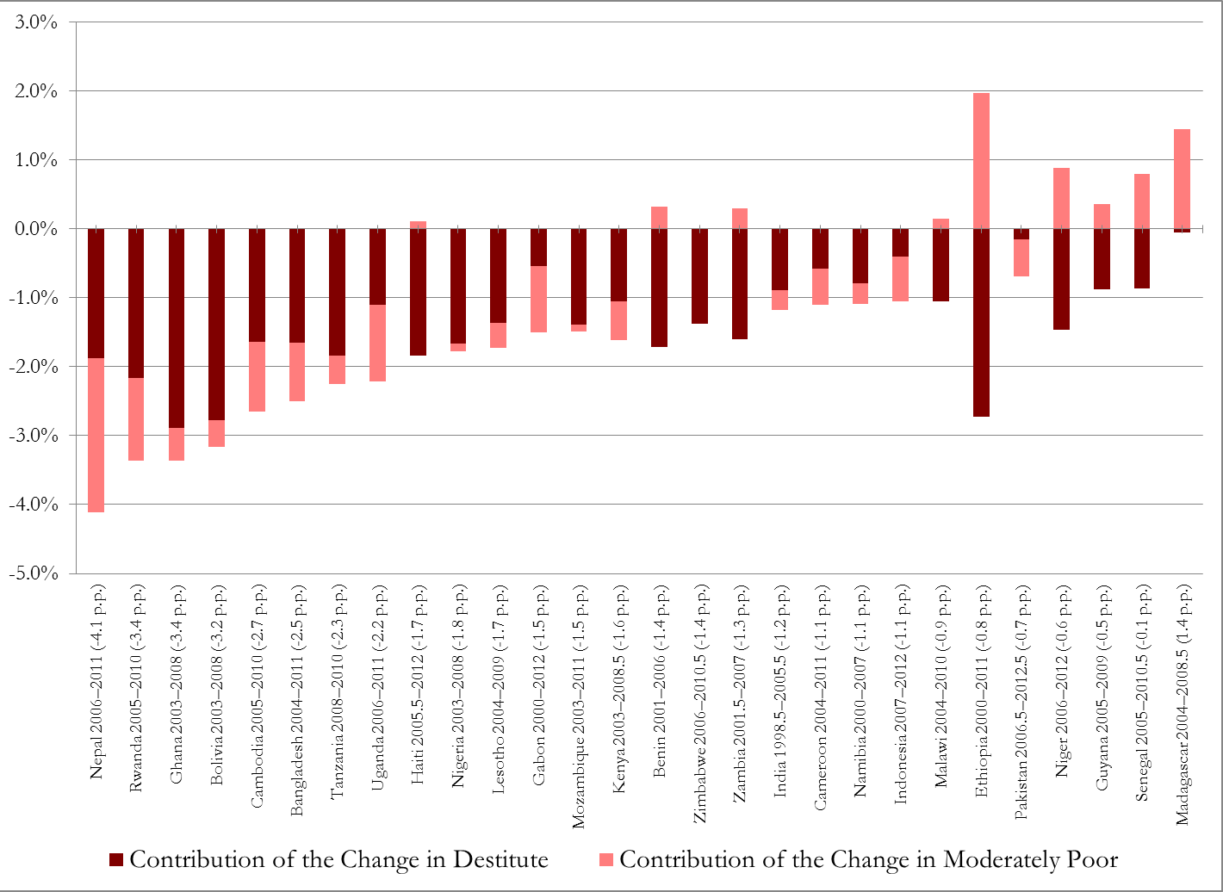
Breaking Down the Change in Multidimensional Headcount Ratio into Change in Moderate Poverty and Change in Destitute
51

Slide 51
Ethiopia: Reduction of Destitution
 |  | National |  | Urban |  | Rural
 |  | Level | Annualised Change | Level | Annualised Change | Level | Annualised Change
MPI^{D} | 2000 | .471 | - | .115 | - | .530 | -
 | 2005 | .339 | -0.26*** | .055 | -.012*** | .377 | -.031***
 | 2011 | .248 | -0.015*** | .054 | -0.000 | .290 | -0.014***
Headcount Ratio | 2000 | 82.1 | - | 25.9 | - | 91.4 | -
 | 2005 | 65.4 | -3.3*** | 12.7 | -2.6*** | 72.6 | -3.8***
 | 2011 | 52.1 | -2.2*** | 12.9 | .0 | 60.7 | -2.0***
Average Intensity | 2000 | 57.4 | - | 44.4 | - | 58.0 | -
 | 2005 | 51.8 | -1.1*** | 43.5 | -0.2 | 52.0 | -1.2***
 | 2011 | 47.6 | -0.7*** | 42.1 | -0.2 | 47.8 | -0.7***
52

Slide 52




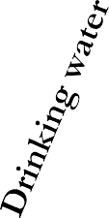












Destitution in Ethiopia 2000 - 2005
Absolute Change in Headcount
0
-1
-2
-3
-4
-5
-6
-7
-8
-9
-10
Raw Headcount Ratio
Censored Headcount Ratio
53

Slide 53
Conclusions
Systemic account of multidimensional poverty dynamics using AF Adjusted Headcount Ratio and its consistent sub-indices
31 out of the 34 countries under study significantly reduced
multidimensional poverty over two or three periods
Variable relationships between the pace of multidimensional poverty reduction and reduction in $1.25/day poverty require further study.
Rather than theoretical or Shapley decompositions we simply study absolute
changes in H and A at this point to avoid overly precise assumptions.
Subnationally 208 regions had statistically significance reduction in MPI.
There were significant changes in all of the ten MPI indicators, although the dimensional reduction profile varied across country.
Destitution affected a disturbing proportion of the MPI poor, pointing to
the need to explore ordinal ‘depth’ or at least subsets of the poor further.
Destitution dynamics did not mirror MPI reduction, and were strongest in LICS and LDCs.

