Slide 1

Scrutinising the MPI:
Brief reflections on Dotter and Klasen’s proposals
Sabina Alkire and OPHI colleagues
4 March 2013
A background paper is available upon request

Slide 2
Proposals by Dotter and Klasen 2013
Empirical Issues
1. Dropping the use of the World Health Survey
2. Dynamics exhibited by the MPI
3. Dropping access to electricity, cooking fuel and sanitation
4. Shortening the attendance to school window by two years
5. Restricting the indicator of mortality to children under 5 years of age
6. Modifying the nutritional indicator
7. On adjusting some indicators for hh size
8. A ‘hybrid’ approach?
9. On severe multidimensional poverty
Conceptual Issues
1. Union vs. intermediate poverty cutoff
2. On reporting H and not MPI nor Intensity
3. On reporting inequality in the spread of deprivations
4. On using a weakly-relative approach to deprivation cutoffs

Slide 3
Proposals by Dotter and Klasen 2013
Empirical Issues
1. Dropping the use of the World Health Survey
2. Dynamics exhibited by the MPI
3. Dropping access to electricity, cooking fuel and sanitation
4. Shortening the attendance to school window by two years
5. Restricting the indicator of mortality to children under 5 years of age
6. Modifying the nutritional indicator
7. On adjusting some indicators for hh size
8. A ‘hybrid’ approach?
9. On severe multidimensional poverty
Conceptual Issues
1. Union vs. intermediate poverty cutoff
2. On reporting H and not MPI nor Intensity
3. On reporting inequality in the spread of deprivations
4. On using a weakly-relative approach to deprivation cutoffs

Slide 4
E1. Dropping the World Health Survey Using only DHS and MICS surveys
Yes!
Data are not good quality
Data are old
Implications: This will entail dropping 14 countries in 2014:
China, Croatia, Czech Republic, Ecuador, Estonia, Guatemala, Hungary, Latvia, Paraguay, Russian Federation, Slovakia, Slovenia, Sri Lanka, United Arab Emirates
We anticipate at least 3 will be updated in 2014:
Tunisia, Uruguay, Chad
Problem: how to update MPI for China?

Slide 5
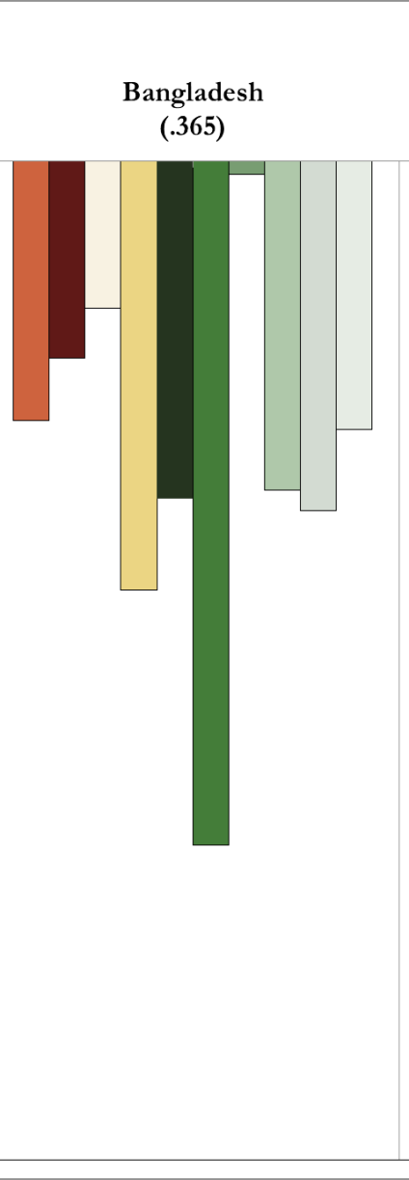
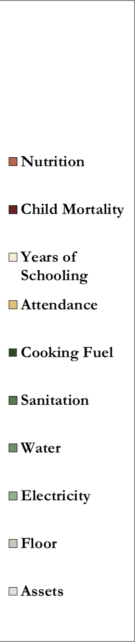
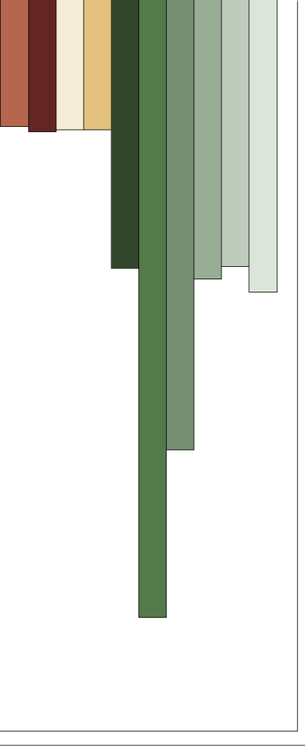
E2. Dynamics exhibited by the MPI
Now clear that all MPI indicators change over time, nationally and by subnational regions or groups.
Notes:
There is no header for the second graph

Slide 6
Inside the Regions of Nigeria
Notes:
Updated graph

Slide 7
E3. Drop electricity, cooking fuel & sanitation
Empirical analysis
We implemented multiple measures of association across MPI censored deprivation indicators as well as raw headcounts and achievements (Alkire and Ballon, 2012).
This was, particularly, to explore redundancy in the standard of living indicators. We had expected to encounter redundancy.
Statistically, we could not detect redundancy: no two indicators moved in lockstep, having consistently high associations across countries having different levels of MPI and different regions.

Slide 8
E3a. Drop electricity? (no)
Electricity
Access to electricity remains key to those who lack it.
Romer’s image of children doing homework under a street light.
A question on loadshutting, affordability would improve accuracy.
Notes:
It seems to me that Klasen’s criticisms had to do with the “depth” of deprivation in electricity. Since you are using an ordinal variable depth is irrelevant

Slide 9
E3b. Drop cooking fuel? (no)
Cooking Fuel -
2010 Global Burden of Disease estimates health burdens from cooking fuel are far higher than previously thought:
4 million deaths, of which 0.5 million are children, from Harmful Air Pollution (HAP) and cookfire smoke.
In DALYs, HAP is 2nd most important risk factor for girls/women’s lost health life years globally and 1st in South Asia and Sub-Saharan Africa.
A follow-up question on ventilation would greatly improve accuracy.

Slide 10
E3c. Drop sanitation? (no)
Sanitation
“1.1 billion people – 15% of the world’s population” – still resort to open defecation. The Report on Progress on Drinking Water and Sanitation 2012 Update UNICEF & WHO, p 19
“far more countries have sanitation coverage of less than 50% than water coverage of less than 50%” (Ibid, p 18)
Dropping sanitation will lead to visible falls in the MPI
Perhaps it should be retained.

Slide 11
E4. Shorten school attendance by 2 years (kids often start late, so increase starting age)
Poor children tend to start school later and drop out earlier. The proposed change will overlook such differences. 2012 EFA
In Guatemala, “indigenous girls from extremely poor households enroll in school 1.2 years later than indigenous girls from non-poor households… and are far more likely to drop out.” (2010 EFA Report p 170)
In [the poorest regions of] Nigeria, Hausa girls who go to school tend to start late... To compound the problem, marriage at 14 or even younger is common and typically signals the end of education’. (2010 EFA Report p.167)

Slide 12
E5. Restrict Child mortality to Children under 5
Normatively, the death of a six-year-old is also a devastating experience of total health functionings failure.
Empirically, This proposal was implemented in 2010 for HDRO Advisors using DHS, and does not affect country rankings.
Our proposal, Where possible, only use information about any child deaths that occurred in the past 5 years. This will reduce any large lag effect. Note: only possible in DHS, not MICS.

Slide 13
C1. Union vs. intermediate poverty cutoff
Union has been implemented before, and criticised as inaccurate (Mack and Lansley 1985, even Townsend)
MPI cutoff ‘cleans’ data of imperfect indicators and spurious deprivations, to identify acute multidimensional poverty.
Permits diversity – e.g. for indigenous groups, climactic variations, personal preferences.

Slide 14
C1. Union vs. intermediate poverty cutoff
Union vs intersection approach two examples
CH Floor: 54.1%
CH Attendance:4.4%
Population deprived in floor dirt/sand/dung: 80%
People living in hh where a child is not attending a recognised school:18%
MPI Poor Population
58%
MPI Poor Population 5.5%
Bangladesh
DHS 2007
Syrian Arab Republic (MICS 2006)
In Bangladesh (DHS 2007) 80% of people have a dirt/sand/dung floor, but only 58% are MPI poor.
In Syrian Arab Republic (MICS 2006) 18% of people live in hh where a child is not attending a recognised school. Only 5.5% are MPI poor.

Slide 15
C1. Union vs. intermediate poverty cutoff
Censored vs Raw Headcounts case of Bangladesh 2007
Bangladesh
DHS 2007
Population
deprived but
not poor

Slide 16
C1. Union vs. intermediate poverty cutoff Example: 16 African Countries
Countries’ high headcount ratios using union (politically possible?)

Slide 17
C2. On reporting H and not MPI nor Intensity
We propose retaining MPI, H and A
UNICEF’s global child poverty headcount was roundly criticised for overlooking intensity (Delamonica and Minujin, 2007)
H lacks dimensional monotonicity altogether.
MPI provides a political incentive to reach the poorest.
Change in intensity is particularly relevant in poor countries, and in MPI ‘superstars’ (Bangladesh) (Alkire and Roche forthcoming 18 March 2013)

Slide 18
C2. Political incentive to reach the poorest.
Ethiopia 2000-05
Nigeria 2003-8
5%
M0(year1)
M0(year1)
A
A
M0(year2)
M0(year2)
Intensity of poverty is unchanged.
Reduction in Intensity of those who remain poor.
5%
9%
H
H
In 5 years, Ethiopia reduced H by 5%; Nigeria, by 9%. Ethiopia reduced intensity A by 5%, Nigeria’s was unchanged. Ethiopia reduced MPI more. H would overlook this.

Slide 19
Reductions by H (beige) and A (rose)
107%
Embargoed
95%
16%
16%
10%
90%
14%
86%
12%
88%
21%
79%
40%
60%
17%
83%
6%
94%
17%
83%
55%
45%
63%
37%
22%
78%
15%
85%
26%
74%
29%
71%
Bangladesh
21%
79%
33%
67%
32%
68%
21%
79%

Slide 20
C3. Reporting inequality in intensity
We will propose reporting an inequality indicator alongside MPI, H, and A (Alkire and Foster, forthcoming)
If that measure were to reflect absolute inequality and to satisfy key principles for policy relevance (Alkire and Seth, 2013):
Additive Decomposability
Population share weighted decomposability
Permutation invariance
Zero inequality when everybody has same deprivation score
Increase in inequality due to regressive transfer (Dalton)
Then exactly one inequality measure can be used: Variance (proof in Chakravarty 2001, discussion in Alkire and Seth 2013)
Other measures can be used if other properties are desired.

Slide 21
MPI Inequality Measure 2014
The measure reflects inequality among the deprivation scores of the poor (or of the society - /n)
V(c) = Σ_{i} (c_{i} – μ(c))²/q
where, V(c) the variance of the deprivation scores c, μ(c)) is the mean of elements in c, and q is the number of poor* people.
Simply put, if all poor people are deprived in half the dimensions, this is more equal than if half are deprived in two-thirds and half in one-third of dimensions.
Alkire and Seth (2013) provide examples of this measure and its insights as well as different options that could be reported.
* could also be whole population

Slide 22
Example: Inequality among the poor in India over time by caste
1998/9 | Intensity (A) | H | Inequality (across poor) |  | Within group | Between Group
caste | A_caste | poor_shr | var_depr_caste_p |  | within_group_p | between_group_A
ST | 57.0% | 12.6% | 2.75
SC | 55.0% | 22.1% | 2.67
OBC | 52.1% | 33.3% | 2.38
General | 50.6% | 32.0% | 2.22
India | 52.9% | 100% | 2.49 |  | 2.44 | 0.05
2005/6
ST | 56.3% | 12.9% | 2.86
SC | 52.6% | 22.9% | 2.44
OBC | 50.8% | 42.1% | 2.26
General | 49.7% | 22.0% | 2.30
India | 51.7% | 100% | 2.43 |  | 2.39 | 0.04
Inequality across all the poor declines gr
Inequality between caste groups (intensity) declines blue
Inequality in poorest caste (ST) increases – some are being left behind. red
Inequality in SC declines, as does poverty – a good sign. yellow
To consider inequality across MPIs, need to consider inequality across the censored deprivation vector

Slide 23
C4. A weakly-relative approach to deprivation cutoffs
Like Ravallion, we think this is interesting but not ready for policy.
Cross-country MPI comparisons: complex
MPI across time: complex
“An absolute approach in the space of capabilities translates as a relative approach in the space of commodities” Ravallion and Chen (2011) citing Sen (1983)
The MPI gets a bit closer to capturing underlying capabilities
Weakly relative requires cardinal data – how adapt?

Slide 24
Our proposals:
Drop the World Health Survey
Restrict Child mortality to deaths in last 5 years
Consider Child Stunting – good arguments either way.
Add Inequality across the MPI Poor to Tables

Slide 25
E6. Drop adult Body Mass Index
Normatively, adult undernutrition data matters, and exists in DHS surveys. It is imperfect, not reflecting micronutrients, but vital.
Empirically, the BMI cutoff debate D&K mention pertains to obesity, not to low BMI.
Empirically, dropping the adult malnutrition indicator, increases the proportion of households with ‘non-applicable’ population, because any households without children are automatically non-deprived in nutrition.
(we suggest retaining BMI)

Slide 26
E7. Adjusting certain indicators by hh size? (worth exploring academically further)
Years of education: The current distinction refers to the qualitative different case of a proximate literate from an isolate literate.
From a human rights perspective, a child death, a malnourished person, or a child not attending school is worthy of consideration itself, even if other household members are not similarly deprived: would need careful justification to ignore these in large households.
Notes:
It seems to me that Klasen’s criticisms had to do with the “depth” of deprivation in electricity. Since you are using an ordinal variable depth is irrelevant

Slide 27
E8. A hybrid approach? (no)
It prevents break-down by indicator.
We are unsure whether the ‘bias’ is actual. Children and women are vulnerable groups and may be actually poorer.
Comparative work has shown hh size consistently matters less for MPI than for income.

