Slide 1

DIGITAL FORENSICS
Implementation and Challenges
INFORMATION SECURITY
Naveen Dayakar
176004603

Slide 2
INDEX
DIGITAL FORENSICS
INTRODUCTION
ROOM FOR IMPROVEMENT?
CHALLENGES
TYPES OF PROBLEMS IN DIGITAL FORENSICS
RESOURCE CHALLENGES
Challenges in Iot & Cloud environments;
Solutions, DIBS
TECHNICAL CHALLENGES
CURRENT FORENSIC MODELS
Challenges in Iot & Cloud environments;
Logicube.
Most commonly used digital forensic models;
Comparison of models
ETHICAL CHALLENGES
FUTURE WORK
Basic legal steps during investigation;
FORZA framework
Solutions and Suggestions

Slide 3

INTRODUCTION
ROOM FOR IMPROVEMENT?
RISE IN E-CRIMES
HACKING SKILLS IMPROVING
E-crimes are unknown, increasing in number and harder to recognize.
With improvement in technology, more ways to commit E-crimes.
DIGITAL FORENSICS:
“Preservation, Identification, Extraction, Interpretation and Documentation of computer evidence which can be used in the court of law”.
AVAILABILITY OF COMPUTERIZED DATA
LACK OF STANDARDIZED PROCEDURE
Higher probability of data being recorded.
DF models currently in use are developed by organizations according to their needs.
EASE OF STORAGE
BACKLOGS OF PENDING CASES
Rise of Cloud Storage,
Increase in data storage capacity of devices.
Number of digital crimes are out of proportion with the pace at which the legal entity operates.

Slide 4




CHALLENGES
TYPES OF PROBLEMS IN DIGITAL FORENSICS
RESOURCE CHALLENGES
TECHNICAL CHALLENGES
ETHICAL CHALLENGES
CHALLENGES IN CURRENT MODELS
Challenges that are faced when trying to collect, store and preserve digital evidence.
Challenges that occur when technicians develop tools and analyze digital evidence.
Challenges that are legally restricting the generation, storage and maintenance of data.
Challenges faced by current models designed by organizations to perform digital forensic investigations.

Slide 5
Need for Data Reduction
01
RESOURCE CHALLENGES
Complexity problem arising from the data being collected at the lowest level, with increasing volume and heterogeneity.
Lack of Standardization
02
It adds to many file formats and operating systems, sharing data between law enforcement agencies becomes difficult.
Also, tools designed for forensics do not follow same framework.
Resource Challenges in Cloud Environments:
Data stored in cloud environments is distributed, cost and time needed for data retrieval is difficult
CSP must comply for data acquisition and distribution
Old data can be overwritten in cloud environments, Frequency depends on the CSP
Signing-up for Cloud service is easy, require less time.
Resource Challenges in IoT Environments:
Lack of similarity between IoT devices
Limited ways to trace information origin and destination
IoT devices are small, and have limited computational ability.
Lack of Automation
03
Since a particular standard is absent, automation is also absent causing pending cases of E-crimes.
Time Difference
04
Due to cloud systems, the data retrieved for evidence can be found anywhere. The difference in time zone and time stamp interpretations can make collecting evidence difficult.

Slide 6
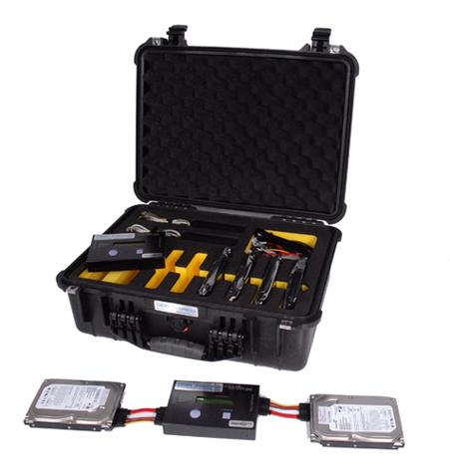
DIBS
The DIBS RAID(Rapid Action Imaging Device) is a device designed to enable fast copying of a suspect’s hard disk into another clean hard disk.
The copy can then be examined for evidential material without the risk of damaging the original.
USE:
Data backup and storage is easier.
Since almost all data is stored or recorded, large amounts of data is to be retrieved and preserved.
More involvement of cloud storage requires more backed up data to be preserved.

Slide 7
Data Volatility
01
TECHNICAL CHALLENGES
Data deemed as evidence cannot be altered until produced in court. Technicians face difficulty in the protection and preservation of data after acquisition phase.
Encrypted Data
02
Most of the data stored is in encrypted format, and powerful decryption and reverse engineering necessary to extract evidence. Sometimes, anonymity of the culprit remains.
Technical Challenges in Cloud Environments:
Access to a data stored may be denied or the cost associated may be tremendously high.
More than one Cloud Service may be involved in a particular event for data extraction.
Interoperability between CSP is rare
Resource Challenges in IoT Environments:
Interoperability is difficult in IoT environment also.
The data collected in IoT also will most probably be stored in the cloud system, same challenges apply here also.
Recovering Lost or Deleted Data
03
The process of recovering lost data, particularly in cloud environments is a big challenge.
Forensic Tool-Kit
04
Due to the lack of standardization, each investigation procedure is different and technicians working should device appropriate strategy and tool-kit to extract evidence.

Slide 8
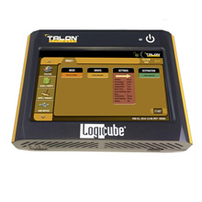
LOGICUBE
One of the leading digital forensics hardware data recovery technology.
Widely used by cybersecurity experts and computer security personnel.
Provides mainly hardware based solutions but does have software solutions also.
USE:
Data recovery done easily.
Since more cloud system involvement is expected in future, data recovery techniques should be improved.
Since Data is volatile, it must be stored till evidence is needed. Again, recovery should be fast.

Slide 9
Lack of Ethical knowledge
01
ETHICAL CHALLENGES
The investigators may be technically sound and up-to-date with technology, but expecting complete legal procedures and consequences from them is impractical.
Privacy Laws
02
If an investigator is not able to prove in court that information collected is not sufficient for a warrant, the suspicions cannot be proved in court. Privacy laws are for protection of citizens.
Basic Legal Steps for a Digital Forensic Investigation:
The original state of devices, information extracted, outcome of investigation etc., should be recorded.
Acquired information must be backed-up on a timely basis.
The investigation must not be done on the information directly to avoid alteration.
Programmed tools used to break down information must be sheltered and secured.
Signature required in each stage of information.
Jurisdiction & Geographic Difference
03
Data to be retrieved may fall under different countries with laws of their own. There are countries where some cyber-crimes are not illegal.
Non-availability of a legal framework
04
Since different entities with different knowledge areas work together in an investigation, a framework specifying the domain of the participating entities and maintains legal procedure is needed.

Slide 10
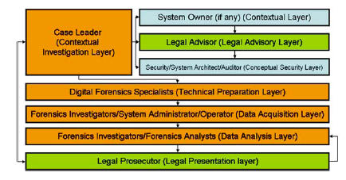
FORZA FRAMEWORK
The framework incorporates all the legal procedures.
The flowchart shows how the framework includes all the different entities involved in a digital forensic investigation.
It gives a holistic approach of how these roles or entities must work with each other, to maintain legal procedures.
USE:
Less confusion.
No Legal procedures are compromised.
Interaction between legal and technical entities is made easier.

Slide 11
1
Lee’s Model
The model addresses the list of events and actions to be taken at a crime scene and not the entirety of the investigation process.
Reith, Carr, Gunsh Model
The model is an improvement to DFRWS and it is compatible across technologies.
The model fits right in, whether the evidence is from a floppy disk or high tech hand-held device.
CURRENT DIGITAL FORENSIC MODELS
2
4
Casey’s Model
Designed to address the procedures for processing and examining digital evidence.
It is applicable to both standalone and network device environments.
According to this model, the evidence processing is a cycle of steps.
DFRWS Model
The model has a series of steps to be followed and each step takes a feedback from the previous one.
The model has no specific technology it supports.
3

Slide 12
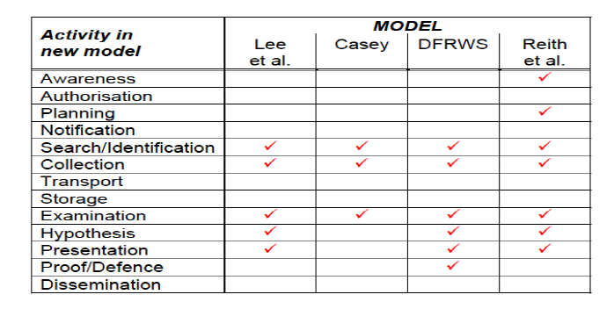
COMPARISON OF CURRENT MODELS:

Slide 13
FUTURE WORK
SOLUTIONS TO THE CHALLENGES
Distributed Processing
Unified Meta Interface for IOT
DFaaS
FPGA
Since the growth of IoT in the future is clear, in forensics, the interface in which a device is a part of can allow or deny the extraction of information.
The future work should aim at creating a unified meta-interface for the IoT devices, compatible with low to high-end devices from different vendors and interfaces.
Delays during acquisition of data, due to lack of processing power are a reason for the backlog of pending cases.
Improving the processing speed of the forensic tools and functions, by adopting the distributed processing techniques should be advantageous.
DFaaS is a cloud-based automated service to assist acquisition, analysis and storage of information.
The framework can be improved by:-
Easy retrieval and upload of information into cloud.
Reduction of impertinent and benign files during the collection of data.
FPGAs are ICs that can be
programmed even after they are manufactured.
They can achieve faster results than CPUs with fewer logical operations and can be implemented inside small devices like the ones used in IoT.
Since they are used in cryptography and visual computing, they show useful traits to digital forensics.

Slide 14
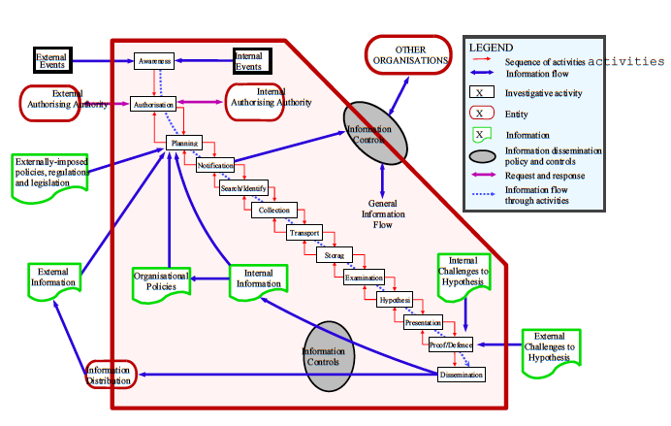

Slide 15
CONCLUSION
The technologies are improving at a fast rate, the tools to prevent or detect cyber-crimes must improve at a faster rate.
Future work should move in a direction to solve ethical, resource and technical challenges addressed.
Incorporate all the solutions in a forensic model.
Research work necessary in standardization of protocols in IoT & Cloud environments.
Standardization of laws for cyber crimes across the world.
Incorporate a digital forensic model, that allows ease of operability between participating entities in a forensic investigation.

