Slide 1
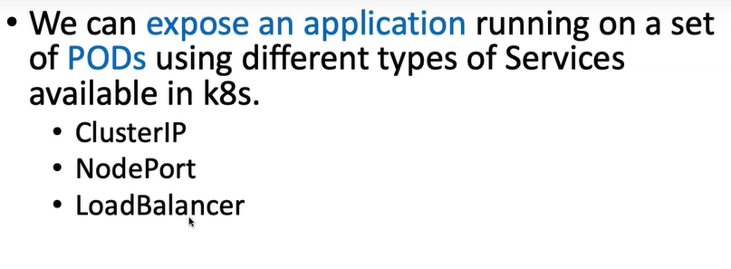
ClusterIP
Specific to a cluster & boundary to particular cluster
Access a pod
Inside a k8s cluster you can access your pod

Slide 2
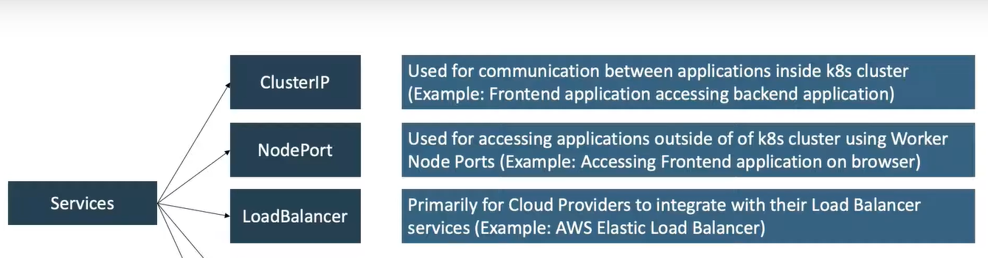

Slide 3
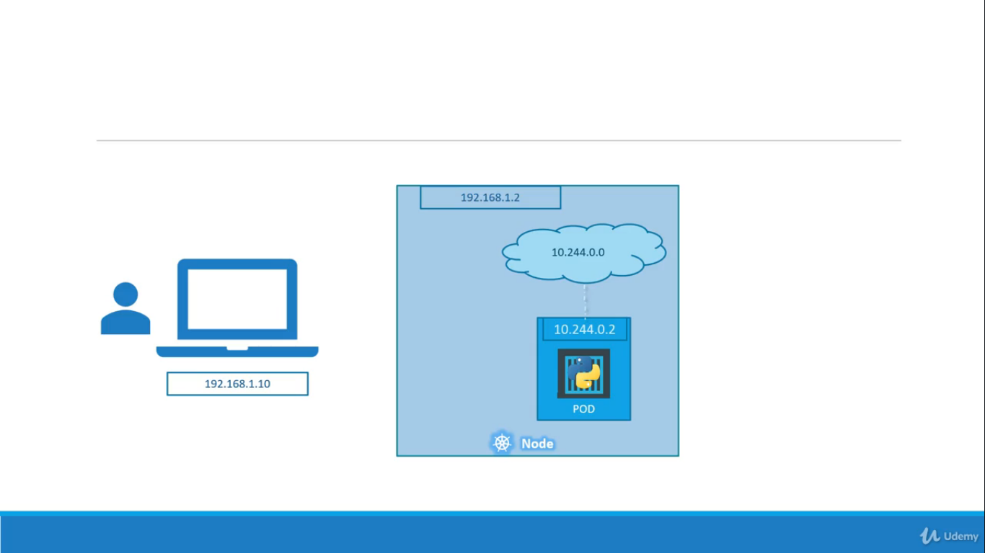

Slide 4
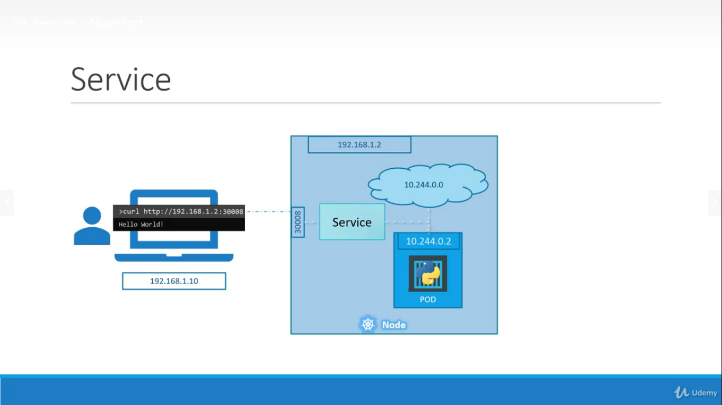

Slide 5
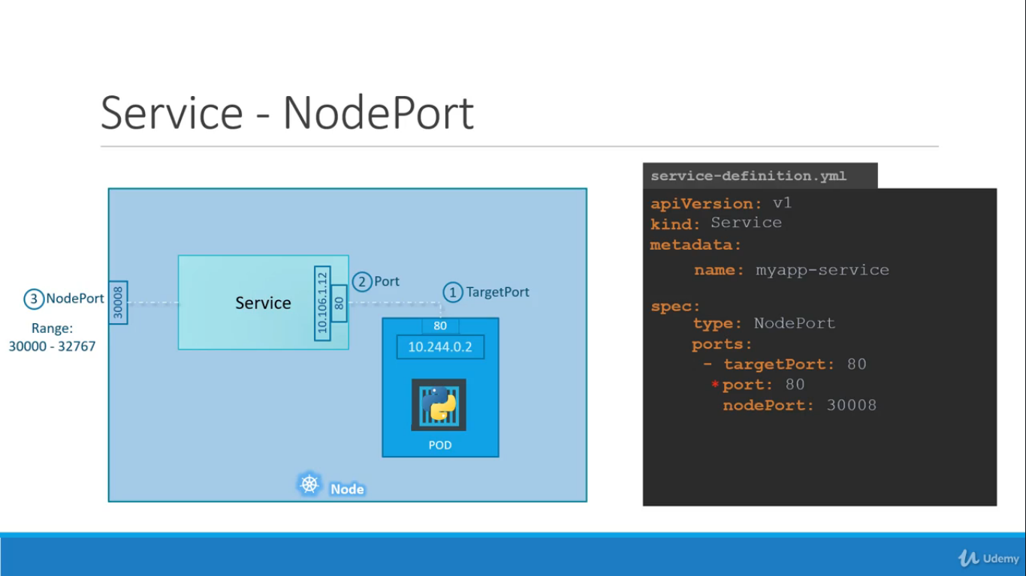

Slide 6
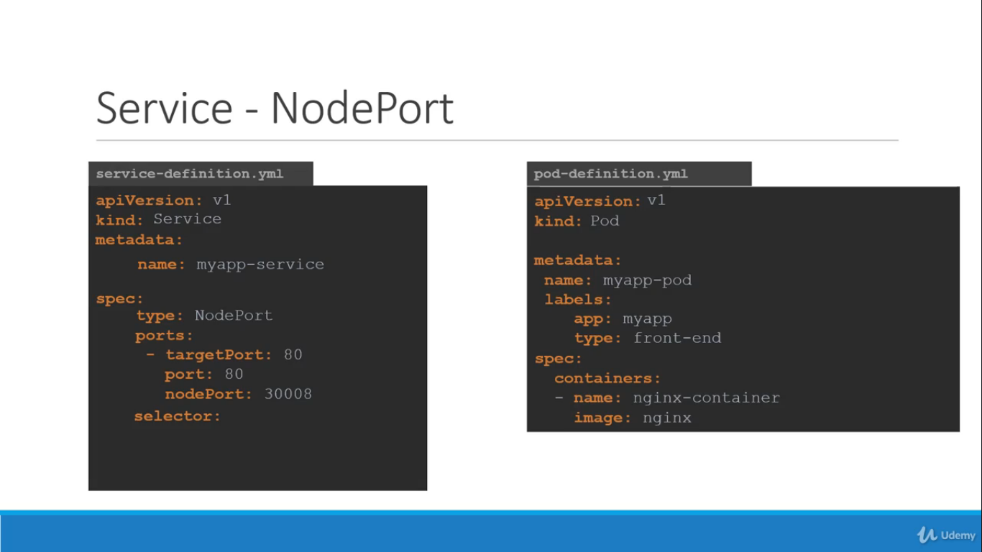

Slide 7


Slide 8
gcloud compute firewall-rules create kubia-svc --allow=tcp:30008
kubectl get nodes -o jsonpath='{.items[*].status.addresses[?(@.type=="ExternalIP")].address}’
Pod Definition
apiVersion: v1
kind: Pod
metadata:
name: myapp-pod
labels:
app: myapp
type: front-end
spec:
containers:
- name: nginx-container
image: nginx
Service Definitions
apiVersion: v1
kind: Service
metadata:
name: myapp-services
spec:
type: NodePort
ports:
- targetPort: 80
port: 80
nodePort: 30008
selector:
app: myapp
type: front-end

