Slide 1


eNlight360 On Premise Cloud
By:
Muralidar Nayak
Naveen G
Aniket Ambuj
Suraj Bhaskaracharya

Slide 2
Contents:
Introduction to eNlight360˚
Features and Benefits of eNlight360˚
Architecture and Infrastructure Management of eNlight360˚
Conclusion

Slide 3
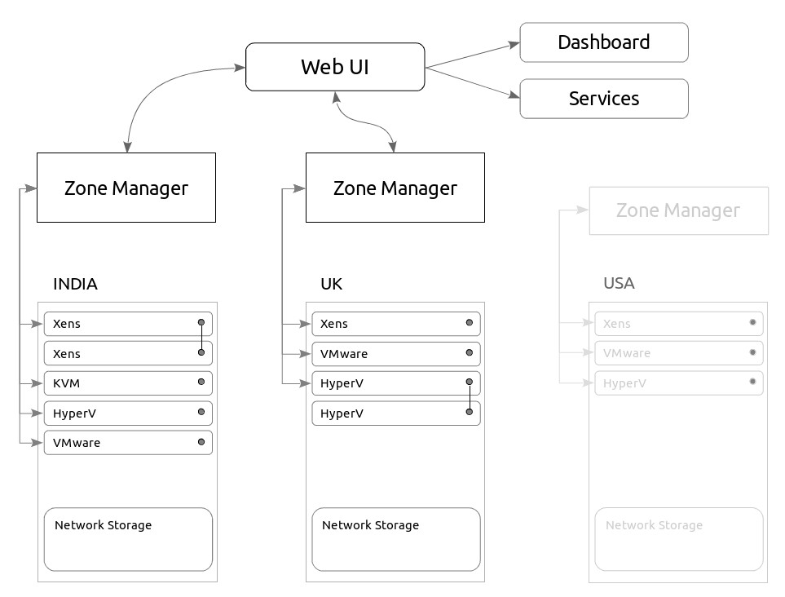
Architecture of eNlight360˚

Slide 4



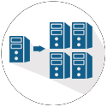
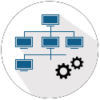

Infrastructure Management
INFRASTRUCTURE AS A SERVICE (IAAS)
Auto Scaling of Virtual Machines(Patented)
Virtual machines
Storage Services
Network Services
Vertical Scaling
Horizontal Scaling
Cloud Bursting

Slide 5



Infrastructure Management
Managed Infrastructure
Physical
Multiple Hipervisor(virtual)
24 x 7 support

Slide 6





Infrastructure Management
Business Process
LDAP & AD
Work Flow
Scheduling
Quota Management
IP Management

Slide 7
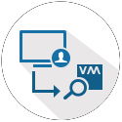





Infrastructure Management
Geo Diverse DC Monitoring
SNMP
Alert & Notifications
ITIL CMS
SysLog
Net Flow
IDS/IPS

