Slide 1

Mobile Phones Price and Ratings Analysis
Team
Dasari Chandu
Shaik Mohammad Kaif
P. Sanath

Slide 2
ABSTRACT
• This project analyzes smartphone prices and customer ratings using data collected from an e-commerce platform through web scraping.
• The dataset includes important attributes such as Product Name, Brand, Price, Rating, RAM, Storage, Screen Size, Original Price, and Discount.
• Data cleaning and preprocessing were performed to handle missing values, convert data types, and structure the dataset for analysis.
• Exploratory Data Analysis (EDA) techniques were applied to study the distribution of Price and Rating and identify patterns in smartphone specifications.
• The analysis helps understand how factors like Brand, RAM, Storage, and Screen Size influence smartphone pricing and market trends.
• The insights generated support data-driven decision making in the competitive smartphone market.

Slide 3
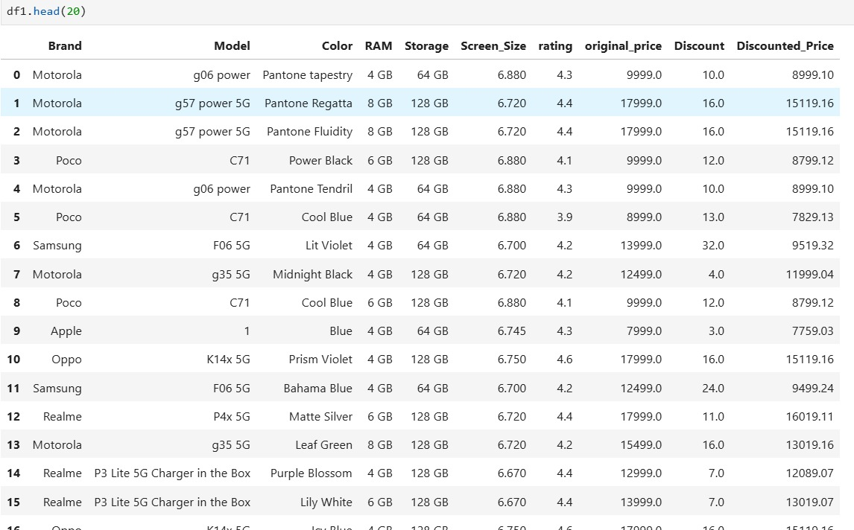
DATA FRAME

Slide 4
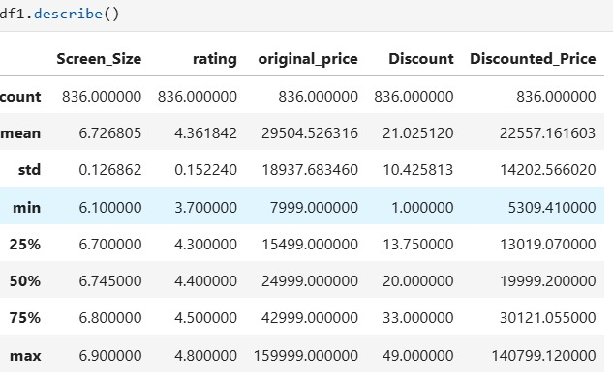
DESCRIPTIVE STATISTICES

Slide 5
WEB SCRAPING – DETAILS (Websites, Process Followed)
Data was collected from an online e-commerce platform using automated web scraping techniques.
Python libraries such as requests and BeautifulSoup were used to access and parse webpage content.
The scraper extracted important product information like product name, price, rating, features, and discount.
Data was collected from approximately 105 pages of smartphone listings.
Each page was processed sequentially and relevant product attributes were stored in lists.
The collected data was finally converted into a structured Pandas DataFrame for further analysis.

Slide 6
DATA CLEANING STEPS
Identified and handled missing values present in columns such as price, rating, and discount.
Converted text-based columns like price and discount into numeric format for analysis.
Removed unnecessary columns and inconsistent records from the dataset.
Standardized brand names to maintain consistency across the dataset.
Filled missing values using statistical techniques such as mean, median, and mode.
Verified that the final dataset contained no null values before performing analysis.

Slide 7
DATA MANIPULATION STEPS
Extracted important attributes like brand, model, color, RAM, and storage using regular expressions.
Created new columns from the existing product name and feature descriptions.
Converted screen size values from text format to numeric format for analysis.
Cleaned textual data by removing unnecessary characters and formatting issues.
Organized the dataset into structured columns suitable for data visualization.
Performed type conversions to ensure numerical operations could be applied.

Slide 8
UNIVARIATE ANALYSIS STEPS
Univariate analysis was performed to understand the distribution of individual variables.
Price distribution was analyzed to identify common price ranges of smartphones.
Rating distribution was examined to understand overall customer satisfaction levels.
Frequency of different RAM and storage configurations was studied.
Brand distribution was analyzed to identify the most common smartphone brands in the dataset.
Histograms and bar charts were used to visualize these distributions.

Slide 9
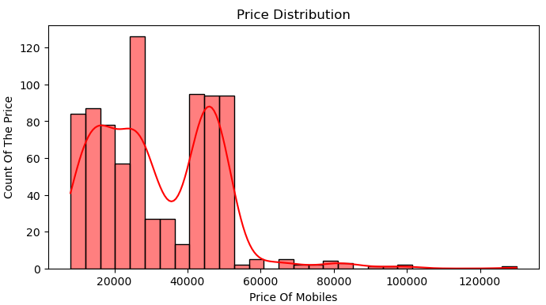
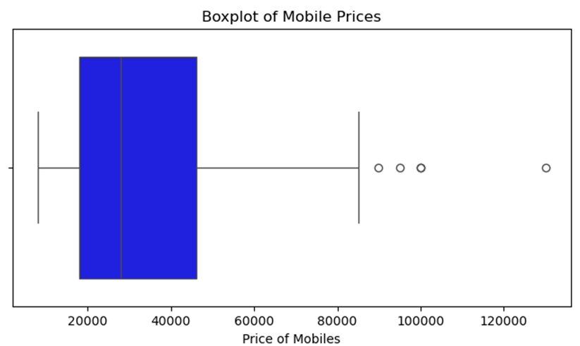
Observation:
- The distribution of mobile phone prices is right-skewed, indicating that most phones are affordable while only a few belong to the premium price segment.
- Most mobile prices lie within a certain range, while a few high-priced phones appear as outliers in the dataset.

Slide 10
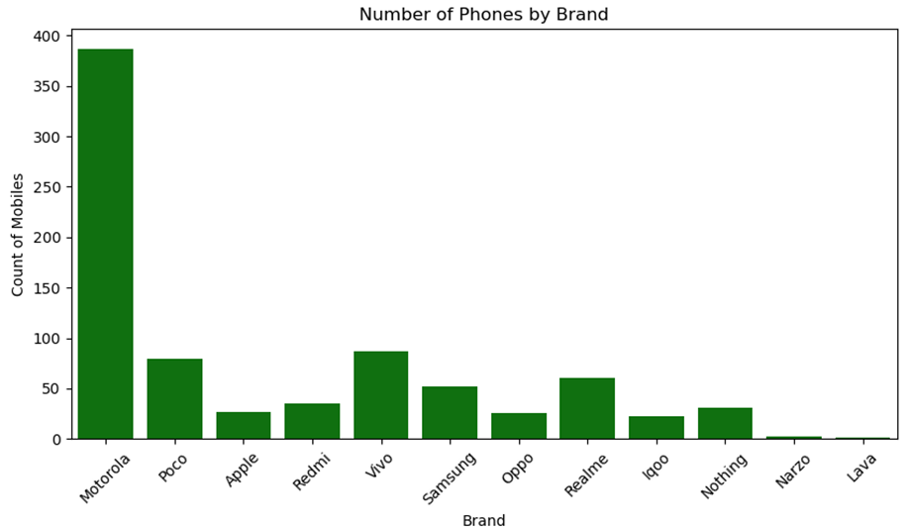
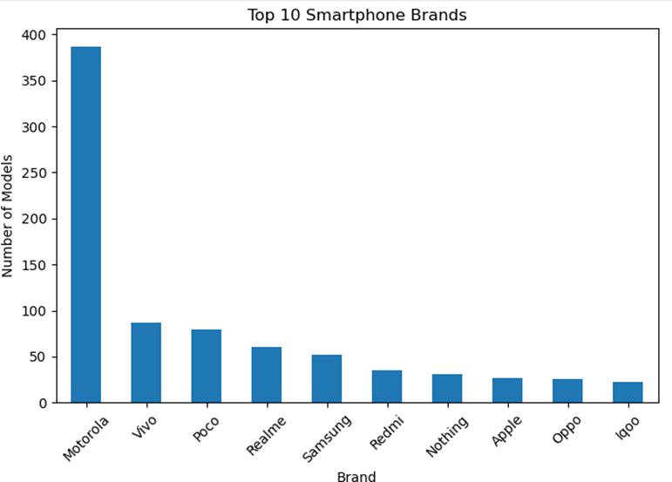
Observation
-Motorola, Realme and poco appear most frequently in the dataset, showing their strong presence in the smartphone market.
-Motorola and Vivo appear most frequently in the dataset,indicating they dominate the online smartphone market.

Slide 11
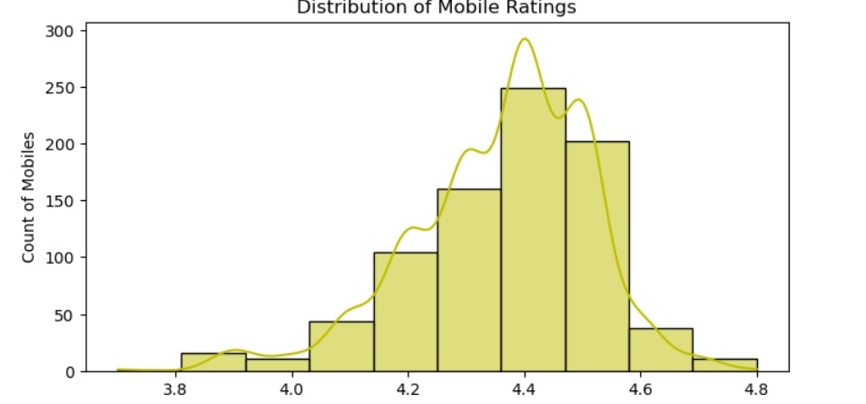
Observation
-Most mobile phones have ratings between 4.0 and 4.5, indicating generally positive user satisfaction.

Slide 12
BIVARIATE ANALYSIS STEPS
Bivariate analysis was performed to study relationships between two variables.
The relationship between smartphone price and customer rating was analyzed.
Price variations among different smartphone brands were examined.
The influence of RAM size on smartphone price was analyzed.
Visualizations such as scatter plots and bar charts were used to identify patterns.
This analysis helps understand how product features influence pricing and ratings.

Slide 13
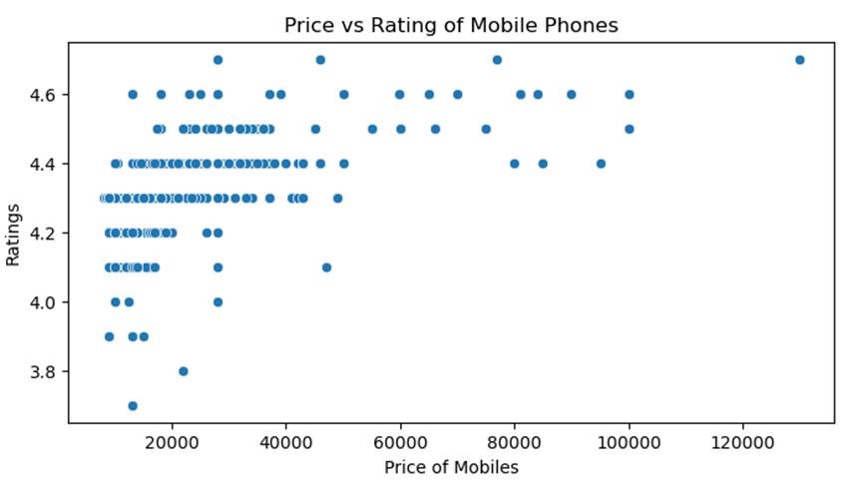
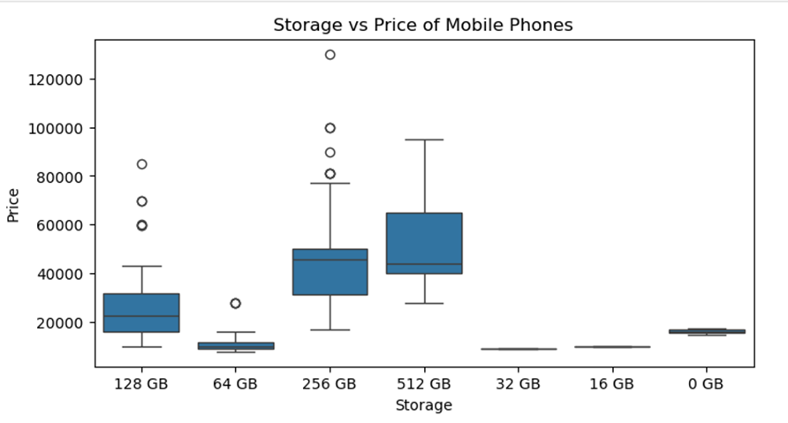
Observation:
-Higher-priced phones generally maintain good ratings, but many mid-range phones also receive strong ratings.
-Phones with higher storage capacity generally tend to have higher prices compared to phones with lower storage.

Slide 14
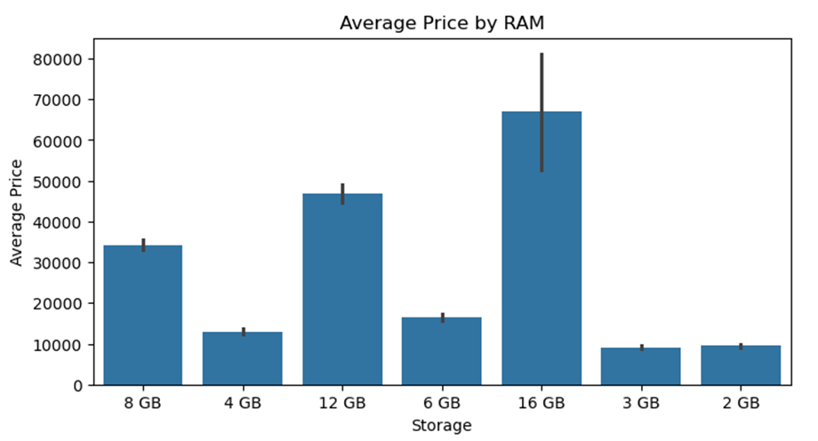
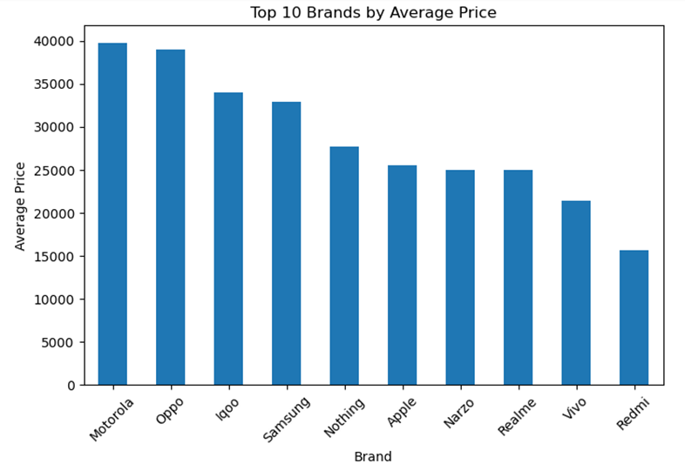
Observation
-Smartphones with higher RAM generally have higher prices, indicating RAM is a major factor affecting price.
-Premium brands like Apple and Samsung have higher average prices while other brands focus on budget and mid-range smartphones.

Slide 15
MULTIVARIATE ANALYSIS STEPS
Multivariate analysis was performed to study the relationship between more than two variables simultaneously.
Key variables considered for this analysis include Price, Rating, Brand, RAM, Storage, and Screen Size.
Grouped analysis was used to compare average price across different brands and RAM configurations.
A heatmap and grouped visualizations were used to identify correlations between numerical variables such as price, rating, and screen size.
This analysis helped understand how multiple specifications together influence smartphone pricing and customer ratings.
Multivariate insights provide a deeper understanding of market patterns compared to simple univariate or bivariate analysis.

Slide 16
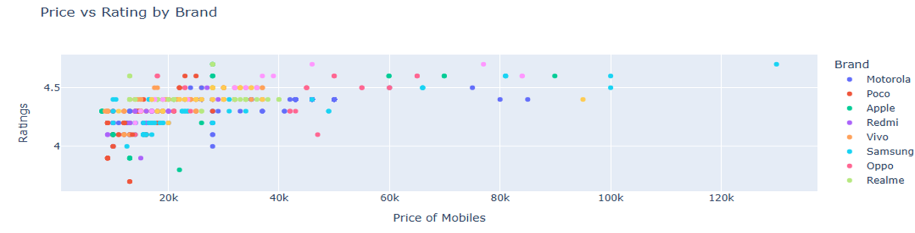
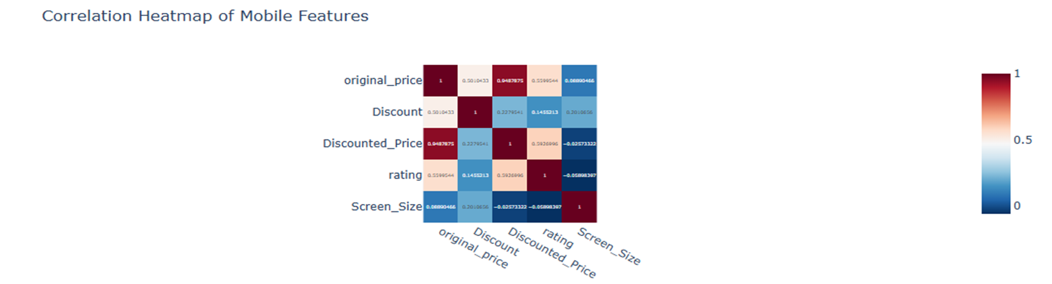

Slide 17
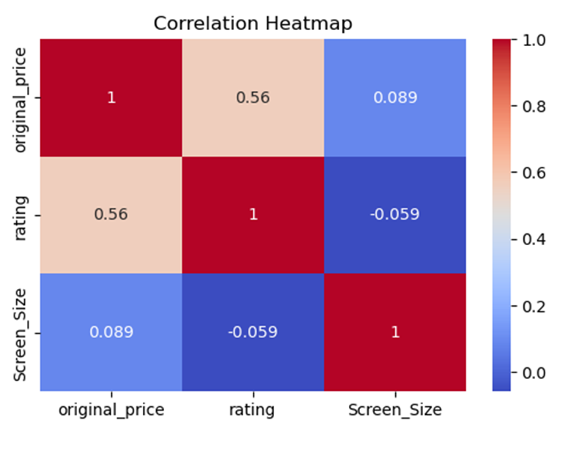
Observation
- Correlation helps understand relationships between variables.
- High correlation between original price and discounted price indicates that expensive phones maintain higher discounted prices.

Slide 18
CONCLUSION
The majority of smartphones fall within the mid-range price segment.
Customer ratings are generally high, with most phones rated above 4.2.
8 GB RAM and 128 GB storage are the most commonly available configurations.
Certain brands dominate the dataset, indicating strong market presence.
Higher prices often correspond to better specifications but not always higher ratings.
Data analysis provides valuable insights into smartphone market trends.

Slide 19
KEY INSIGHTS
Budget phones dominate the dataset.
2. Higher RAM phones generally have higher prices.
3. Ratings are mostly clustered around 4 – 4.5.
4. Popular brands include Samsung, Vivo, Realme.
BUSINESS INSIGHT:
- Companies should focus on mid-range smartphones withgood RAM and storage as they dominate the market and receive strong customer ratings.

Slide 20

THANK YOU

