Slide 1

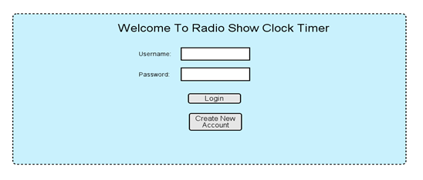
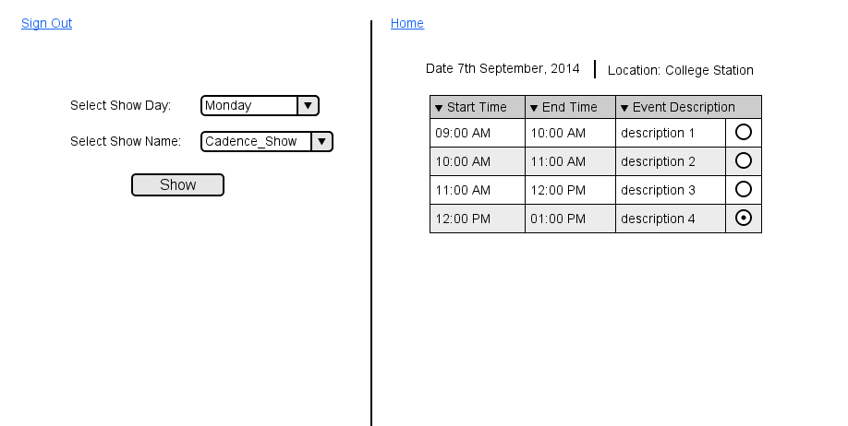
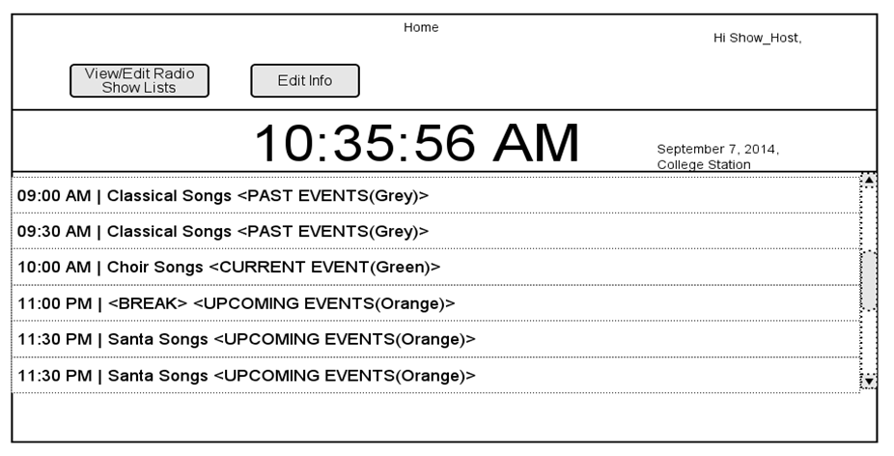
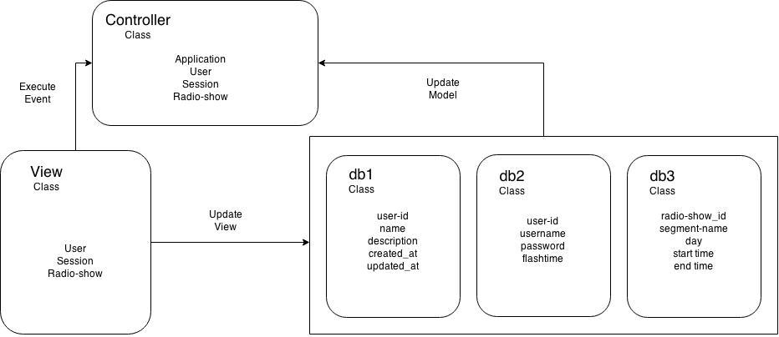
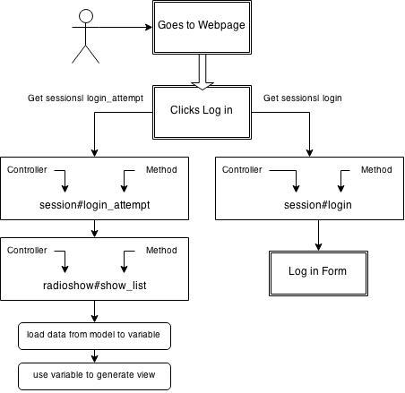
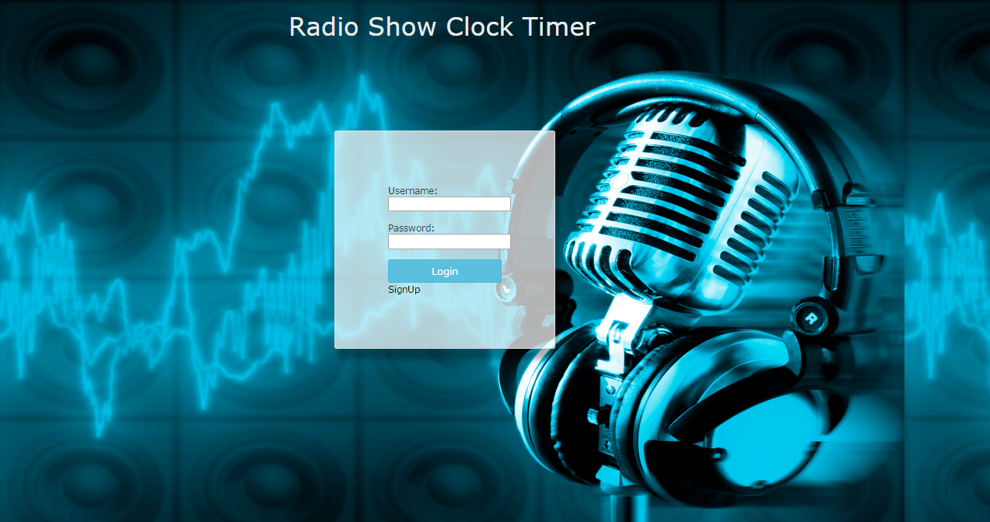
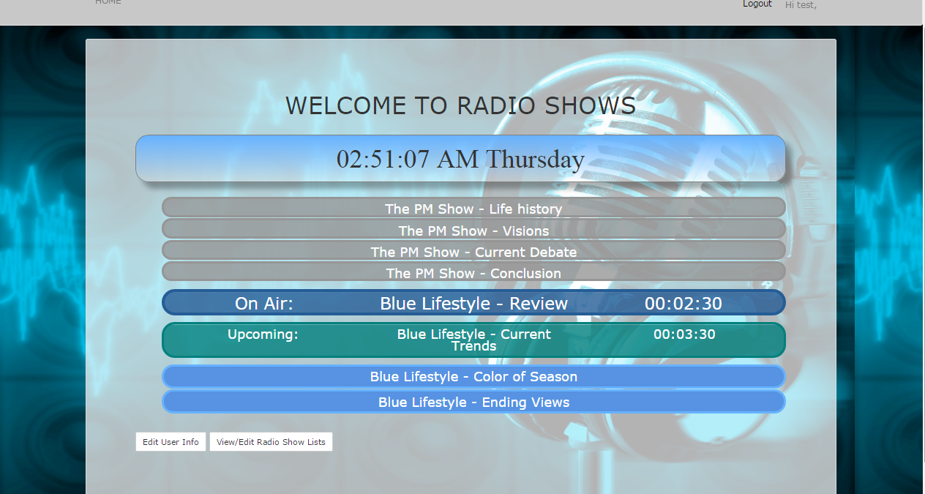
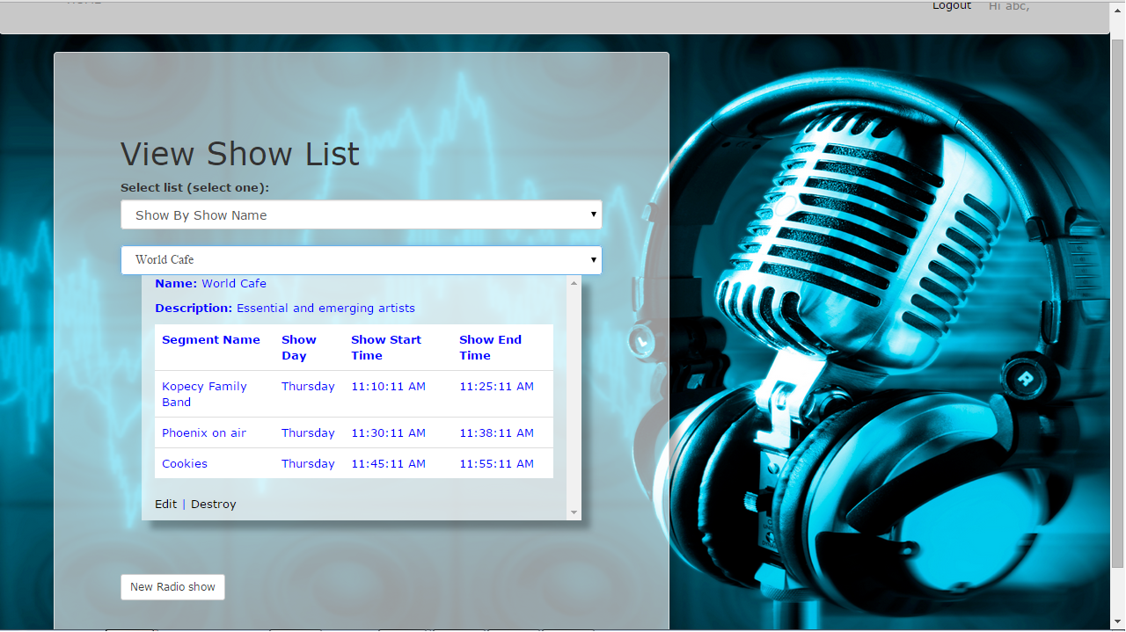
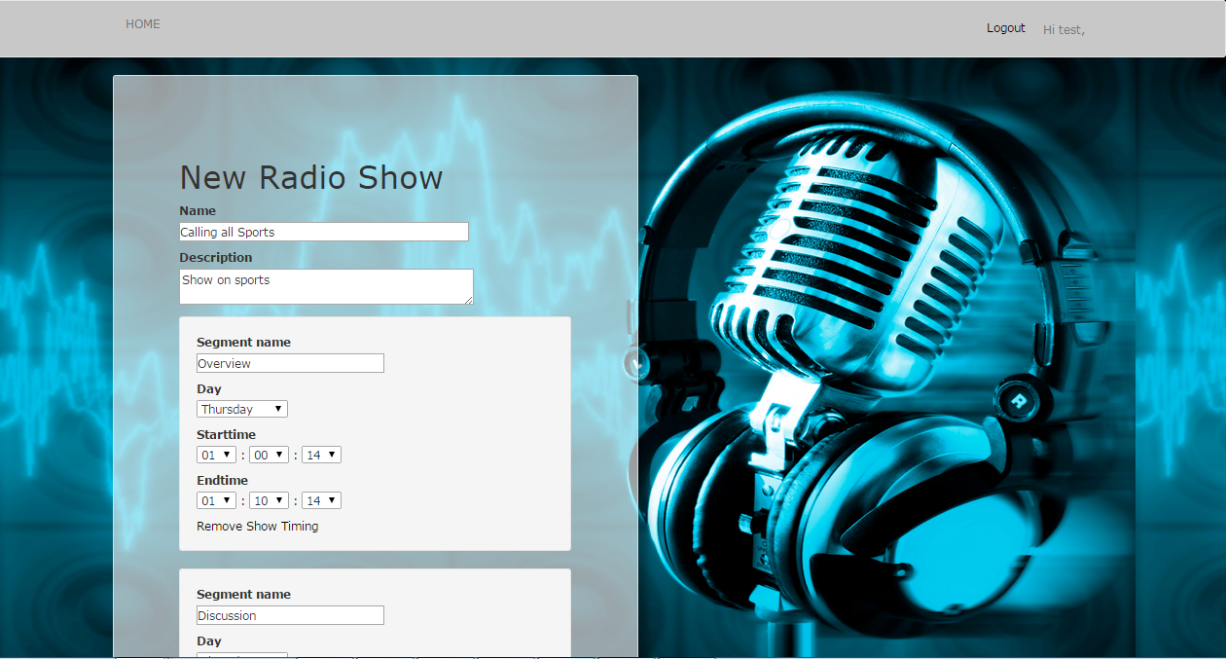
Clock Timer for scheduling and synchronizing Radio Shows
Naveen Thomas, Sanghita Bandyopadhyay, Manisha Tripathy, Ranbir Das, Sangeeta Panigrahy and Atin Ruia
Dept. of Computer Science and Engineering, Texas A&M University
Introduction
UI Mockup Diagrams
The project “Show Clock Timer” was undertaken to help radio show hosts pay attention to time of segments in each hour, with visual warnings, synched w/NIST time.
Show Clock Timer and Event List: On the home page, there is ticking clock timer synchronized with a standard time server. The display includes an event list of elapsed, current and upcoming shows for the day.
Objectives
The user stories were deduced as: 1. On screen display clock in HH:MM:SS format.
2. Description of current and upcoming event.
3. Alert (flash warning) before the upcoming event.
4. Login capable for authorized access.
5. Customizable hourly segment / day planner.
6. Clock timer synced to internet Time server.
7. Resizable window show for viewing convenience.
8. Cross platform compatibility.
User Login Display: If user has an account created, he/she enters his/her login credentials and clicks on login button. If the credentials entered are correct, this re-directs the user to show clock timer home page. Else an error message pops up on the same page.
The project “Show Clock Timer” was undertaken to help radio show hosts pay attention to time of segments in each hour, with visual warnings, synched w/NIST time, chat tool to send messages to show host, interface to set up show schedules
View/Edit Shows by Day or Name: Form which allows user to view and modify shows selected based on the show name or the day of the week. It provides user with capabilities to reorder or delete a show.
Functionalities
MVC model
Administrator
User
Show existing users
Add a new user
Delete existing users
Add show segment info
Destroy segment
Edit segment
Admin Page:
Show User Add User
Delete User
New show info:
Add show segment
Administrator functionalities
User
User
New User
Administrator
Set User Info
Login existing users
Create new user
Administrator login
Add new show:
Set user info
User Case Example
Login Page:
User login Admin login
User Signup
Radio Segment functionalities
Login functionalities
User
User
Edit user profile
Add new show
Edit selected show
Select show by day
Add new show
Destroy selected show
Edit selected show
Display timer
Display flash warning
Manage display of show list
Logout
Add New Show:
Select show by time
Select show by name Edit selected show
Destroy selected show
Create new show
Add New Show:
Select show by time
Select show by name Edit selected show
Destroy selected show
Create new show
Radio Show functionalities
User functionalities
UI Scenarios
Conclusion
Successfully created a “Show Clock Timer” with effective visual aids and messages to help radio show hosts keep track of show segments. Server synced with w/NIST time in-order to effectively schedule shows in different time zones across the country.
References
Radio Jockey Login Page
Daily Radio Show List synched with NIST time server
Engineering Software as a Service: An Agile Approach Using Cloud Computing, Armando Fox and David Patterson, Strawberry Canyon LLC, 2013.
Acknowledgment
We are thankful to Mr. Dennis Mancha and Dr. D.H.Walker for giving us this unique opportunity to explore the application development using "Ruby on Rails" and experience the "Agile Development Process".
Radio Show Segments
Addition of New Radio Show Segments

