Slide 1
Credit Card Approval Analysis
281772 |Naveen Rajan

Slide 2
Contents
Introduction
Data Overview
Data Transformation
Visualization
Key Insights
Future initiatives
Challenges
Conclusion

Slide 3
Introduction

Slide 4
OBJECTIVE
Identify the key demographic and financial factors that significantly influence credit card approval decisions.
Visualization of the analysis

Slide 5
ETL Pipeline
Source : GitHub , Azure SQL Database , Azure Data Lake
Landing Zone : CosmosDB
Transformation &
Optimization : Databricks
Visualization : Databricks

Slide 6
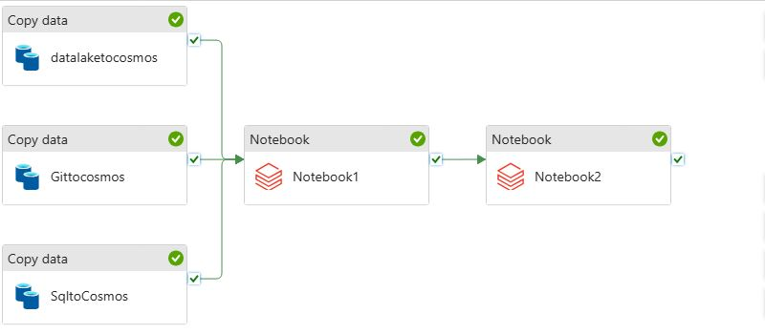
Azure Data Factory Pipeline
Transformation
Visualization

Slide 7
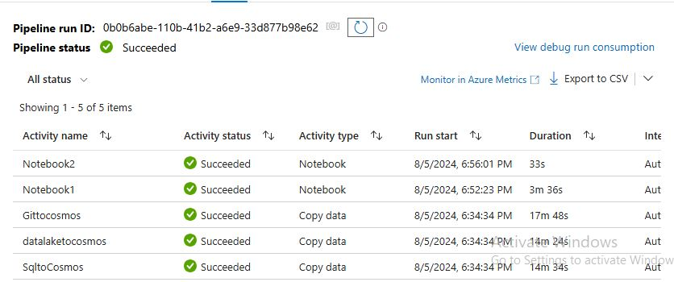

Slide 8

Data Transformation
Replacing Null values
Deriving New Columns
Renaming the Columns
Dropping the columns with same values
Joining the data's

Slide 9
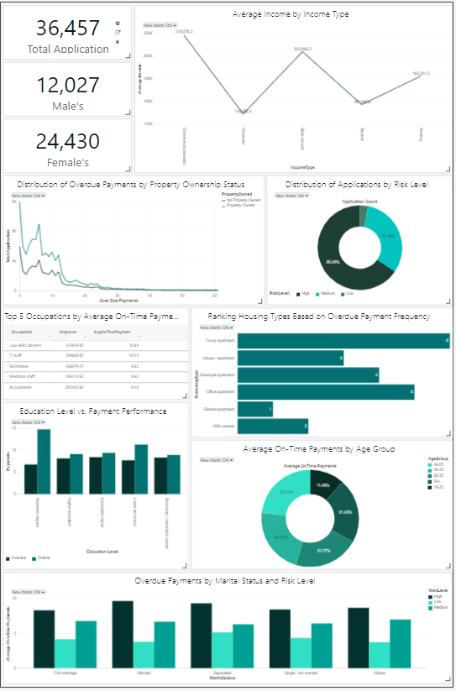
Click Here
Visualization

Slide 10
Key Insights
Lower-income jobs often have better payment behavior than higher-income roles
Property Owners may indicate low risk to credit issuers
Higher education levels are linked to fewer overdue payments and more on-time payments.
Effective communication is vital for understanding payment obligations.
Marital status should be prioritized, as many individuals are classified as high risk.
Customers aged 26-55 category show better payment behavior.

Slide 11
Future Initiatives
Create rewards for timely payments
Develop financial literacy programs to enhance strengths in Low Skill Laborers
Regular reminders about payment due dates can help customers avoid late fees
Give customer support to older adults

Slide 12
Challenges
Data cleaning and classifying data’s based on Risk level
Pipeline Running Stage

Slide 13
Conclusion
In conclusion, the data provides valuable insights into how income, occupation, education, and payment behavior are interconnected, enabling credit card companies to make more informed decisions.
To enhance the credit approval process, it is crucial for companies to implement strategies that improve data analysis, develop personalized products, and strengthen communication with customers. By doing so, they can create a more inclusive and effective credit approval system that benefits both borrowers and lenders.

Slide 14
THANK YOU

