Slide 1
Fatality and Disease Analyzation and Statistics

Slide 2
About the clients
CDC
The Centers for Disease Control and Prevention is the nation’s health protection agency
They conduct science and provides health information that protects our nation against health threats
The CDC saves lives
Elder Research
A data science and predictive analytics company
Develops analytic solutions and provides analytics consulting

Slide 3
Client objective
Use US mortality data to find trends in fatal diseases and injuries that co-occur (meaning two or more conditions that are commonly listed together on death certificates as factors that contributed to or caused death).

Slide 4
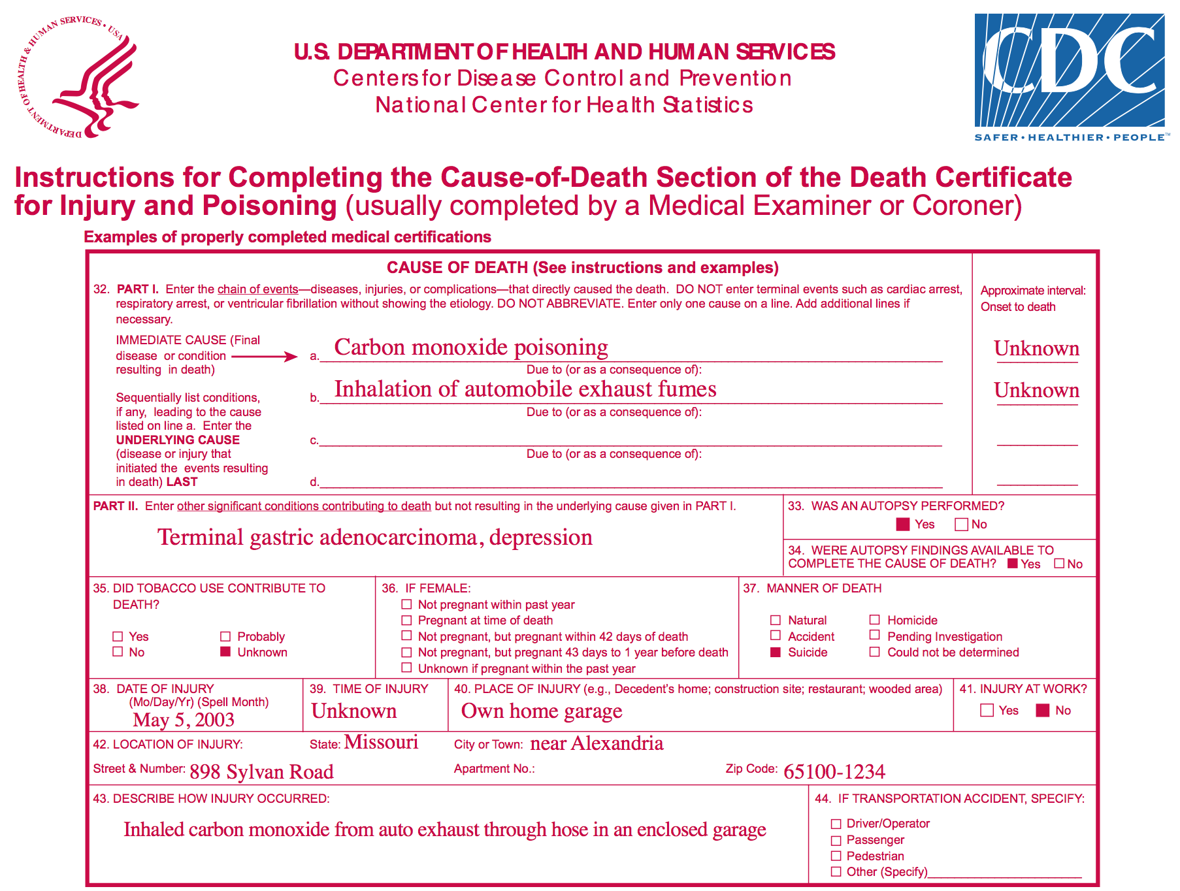
Understanding the data

Slide 5
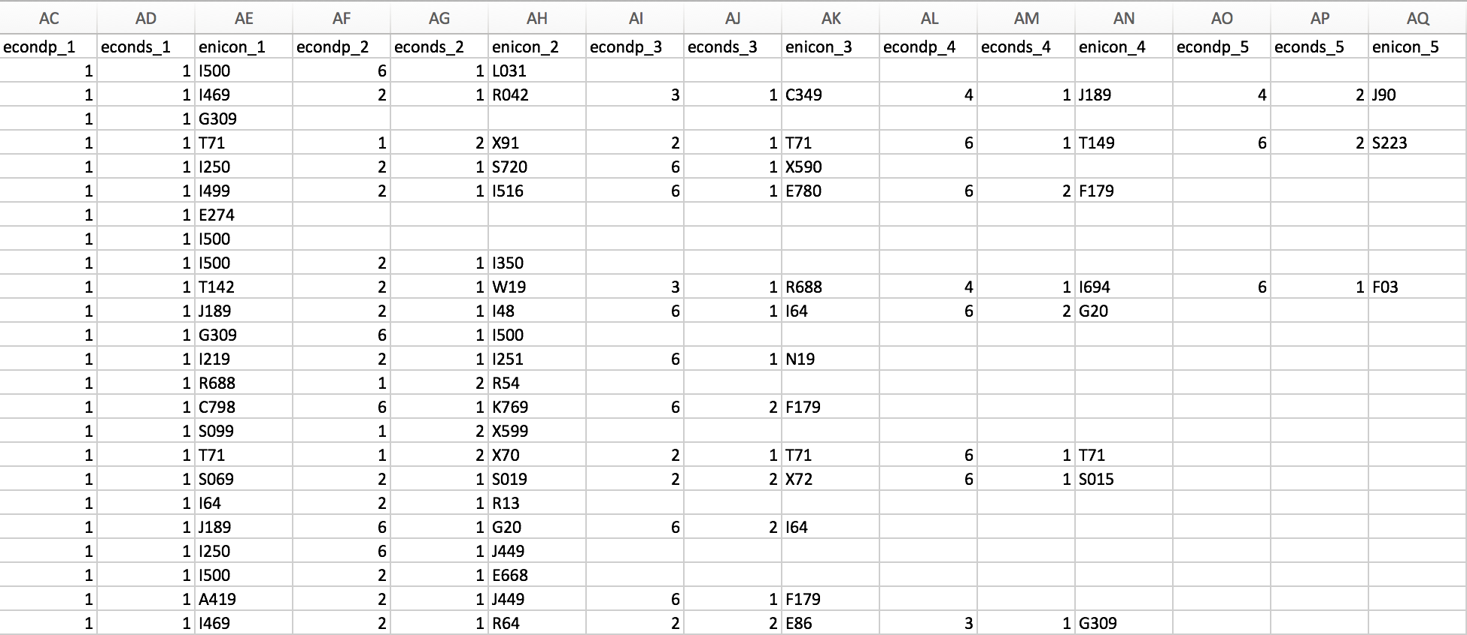
Understanding the data (cont.)
ICD 10
10th revision of the International Statistical Classification of Diseases and Related Health Problems (ICD), a medical classification list by the World Health Organization(WHO).
It contains codes for diseases, signs and symptoms, abnormal findings, complaints, social circumstances, and external causes of injury or diseases.
The code set allows more than 14,400 different codes and permits the tracking of many new diagnoses.

Slide 6
Understanding the data (cont.)
Used mortality data of 10 years (2006-2015)
Approx 25 million records
Approx 10 GB data
A record can contain up to 20 causes of death (specified as 4-char ‘ICD’ codes)
To find patterns of co-occurring codes, ‘association rules’ to be used

Slide 7
Technical setup
R for data cleaning
Python with Spark on AWS - for scalable analysis (as data increases YoY)
1 master, 10 worker nodes setup on AWS (each 16CPU, 30GB memory)
FPGrowth (Frequent Pattern Growth) algorithm
‘Support’ parameter (used 0.0001)
‘Partitions’ parameter (used 480)
Tableau for visualizations

Slide 8
Key Findings

Slide 9
Top co-occurring code pairs
Rank | Combination |  | Code1 Desc | Code2 Desc | Frequency
1 | I500 | I251 | Congestive heart disease | Atherosclerotic heart disease, Coronary | 667,039
2 | I10 | I251 | Essential (primary) hypertension | Atherosclerotic heart disease, Coronary | 648,739
3 | J449 | F179 | Chronic obstructive pulmonary disease | Mental/behavioural disorders due to use of tobacco | 619,174
4 | C349 | F179 | Malignant neoplasm: Bronchus or lung | Mental/behavioural disorders due to use of tobacco | 584,057
5 | I219 | I251 | Acute myocardial infarction | Atherosclerotic heart disease, Coronary | 535,480
6 | E149 | I10 | Diabetes mellitus without complications | Essential (primary) hypertension | 501,615
7 | I500 | I10 | Congestive heart disease | Essential (primary) hypertension | 477,711
8 | I469 | I251 | Cardiac arrest | Atherosclerotic heart disease, Coronary | 461,224
9 | I10 | I469 | Essential (primary) hypertension | Cardiac arrest | 401,446
10 | F179 | I251 | Mental/behavioural disorders due to use of tobacco | Atherosclerotic heart disease, Coronary | 390,096

Slide 10
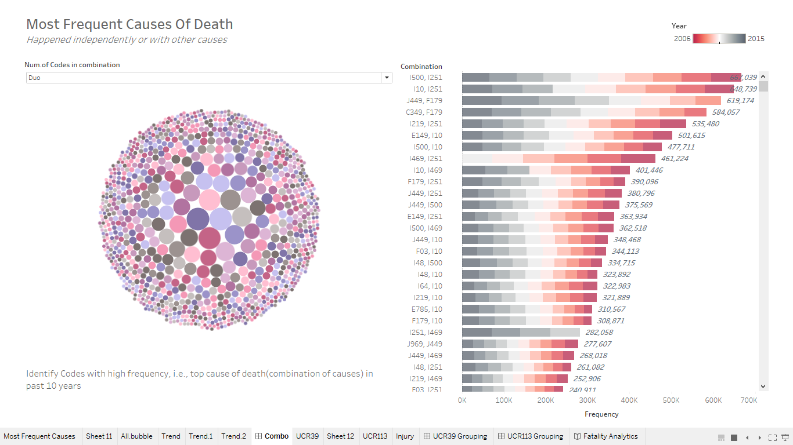
Top co-occurring code pairs

Slide 11
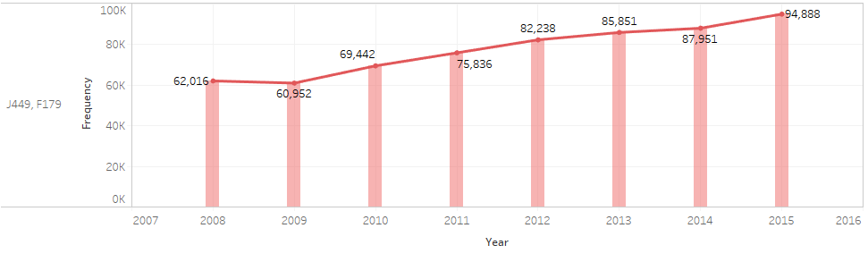
Trends in (selected) co-occurring code pairs
Highest increase (~62k to ~95k):
J449 - Chronic obstructive pulmonary disease, unspecified
F179 - Mental and behavioural disorders due to use of tobacco: Unspecified mental and behavioural disorder

Slide 12
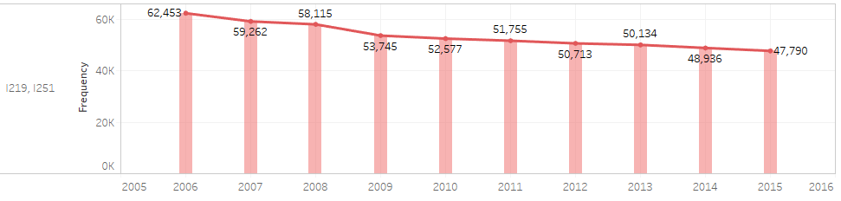
Trends in (selected) co-occurring code pairs
Highest decrease (~62k to ~48k):
I219 - Acute Myocardial Infarction, Unspecified
I251 - Atherosclerotic Heart Disease

Slide 13
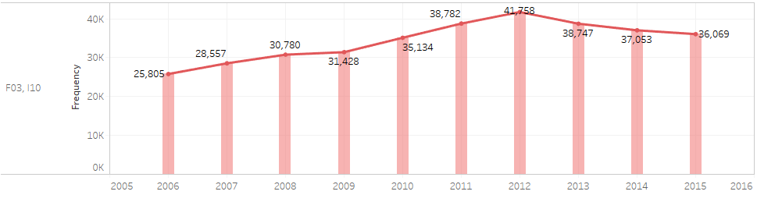
Trends in (selected) co-occurring code pairs
Most interesting (increasing till 2012 and then decreasing):
F03 - Unspecified dementia
I10 - Essential (primary) hypertension

Slide 14
Other Findings

Slide 15
Top ‘underlying causes of death’
Rank | UCOD | Description | Count
1 | I251 | Atherosclerotic heart disease of native coronary artery | 1,936,376
2 | C349 | Malignant neoplasm: Bronchus or lung, unspecified | 1,723,585
3 | I219 | Acute myocardial infarction, unspecified | 1,388,327
4 | J449 | Chronic obstructive pulmonary disease, unspecified | 1,136,896
5 | F03 | Unspecified dementia | 1,049,358
6 | G309 | Alzheimer's disease, unspecified | 896,200
7 | I64 | Stroke, not specified as haemorrhage or infarction | 755,369
8 | I250 | Atherosclerotic cardiovascular disease | 657,654
9 | I500 | Congestive heart failure | 607,764
10 | J189 | Pneumonia | 512,409

Slide 16
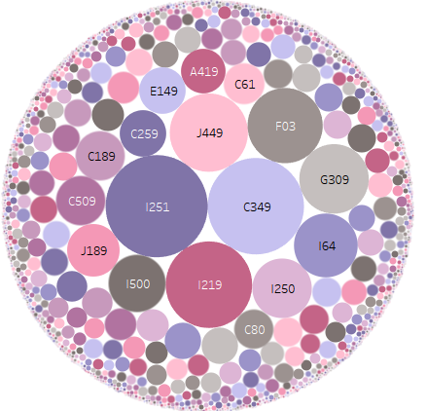
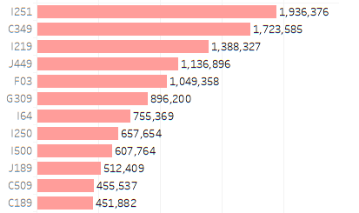
Top ‘underlying causes of death’

Slide 17
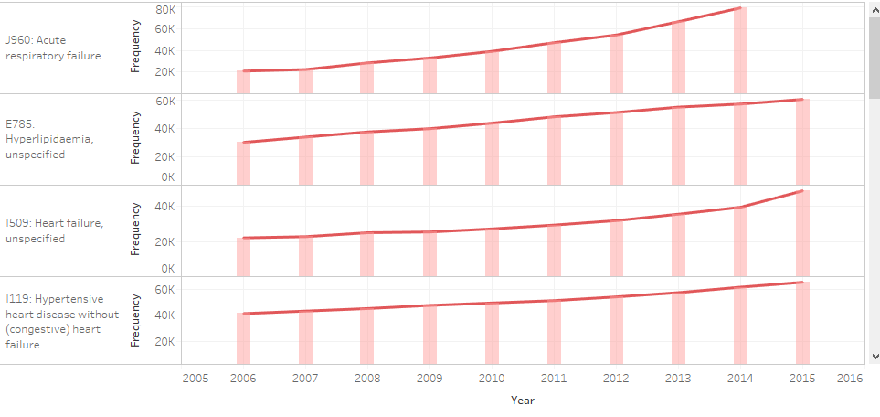
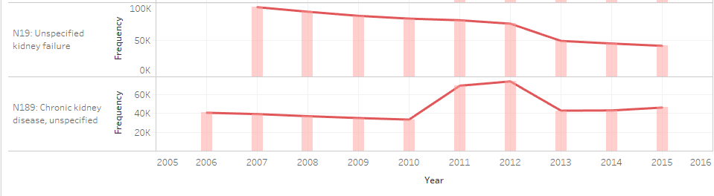
Trends in (selected) codes

Slide 18
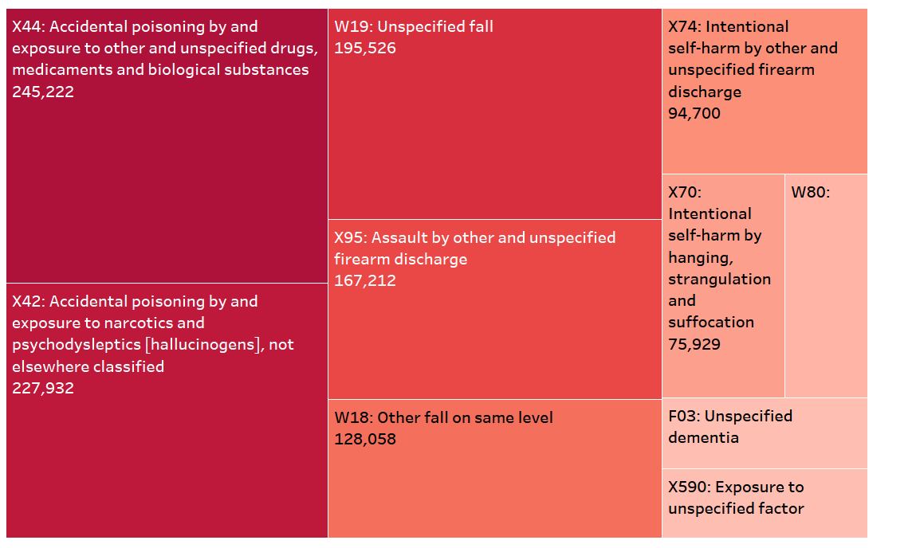
Top occurring codes where injury was involved

Slide 19
Thank You

