Slide 1
Blood Donation Software Development Project
Notes:
“Good [morning/afternoon], everyone. Today, we are excited to present our group project — a Blood Donation Web Application, developed as part of the 7047CEM Software Development Project module at Coventry University. Our team of five collaborated over several weeks to build a secure, functional, and socially impactful system. The aim is to connect people who need blood with willing donors in their area. We’ll take you through our development journey — the design, implementation, testing, agile process, and final outcomes.”

Slide 2
Team Members
Madhava Reddy BhumiReddy
Naveen Inala
Karthik Samineni
Chandu mallempati
Uma Ravi Teja Chowdary Kandula

Slide 3
Project Overview
A complete web solution to simplify blood donation and requests
Addresses the need for fast and secure donor-recipient connections
Core modules include authentication, registration, request handling, and search
Designed with a minimalistic, intuitive UI and responsive templates
Built using Flask as backend framework and SQLite for database
User authentication system ensures secure access to features
Allows logged-in users to register as donors or submit blood requests
Admin dashboard provides oversight and moderation tools
Emphasizes real-world practicality and social responsibility
Focused on efficiency, performance, and simplicity
Peer-tested and refined based on feedback and test cases
Functional across various device sizes using Bootstrap
User-centric design to support emergency use cases
Minimal dependencies and simple deployment make it scalable
Overall, the project balances function, ethics, and maintainability
Notes:
“Our goal was to develop a full-stack web platform that helps people find blood donors in urgent situations. The platform allows users to sign up, register as donors, request blood, search for matching donors, and manage the system through an admin panel. The application uses Flask for the backend, SQLite for data, and Bootstrap for responsive design. We focused on user-friendliness and practicality, ensuring the system is fast, ethical, and easy to deploy. Each of us handled a different core feature.”

Slide 4
Agile Methodology
Followed Scrum-based Agile methodology with sprint planning
Team formed clear user stories and task breakdown at project start
Used Trello for backlog management and daily task tracking
Weekly sprints allowed continuous delivery and focused progress
User stories included: user registration, donor match, admin actions
Sprint goals refined through weekly stand-ups on Google Meet
Used story points to estimate effort for each task
Allowed flexibility in handling blockers and reassignment of tasks
Frequent internal reviews kept progress on track
Encouraged shared ownership and communication
Regular documentation updates were maintained for each sprint
Peer feedback integrated into sprint retrospectives
Agile helped us prioritize functional MVP delivery
Each team member led one major feature module
Resulted in incremental, testable builds delivered on schedule
Notes:
“We followed the Scrum framework throughout this project. At the beginning, we created user stories like ‘As a user, I want to sign up securely’ or ‘As an admin, I want to delete suspicious accounts.’ We used Trello to manage our backlog and split tasks into sprints. Each week, we conducted short daily standups on Google Meet to update each other, resolve blockers, and plan priorities. We also estimated effort using story points, which helped us balance the work and move forward efficiently.”

Slide 5
Sprint Breakdown
Sprint 1: Set up Flask app, database connection, signup/login
Sprint 2: Created donor registration, blood request form, form validation
Sprint 3: Implemented donor matching logic and admin dashboard
User stories were decomposed into task cards on Trello board
Story points assigned for each based on complexity and urgency
Tasks distributed based on skill, interest, and availability
Sprint planning sessions identified and resolved dependencies
Daily standups encouraged accountability and quick debugging
Completed work pushed via GitHub branches, reviewed by peers
Velocity and progress measured via burndown charts
Backlog refined after each sprint retrospective session
Adjustments made mid-sprint based on tester feedback
Sprint review included internal walkthroughs and bug logging
Collaboration during sprints enhanced both code and documentation quality
Agile cadence ensured a stable, functional product by final week
Notes:
“Our project was divided into three sprints. In Sprint 1, we focused on setting up the Flask environment and implementing user authentication. Sprint 2 tackled donor registration and the blood request form. In Sprint 3, we added the admin dashboard and the donor matching feature. At the end of each sprint, we reviewed what we’d achieved using burndown charts and adjusted our backlog accordingly. This iterative process helped us deliver a testable, functional product by the end.”

Slide 6
Tools & Technologies
Flask (Python) used for backend route management and logic
SQLite selected for lightweight, file-based data storage
HTML, CSS, Bootstrap for responsive and user-friendly frontend
Git and GitHub used for version control and collaboration
Trello enabled real-time task tracking and agile planning
Google Meet used for virtual meetings and daily standups
GitHub issues used to manage bugs and enhancements
Code shared via branches, reviewed and merged after testing
Templates extended using Flask’s Jinja templating engine
CSS styles reused across components via a central stylesheet
Bootstrap grid system made layout mobile-friendly
Flash messages used for dynamic feedback (success/errors)
Flask sessions implemented for secure login/admin routing
Browser DevTools and SQLite Browser supported testing
Simple tech stack made project easy to deploy and maintain
Notes:
“We used a straightforward yet powerful tech stack. Flask was our backend framework, perfect for rapid development. We chose SQLite as it’s lightweight and easy to use during development. On the frontend, HTML, CSS, and Bootstrap provided a clean and responsive UI. Trello helped us organize our sprints, while Git and GitHub ensured smooth version control and collaboration. We also used Google Meet for our standups and internal testing. These tools allowed us to stay productive and in sync.”

Slide 7
System Architecture
The application follows the MVC (Model-View-Controller) design
Model: SQLite database with normalized tables (users, donors, requests)
View: HTML templates extended from layout.html using Jinja2
Controller: Flask routes that handle HTTP requests and session logic
Authentication guarded routes using Flask session checks
get_db_connection() centralized DB access for reusability
Templates dynamically rendered based on user data
Admin dashboard and donor search used SQL JOINs
HTML views designed to display contextual feedback
Static assets (CSS, images) served from /static folder
Data integrity ensured with form validations and foreign keys
Lightweight and modular, supporting easy testing and refactoring
Scalability possible with upgrade to PostgreSQL or MySQL
Clean separation of concerns ensured maintainable code
Logical route structure improves future enhancements and debugging
Notes:
“Our system follows the MVC architecture — Model, View, Controller. The model includes all our database logic with normalized tables like users, donors, and requests. Views are written in HTML with Jinja2 templating, styled using Bootstrap, and rendered by Flask routes. Controllers, or routes, handle requests and responses. This architecture helped us separate logic, keep the code clean, and made it easier to debug or enhance individual modules later. It also ensured consistent data flow and security.”

Slide 8
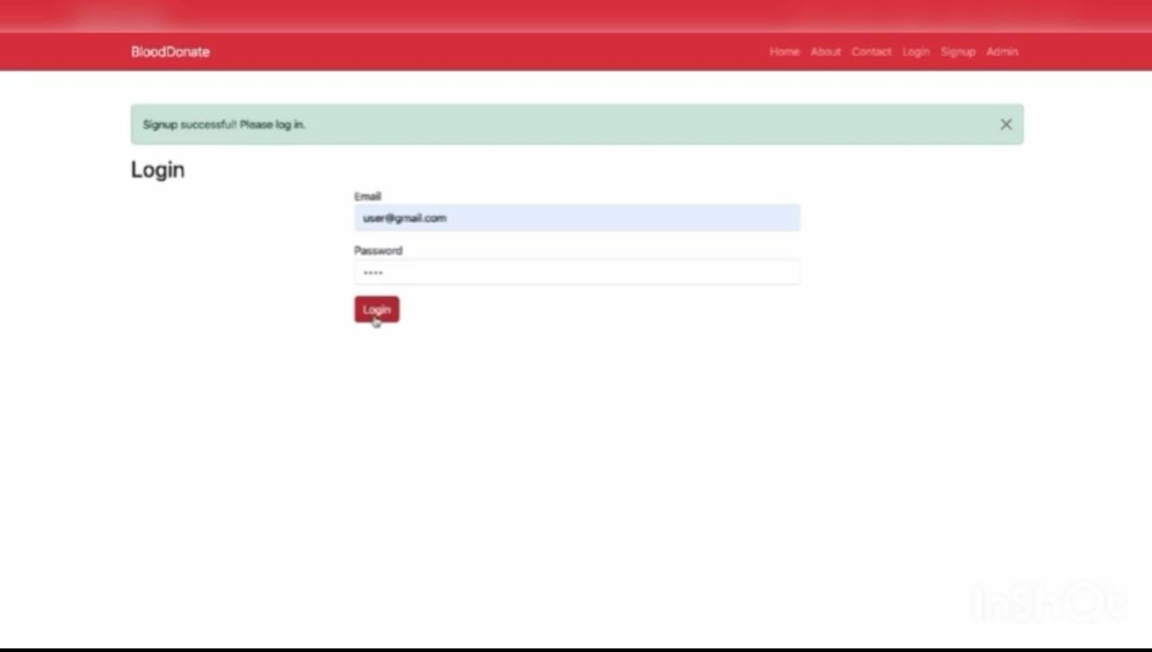
User Authentication
Secure login/signup implemented using Flask and bcrypt
Passwords encrypted before storing in database
Session variables used to manage login state securely
Signup route validates email uniqueness, handles exceptions
Login route checks hashed passwords with bcrypt checker
Flash messages provide feedback: success, invalid credentials, etc.
Unauthorized access blocked by redirecting to login page
Session termination on logout ensures privacy and protection
Notes:
“Authentication is the foundation of our app. We implemented secure signup and login features using Flask sessions and bcrypt for password hashing. Sessions were used to manage login states and prevent unauthorized access. Flash messages provided real-time feedback — whether login succeeded or failed. We structured the routes clearly and added validations to prevent duplicate email registrations. Security was a top priority, and this module set the tone for all other user-facing features.”

Slide 9
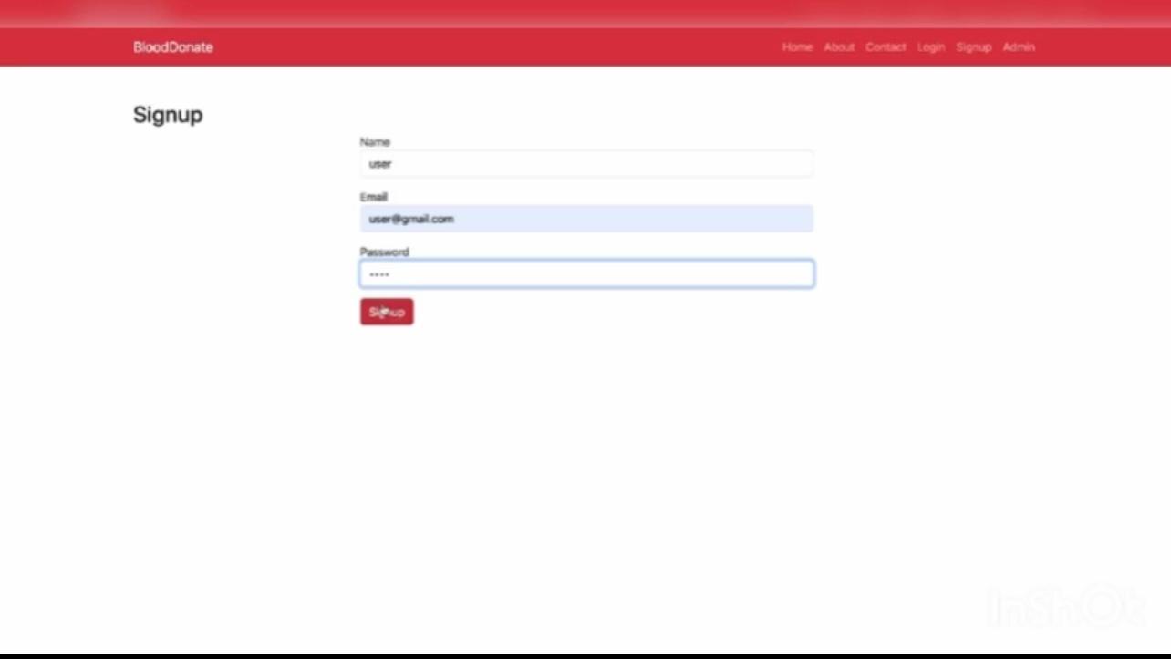
Donor Registration
Only logged-in users can access donor registration form
Form captures: blood group, city, and phone number
Inputs validated both client-side and server-side
Data stored in donors table and linked to user ID
Simplistic design improves usability under stressful conditions
Flash feedback confirms successful registration
Bootstrap form ensures responsive input fields
Centralized route handles both GET and POST requests
Notes:
“Once a user logs in, they can register as a blood donor. We created a simple form with fields for blood group, phone number, and city. The form is validated at both client and server levels. Once submitted, the donor’s details are stored in the database, linked to their user ID. This allows for later retrieval during donor matching. The layout is responsive and clear, making it easy to fill out, even under time pressure. This feature helps build the donor database.”

Slide 10
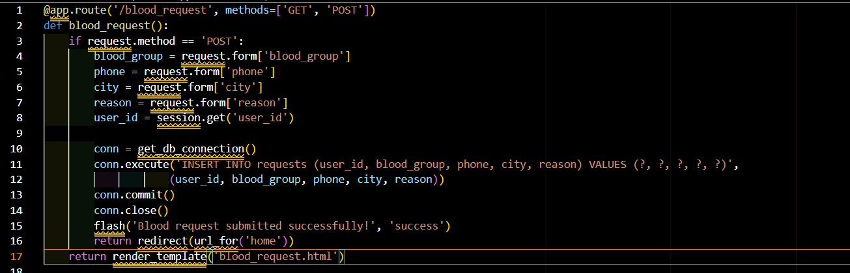
Blood Request Feature
Allows logged-in users to submit blood requests for emergencies
Captures: blood group, contact phone, city, reason
Stored in requests table with user ID link
Used later in donor match queries for reverse lookup
Form structured with clear input labels and tooltips
Feedback message confirms submission or highlights issues
Enforced required fields for completeness and consistency
Validated using HTML5 and Python backend logic
Notes:
“For users who need blood, we built a blood request form. It collects the blood group needed, contact phone, city, and a brief reason. This request is stored in our database and used later for matching. We included validations to ensure complete and accurate data. This feature is essential for creating demand-side data that powers our donor matching system. We tested this extensively to ensure data integrity and submission flow. It provides a seamless experience for people in need.”

Slide 11
Donor Matching
Users can search for matching donors by city and blood group
Backend performs JOIN on donors and users tables
Secure parameterized queries prevent SQL injection
Matching results displayed in styled, scrollable table
Flash messages shown for zero-result queries
Enables life-saving decision-making with real-time data
Only accessible to logged-in users to ensure privacy
View shows donor name, email, phone, city, and blood type
Optimized for speed and efficient lookup
Can be extended with donor availability status
Implemented route logic clean and reusable
Prevents performance lag using indexed queries
Designed with accessibility (font sizes, contrast) in mind
Encourages community-based peer support
A central component of the entire web application
Notes:
“This is one of our most powerful features. When a user enters a city and blood group, the system searches for registered donors who match both criteria. The logic uses a SQL JOIN query between users and donors tables. If matches are found, they’re displayed in a table with name, email, phone, city, and blood group. If no matches exist, the user gets a clear flash message. We made sure the results are fast, accurate, and safe from injection attacks.”

Slide 12
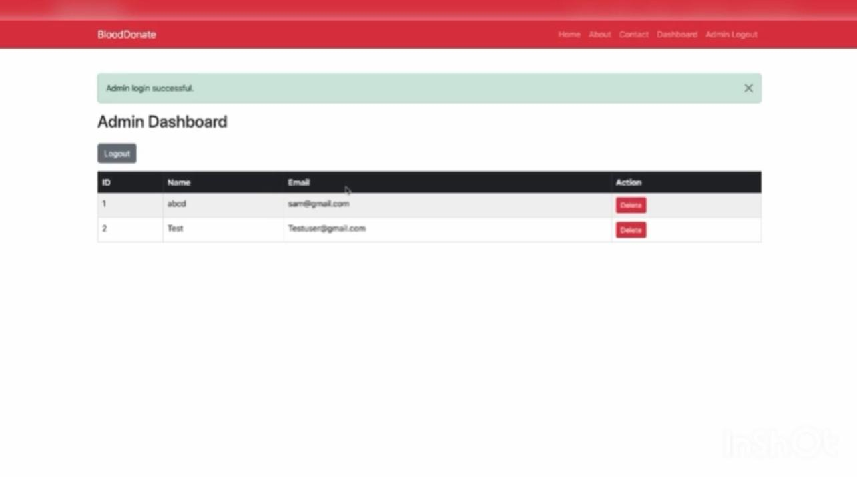
Admin Dashboard
Admin-only section with access control via secure login
Admin can view all registered users in a formatted table
Option to delete suspicious or inactive accounts
Route protected by session check: only admin_logged_in allowed
Deletion is confirmed via a browser prompt (JavaScript confirm())
Enhances system safety and user trust
Admin dashboard uses Bootstrap table with responsive design
Notes:
“To manage the system, we created a secure admin dashboard. Only admins can access this view, and it’s protected by a separate login route. Admins can view all users and delete them if needed. The layout is clean and the table is responsive. Each delete button triggers a confirmation popup. We used session checks to restrict access and flash messages to notify actions. This dashboard helps enforce rules, manage misuse, and gives a layer of control over the user base.”

Slide 13
Testing and Validation
Each module tested for functional correctness and security
Manual and exploratory tests conducted across use cases
SQLite Browser used to confirm DB entries and relational mapping
Input fields validated using HTML5 and backend assertions
Session handling checked using browser DevTools
SQL injection attempts blocked using parameterized statements
Edge cases (empty fields, incorrect login, duplicate entries) tested
Admin routes tested without login to ensure redirect
Donor matching accuracy verified against manually input data
Flash message feedback confirmed under all scenarios
Error logs reviewed during development to fix issues
Cross-browser behavior observed for responsiveness and styling
Testing process documented for reproducibility
Peer testing feedback helped improve usability and clarity
Future scope: implement automated tests with unittest or pytest
Notes:
“Testing was done through a combination of manual and exploratory methods. We used SQLite Browser to validate data entries and tested session handling through DevTools. All forms were checked for proper validation and edge cases. We also attempted SQL injection and other common exploits to test the security of our system. Admin routes were tested without login to confirm access blocks. Overall, each feature was tested for reliability, security, and performance under normal and abnormal use.”

Slide 14
Quality Metrics
Evaluated modules using appropriate software quality metrics:
  Authentication: Security (Password hashing, session integrity)
  Donor Registration: Functionality (Reliable, validated inputs)
  Blood Request: Usability (Simplicity and clarity of forms)
  Admin Panel: Reliability (System stability under edge cases)
  Donor Matching: Efficiency (Quick, accurate result rendering)
Additional focus on Modularity and Maintainability
Routes and templates separated logically by responsibility
Code follows PEP8 conventions and clear naming practices
Centralized DB access function improves code reuse
Templates use consistent styling and extend base layout
No hardcoded values; all logic structured for reuse
Efficient DB queries reduce latency and support scalability
Layout adaptable for future features like availability toggle
Quality ensured via team reviews and iterative improvements
Notes:
“We evaluated our application against several software quality metrics. For example, the login system was assessed for security, the donor registration for functionality, and the donor matching for efficiency. Our code followed clean standards, used centralized database connections, and maintained separation of concerns. We focused on maintainability and modularity so the application could scale. Templates reused layout components, routes were logically organized, and queries were optimized. These quality checks ensured a professional, robust product.”

Slide 15
Risks and Ethics
Legal Risks: No use of real user data; fake entries for testing
Security Risks: Password hashing, access control, session validation
Project Risks: Feature creep avoided by prioritizing MVP features
Ethical Risks: Avoided misrepresentation of medical data or urgency
Peer testers signed consent forms before usability tests
Admin panel prevents misuse by enabling user moderation
Complies with British Computer Society (BCS) Code of Conduct
Sessions cleared on logout to protect privacy
Data collected limited to minimal identifiers only
Communication respectful and inclusive during collaboration
Team ensured proper citations of AI and external tools
Code repository secured and contributions tracked
No bias introduced in donor filtering logic
Future risks mitigated via modular, extensible architecture
Project implemented with social responsibility in mind
Notes:
“We carefully considered the ethical and legal implications of our project. No real user data was used, and any testers signed consent forms. Passwords were encrypted, and access to data was restricted through session control. Admins had to log in to access sensitive routes. We complied with British Computer Society’s Code of Conduct and focused on social responsibility. Risks like data loss, misuse, or bias were mitigated through validation, secure coding, and admin moderation features.”

Slide 16
Conclusion & Reflection
Completed a secure, functional, and user-friendly web application
Real-world problem: streamlined blood donor-recipient coordination
Modular design enables easy maintenance and future growth
Agile practices improved collaboration and task distribution
Individual strengths leveraged across design, backend, testing
Gained hands-on experience with Flask, routing, and DB integration
Peer assessment revealed strong team synergy and shared ownership
Adjusted UI and logic based on user feedback
Implemented ethical and secure software development practices
Enhanced understanding of sprint planning and review cycles
Project encouraged real-world thinking and community impact
Ready for demo presentation and possible deployment
Entire team met learning outcomes through active participation
Future roadmap includes map integration and notification systems
Proud of the outcome and the lessons learned through teamwork

Slide 17
References
Sardi, L., Kharbouch, M., Rachad, T., Idri, A., De Gea, J. M. C., & Fernández-Alemán, J. L. (2019). Blood4Life: a mobile solution to recruit and retain blood donors through gamification and Trans-Theoretical model. In Advances in intelligent systems and computing (pp. 3–12). https://doi.org/10.1007/978-3-030-16187-3_1
Prathima, S., & Durga, R. (2024). An efficient CH based authentication and authorization for secure EHR using DF-BCrypt and hashed access structure. In Communications in computer and information science (pp. 207–226). https://doi.org/10.1007/978-3-031-59100-6_16
Unit Penerbitan UiTM Kelantan. (n.d.). Applying personal scrum methodology in system development for project-based learning course / Nor Asma Mohd Zin . . . [et al.] - UiTM Institutional Repository. https://ir.uitm.edu.my/id/eprint/113381/
Calzavara, S. (2024, July 8). A Whitebox analysis of session management and account creation in web applications. https://unitesi.unive.it/handle/20.500.14247/23754
Lundmark, O. (2022). Responsive web design for modern devices. DIVA. https://www.diva-portal.org/smash/record.jsf?pid=diva2%3A1673527&dswid=1971
Naik, N., Hameed, B. M. Z., Shetty, D. K., Swain, D., Shah, M., Paul, R., Aggarwal, K., Ibrahim, S., Patil, V., Smriti, K., Shetty, S., Rai, B. P., Chlosta, P., & Somani, B. K. (2022). Legal and ethical consideration in artificial intelligence in healthcare: Who takes responsibility? Frontiers in Surgery, 9. https://doi.org/10.3389/fsurg.2022.862322
Ramírez‐Noriega, A., Martínez‐Ramírez, Y., Jiménez, S., Soto‐Vega, J., & Figueroa‐Pérez, J. F. (2021). inDev: A software to generate an MVC architecture based on the ER model. Computer Applications in Engineering Education. https://doi.org/10.1002/cae.22455
Rodrigues, R., Donald, J., Cicek, J. S., Miller-Koren, F., Kia, Y. J., & Donald, S. (2024). Engineering leadership and cultural awareness development through a student-led workshop. Proceedings of the Canadian Engineering Education Association (CEEA). https://doi.org/10.24908/pceea.2023.17063
Enhancing emergency blood supply chain management through a Demand-Driven mobile application for rapid donor mobilization. (n.d.). IEEE Conference Publication | IEEE Xplore. https://ieeexplore.ieee.org/abstract/document/11005122
Ugwunna, C. O., Orji, E., Alabi, O., Okimba, P., & Enebeli, G. C. (2024, August 5). Development of a web based hospital emergency application. http://laujci.lautech.edu.ng/index.php/laujci/article/view/124

