Slide 1
Introduction
to
Django
Presented by –
Guided by –
Lokendra Khedekar
0801IT211046
Dr. Lalit Purohit Sir
Mr. Upendra Singh Sir
Naveen Kumar Jatav
0801IT211054
Harsh Raj Sharma
0801IT211034

Slide 2
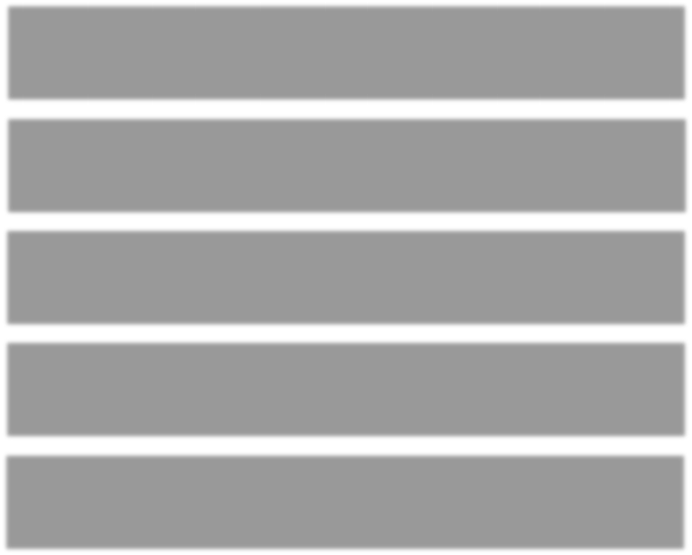





Agenda
01
What is a Web Framework?
02
What
is a
Django?
03
History of Django
04
Features of Django
05
Django Installation

Slide 3
What is Web Framework?
^{Web} ^{framework} ^{is} ª ^{set} ^{of} ^{components} ^{designed} ^{to}
simplify your web development process. It has basic structuring tools in it, which serve as a solid base for your project. It allows you to focus on the most important details and project’s goals instead of creating things, that you can simply pull out of the framework.

Slide 4





What is Django?
01
Django is a web application framework written in Python programming language.
04
It takes less time to build application after collecting client requirement.
This framework uses a famous tag line: The web framework for perfectionists with deadlines.
02
It is based on MVT (Model View Template) design pattern.
05
03
The Django is very demanding due to its rapid development feature.

Slide 5
Version
0.90
0.91
0.96
1.0
1.1
1.2
1.3
1.5
1.6
Date
16 Nov 2005
11 Jan 2006
23 Mar 2007
3 Sep 2008
29 Jul 2009
17 May 2010
23 Mar 2011
26 Feb 2013
6 Nov 2013
Description
magic removal
newforms, testing tools
API stability, decoupled admin, unicode
Aggregates, transaction based tests
Multiple db connections, CSRF, model validation
Timezones, in browser testing, app
templates.
Python 3 Support, configurable user model
Dedicated to Malcolm Tredinnick, db
transaction management, connection
pooling.

Slide 6
1.7 | 2 Sep 2014 | Migrations, application loading and configuration.
1.8 LTS | 2 Sep 2014 | Migrations, application loading and configuration.
1.8 LTS | 1 Apr 2015 | Native support for multiple template engines.Supported until at least April 2018
1.9 | 1 Dec 2015 | Automatic password validation. New styling for admin interface.
1.10 | 1 Aug 2016 | Full text search for PostgreSQL. New-style middleware.
1.11 LTS | 1.11 LTS | Last version to support Python 2.7.Supported until at least April 2020
2.0 | Dec 2017 | First Python 3-only release, Simplified URL routing syntax, Mobile friendly admin.
6

Slide 7
Features of Django
!1
Rapid Development
Scalable
Secure
Versatile
Open Source
Vast and Supported Community

Slide 8
Django Installation
To install Django, first visit to django official site
(https://www.djangoproject.com) and download django by
clicking on the download section. Here, we will see various
options to download The Django.
Django requires pip to start installation. Pip is a package
manager system which is used to install and manage
packages written in python. For Python 3.4 and higher
versions pip is used to manage packages.

Slide 9
Django Installation
We are installing Django in Windows operating system.
The complete installation process is described below.
Before installing make sure pip is installed in local system.
Here, we are installing Django using pip3, the installation
command is given below.

Slide 10
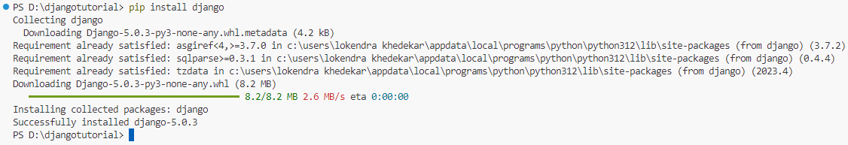
pip install django

Slide 11
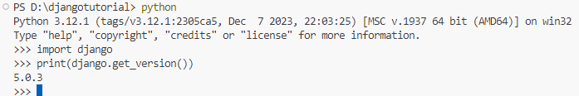
Verify Django Installation
After installing Django, we need to verify the installation. Open terminal and write python3 and press enter. It will display python shell where we can verify django installation.

Slide 12
Django Project
A project is our website. Projects contain the configuration information for
our site. Create a project:
django-admin.py startproject [PROJECT_NAME] Projects contain 3 files:
• settings.py - configuration information for your project
• urls.py - URL routes defined by your project
• manage.py - alias of django-admin.py tuned to your project

Slide 13

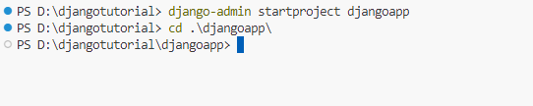
Django Project Example
Here, we are creating a project djangoapp in the current directory.
django-admin startproject djangoapp

Slide 14
Running the Django Project
Django project has a built-in development server which is used to run application instantly without any external web server. It means we don't need of Apache or another web server to run the application in development mode.
To run the application, we can use the following command.
python manage.py runserver

Slide 15
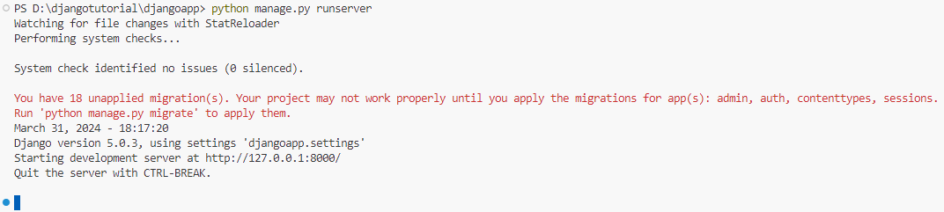

Slide 16
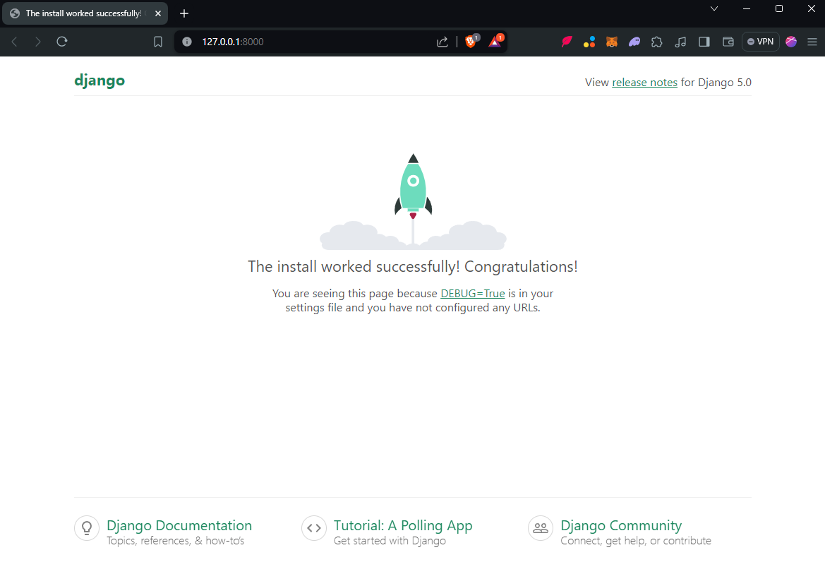
The server has started and can be accessed at localhost with port 8000. Let's access it using the browser, it looks like the
below.

Slide 17
DJANGO
MODELS AND
DATABASE

Slide 18



Agenda
01
What is Model
Model Fields
02
Create First Model
Databases
03
04

Slide 19
What is Model?
A model is the single, definitive source of information about your data.
It contains the essential fields and behaviors of the data you’re storing
Generally, each model maps to a single database table.
Each model is a Python class that subclasses django.db.models.Model.
Each attribute of the model represents a database field.

Slide 20
CREATE YOUR FIRST MODEL
from django.db import models class Person(models.Model): first_name = models.CharField(max_length=30) last_name = models.CharField(max_length=30)

Slide 21
MODEL FIELDS
Fields are organized into records, which contain all the
information within the table relevant to a specific entity.
There are concepts to know before creating fields:
Field
Options
Field Type
Relationship

Slide 22
1. FIELD TYPE
The fields defined inside the Model class are the columns name of the mapped table
E.g.
AutoField()
An integer field
that
automatically
increments
BooleanField()
Store true/false
value and
generally used
for checkboxes
CharField()
A string field
for small to
large-sized
strings.
DateField()
A date field
represents
python
datetime. date
instance.

Slide 23
2. FIELD OPTIONS
Field option are used to customize and put constraint on the table rows.
E.g.
name= models.CharField(max_length = 60) here "max_length" specifies the size of the VARCHAR field.

Slide 24
The following are some common and mostly used field option:
01
03
Null
02
04
Blank
to store empty values as NULL in database.
if True, the field s allowed to be blank.
05
unique_key
default
primary_key
puts unique key constraint for column.
store default value for a field
this field will be the primary key for the table

Slide 25
3. MODEL FIELD RELATIONSHIP
The power of relational databases lies in relating tables to each other Django offers ways to define the three most common types of database relationships:
1. many-to-one
2. many-to-many
3. one-to-one.

Slide 26
1) Many-to-one relationships:
To define a many-to-one relationship, use
django.db.models.ForeignKey.
You use it just like any other Field type: by including it as a class attribute of your model.
E.g.
class Manufacturer(models.Model) pass class Car(models.Model): manufacturer = models.ForeignKey(Manufacturer, on_delete=models.CASCADE)

Slide 27
2) Many-to-many relationships
To define a many-to-many relationship, use ManyToManyField. You use it just like any other Field type: by including it as a class attribute of your model.
For example, if a Pizza has multiple Topping objects – that is, a Topping can be on multiple pizzas and each Pizza has multiple toppings – here’s how you’d represent that:

Slide 28
from django.db import models class Topping(models.Model): # ... pass class Pizza(models.Model): # ... toppings = models.ManyToManyField(Topping)

Slide 29
3) One-to-one relationships
To define a one-to-one relationship, use OneToOneField. You use it just like any other Field type: by including it as a class attribute of your model.
E.g.
from django.conf import settings from django.db import models class MySpecialUser(models.Model): user = models.OneToOneField(settings.AUTH_USER_MODEL) supervisor = models.OneToOneField(settings.AUTH_USER_MODEL)

Slide 30

Meta Option
A metaclass is the class of a class.
A class defines how an instance of the class behaves while a metaclass defines how a class behaves.
A class is an instance of a metaclass.
Give your model metadata by using an inner class Meta.

Slide 31
E.g.
from django.db import models class Student(models.Model): name = models.CharField(max_length =50) class Meta: ordering =["name"] db_table = "students"

Slide 32
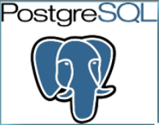


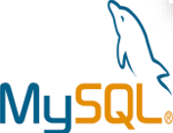
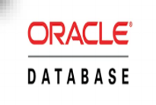
Databases
Django officially supports the following databases:

Slide 33
Telling Django About Your Database
Before we can create any models, we must first setup our database configuration. To do this, open the settings.py and locate the dictionary called DATABASES.
modify the default key/value pair so it looks something like the following example.
DATABASES = { 'default': { 'ENGINE': 'django.db.backends.sqlite3', 'NAME': DATABASE_PATH, } }

Slide 34
Also create a new variable called "DATABASE_PATH" and add that to the top of your settings.py
DATABASE_PATH = os.path.join(PROJECT_PATH, 'rango.db')

Slide 35
Views
Perform a task and render output
(HTML/JSON/XML)
Python function that takes an HttpRequest
and returns an HttpResponse
Defined in an app's views.py file
View Example:-
from django.http import HttpResponse
def hello_world(request):
return HttpResponse("Hello World“)

Slide 36
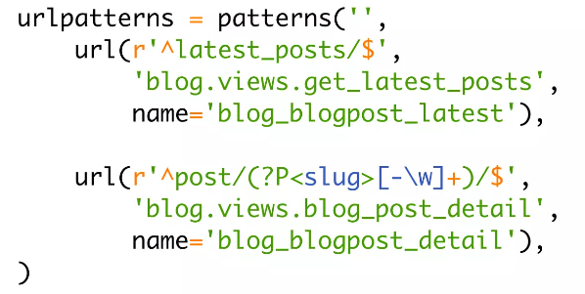
URL Routes
Defines the URLs used in your project
Maps a URL to a View Function
Defined using Regular Expressions
Defined in an app's urls.py file.
URL Example:-

Slide 37
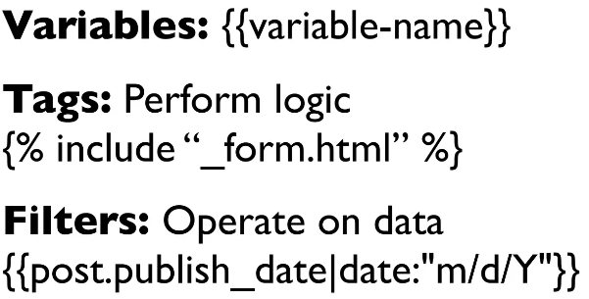
Templates
Describes the Presentation of your data
Separates Logic from Presentation
Simple Syntax & Designer Friendly
Supports Reuse through inheritance & inclusion
Template Syntax :-

Slide 38
Thank You!

