Slide 1
Understanding the timing of eruption end using a machine learning approach to classification of seismic time series
221710304036 N.Madhumita
221710304064 Vantipalli Pravarsha
221710304022 Jujaray Naveen
221710304044 Pitchka Raghavendra Rao

Slide 2
OBJECTIVE
Earthquakes => Volcanoes

Slide 3
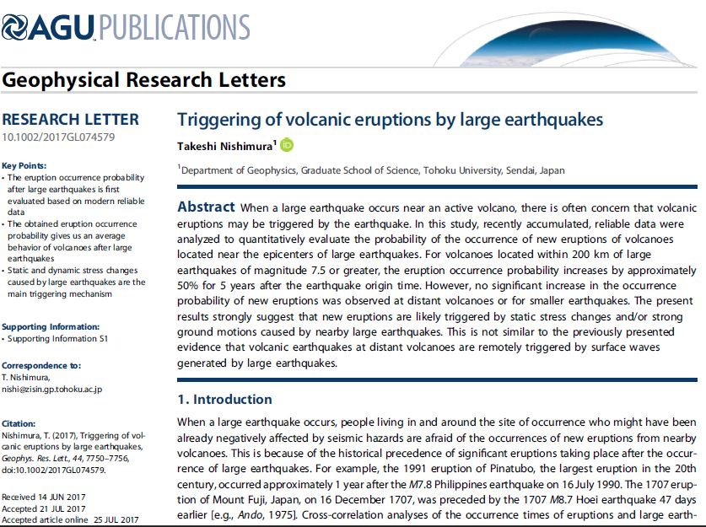

Slide 4
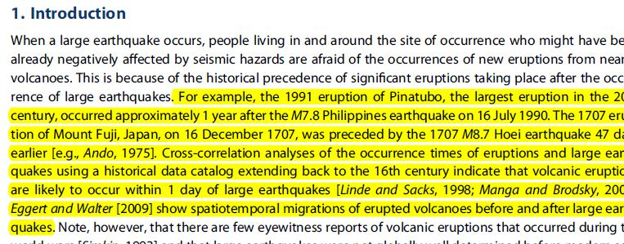

Slide 5
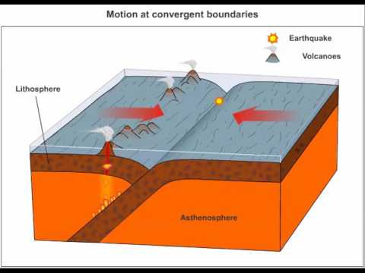
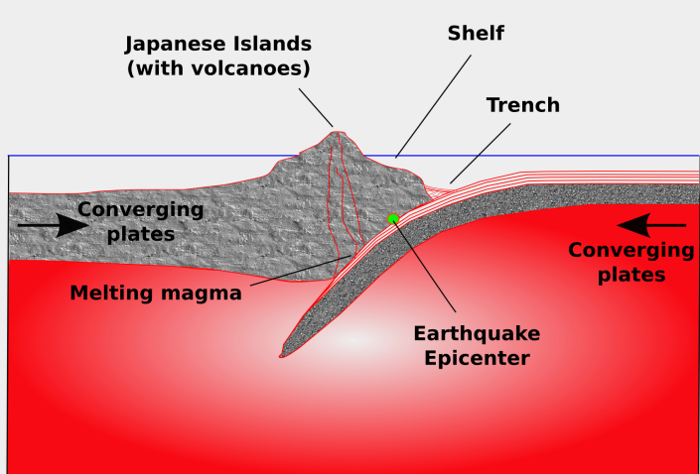
Model Constraints

Slide 6
Features
Latitude
Longitude
Magnitude
Why have we chosen these features?

Slide 7
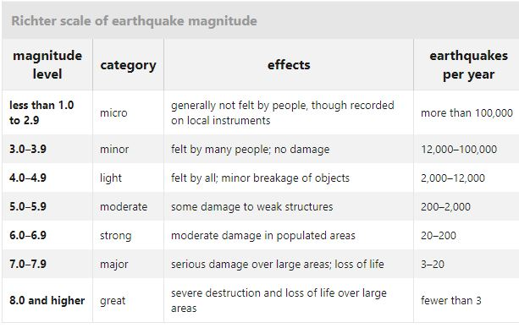

Slide 8
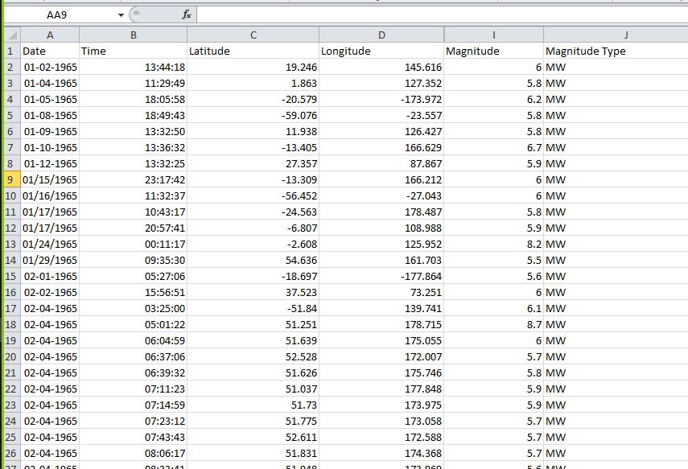
Dataset(1)

Slide 9
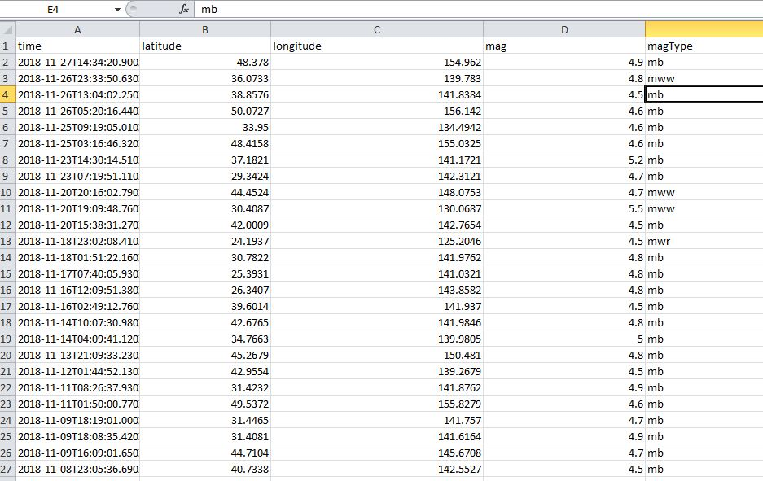
Dataset(2)

Slide 10
Implementation

Slide 11
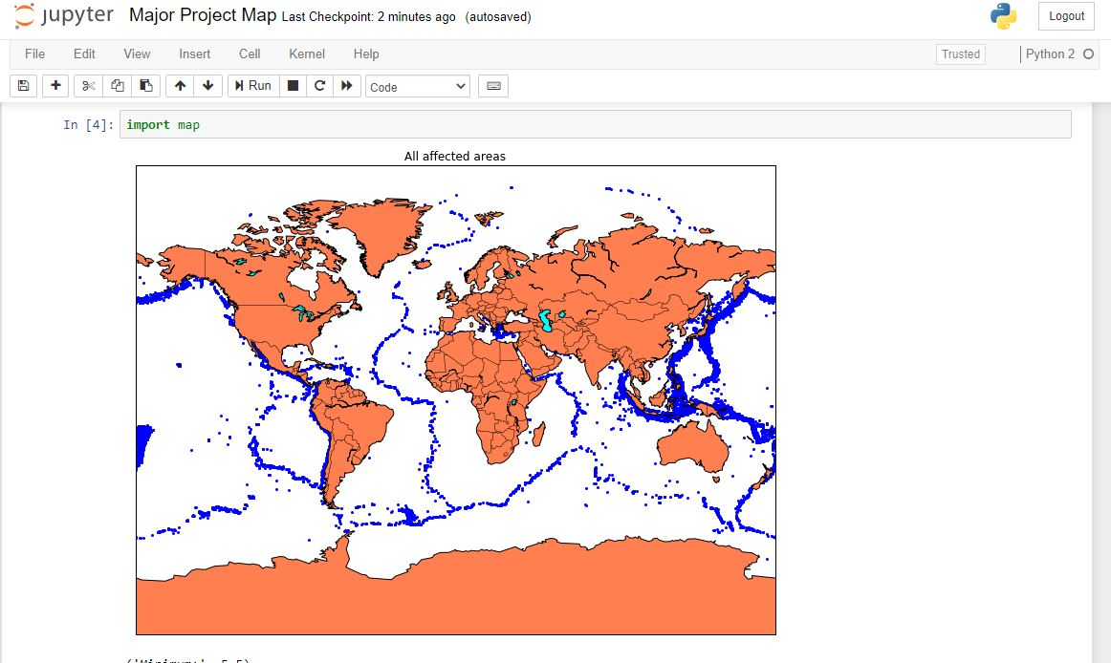
Earthquakes since 1965-2016

Slide 12
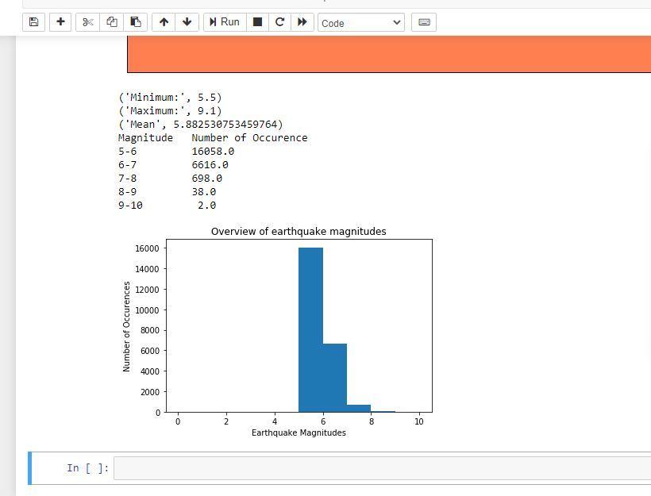

Slide 13
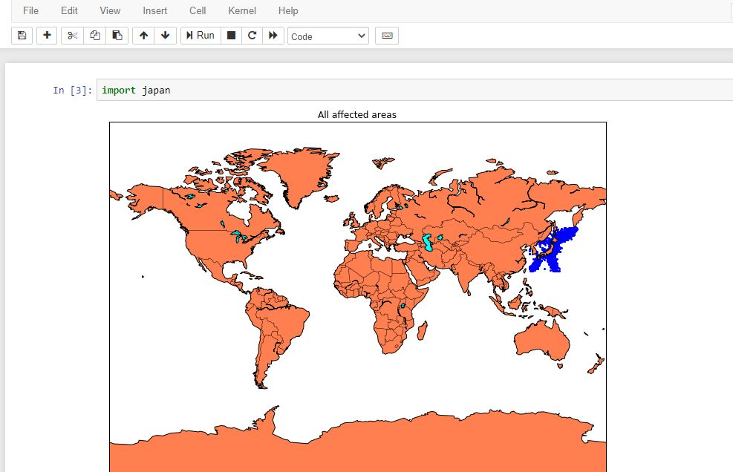
Earthquakes in japan

Slide 14
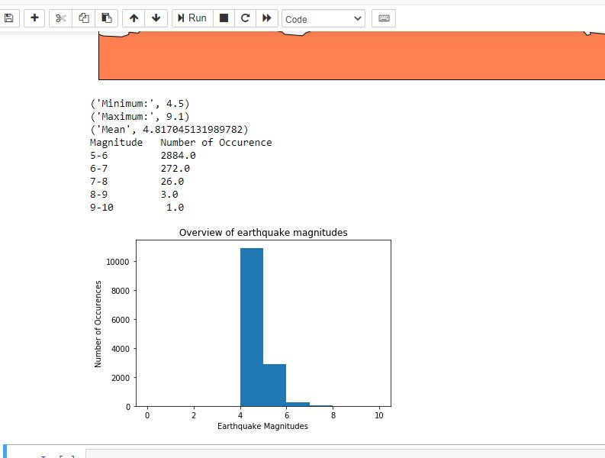

Slide 15
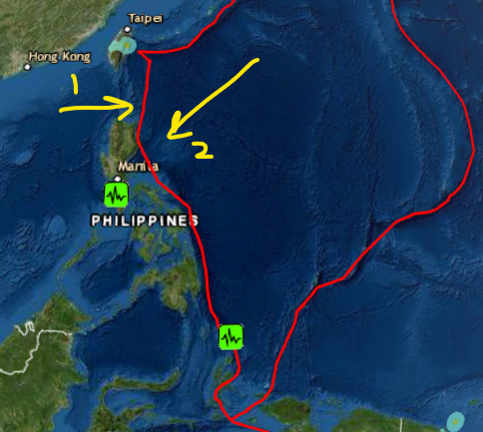

Slide 16
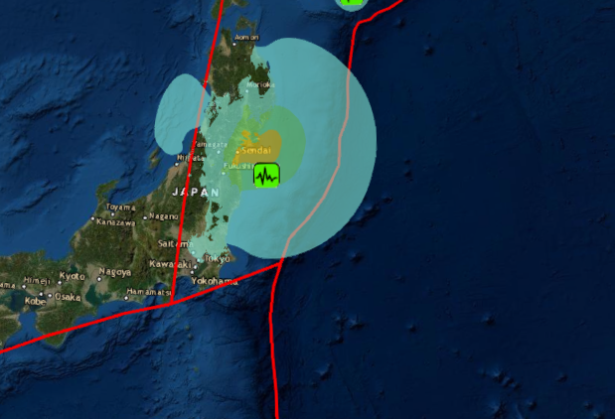

Slide 17

RESULT
X is the number of volcano eruptions within unit time t
waiting time between volcano eruptions is a random variable with an exponential distribution with rate
λ=0.10 eruptions/year and t is time(1 year)
eg: λt =0.10* 60=6
P[X<=9]= P[X=6]+P[X=7]+P[X=8]+P[X=9]

Slide 18
