Slide 1

PRESENTATION ON
CEA
COLD EMAIL AGENT

Slide 2


VISVESVARAYA TECHNOLOGICAL UNIVERSITY
A MINI PROJECT PRESENTATION ON
CEA : Cold Email Agent
Under the guidance of Ms. Sanjana K P Assistant Professor Department of CSE
Presented By
Aravind Pawar Arun Kumar K H Chandan R Naveen Kumar
1SZ23CS006
1SZ23CS009
1SZ23CS014
1SZ23CS037

Slide 3


Table of Contents
SL.no. | Chapters
1 | Introduction
2 | Problem Statement
3 | Objectives
4 | Literature survey
5 | Existing and Proposed System
6 | System design
7 | Requirement specification
8 | Working
9 | Test Cases
10 | Snapshots
11 | Conclusion
12 | References

Slide 4

1. Introduction
Cold emailing is a common method used for marketing, sales, recruitment, and communication.
Writing personalized emails manually for many recipients is time-consuming and
repetitive.
Users often struggle with maintaining consistency, tone, professionalism, and accuracy in emails.
The Cold Email Agent automates the entire process of generating professional, customized emails.
It uses AI to understand user inputs and create context-specific email content instantly.
The system also supports bulk email sending using Gmail/SMTP integration.

Slide 5

2. Problem Statement
Manually writing cold emails is time-consuming and inefficient for large-scale outreach.
Users often face difficulty personalizing emails for each recipient.
Maintaining consistency, tone, and professionalism becomes challenging when writing multiple emails.
Human errors in formatting, grammar, or recipient details reduce email quality.
Bulk email sending through manual methods is slow and prone to mistakes.
Ensuring proper email deliverability and avoiding spam triggers is difficult without automated checks.

Slide 6

3. Objectives
To automate the creation of personalized and professional cold emails.
To reduce manual effort and save time in drafting repetitive emails.
To use AI for generating context-relevant content based on user inputs.
To validate email formats and recipient data before sending.
To support bulk email sending through Gmail or SMTP integration.
To maintain consistency in tone, structure, and formatting of emails.

Slide 7


4. Literature survey
SL.NO. | PAPER NO | AUTHOR(S) | YEAR | SUMMARY | CHALLENGES
1 | AI Email Automation | Patel et al. | 2020 | Uses AI to generate automated email drafts. | Limited personalization
2 | NLP-Based Email Personalization | Sharma et al. | 2021 | Applies NLP to create context-aware emails | Requireslarg e training data.
3 | Bulk Email Send System | Gupta & Kumar | 2022 | Automates sending emails to multiple recipients. | Deliverabilit y issues
4 | Intelligent Email Manager | Das et al. | 2023 | Provides template creation & scheduling. | Notscalablefor large outreach.
5 | AI Outreach Communication | Hussain et al. | 2024 | Enhances outreach using AI-generated messages.. | Complex UI reduces usability.

Slide 8

5. Existing &Proposed System
FEATURES/ASPECTS | EXISTING SYSTEM | PROPOSED SYSTEM
Email Creation | Manual writing | AI-generated personalized emails
Personalization | Limited or generic content | Automated, data-based personalization
Bulk Sending | Time-consuming and error-prone | One-click bulk email sending
Data Handling | Manual handling of contacts | Auto-import and organized recipient data
Error Handling | Frequent grammar & formatting errors | AI-corrected, error-free email drafts
Deliverability | No validation; high bounce chance | Email format verification + spam check
Time Required | Slow, repetitive tasks | Fast and automated workflow
Consistency | Tone and format vary in every email | Consistent structure and professional style

Slide 9

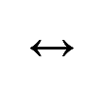
6. System design
Architecture Overview:
Frontend (React / HTML / Tailwind) Backend (Node.js / Express / Python API) Email Service (Gmail API / SMTP) Database (MongoDB / Firebase)
Flow:
User logs in using their credentials.
Frontend sends login data to backend → /api/auth/login.
Backend verifies the user and returns an authentication token.
User uploads recipient data (CSV/Excel) → /api/upload.
Backend stores and validates the contacts in the database.
User enters prompt and requests email generation → /api/generate-email.
AI engine generates a personalized cold email and sends it back to frontend.
User approves the final email and clicks send → /api/send-email.
Backend uses Gmail API/SMTP to deliver emails to all recipients.
Email status, logs, and responses are stored and fetched via → /api/status/:id.

Slide 10

7. Requirement specification
Hardware Requirements:
  Processor: Intel i3 or higher
  RAM: Minimum 4GB
  Storage: At least 500 MB free space
  Network: Stable Internet Connection
Software Requirements:
  Operating System: Windows / Linux / macOS
  IDE / Code Editor: Visual Studio Code
  Database: MongoDB / Firebase
  Backend: Node.js + Express (or Python Flask/FastAPI)
  Frontend: React + Tailwind CSS / HTML + JS
  APIs Used: Gmail API / SMTP
  Libraries: CSV parser, JWT authentication, Axios for API calls

Slide 11

8. Working
Sign Up Page:
User enters Name, Email, and Password.
Creates an account to access the Cold Email Agent.
Sign In Page:
User enters email and password to log in.
After successful login, an authentication token is generated.
Dashboard Page:
Displays options to upload recipient list (CSV/Excel). Shows recent email activities and status of sent emails. Allows users to choose templates or create a custom prompt.
Email Generation Page:
User enters the purpose or prompt of the cold email.
AI generates a personalized, professional email based on the input.
User can edit, regenerate, or approve the final email.
Sending Page:
System validates email addresses and checks for formatting errors. Sends emails using Gmail API/SMTP with one click.

Slide 12
9. Test Cases
S.NO | TEST SCENARIO | EXPECTED RESULT | ACTUAL RESULT | STATUS
1 | Load Dashboard PAGE | Homepage Loads | Loaded Successfully | Pass
2 | Upload Recipient File | Redirect To The Event Details | Uploaded Successful | Pass
3 | Submit Empty Prompt | Show Error Message | Error Shown | Pass
4 | Submit Valid Prompt | Generate Email | Email Generated | Pass
5 | Invalid Email Prompt | Show Error Message | Error Shown | Pass
6 | Send Email | Email Sent Successfullly | Sent Successfully | Pass

Slide 13

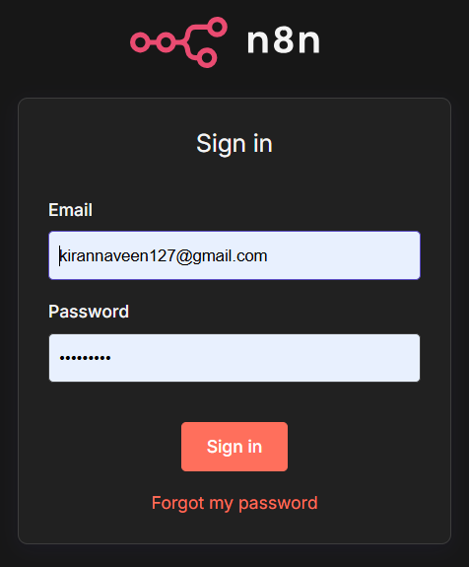
10.Snapshots
Figure 10 : Sign Up Page

Slide 14
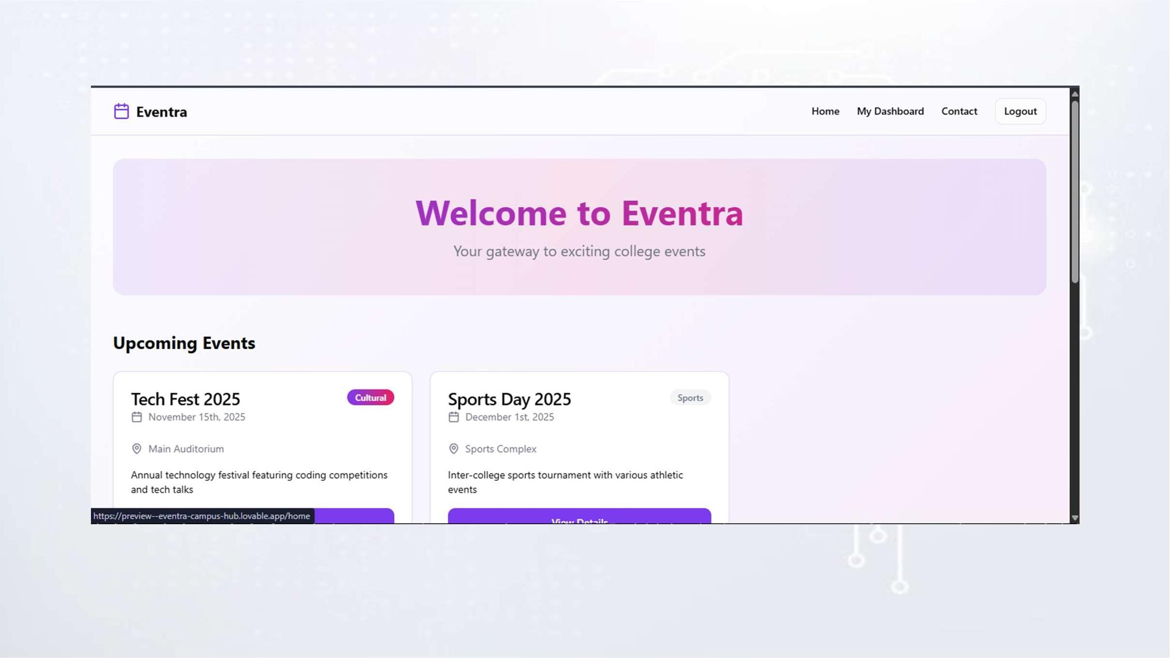
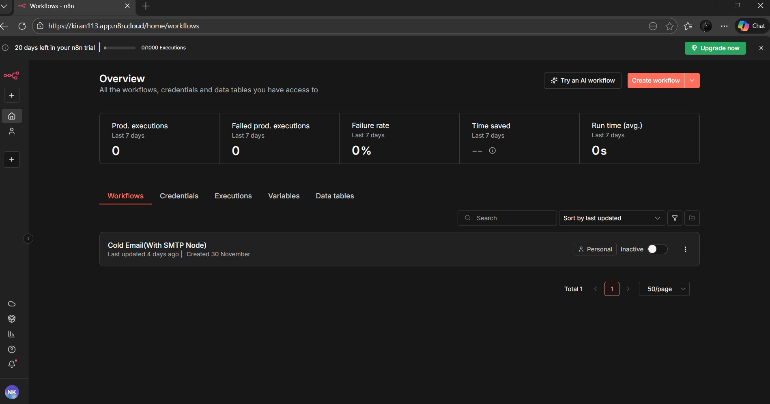
Figure 10.1 : Home Page

Slide 15
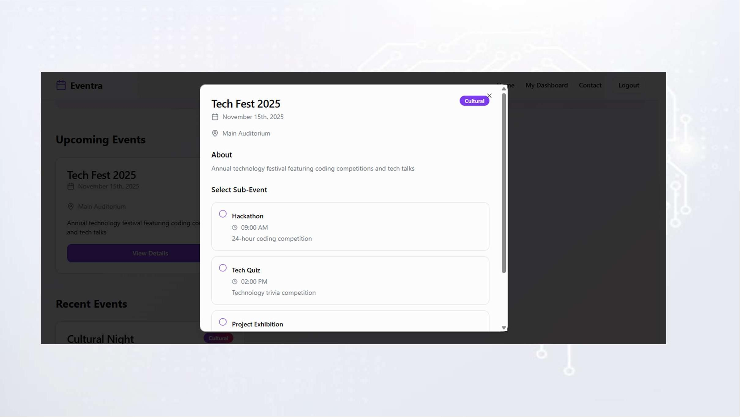
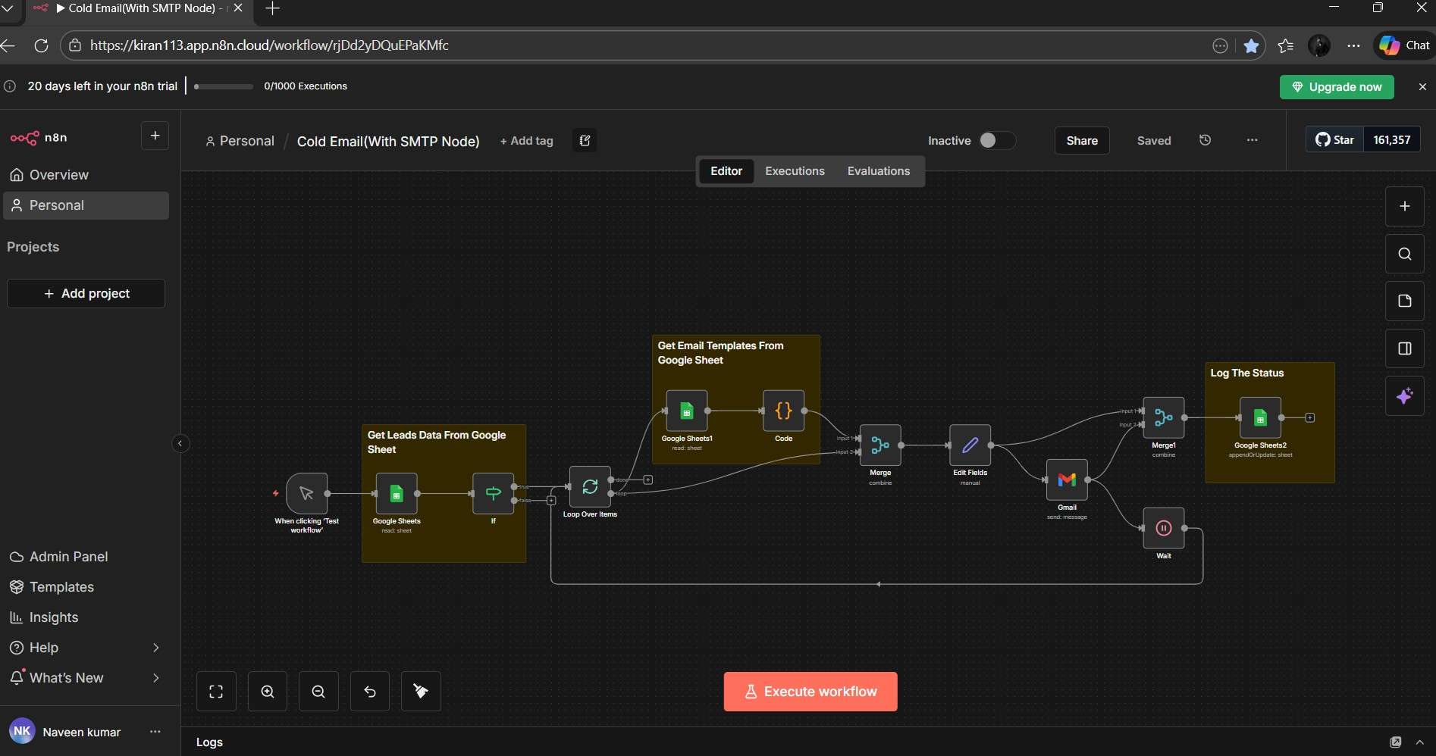
Figure 10.2 : Work Flow

Slide 16
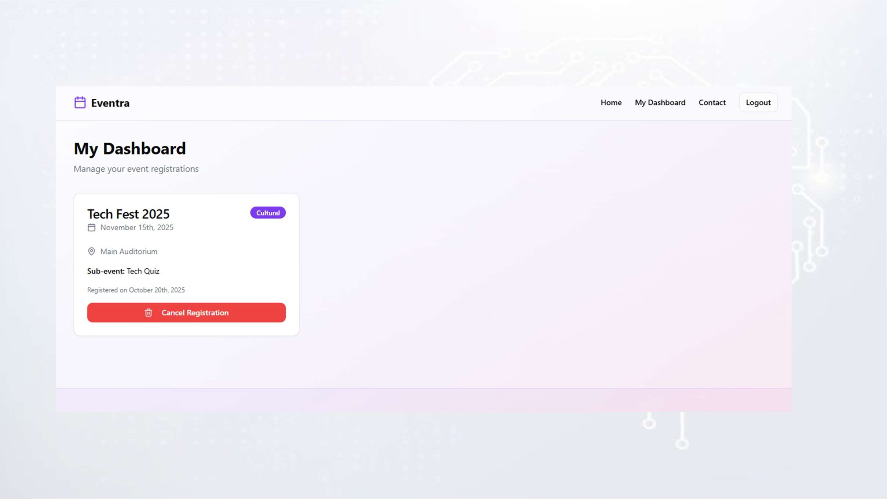
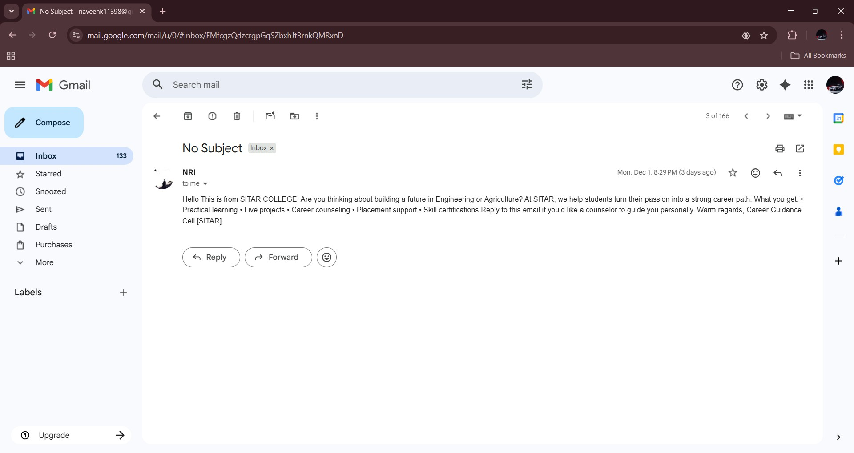
Figure 10.3 : Output

Slide 17

11. Conclusion
The Cold Email Agent successfully automates the entire process of generating and sending personalized cold emails. By integrating AI, template management, and bulk email delivery, the system reduces manual effort and improves the efficiency of outreach tasks. It ensures consistency, professional quality, and accuracy in every email generated. Features such as email validation, automated personalization, and activity tracking help enhance productivity and reduce errors. Overall, the Cold Email Agent provides a fast, reliable, and user-friendly solution for individuals and organizations looking to streamline communication and improve engagement with recipients.

Slide 18

12.References
T. Brown, B. Mann, N. Ryder et al., “Language Models are Few-Shot Learners,”
Advances in Neural Information Processing Systems (NeurIPS), pp. 1–15, 2020.
OpenAI, “OpenAI API Documentation,” Online, Available:
https://platform.openai.com/docs, 2023.
Google Developers, “Gmail API: Sending Email,” Google Workspace for Developers, Available: https://developers.google.com/gmail/api, 2023.
Google Developers, “Google Sheets API Overview,” Google Developers,
Available: https://developers.google.com/sheets/api, 2023.
M. Hirt, “Workflow Automation with n8n: Concepts and Best Practices,” n8n Blog, 2023.

Slide 19




