Slide 1


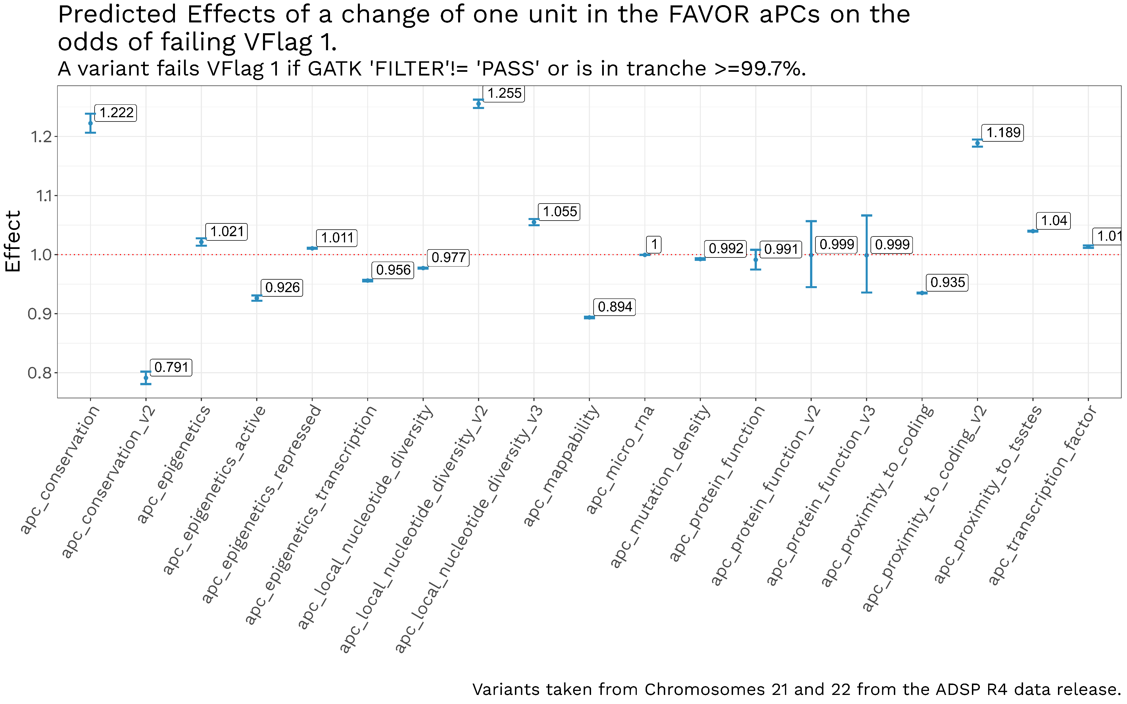
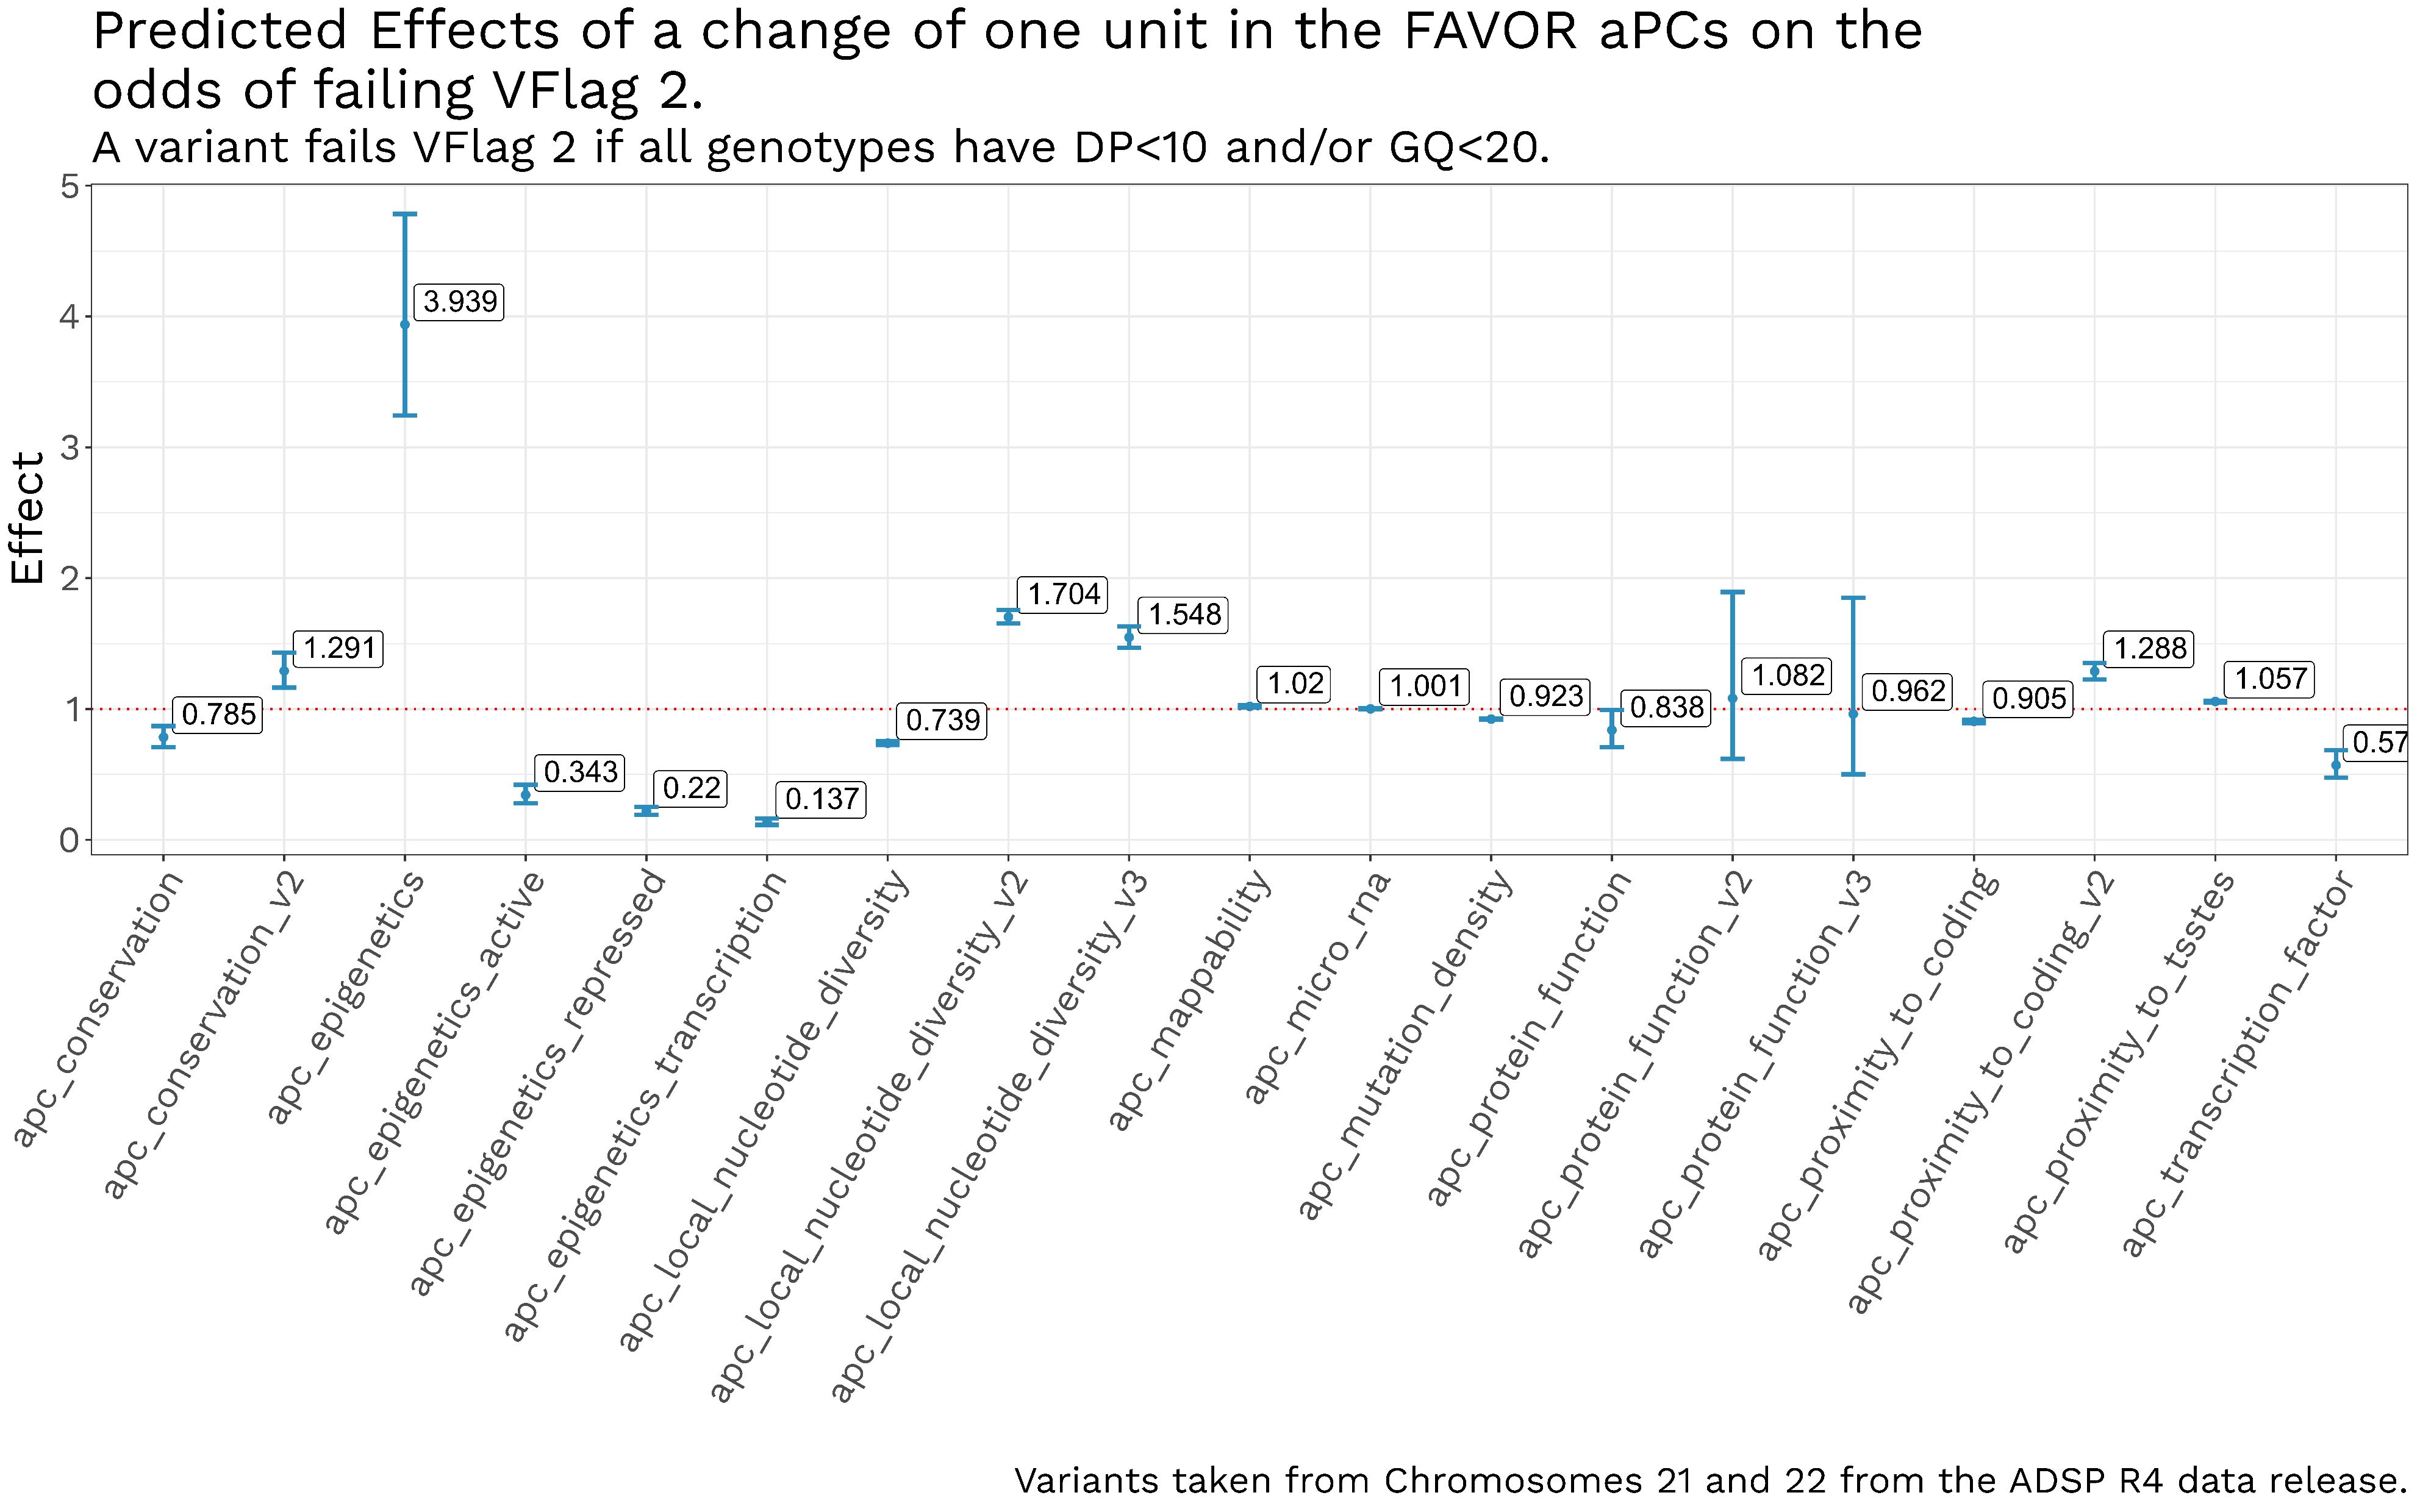
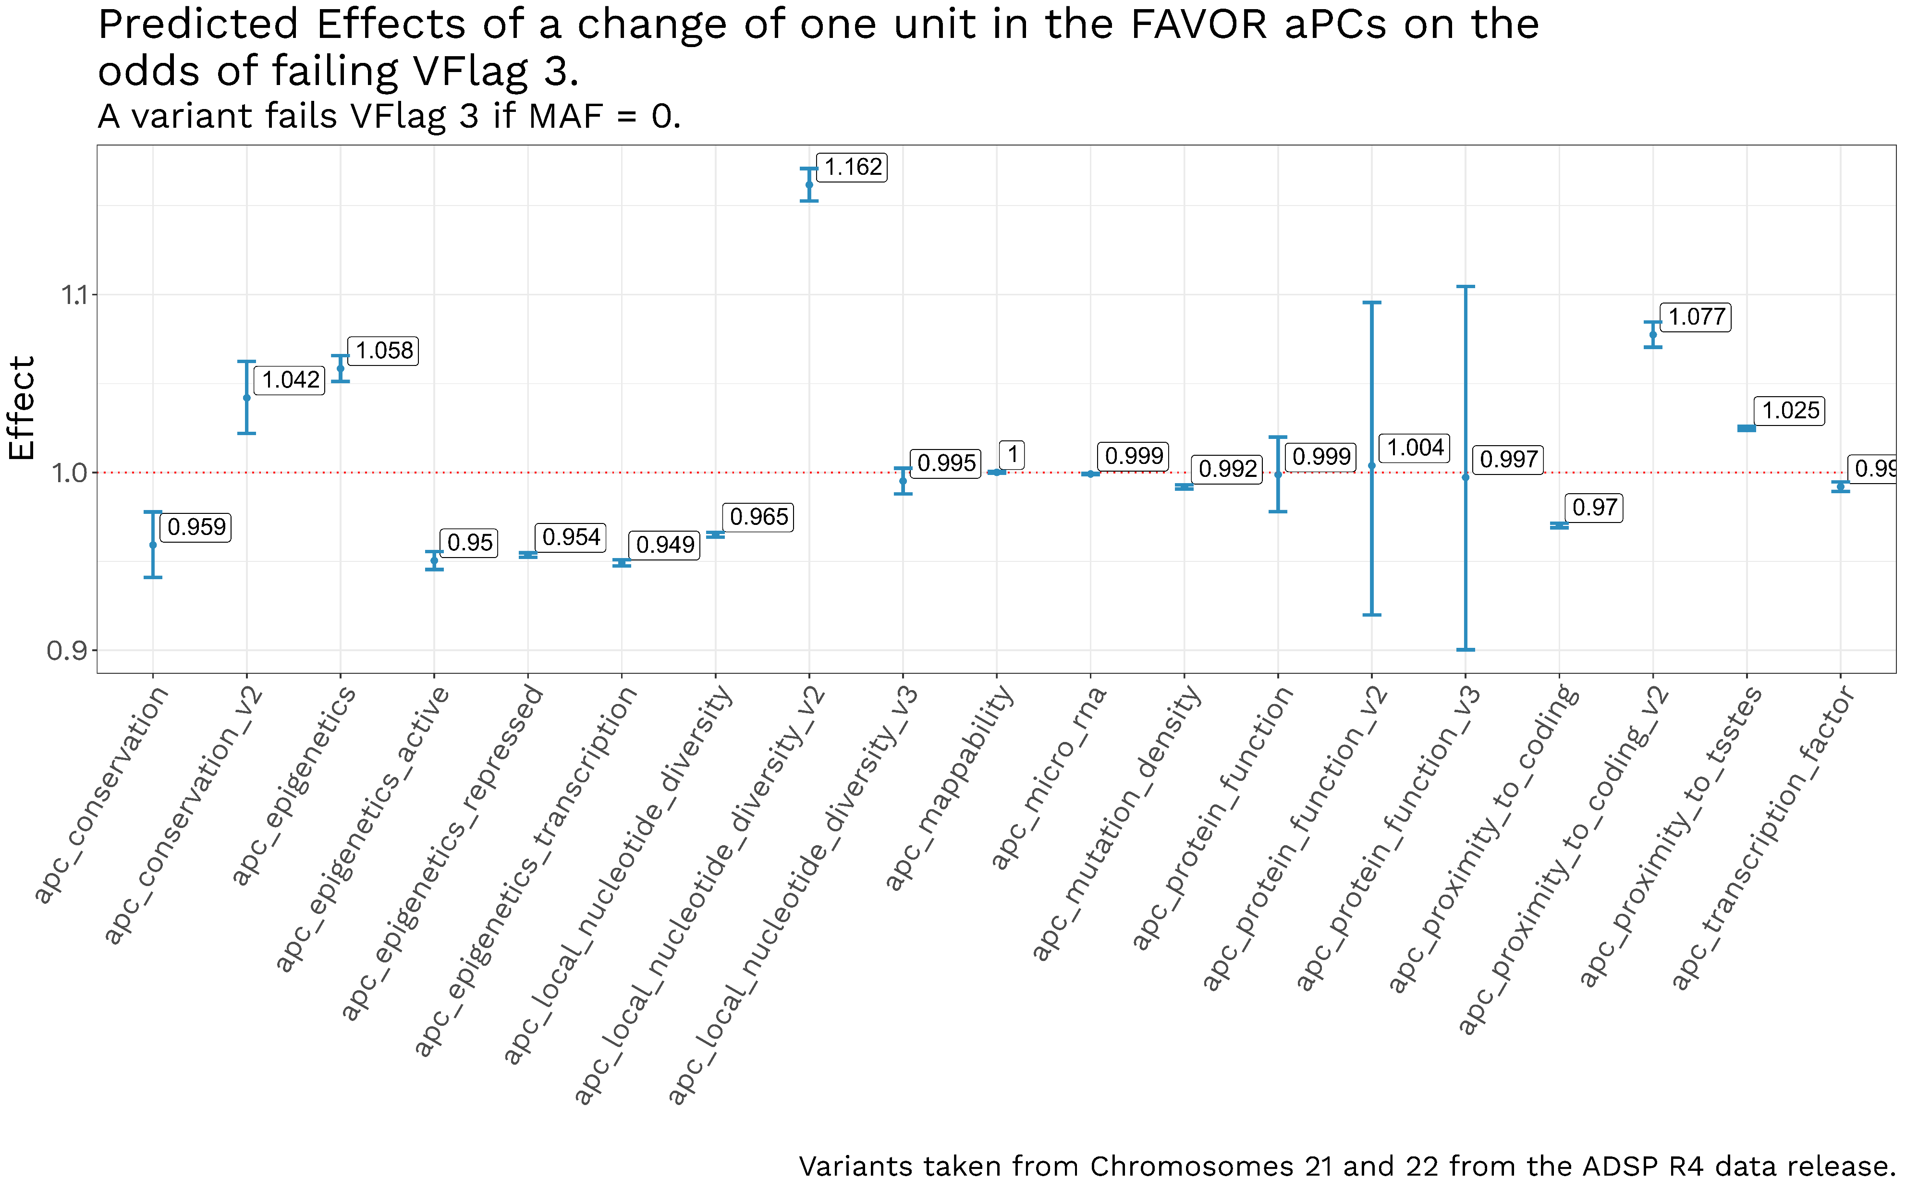
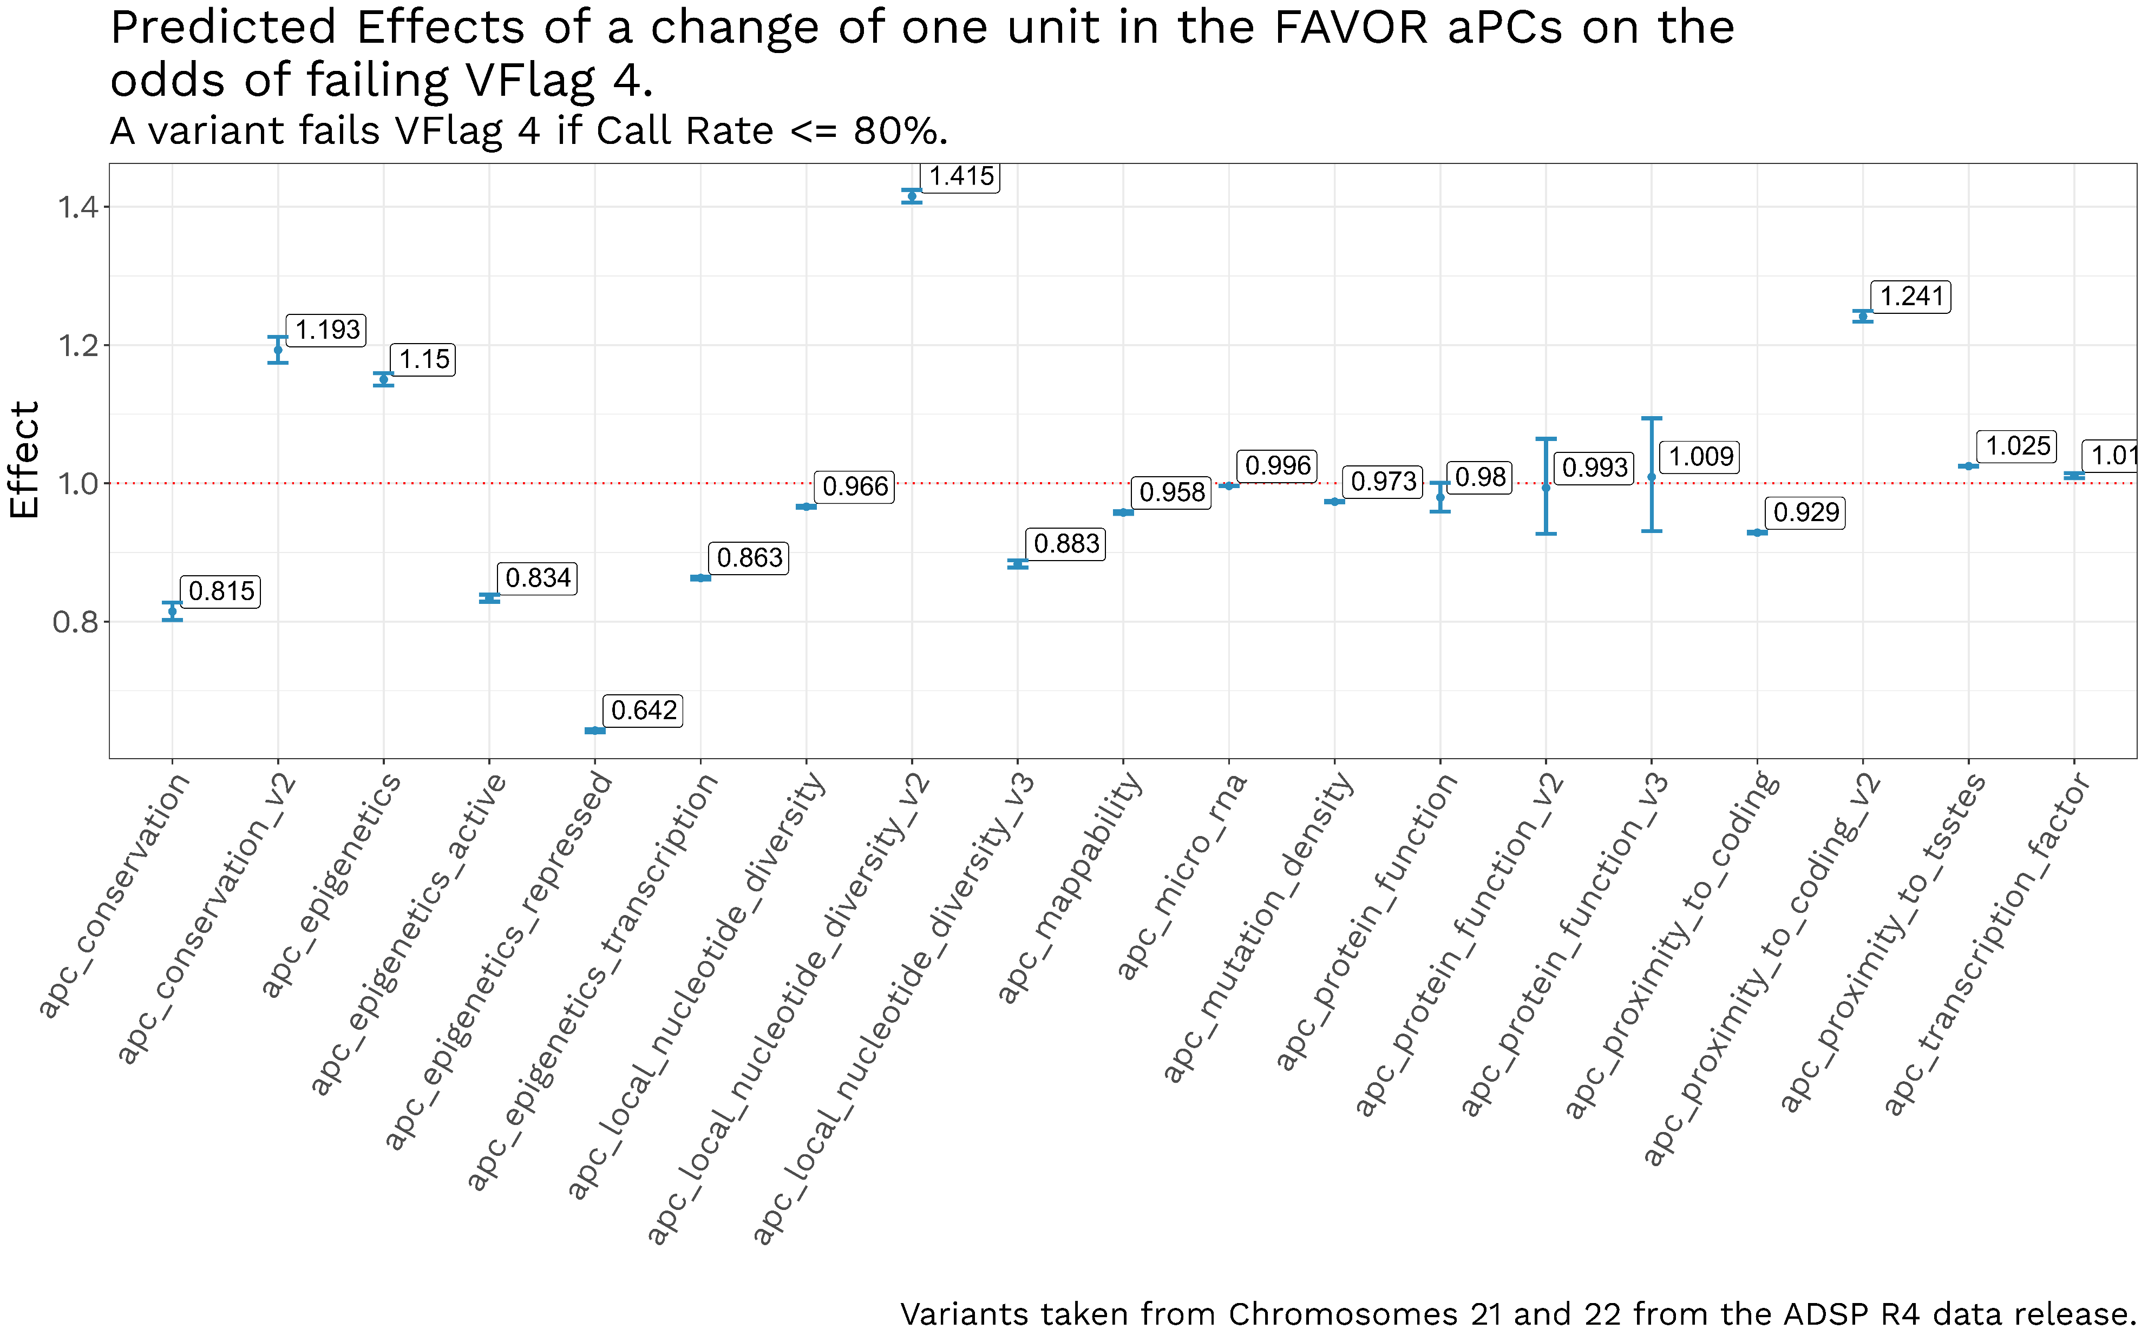
Quality Control metrics of individual genetic variants in the Alzheimer’s Disease Sequencing Project are associated with FAVOR annotations.
Naveen Kannan¹, Nicholas Wheeler¹, Genome Center for Alzheimer’s Disease, Li-San Wang², Yuk Yee Leung², William S. Bush¹
1) Cleveland Institute for Computational Biology, Department for Population and Quantitative Health Sciences, Case Western Reserve University, Cleveland, Ohio 44106, USA. 2) Department of Pathology and Laboratory Medicine, Penn Neurodegeneration Genomics Center, Perelman School of Medicine, University of Pennsylvania, Philadelphia, Pennsylvania 19104, USA.
Introduction
FAVOR annotations
The ADSP (Alzheimer’s Disease Sequencing Project) released their 4th dataset consisting of 36,361 sequenced genomes, with 362 million variants.
The R4 release has 35,569 unique subjects, with 5,218 individuals of African Ancestry, 2,791 with Asian ancestry, 10,398 with Hispanic ancestry, 16,191 with Non-Hispanic White (NHW) ancestry, and 971 of Other/Unknown ancestry.
Each of the 362 million genetic variants were processed to generate functional annotations using the FAVOR database.
FAVOR integrates data from multiple databases, including CADD v1.5, GENCODE v31, Annovar, WGSA, ClinVar, ENCODE, SnpEff, 1000 Genome, TOPMed Bravo Freeze 8 and gnomAD v3.
FAVOR functional scores are divided into 17 groups, along with annotation Principal Components (aPCs), which are the first variant-specific PC calculated from each standardized individual annotation score within these 17 groups.
Acknowledgements: This work was supported by funding from the National Institute on Aging U54 AG052427 (Schellenberg, Wang).

