Slide 1


ZERO-KNOWLEDGE ENCRYPTED FILE STEGANOGRAPHY VAULT
StegaVault
Hiding what's encrypted. Encrypting what's hidden.
PROJECT TEAM
Naveen K • Likhith Kumar R P • Mahamad Usen • Akash B V
Guided by Prof. Sheela Rani C M
Department of Computer Science & Engineering
Sapthagiri College of Engineering, Bengaluru
STEGAVAULT
01

Slide 2




INTRODUCTION
What is StegaVault?
Digital security today usually means choosing between encryption (unreadable) or steganography (undetectable) — rarely both together.
StegaVault combines authenticated AES-256-GCM encryption with 1-bit LSB steganography, so a protected file is both unreadable and invisible.
The entire cryptographic and steganographic pipeline runs client-side, in the browser — no plaintext, passphrase, or key is ever transmitted to a server.
Built as a full-stack web application: React/TypeScript frontend, NestJS/PostgreSQL backend architecture, with OAuth-based multi-provider login.
ENCRYPT
AES-256-GCM in your browser
HIDE
1-bit LSB steganography in a cover image
STEGAVAULT
Introduction
02

Slide 3


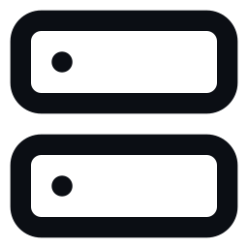

PROBLEM STATEMENT
Why existing approaches fall short
Visible ciphertext
Undefended hiding
Server-side trust
An encrypted file is still obviously encrypted — it can be flagged, seized, or specifically targeted.
Steganography alone conceals data, but leaves it completely unprotected once discovered.
Most “secure vault” apps require the server to see your password or encryption key at some point.
THE GAP
A system is needed where a file is simultaneously encrypted AND hidden — with the passphrase and derived key never leaving the user's device.
STEGAVAULT
Problem Statement
03

Slide 4
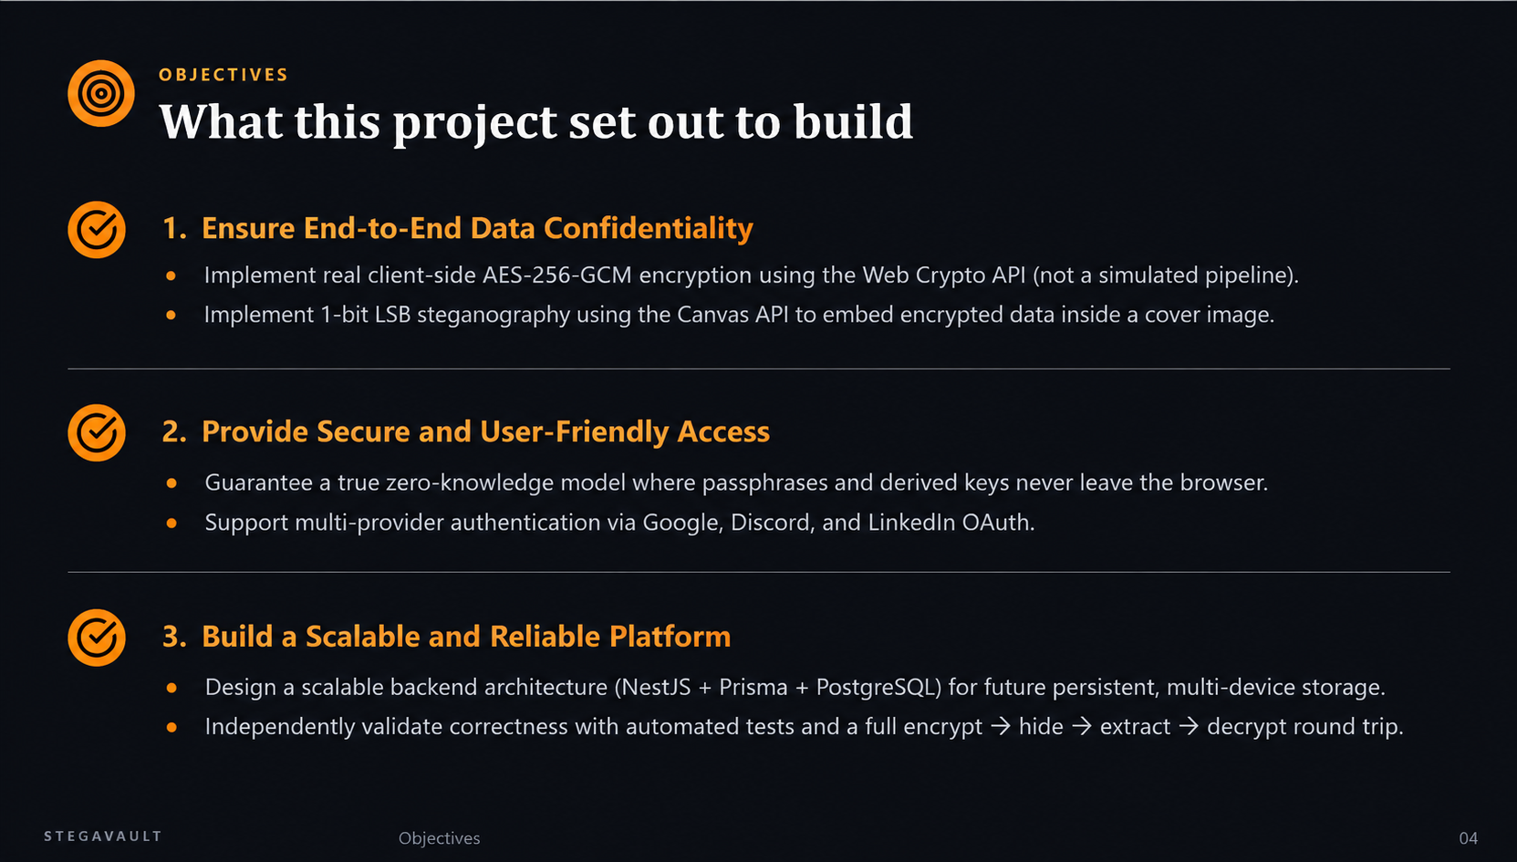

Slide 5

EXISTING SYSTEM
SecureCloud — the predecessor system
ARCHITECTURE
LIMITATIONS
PHP + MySQL encrypted cloud storage application
AES-256-CBC encryption performed server-side
LSB steganography used only to hide the encryption key — not the full file
Single-provider Google OAuth login
Graphical password authentication with role-based access control
Server has access to keys/plaintext at some point — not zero-knowledge
CBC mode provides no built-in integrity or authentication check
Single OAuth provider limits accessibility
Monolithic PHP architecture, harder to scale or maintain
STEGAVAULT
Existing System
05

Slide 6

LITERATURE SURVEY
Categories of prior approaches reviewed
Steganography-only systems
Encryption-only cloud vaults
Effectively hide data, but leave it fully unencrypted — vulnerable once detected via statistical steganalysis (chi-square, RS analysis).
Provide strong confidentiality, but visibly “suspicious” ciphertext can itself invite targeted attacks.
Server-assisted crypto + stego systems
OAuth-federated storage systems
Combine both techniques, but typically perform key derivation or encryption server-side, requiring user trust.
Simplify identity and access management, but rarely address zero-knowledge data confidentiality.
RESEARCH GAP
A system performing both steganography and strong authenticated encryption entirely client-side, with verifiable zero server-side key exposure.
STEGAVAULT
Literature Survey
06
Notes:
Research gap identified: a system performing both steganography and strong authenticated encryption entirely client-side, with verifiable zero server-side key exposure. Add the specific papers from your course-required literature survey here if needed for submission.

Slide 7

PROPOSED SYSTEM
StegaVault's approach
A 100% client-side pipeline: PBKDF2 key derivation → AES-256-GCM encryption → 1-bit LSB embedding, all inside the browser.
True zero-knowledge: the passphrase, derived key, and plaintext file are never transmitted anywhere.
Multi-provider OAuth authentication: Google, Discord, and LinkedIn.
Modern full-stack architecture: React 19 + TypeScript frontend, NestJS + Prisma + PostgreSQL backend.
Backend schema and infrastructure (S3 storage, JWT auth, rate limiting) already designed for the next milestone — persistent, multi-device encrypted storage.
WHY IT'S DIFFERENT
Real cryptography
Web Crypto API, not a simulation
Real steganography
Actual pixel-level LSB embedding
Zero server trust
Nothing sensitive ever leaves the browser
STEGAVAULT
Proposed System
07

Slide 8
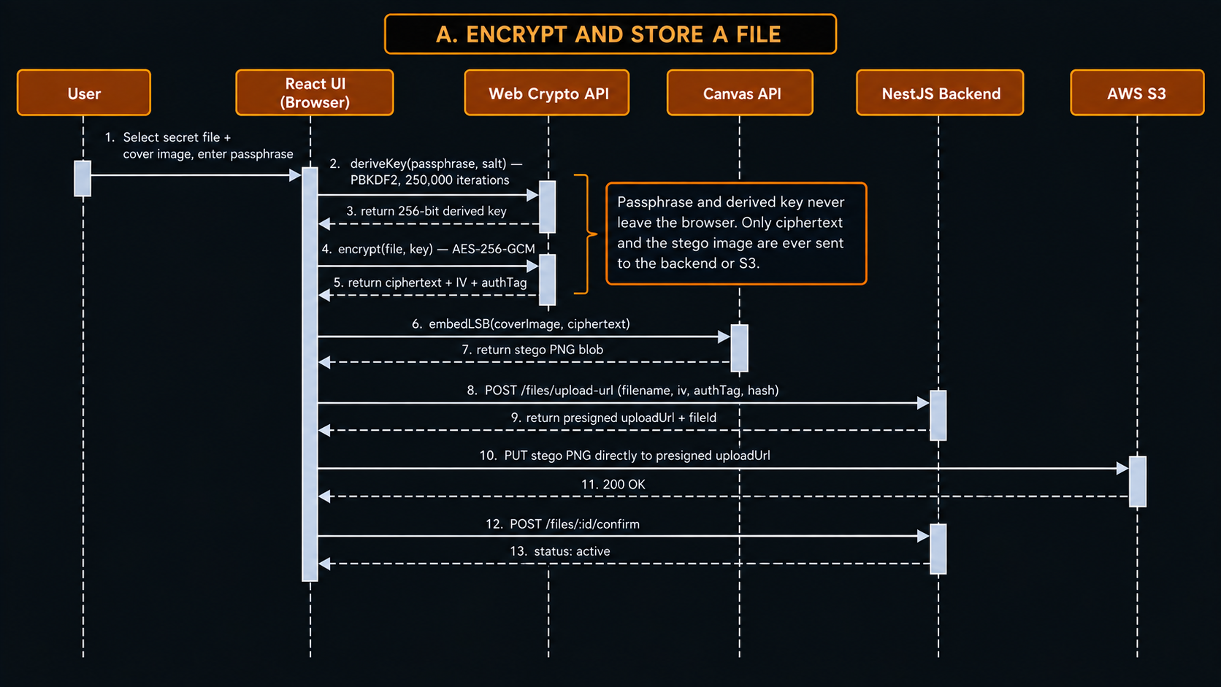
SYSTEM ARCHITECTURE(PART-A)
STEGAVAULT
System Architecture
08

Slide 9
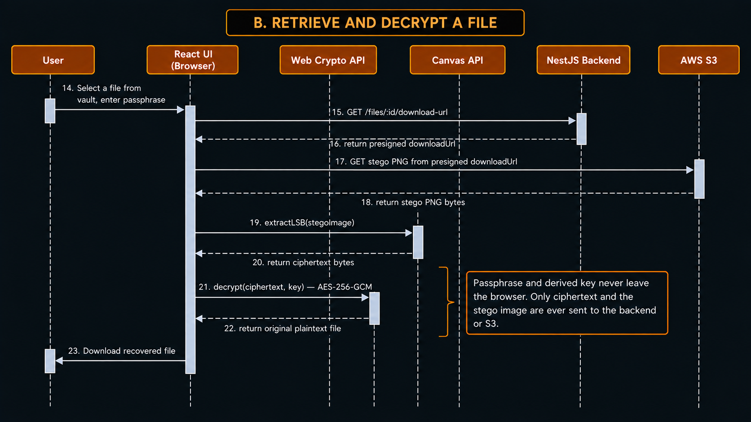
SYSTEM ARCHITECTURE(PART-B)
STEGAVAULT
System Architecture
08

Slide 10

METHODOLOGY / WORKFLOW
Step-by-step: encrypt, hide, and recover
1
Select files
User selects a secret file and a cover image.
2
Enter passphrase
User provides a passphrase known only to them.
3
Derive key
PBKDF2-HMAC-SHA256 derives a 256-bit key (250,000 iterations, random salt).
4
Encrypt
AES-256-GCM encrypts the file client-side with a random IV and authentication tag.
5
Embed
1-bit LSB writes the ciphertext into the cover image's R, G, B pixel channels.
6
Recover
Reversing the steps — extract, then decrypt with the correct passphrase — restores the original file exactly, or fails clearly if the passphrase is wrong.
STEGAVAULT
Methodology / Workflow
09

Slide 11

SYSTEM DESIGN
Data formats behind the pipeline
ENCRYPTED PAYLOAD FORMAT
Salt
IV
Ciphertext + Auth Tag
16 bytes
12 bytes
variable length
STEGANOGRAPHIC FRAME (EMBEDDED IN COVER IMAGE)
Length Header
Payload (packed ciphertext above)
4 bytes (uint32, big-endian)
N bytes, 1 bit per R/G/B channel
BACKEND DATA MODEL — PRISMA `File` ENTITY (NEXT MILESTONE)
id • ownerId • s3KeyEncrypted • s3KeyStego • iv • authTag • ciphertextSha256 • createdAt
STEGAVAULT
System Design
10

Slide 12


ALGORITHM / TECHNIQUE USED
The two engines behind StegaVault
AES-256-GCM + PBKDF2
1-BIT LSB STEGANOGRAPHY
PBKDF2-HMAC-SHA256 with 250,000 iterations and a random 16-byte salt derives a 256-bit key from the passphrase.
AES-256-GCM is authenticated encryption — any tampering or wrong passphrase is cryptographically detected via the auth tag.
A fresh random 12-byte IV is generated for every single encryption operation.
Replaces the least-significant bit of the R, G, and B channels of each pixel with one payload bit; the alpha channel is left untouched to avoid transparency artifacts.
Capacity: 3 usable bits per pixel → capacity (bytes) = floor(width × height × 3 / 8).
Acknowledged trade-off: detectable via statistical steganalysis (chi-square, RS analysis) — addressed under Future Scope.
STEGAVAULT
Algorithm / Technique Used
11

Slide 13



IMPLEMENTATION
Technology stack
Frontend
Backend
Authentication
Testing
React 19 + Vite + TypeScript
Web Crypto API, Canvas API
Deployed on Vercel
NestJS + Prisma ORM
PostgreSQL (Supabase)
Deployed on Render
Google OAuth
Discord OAuth
LinkedIn OAuth
Vitest unit tests
TypeScript strict compilation
Manual end-to-end verification
CORE MODULES
apps/web/src/lib/crypto.ts — AES-256-GCM + PBKDF2 key derivation
apps/web/src/lib/steganography.ts — 1-bit LSB embed / extract
STEGAVAULT
Implementation
12

Slide 14

RESULTS & SCREENSHOTS
Screenshot placeholders
Replace each dashed frame below with a real screenshot before presenting.
[ Insert screenshot: Login / OAuth Screen ]
[ Insert screenshot: Encrypt & Embed Flow ]
[ Insert screenshot: Decrypt & Recover Flow ]
[ Insert screenshot: Vault Dashboard ]
Key result: full encrypt → embed → extract → decrypt pipeline verified byte-for-byte, with wrong-passphrase attempts correctly rejected.
STEGAVAULT
Results & Screenshots
13

Slide 15
TESTING & VALIDATION
Verified, not assumed
5 / 5
0
100%
2 / 2
Automated tests passing (Vitest)
TypeScript compile errors
Byte-for-byte round-trip accuracy
Failure cases correctly rejected
WHAT WAS INDEPENDENTLY VERIFIED
Encrypt → decrypt with the correct passphrase returns the exact original file.
Decrypting with the wrong passphrase fails immediately with a clear, visible error — GCM authentication tag check.
Embedding into a real cover image, then extracting, returns bytes that exactly match what was embedded.
Embedding a payload larger than the cover image's capacity is correctly rejected with a descriptive error, not silent corruption.
Full pipeline (file → encrypt → embed → extract → decrypt → original file) confirmed end-to-end, and both frontend and backend build cleanly with zero errors.
STEGAVAULT
Testing & Validation
14

Slide 16

CONCLUSION & FUTURE SCOPE
Where the project stands, and what's next
CONCLUSION
FUTURE SCOPE
StegaVault demonstrates a working, independently verified, zero-knowledge encryption and steganography pipeline that runs entirely in the browser — with a scalable backend architecture already designed for the next phase of persistent storage.
Wire persistent, multi-device storage using the existing S3 + Prisma schema.
Strengthen steganography against statistical steganalysis (adaptive / spread-spectrum embedding).
Add audit logging, rate limiting, and brute-force lockout protection.
Extend to a mobile app or browser extension.
Support additional cover-file types, such as audio and video.
STEGAVAULT
Conclusion & Future Scope
15

Slide 17
REFERENCES
Standards and technical foundations
1.
National Institute of Standards and Technology (NIST), FIPS 197 — Advanced Encryption Standard (AES).
2.
NIST Special Publication 800-132 — Recommendation for Password-Based Key Derivation (PBKDF2).
3.
W3C Web Cryptography API Specification — defines the crypto.subtle interface used for client-side encryption.
4.
R. Chandramouli and N. Memon, “Analysis of LSB Based Image Steganography Techniques,” IEEE International Conference on Image Processing (ICIP), 2001.
Add the specific papers from your course-required literature survey here.
STEGAVAULT
References
16

Slide 18
Thank You
Questions & Discussion
Naveen K • Likhith Kumar R P • Mahamad Usen • Akash B V
Guided by Prof. Sheela Rani C M
github.com/naveenk4250-code/stegavault
STEGAVAULT
17

