Slide 1

Dell Decoders
Naveen K N
Rohan Sharma
Amayaranjan Das

Slide 2
Targeted Problems
Unavailability of Retail Store nearby
Unavailability of Physical Models
Accessibility
Product Based Knowledge Gap

Slide 3

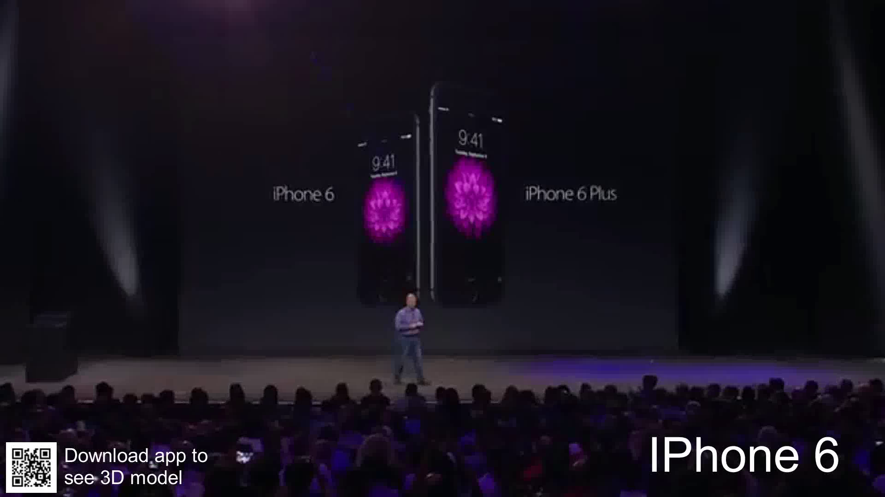
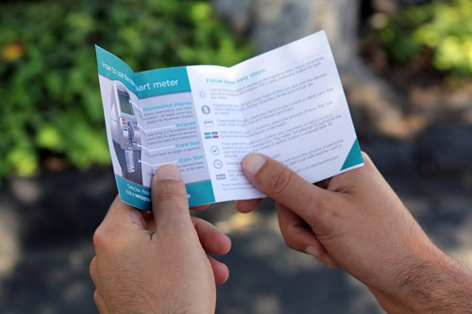
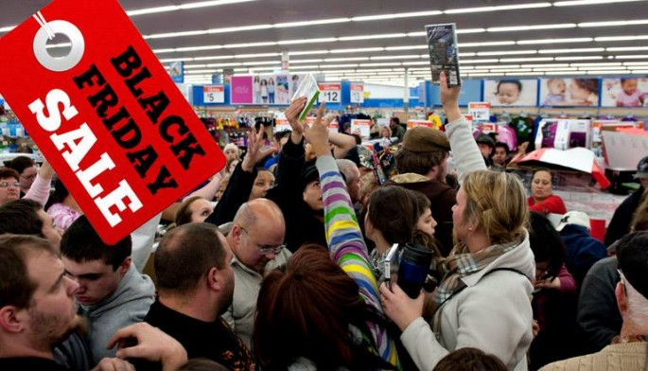

Slide 4


