Slide 1
Project P215 Customer Segmentation Team No : 05 Mentor : Bapuram Pallavi Team Members : ANIKET PANVAL ATHIRA P R VARSHA VARKEYCHAN SHIVANI CHAVAN BABITA BHADOURIA NILESH LONDHE NAVEENKUMAR KOLI

Slide 2
Project Flow
Business Objectives
EDA
Perform Clustering
Deployment
Compare Results

Slide 3
Business Problem Need to perform clustering to summarize customer segments.

Slide 4
Attributes ID: Customer's unique identifier Year_Birth: Customer's birth year Education: Customer's education level Marital_Status: Customer's marital status Income: Customer's yearly household income Kidhome: Number of children in customer's household Teenhome: Number of teenagers in customer's household Dt_Customer: Date of customer's enrollment with the company Recency: Number of days since customer's last purchase Complain: 1 if customer complained in the last 2 years, 0 otherwise MntWines: Amount spent on wine in last 2 years MntFruits: Amount spent on fruits in last 2 years MntMeatProducts: Amount spent on meat in last 2 years MntFishProducts: Amount spent on fish in last 2 years MntSweetProducts: Amount spent on sweets in last 2 years MntGoldProds: Amount spent on gold in last 2 years Promotion NumDealsPurchases: Number of purchases made with a discount

Slide 5
Continuation: AcceptedCmp1: 1 if customer accepted the offer in the 1st campaign, 0 otherwise AcceptedCmp2: 1 if customer accepted the offer in the 2nd campaign, 0 otherwise AcceptedCmp3: 1 if customer accepted the offer in the 3rd campaign, 0 otherwise AcceptedCmp4: 1 if customer accepted the offer in the 4th campaign, 0 otherwise AcceptedCmp5: 1 if customer accepted the offer in the 5th campaign, 0 otherwise Response: 1 if customer accepted the offer in the last campaign, 0 otherwise NumWebPurchases: Number of purchases made through the company’s web site NumCatalogPurchases: Number of purchases made using a catalogue NumStorePurchases: Number of purchases made directly in stores NumWebVisitsMonth: Number of visits to company’s web site in the last month

Slide 6
Data cleaning
Check for unwanted columns, null values, replacing null values, duplicates etc..
df = data.drop(["Z_CostContact","Z_Revenue"], axis=1)
df.isnull().sum() “Income attribute has 24 null values”
df['Income'] = df['Income'].replace(np.NaN, df['Income'].mean())
data1=df.drop_duplicates()

Slide 7
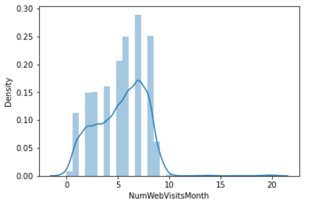
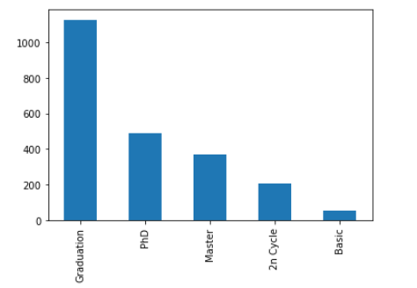
Uni-variate analysis without considering relationships with other variables

Slide 8
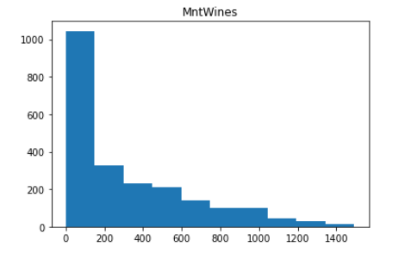
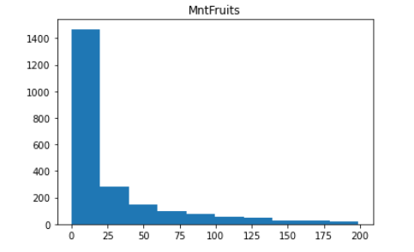
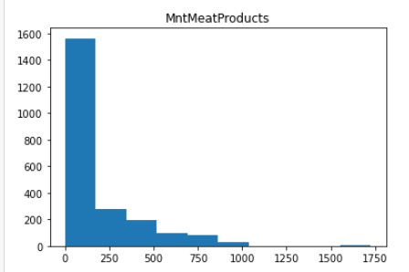
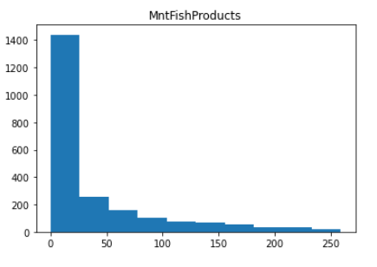

Slide 9
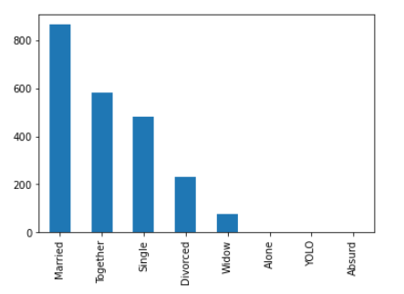
Difference in Marital_Status
Married 864
Together 580
Single 480
Divorced 232
Widow 77
Alone 3
YOLO 2
Absurd 2

Slide 10
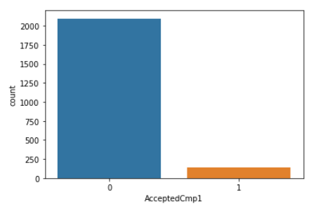
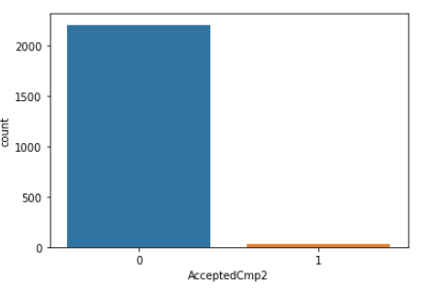
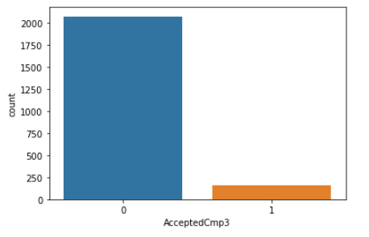
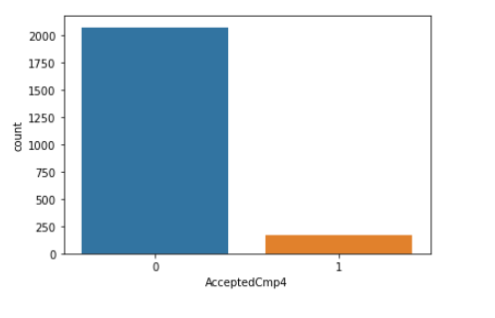
Customers accepting offer in 1st, 2nd ,3rd,4th and 5th campaigns

Slide 11
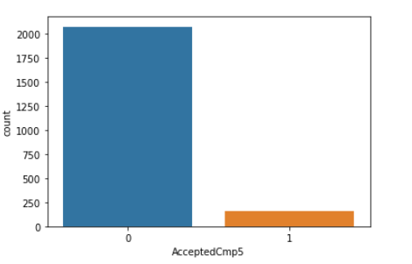
Continuation:

Slide 12
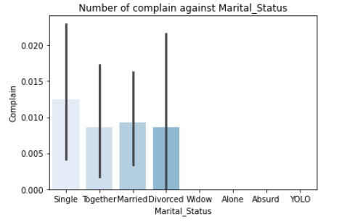
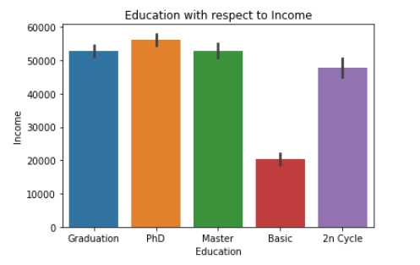
Bi-variate analysis

Slide 13
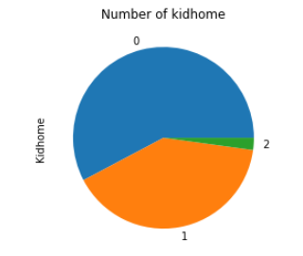
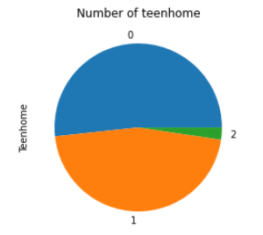

Slide 14
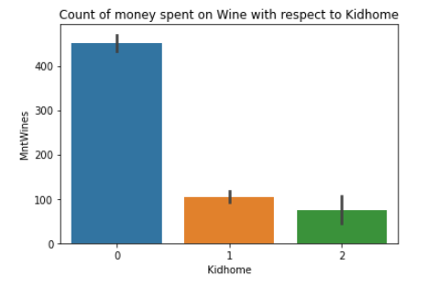
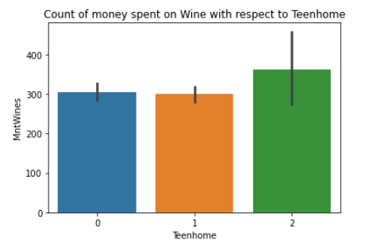
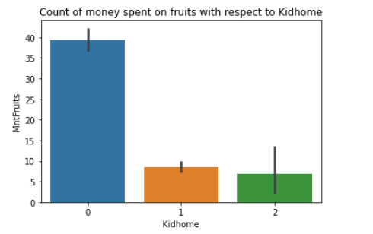
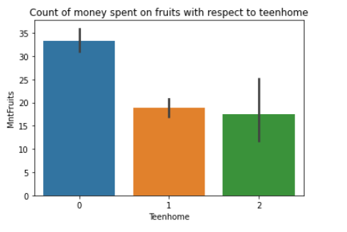

Slide 15
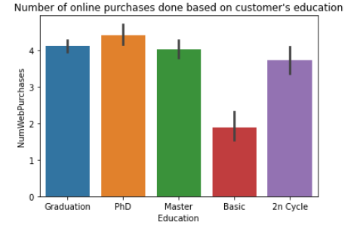
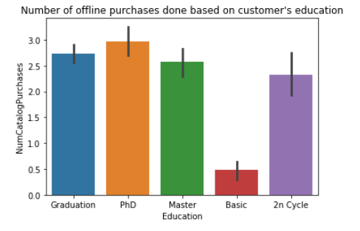

Slide 16
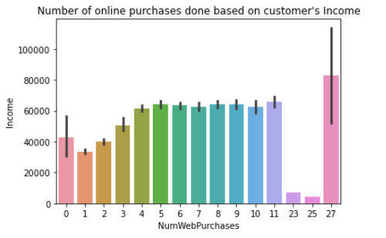
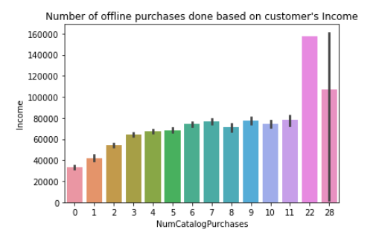

Slide 17
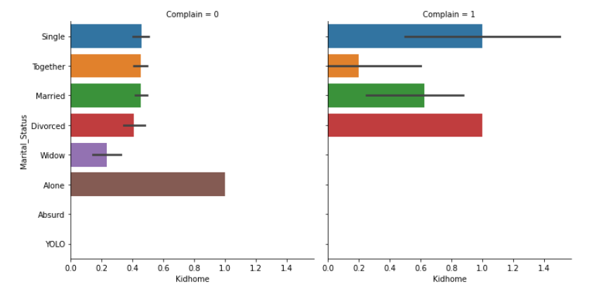
Number of complain with marital status respect to kidhomes

Slide 18
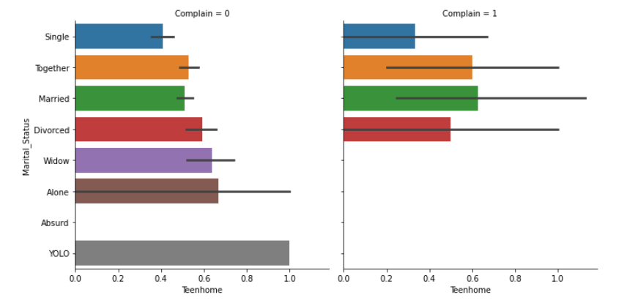
Number of complain with marital status respect to Teenhome

Slide 19
Correlation analysis

Slide 20
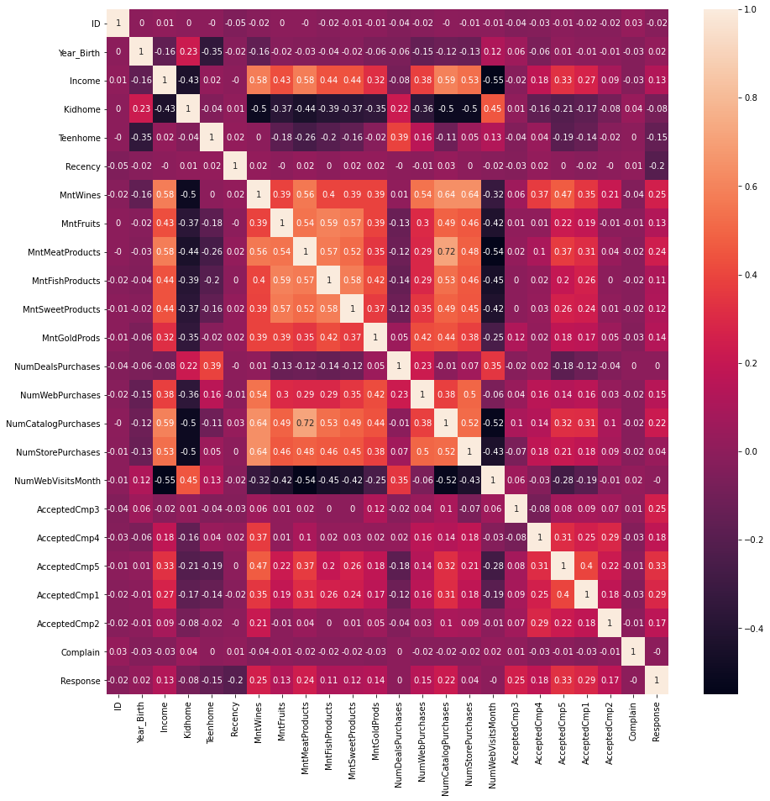

Slide 21
Overview of Machine Learning Lifecycle
Stage 1: Problem Definition
Stage 2: Data Collection
Stage 3: Data Exploration and Pre-processing
Stage 4: Model Building
Stage 5: Model Deployment

Slide 22
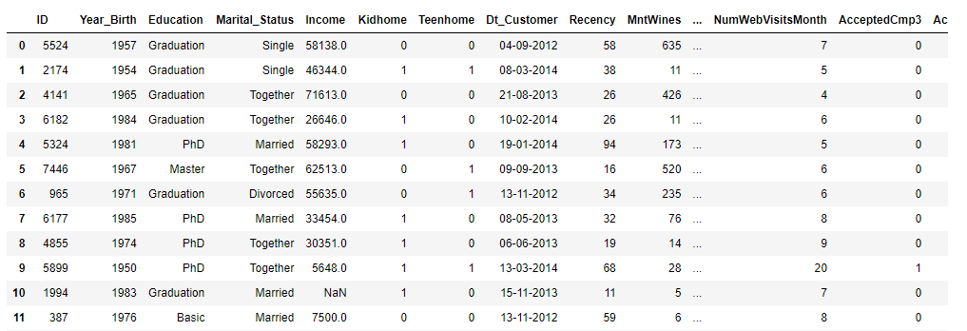
Import Data

Slide 23
Feature Engineering
data["Dt_Customer"] = pd.to_datetime(data["Dt_Customer"]) dates = [] for value in data["Dt_Customer"]: value = value.date() dates.append(value) print("Oldest customer join date: ", min(dates)) print("Newest customer join date:", max(dates))
# Get newest customer date number_of_days = [] ref_date = max(dates) for d in dates: delta = ref_date - d number_of_days.append(delta) # Create 'Customer_For' feature data["Customer_For"] = number_of_days data["Customer_For"] = pd.to_numeric(data["Customer_For"], errors="raise")
Oldest customer join date: 2012-01-08
Newest customer join date: 2014-12-06
Explore unique values in categorical features to get a clearer picture of data

Slide 24
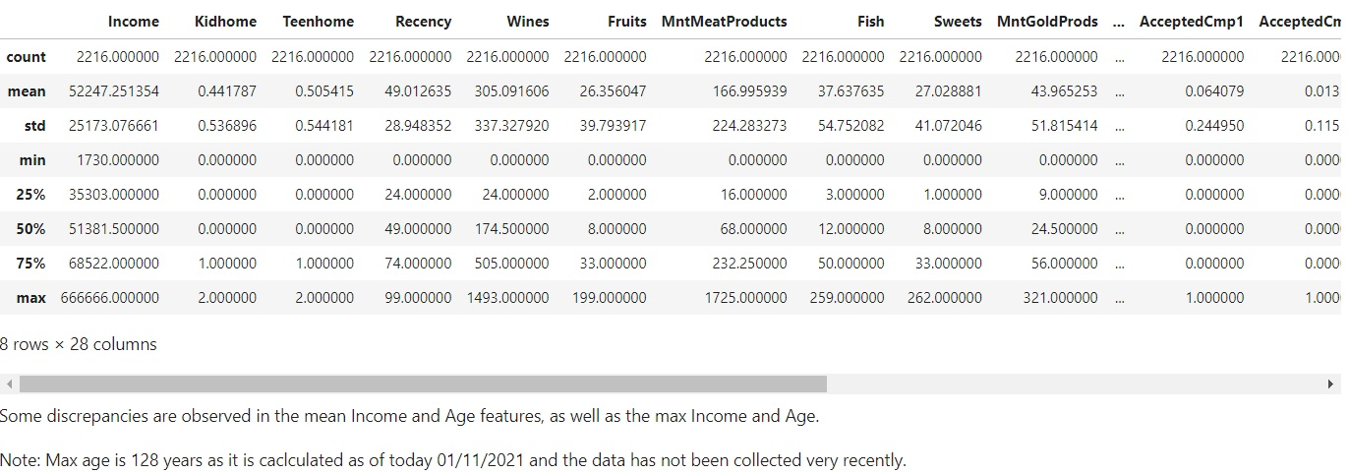
Further feature engineering
data.describe()
Some discrepancies are observed in the mean Income and Age features, as well as the max Income and Age.
Note: Max age is 128 years as it is caclculated as of today 01/11/2021 and the data has not been collected very recently.

Slide 25
Basic Transformations
Combine different types of purchase into one column
→ data['Purchases'] = data['NumDealsPurchases'] + data['NumWebPurchases'] + data['NumCatalogPurchases'] + data['NumStorePurchases']
Combine all types of amount spend into one column
→ data['Expenses'] = data['MntWines'] + data['MntFruits'] + data['MntMeatProducts'] + data['MntFishProducts'] + data['MntSweetProducts'] + data['MntGoldProds']
Combine all campaign into one column
→ data['Campaign'] = data['AcceptedCmp1'] + data['AcceptedCmp2'] + data['AcceptedCmp3'] + data['AcceptedCmp4'] + data['AcceptedCmp5']

Slide 26
Group Income data into 4 ranges (Below 25000, Income 25000-50000, Income 50000-100000, Above 100000)
→ data=data.assign(Incomes=pd.cut(data['Income'], bins=[ 0, 25000, 50000,100000,666666], labels=['Below 25000', 'Income 25000-50000 ', 'Income 50000-100000 ','Above 100000']))
Group Expense data into 4 ranges (0-500, 500-1000, Above 1000)
data=data.assign(Expense=pd.cut(data['Expenses'], bins=[ 0, 500, 1000, 2525], labels=['Below 500', 'Expense 500-1000 ','Above 1000']))
Group Birth Year data into 3 ranges (1959-1997, 1997-1977, Above 1997)
→ data=data.assign(DOB=pd.cut(data['Year_Birth'], bins=[ 0, 1959, 1977, 1996], labels=['Below 1959', 'DOB 1959-1977', 'DOB 1977-1996']))

Slide 27
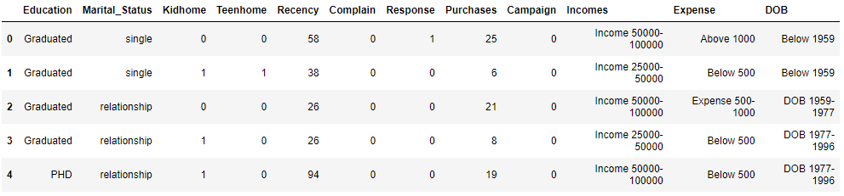
Group different marital status into two category
→ data['Marital_Status'] = data['Marital_Status'].replace(['Married', 'Together'], 'relationship')
→ data['Marital_Status'] = data['Marital_Status'].replace(['Single', 'Divorced', 'Widow', 'Alone', 'Absurd', 'YOLO'], 'single')
Group different education status into three category
→ data['Eduation'] = data['Education'].replace(['2n Cycle', 'Basic'], 'Basic')
→ data['Education'] = data['Education'].replace(['Graduation', 'Master'], 'Graduated')
→ data['Education'] = data['Education'].replace(['PhD'], 'PHD')

Slide 28
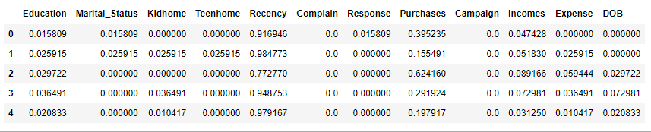
Data Pre- Processing
Label encoding to convert data into numeric
→ data['Education']= label_encoder.fit_transform(data['Education'])
→ data['Marital_Status']= label_encoder.fit_transform(data['Marital_Status'])
→ data['Incomes']= label_encoder.fit_transform(data['Incomes'])
→ data['DOB']= label_encoder.fit_transform(data['DOB'])
→ data['Expense']= label_encoder.fit_transform(data['Expense'])
Data normalize

Slide 29
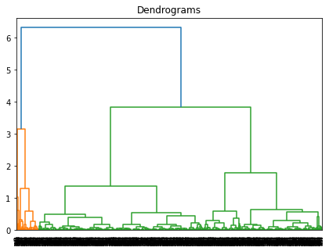
Clustering & Model Building
→ hc=AgglomerativeClustering(n_clusters=4,affinity='euclidean',linkage="ward")
The x-axis contains the samples and y-axis represents the distance between these samples. The vertical line with maximum distance is the blue line and hence we can decide a threshold and cut the dendrogram

Slide 30
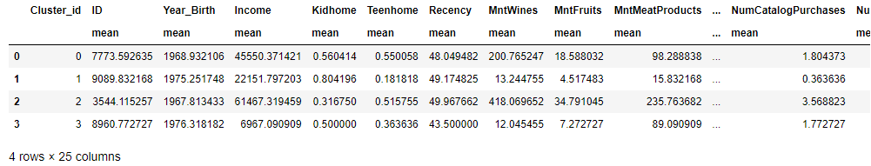
Group data by Cluster ID :
→ df.groupby("Cluster_id").agg(['mean']).reset_index()

Slide 31
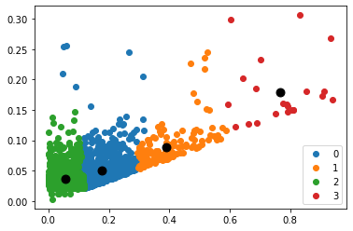
Getting centroid for Agglomerative Clustering

Slide 32
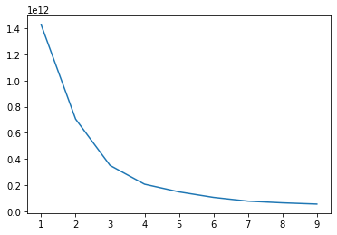
K-MEANS
Elbow curve / Scree plot
kmeans = KMeans(n_clusters= 3)

Slide 33
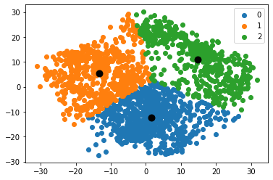
Plotting the Cluster Centroids

Slide 34
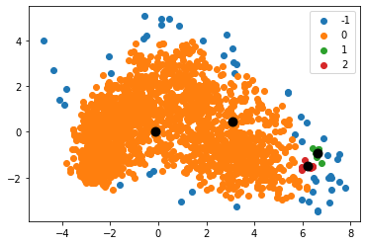
DBscan Clustering
db_default=DBSCAN(eps=0.4,min_samples=5).fit(X_principal)
Plotting the Cluster Centroids

Slide 35
Split data into X and Y variable
→ X = data.drop("Cluster_id", axis=1)
→ y = data.Cluster_id
→ X.shape, y.shape
→ from sklearn.model_selection import train_test_split
→ x_train, x_cv, y_train, y_cv = train_test_split(X,y, test_size = 0.2, random_state = 10)
Import Classifier
→ from sklearn.ensemble import RandomForestClassifier
→ model = RandomForestClassifier(max_depth=4, random_state = 10)
→ model.fit(x_train, y_train)
Saving the model
→ import pickle
→ pickle_out = open("classifier.pkl", mode = "wb")
→ pickle.dump(model, pickle_out)
→ pickle_out.close()

Slide 36
Model Deployment Using Streamlit
Model Building
Creating a python script
Create front-end: Python
→ Deploy

Slide 37
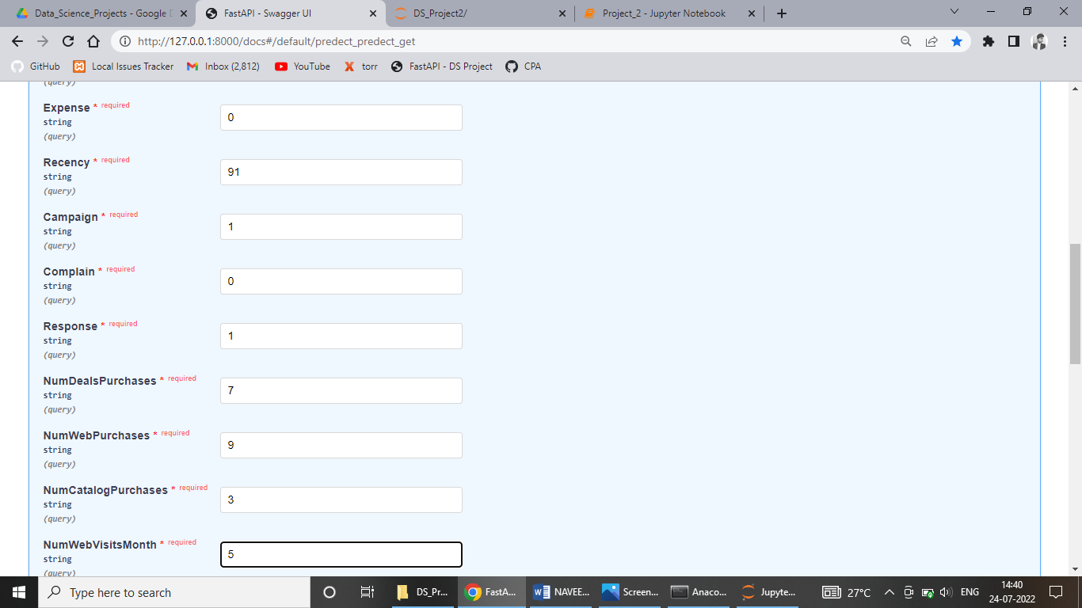
OUTPUT

Slide 38
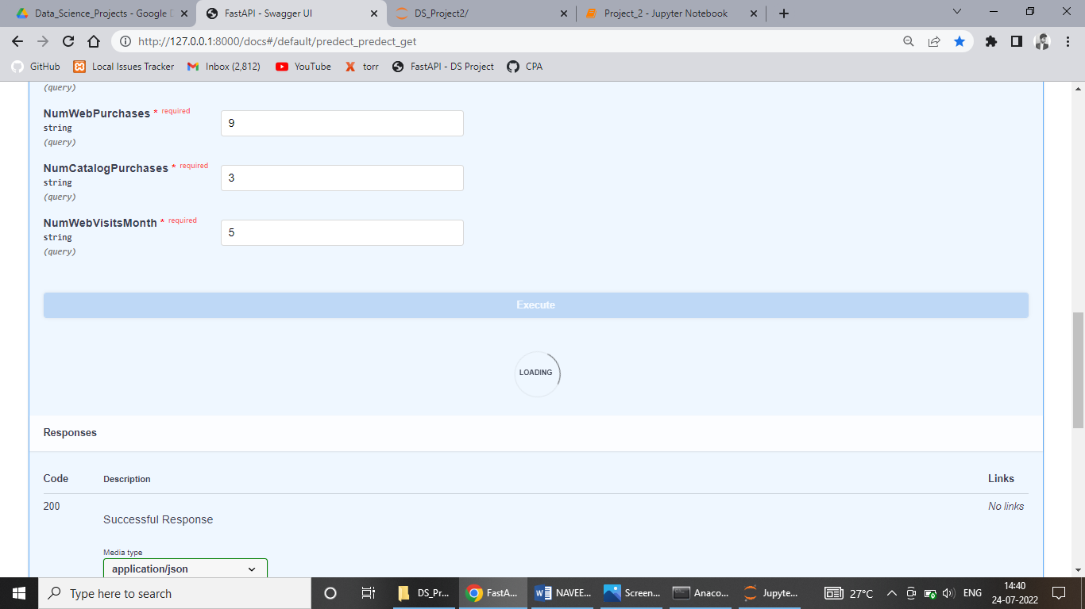
OUTPUT

Slide 39
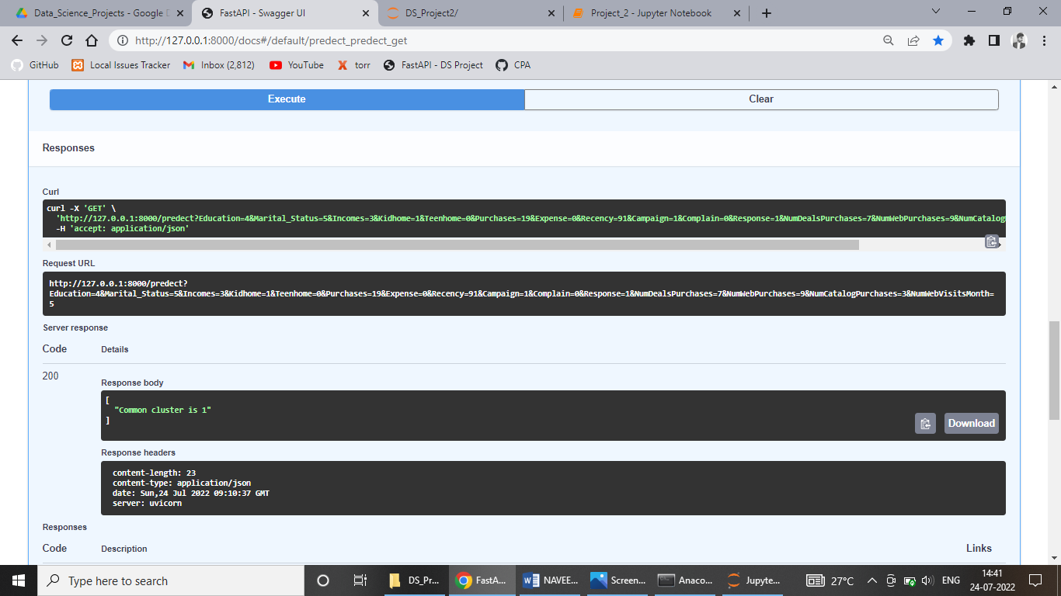
OUTPUT

