Slide 1
UART
Universal Asynchronous Receiver and Transmitter

Slide 2
Main Modules
Three Main Modules are required to UART
1. Baud Rate Generator
2. UART Transmitter
3. UART Receiver
4. RS232 interface
Rs232 interface used between transmitter and receiver
This Modules are further divided into submodules
All the modules are connected by instantiating each module in the main Module

Slide 3
Transmitter
This Module sub divided into four modules
1.start: ideally the transmitter is high if it detect 0 then start sending data
2.Parity Generator: Generates parity for the 8bit input data
3. PISO(Parallel in Serial out): Takes the 8bit input binary data and convert it into 1bit serial data
4. Transmitter Mux: It is a 4x1 mux to transmit different type of data like- start bit, data bit, parity bit and stop bit
5.Tx FSM: Generates all the necessary signal required to transmit data at right time

Slide 4
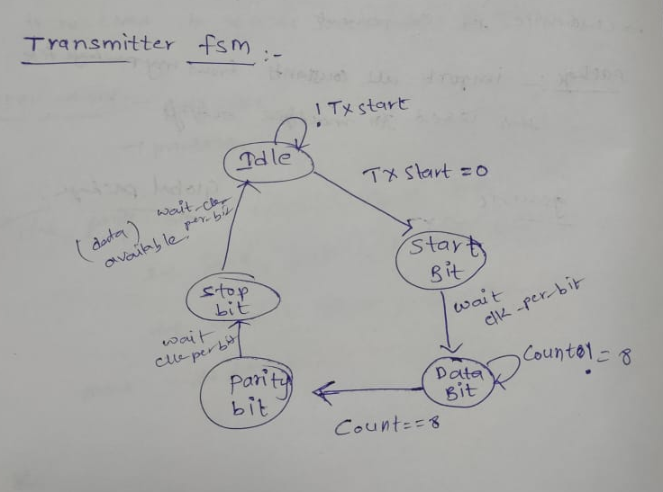
Transmitter FSM

Slide 5
Receiver
start: ideally the receiver is high if it detect 0 then start receiving data
SIPO(serial in parallel out): Converts serial data into 8bit parallel data
Parity checker: checks the correctness of data by xoring the received data
Stop bit: Stops accepting the new data(indicates that current data reception is completed)
RX_FSM: Generates all the control signals for the UART receiver

Slide 6
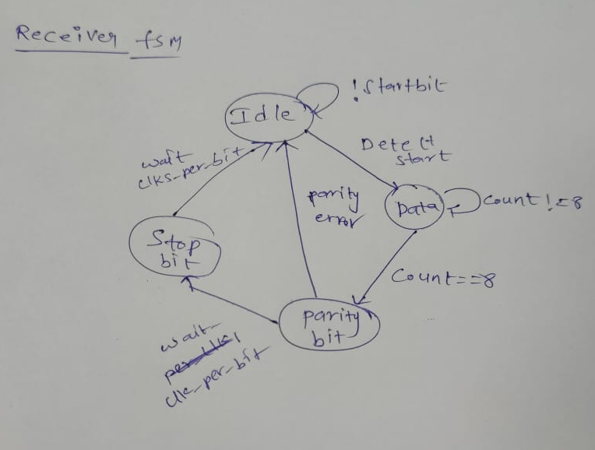
Receiver FSM

Slide 7
Interface
Microcontrollers
RS232
UART
RS232:
The UART provides serial communication capabilities, which allow Communication with modem or other external Devices , like another computer using a serial cable and RS232 protocol.

Slide 8
UART TOP Module
1.Baudrate generator
2.Transmitter
3.Receiver

