Slide 1
UART
Universal Asynchronous Receiver and Transmitter

Slide 2
Main Modules
Three Main Modules are required to UART
1. Baud Rate Generator
2. UART Transmitter
3. UART Receiver
This Modules are further divided into submodules
All the modules are connected by instantiating each module in the main Module

Slide 3
Transmitter
Receives 8-bit parallel data and loads it into the SBUF Register (1 tick pulse).
Shifts data bit by bit, synchronized with the baud rate generator.
Transmits serially via the TxD line (8 tick pulses).
Includes start and stop bits for proper synchronization.

Slide 4
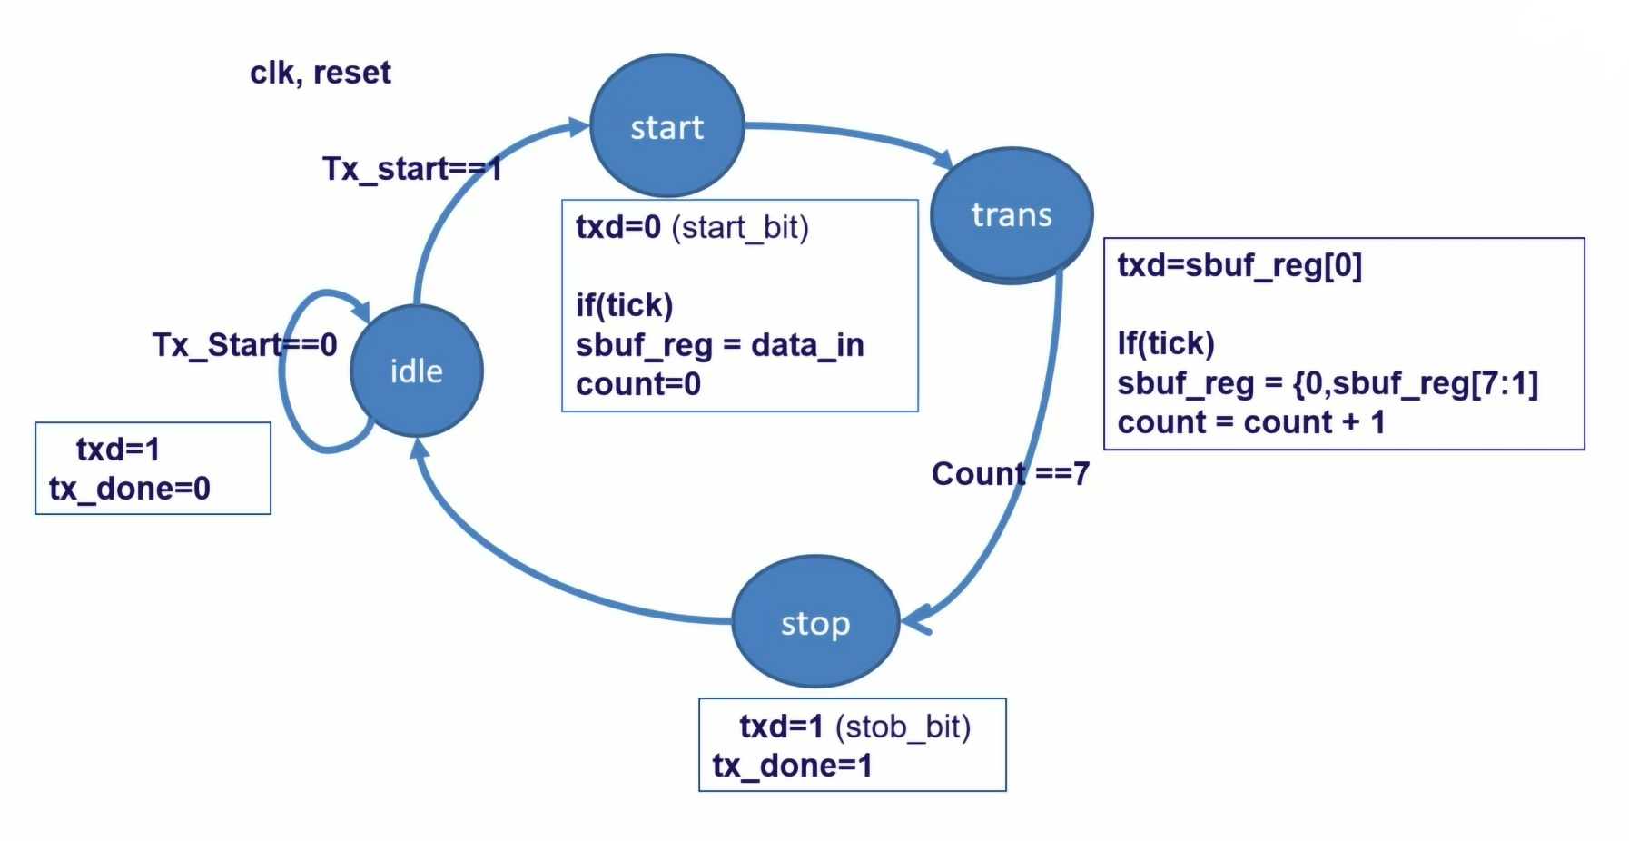
Transmitter FSM

Slide 5
Receiver
Captures serial data from the RxD line and shifts it into SBUF (8 tick pulses).
Converts serial data to 8-bit parallel format after reception.
Makes parallel data available for processing in 1 tick pulse.
Forwards received data to the connected system.

Slide 6
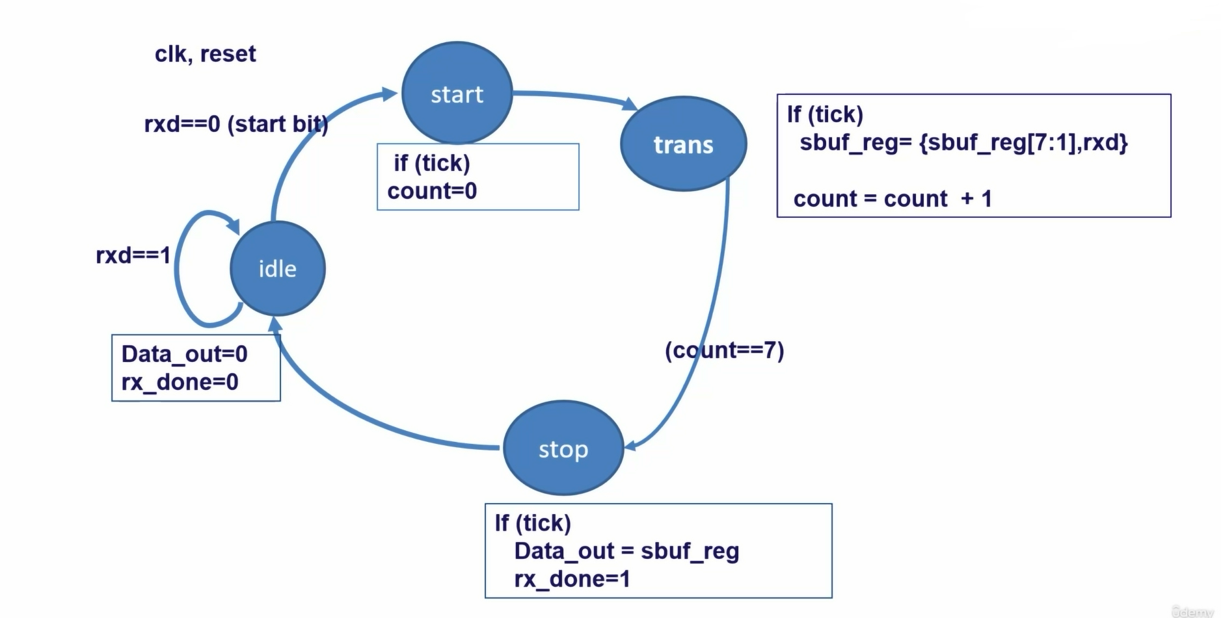
Receiver FSM

Slide 7
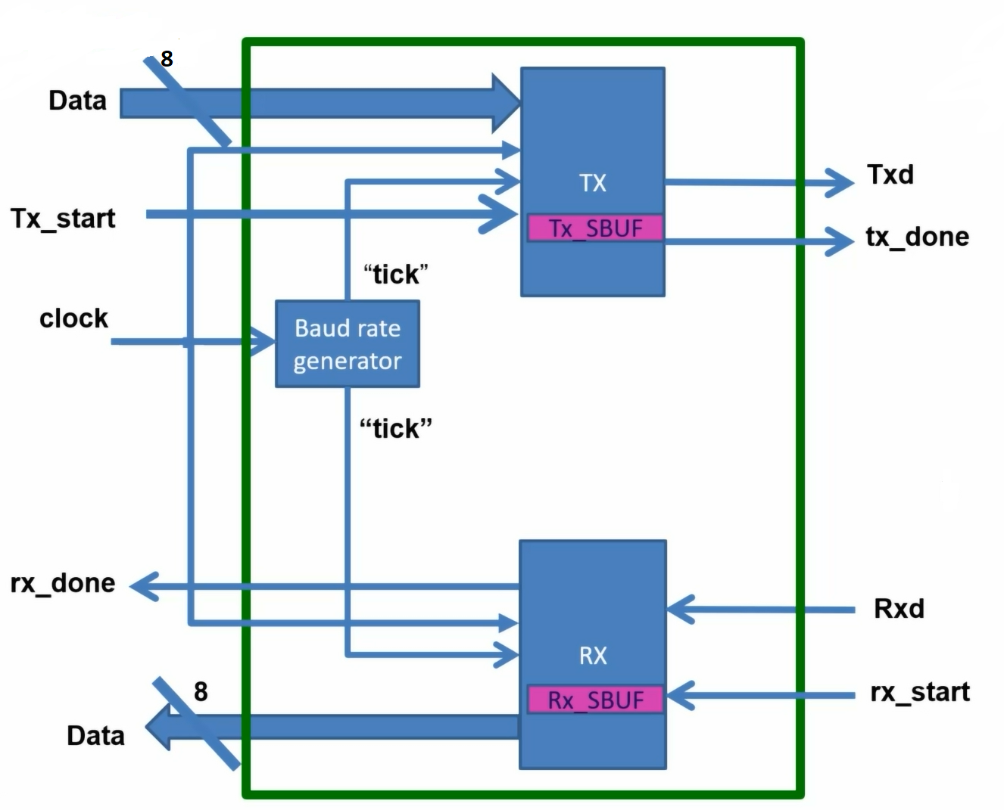
UART TOP Module
1.Baudrate generator
2.Transmitter
3.Receiver

