Slide 1
Team Members | Roles
Kiran J | Data Preprocessing and Augmentation
Naveen Kumar S | Model Training and Evaluation Feature Extraction and Analysis Architecture Design and Model Creation

Slide 2
Problem Statement
Manual interpretation of X-ray images by radiologists is time-consuming and prone to human error.
Variability in radiologists' expertise may lead to inconsistencies in diagnosis, affecting treatment outcomes.
Delays in diagnosis can impact critical treatment timelines, potentially compromising patient care.
The rising demand for rapid and accurate fracture detection has highlighted the limitations of manual methods.
(cont..)

Slide 3
Problem Statement
An automated diagnostic system can significantly reduce interpretation time, improve accuracy, and standardize fracture detection across diverse medical settings.
Automation can streamline diagnostic workflows, alleviate the burden on radiologists, and enhance patient outcomes by enabling faster intervention.
Reducing the reliance on human expertise mitigates the risk of misinterpretation and ensures more consistent diagnostic results.

Slide 4
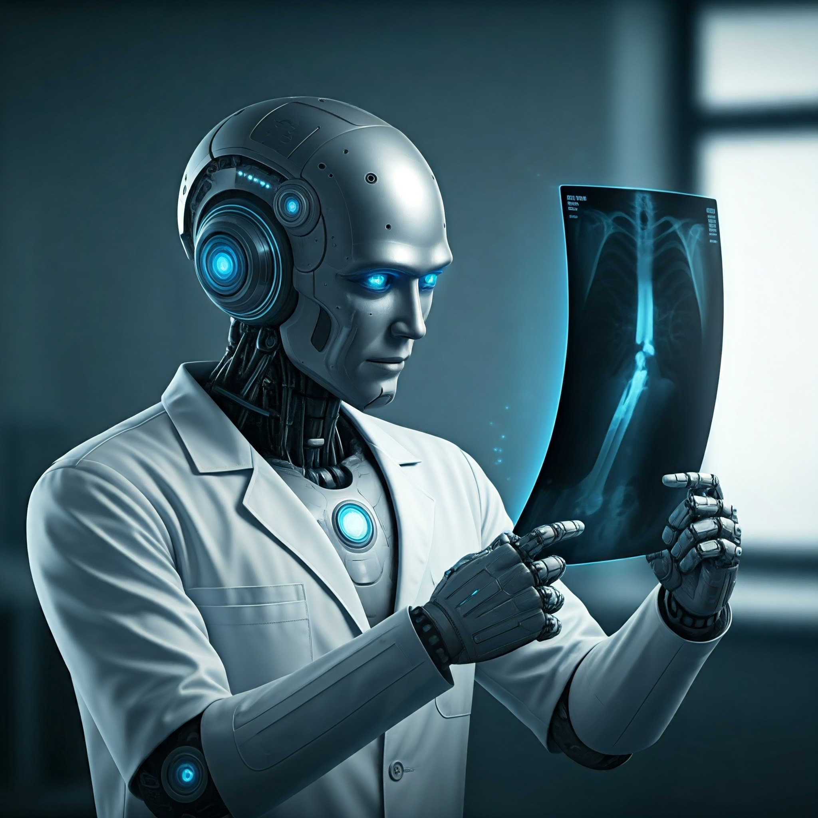
Osteo-Synergy
An Automated Osteo Fracture Detection System Supported by Azure ML Studio

Slide 5
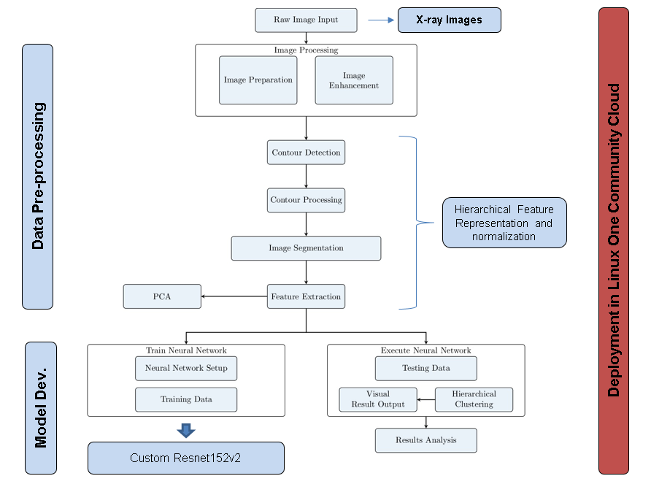
Solution
ResNet152V2 Model for advanced fracture detection capabilities.
Custom residual blocks enhancing fracture pattern recognition.
Data preprocessing ensuring high quality input for model.
Hierarchical feature extraction for precise localization analysis.
Real-time diagnostics improving patient care and treatment.

Slide 6
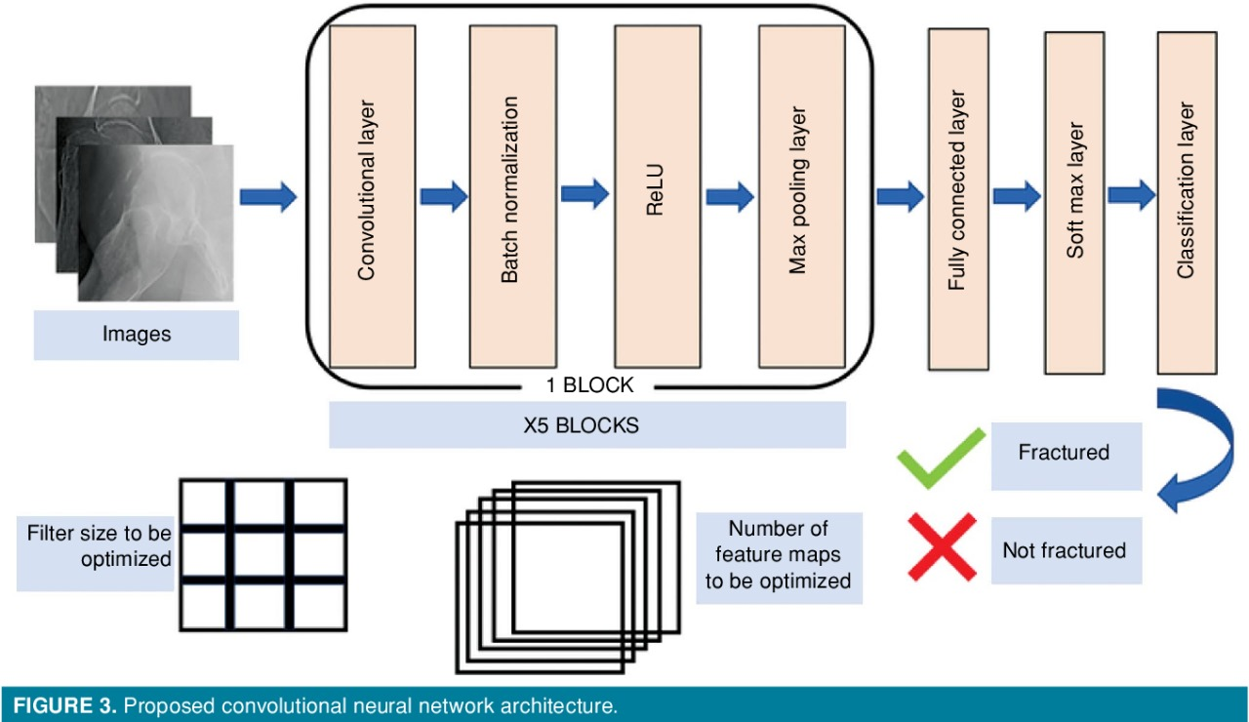
Architecture Diagram :

Slide 7
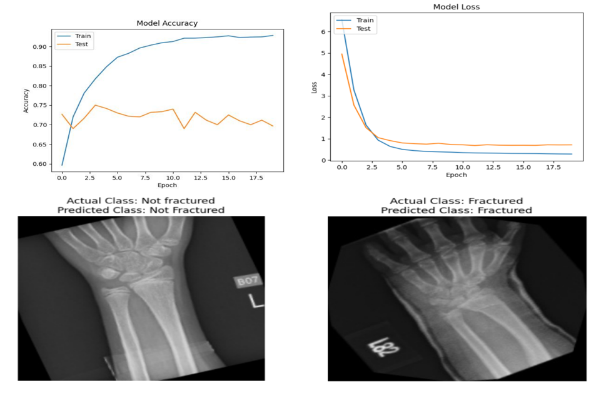
Final Results :

Slide 8
Wow factors
Innovative Neural Architecture: Combines the powerful ResNet152V2 model with custom residual blocks, optimizing fracture detection capabilities.
Efficient Training Mechanism: Utilizes residual learning to alleviate vanishing gradient issues, facilitating faster convergence during training.
Comprehensive Data Preprocessing.
Hierarchical Feature Representation and Subtle Pattern Recognition.
Leverages the robust capabilities of Azure ML Studio for seamless deployment, ensuring scalability and high performance in real-world healthcare environments.

Slide 9
Learnings during the Datathon
Team Collaboration: Enhanced communication and teamwork skills through diverse perspectives.
Data Preprocessing: Gained expertise in normalization, augmentation, and dataset cleaning.
Model Selection: Learned to choose and fine-tune machine learning models effectively.
Deep Learning Frameworks: Hands-on experience with TensorFlow for model development.
Feature Engineering: Developed skills in extracting and selecting relevant features.
Performance Metrics: Understood evaluation metrics like accuracy, precision, and recall.
Time Management: Improved ability to prioritize tasks under tight deadlines.
Real-World Application: Bridged theory with practical applications in data science.

