Slide 1

SIMATS ENGINEERING
PRESENTED BY
B NAVEEN KUMAR(192210680)
GUIDED BY –ANITHA MAM
CSA1337 Theory of Computation with Logical Model
CAPSTONE PROJECT
NLP Innovations in Cryptography

Slide 2
INDTRODUCTION
The project brings together two important things: cryptography and natural language processing (NLP). cryptography is all about keeping information safe, like secret codes in spy movies. And NLP is about teaching computers to understand human language, like when you talk to Siri or Alexa.
Usually, people think of cryptography and NLP as separate things, but am going to show you how they can work together in a really interesting way. Imagine if you could use the power of language to make secret codes even stronger! That's exactly what we're trying to do in this project.
By combining cryptography and NLP, we can make communication safer and more secure. Think about all the important information we send over the internet every day – from passwords to bank details. We want to make sure that information stays safe from bad guys who might try to steal it.
But this project isn't just about keeping secrets. It's also about learning and discovery. We want to understand how computers can understand language better and how we can use that knowledge to protect information. So, get ready to dive into the exciting world where language meets security! Let's get started!

Slide 3
OBJECTIVE
This project combines two different subjects, cryptography and natural language processing .I want to explore how these two subjects can work together to make a new way of keeping information safe, especially when it's written in human languages like English . By doing this, we hope to find better ways to protect information and learn more about how computers understand language. Join with me to explore this interesting mix of language and security!

Slide 4
CRYPTOGRAPHY
Encryption:
Decryption:
Encryption is the process of converting plaintext into ciphertext using an encryption algorithm and an encryption key. The ciphertext appears as a random sequence of characters, making it unintelligible to anyone who doesn't have the corresponding decryption key. Encryption ensures data confidentiality and prevents unauthorized access to sensitive information.
Decryption is the process of converting ciphertext back into plaintext using a decryption algorithm and a decryption key. It reverses the encryption process, restoring the original data from its encrypted form. Decryption requires the correct decryption key to be able to recover the plaintext accurately.

Slide 5
Encryption Decryption
Plaintext Input
Encryption Algorithm
Encryption Key
Ciphertext Output:
Ciphertext Output
Encryption Algorithm
Encryption Key
Plaintext Input

Slide 6
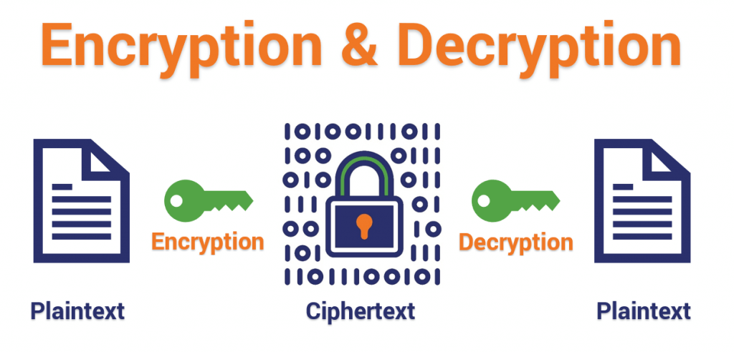

Slide 7
ALGORITHM DEVELOPMENT:
Tokenization: Break down the plaintext text into individual tokens, such as words or characters.
Embedding: Represent tokens as numerical vectors using NLP techniques like word embeddings.
Encryption Algorithm:Apply cryptographic transformations to the embedded vectors to generate ciphertext.
Decryption Algorithm:Reverse the cryptographic transformations applied during encryption to recover the original embeddings.
Reconstruction: Convert the decrypted embeddings back into plaintext tokens.

Slide 8
Postprocessing: Perform any necessary postprocessing steps, such as joining tokens to form coherent sentences.
Key Management: Utilize encryption keys to control the encryption process and ensure data security.
Testing and Evaluation:Test the algorithm's performance using various datasets and evaluate its effectiveness in securely encrypting and decrypting text.
Optimization:Optimize the algorithm for efficiency and scalability, considering factors like computational complexity and memory usage.
Documentation and Reporting:Document the algorithm's design, implementation, and evaluation process for future reference and dissemination.

Slide 10
CONCUSION
Our project exploring cryptography and natural language processing (NLP) has driven innovation in data security. By blending linguistic features into cryptographic algorithms, we've created efficient encryption methods. Our findings advance both fields and offer practical solutions. Through collaboration, we've gained insights and paved the way for future developments in cryptolinguistics. Thank you for joining us on this journey toward safer digital communication.

