Slide 1
Positional Tracking with ZED-M using RTAB-Map
Naveen Kumar

Slide 2
Launching of RTAB-Map after installation
roslaunch zed_rtabmap_example zed_rtabmap.launch

Slide 3
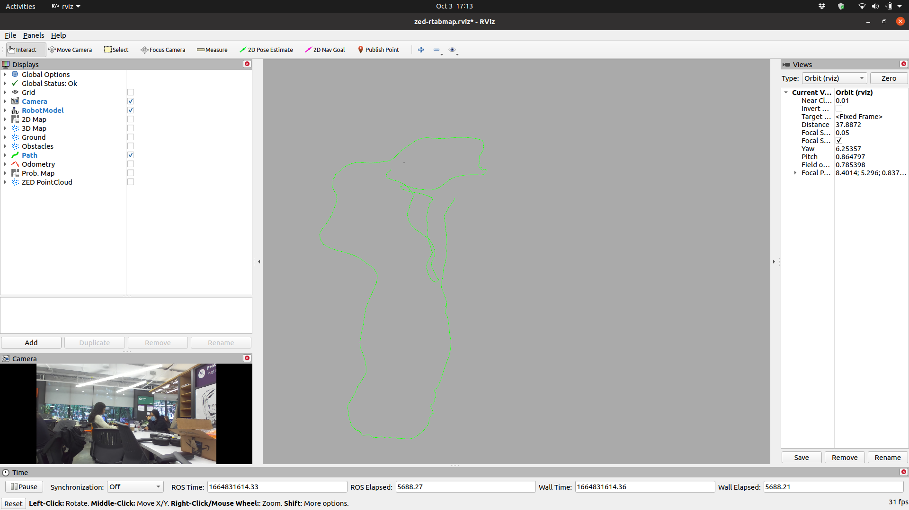
RVIZ Window

Slide 4
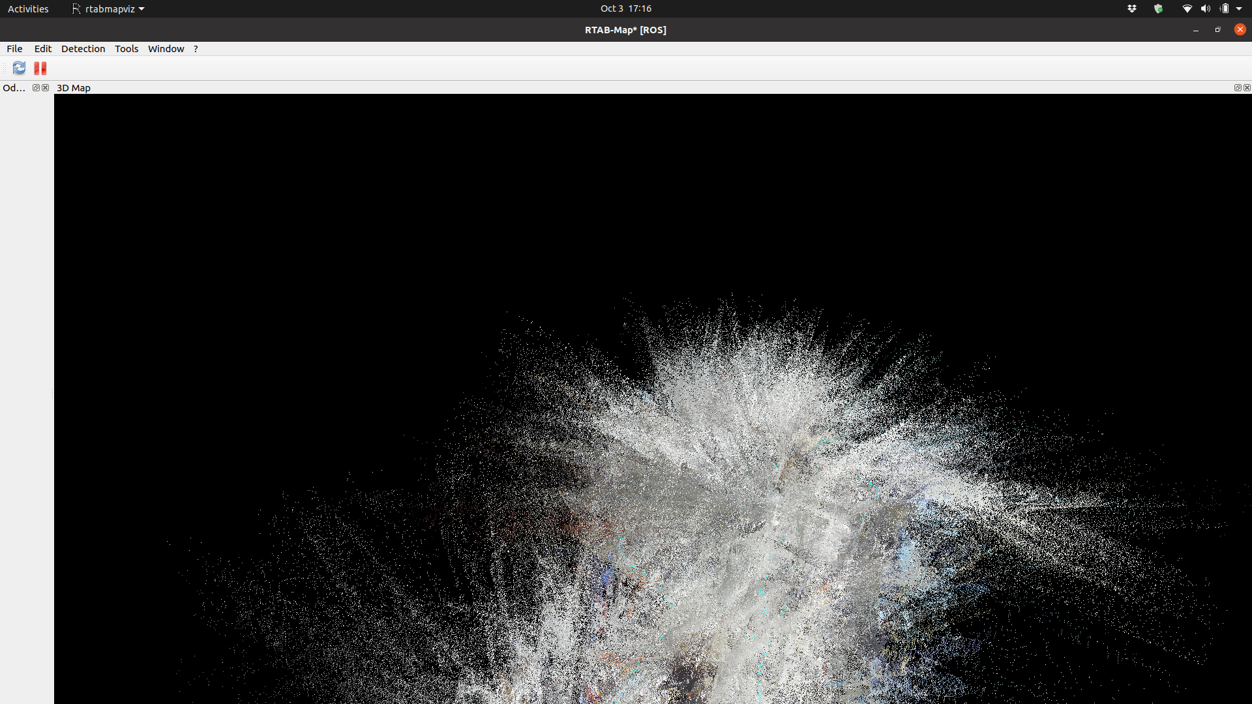
RTAB-Map

Slide 5
Exporting Poses from RTAB-Map
In RTAB-Map, go to files after loop closure and pausing RTAB-Map. Export the data as RAW text.
In a text editor, use find and replace to replace spaces with commas and rename the extension of file as .csv.

Slide 6
Use MATLAB to import CSV file and plot 4th, 8th and 12th column of CSV.
M = csvread("posesCamera2.csv")
x = M(:,4)
y = M(:,8)
z = M(:,12)
plot3(x,y,z)
axis equal

Slide 7
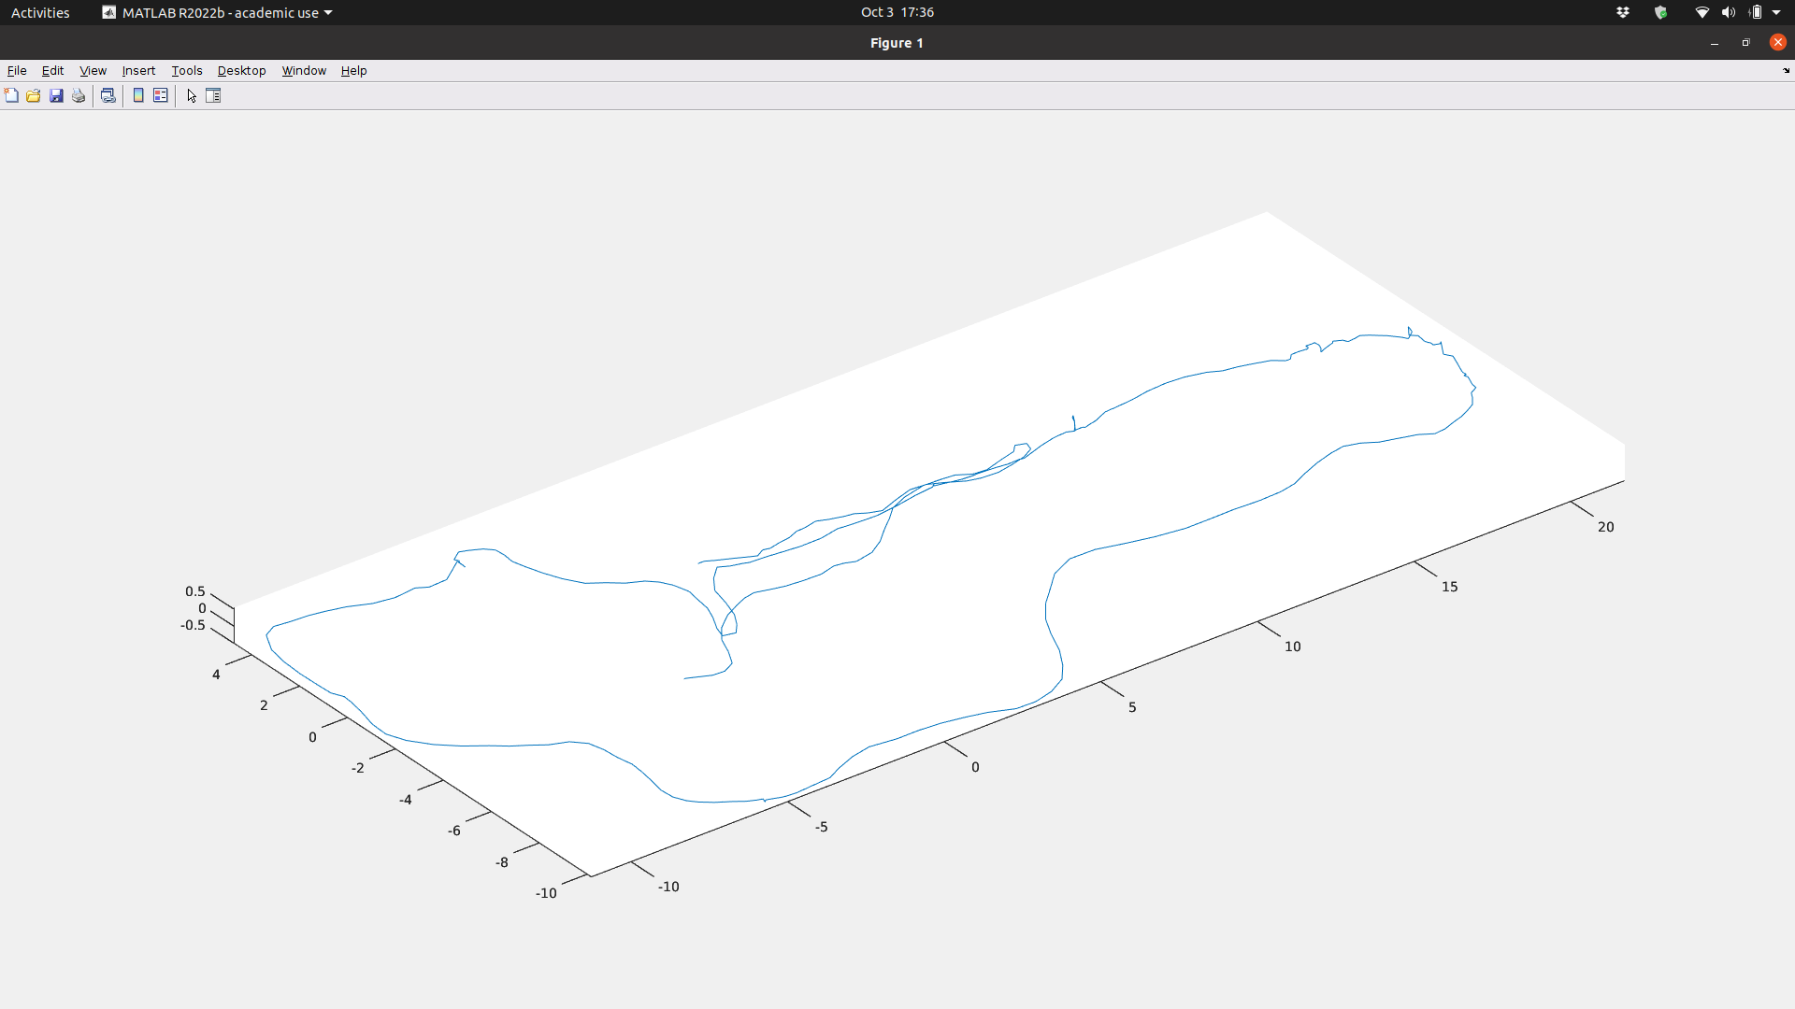
MATLAB Plot

