Slide 1

Robust Multi-Robot Mapless Navigation in Dynamic Hospital Environments with Accurate Intention Inference, Trajectory Prediction, and Explainable AI
Presented by: Naveen Kumar
Supervisor:
Prof. Dr. Amar Behera
Date: July 2026

Slide 2


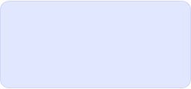
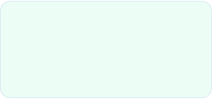
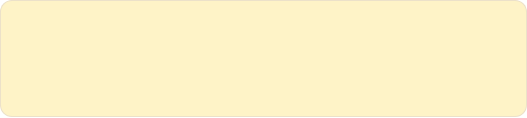
Core Research Objectives
Synthesizing state-of-the-art sensory architectures and learning pipelines to safely pilot robots in dynamic hospital environments.
4
160D
Autonomous Framework: Build a complete model for navigation inside unpredictable human environments.
SENSOR INPUTS
STATE SPACE
State Construction: Aggregate spatial, human tracking, and odometry metrics comprehensively.
PPO
Social Safety: Learn dynamic policies obeying human social boundaries.
OPTIMIZED CONTROL POLICY
Hospital Social Navigation
Slide 2

Slide 3


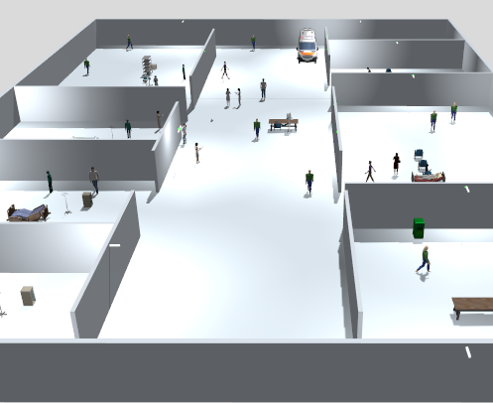
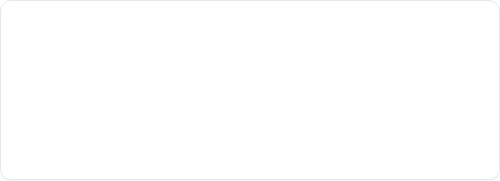
Gazebo Environment & Sensor Suite
Simulation Platform
ROS2 Jazzy & Gazebo Harmonic: Real-time hardware emulation in a dynamic hospital world with moving pedestrians and nurse stations.
Robot Base: Custom TurtleBot3-inspired differential chassis mapped to real-time odometry metrics.
Active Sensor Topics
3D LiDAR — /velodyne_points
Depth Camera — /depth/image_raw
IMU Sensor — /imu
Wheel Encoder — /joint_states
Hospital Social Navigation
Slide 3

Slide 4
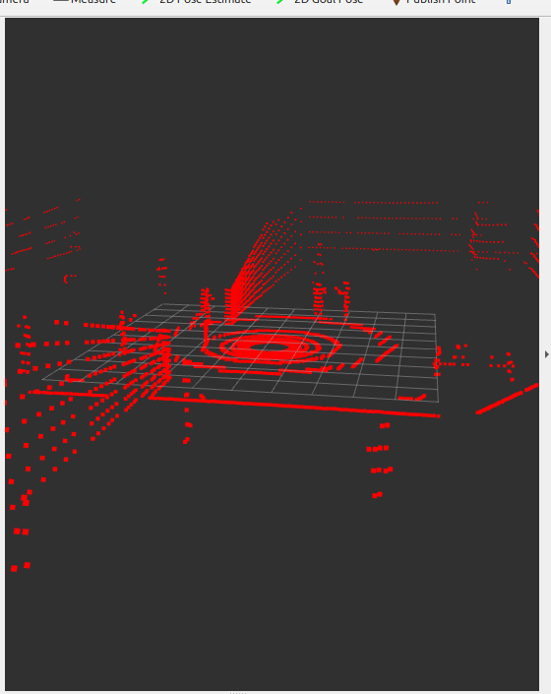


LiDAR Encoder: PointNet++
We utilize hierarchical feature extraction to process raw 3D point clouds into a compact 64D embedding.
PointNet++ Stages
Sampling: Downsamples Raw points to 1024 points
1. Input (1024 points)
Grouping: Captures local neighborhoods
2. Set Abstraction (SA) Layers
Projection: MLP reduces 1024D to 64D
3. Global Feature Aggregation
4. Output Embedding (64D)

Slide 5









PROCESSING PIPELINES DEPTH IMAGE PROCESSING
Depth Camera Processing Pipeline
Feature Generation Map
Spatial Geometry Mapping
The CNN encoder directly processes camera frames to understand scene layout. This acts as a secondary layer of protection against highly reflective or transparent objects that confuse traditional LiDAR scanners.
Input Frame Acquisition
Reads raw image matrices via /depth/image_raw
CNN Feature Backbone
Processes structural patterns, edges, and objects
Key Spatial Signals
Captures near-obstacle 3D geometries.
Formulates pixel-to-obstacle distance metrics.
Feature Map Projection
Provides structural context for narrow hallways.
Outputs compressed 64-Dimensional Depth Features
Hospital Social Navigation
Slide 5

Slide 6




PROCESSING PIPELINES KINEMATICS & INERTIAL NAVIGATION
Kinematic Pipelines: IMU & Wheel Encoder
IMU Encoder
Wheel Encoder
Handles linear acceleration, angular velocity, and inertial heading variations to prevent slide slip.
Collects continuous speed steps via joint state subscriptions to record real robot speed commands.
Tracks continuous, high-frequency orientation trends.
Prevents cumulative odometry drift errors over run-times.
Hospital Social Navigation
Slide 6

Slide 7
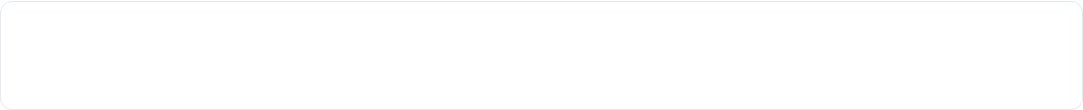







ARCHITECTURE LAYOUT MULTI-MODAL ATTENTION FUSION
Multi-Modal Sensor Fusion
PointNet++ Output
CNN Output
MLP + Upscale
MLP + Upscale
Dimension Expansion & Linear Steps
Unified Output Projection
Kinematic vectors (IMU & Wheel) are upscaled using dense linear layers from 32D to 64D before concatenation to align temporal influence across sensory modes.
Outputs a clean, rich 128-Dimensional Fused Feature vector.
This compressed space encapsulates raw spatial maps, structural features, and kinematic states into a unified, high-density observation vector.
Hospital Social Navigation
Slide 7

Slide 8


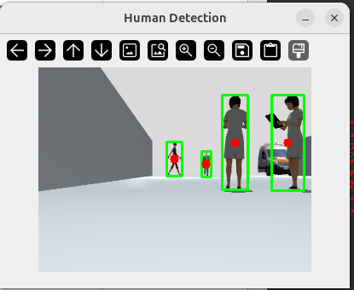

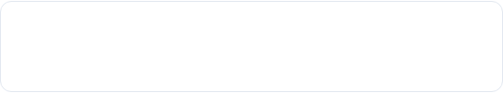




PERCEPTION STACK PEDESTRIAN MONITORING
Human Detection, Localization & Tracking
Human Detection Layer
Segment camera frames & scans to isolate pedestrians.
Dynamic Localization
Transforms coordinates into the base robot frame. Calculates Euclidean distance and bearing angle.
Kalman Identification
Associates targets across sequential frames to maintain track continuity.
Pipeline Output: Compressed 30-Dimensional Human Feature Matrix
Hospital Social Navigation
Slide 8

Slide 9



Kalman Filter State Prediction
Future Prediction
Robust Tracking Benefits
State Vector:
The system maintains active tracking estimates during occlusions, preventing the robot from 'forgetting' pedestrians when they step briefly behind nurse desks or visual blockages.
Predicting position at time :
Smoothes raw sensor noise and coordinate jitter.
Prevents navigation policy breakdown.
Transition Matrix:
Sustains pedestrian IDs across frames.
Used to generate safe navigation buffers around humans.

Slide 10





Human Intention Prediction
Evaluation Inputs
Prediction Targets
Navigation Safety
The intention module continuously evaluates key motion properties of pedestrians:
Forecasts behaviors over a short-term future window:
Predicting paths reduces proactive collision risks and prevents freezing-robot issues in crowded corridors.
Speed & Heading Angle
Projected path direction
Trajectory History Logs
Dynamic velocity trends
Orientation changes
Enables active deceleration or path corrections early.
Human-Robot space intersection
LEFT
RIGHT
STOP
Speed < 0.05 m/s
Predicted path crossing.
Trajectory adjustment.
Stationary obstacle.
Hospital Social Navigation
Slide 10

Slide 11
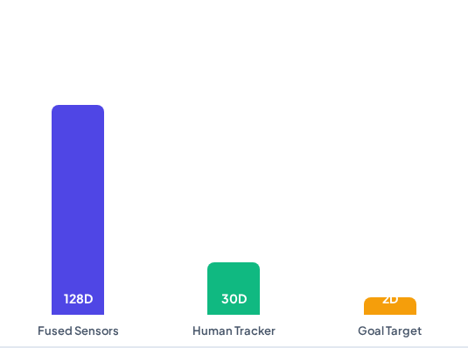

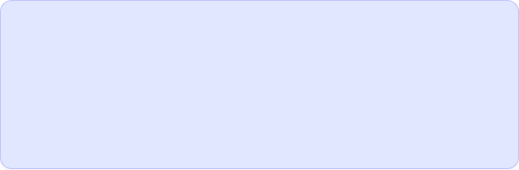
DATA ASSEMBLER STATE AGGREGATOR & SPACE
State Aggregator (Total Feature Space)
A unified aggregator subscribes to all independent processing modules and concatenates features into a comprehensive state representation vector.
Vector Concatenation
128D + 30D + 2D = 160D Vector
This combined array constructs a complete environmental, personal, and target space footprint.
ROS2 Output Stream
Topic Name: /ppo_state
Array Dimension: [160, 1]
Update rate: 20 Hz Sync Cycle
Hospital Social Navigation
Slide 11

Slide 12


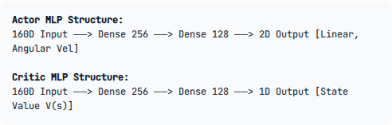
DECISION MAKING PPO ARCHITECTURE & OPTIMIZATION
Proximal Policy Optimization (PPO) Network
Actor-Critic Architecture
Reward Function Formulation
Splits the unified state vector into actor policy distributions and state value assessments.
The reinforcement policy optimization relies on a balanced multi-objective reward structure:
Goal Progress: Positive reward on distance reduction.
Collision Penalty: Severe penalty on obstacle contact.
Smooth Motion: Penalizes jittery or erratic velocity changes.
Social Space Penalty: Discourages personal space encroachment.
Hospital Social Navigation
Slide 12

Slide 13



EXECUTION DIAGNOSTICS CHALLENGES & RESOLUTIONS
Challenges Faced & Resolutions
CUDA & PointNet++
Gazebo Simulation Freezing
Dynamic Synchronization
CUDA-dependent custom operators caused build failures and compatibility issues with the ROS 2 setup.
Multi-sensor processing and PPO training caused simulation slowdown.
Each sensor pipeline (LiDAR, Depth, IMU, Odometry) updated asynchronously, causing fusion lag.
Resolution: Implemented a lightweight CPU-compatible encoder as a stable fallback.
Resolution: Optimized update frequencies and reduced computational overhead.
Resolution: Used MessageFilters approximate-time policies to align topics.
Hospital Social Navigation
Slide 13

Slide 14
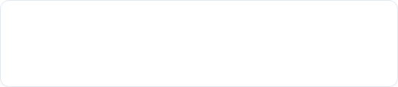
PROJECT BENCHMARKING COMPLETED PIPELINE CHECKLIST
Project Status & Accomplishments
All core layers of the perception, localization, fusion, state-aggregator, and training pipelines are fully implemented.
ROS 2 Jazzy Integration
Sensory Encoders: Verified independent pipelines for 3D LiDAR, depth, and dynamics.
Full communication loops between nodes and Gazebo Harmonic simulation are established and verified.
Tracking Layer: Completed Kalman trajectory smoothing.
Fusion Module: Active attention model mapped to 128D space.
Training Baseline: Concurrent PPO training and sensor processing increased computational overhead, leading to Gazebo freezes and low real-time factor.
Hospital Social Navigation
Slide 14

Slide 15

Thank You!
Questions & Discussion

