Slide 1


BioInsight AI
Drug–Target Interaction Analysis System
Presented By
Naveen Kumar G (11440)

Slide 2
Problem Statement
Understanding drug–target interactions is critical in drug discovery, pharmacology, and clinical research, where researchers must accurately determine how a drug affects a specific biological target and evaluate the strength of supporting evidence.
However, analyzing these interactions is challenging because biomedical data is complex, scattered across multiple databases, and often requires expert interpretation.
Existing AI systems and chatbots frequently generate fluent but ungrounded explanations, leading to:
Hallucinated or incorrect results
Lack of supporting evidence or citations
No confidence or reliability measure
Reduced trust for scientific decision-making
As a result, researchers cannot fully rely on automated tools for evidence-based insights

Slide 3
Proposed Solution
To address the limitations of existing AI systems, this project proposes BioInsight AI – an Evidence-Grounded Drug–Target Interaction Analysis System that combines biomedical databases, retrieval mechanisms, and explainable AI to deliver reliable and trustworthy insights.
Instead of relying solely on large language models, the system integrates curated scientific evidence with AI reasoning, ensuring that every response is supported by validated data rather than generated assumptions.
The solution introduces a hybrid architecture consisting of:
Entity Extraction Layer to accurately identify drug and target names
Evidence Retrieval Layer using Open Targets API for real-world clinical and experimental data
RAG-based Local Knowledge Base (TTD + ChromaDB) for fast, offline semantic search
Confidence Scoring Engine to quantify reliability using evidence quality and source counts
LLM Explanation Generator to convert structured evidence into clear, human-readable insights

Slide 4
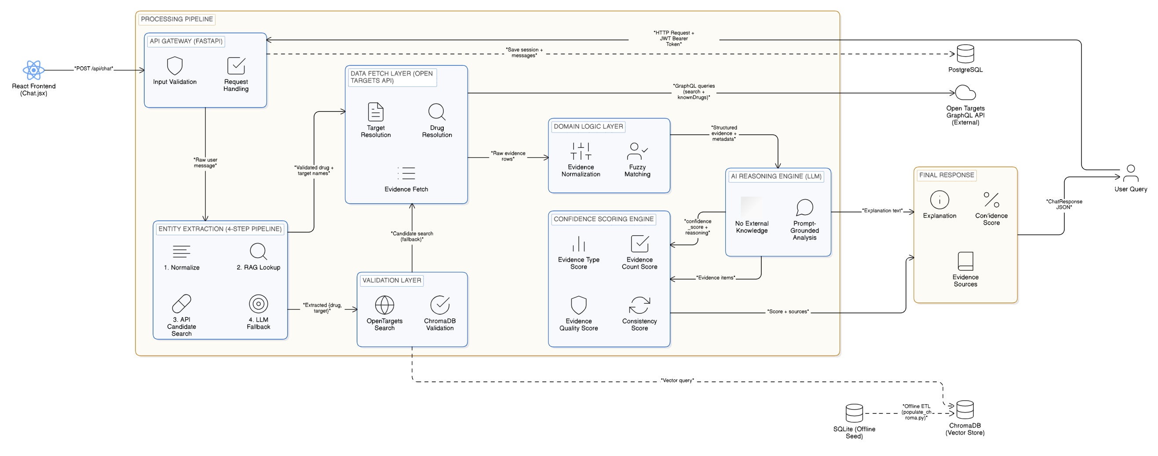
High-Level Architecture

Slide 5
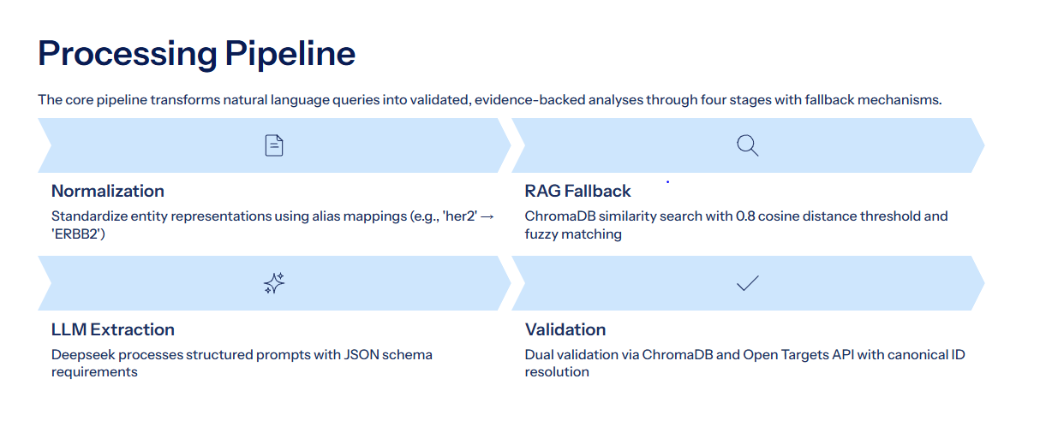

Slide 6
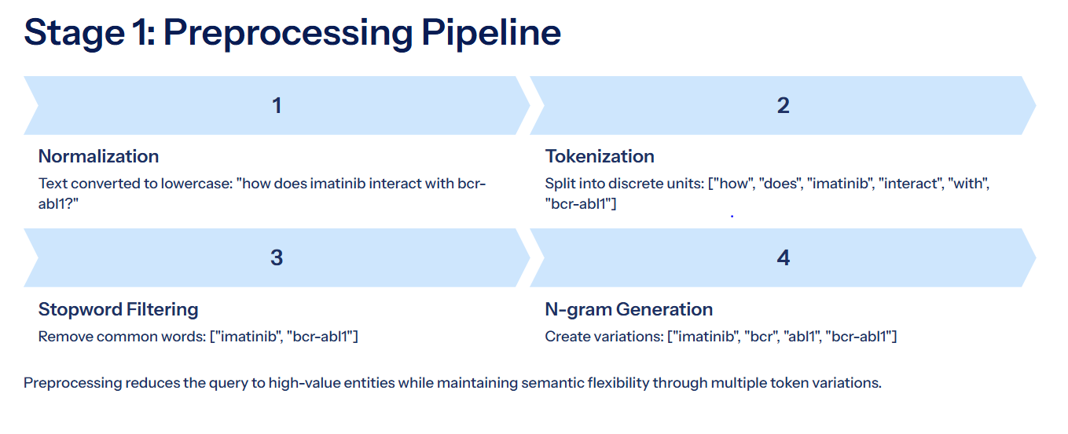

Slide 7
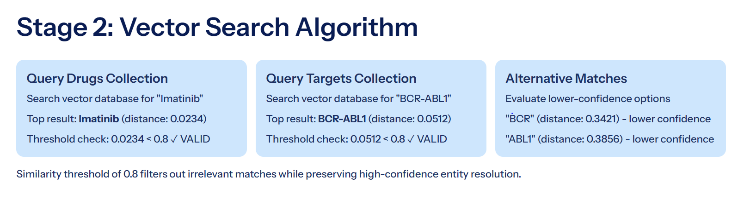

Slide 8
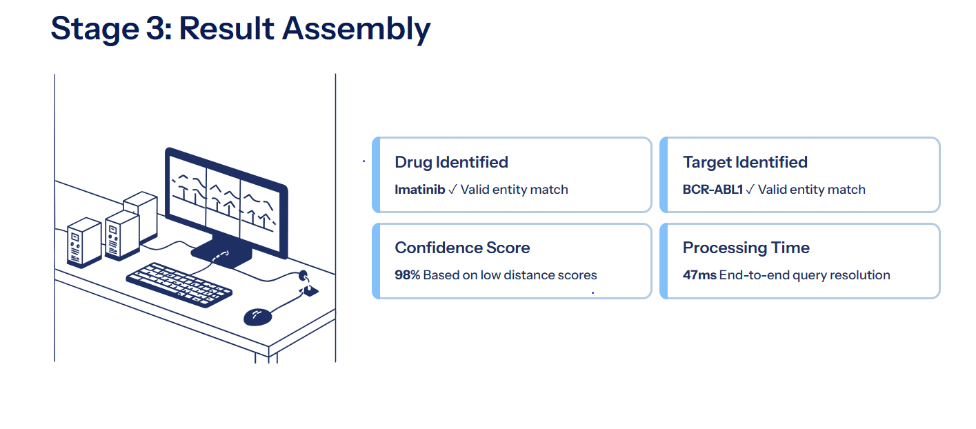

Slide 9
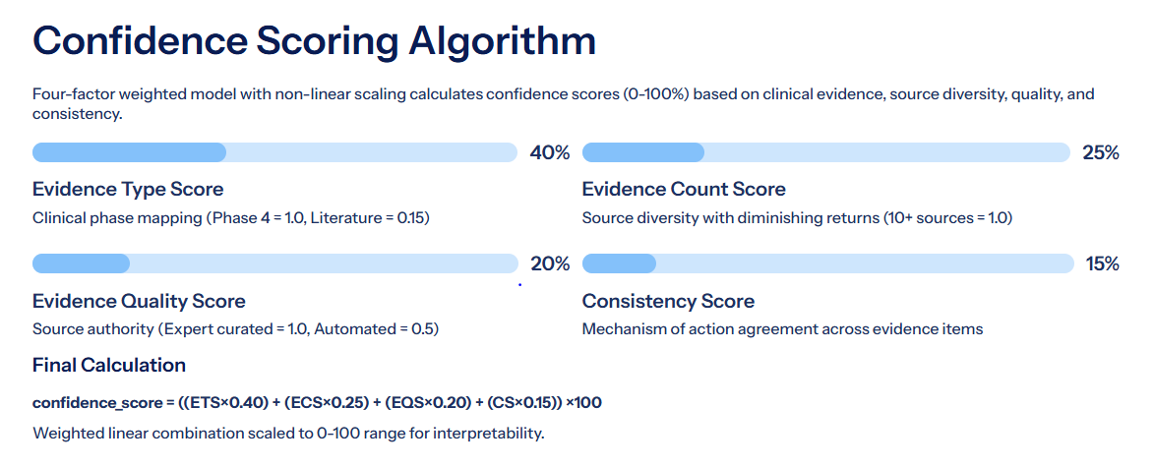

Slide 10
Evidence Type Score (ETS)
ETS maps clinical trial phases to confidence values reflecting regulatory validation levels:
Evidence Count Score (ECS)
ECS quantifies evidence breadth through source diversity using non-linear scaling with diminishing returns:
Clinical Phase | ETS Value
Phase 4 (Approved / Post-marketing) | 1.0
Phase 3 | 0.85
Phase 2 | 0.65
Phase 1 | 0.45
Early Clinical (Phase 0.5) | 0.35
Preclinical | 0.25
Literature Only | 0.15
Unique Sources | ECS Value
>=10 | 1.0
7-9 | 0.95
5-6 | 0.85
3-4 | 0.75
2 | 0.50
1 | 0.30
Evidence Quality Score (EQS)
EQS weights evidence by source authority. The system classifies sources into three tiers:
Expert curated (ChEMBL, FDA, manual curation): 1.0
Database curated (general databases): 0.75
Automated text mining (EuropePMC, automated extraction): 0.5
The final EQS uses the maximum quality score across all sources, reflecting best-available evidence.
Consistency Score (CS)
CS evaluates mechanism of action agreement across evidence items:
Single mechanism or complete agreement: 1.0
Two distinct mechanisms: 0.80
Three distinct mechanisms: 0.55
Greater than Three:0.30

Slide 11
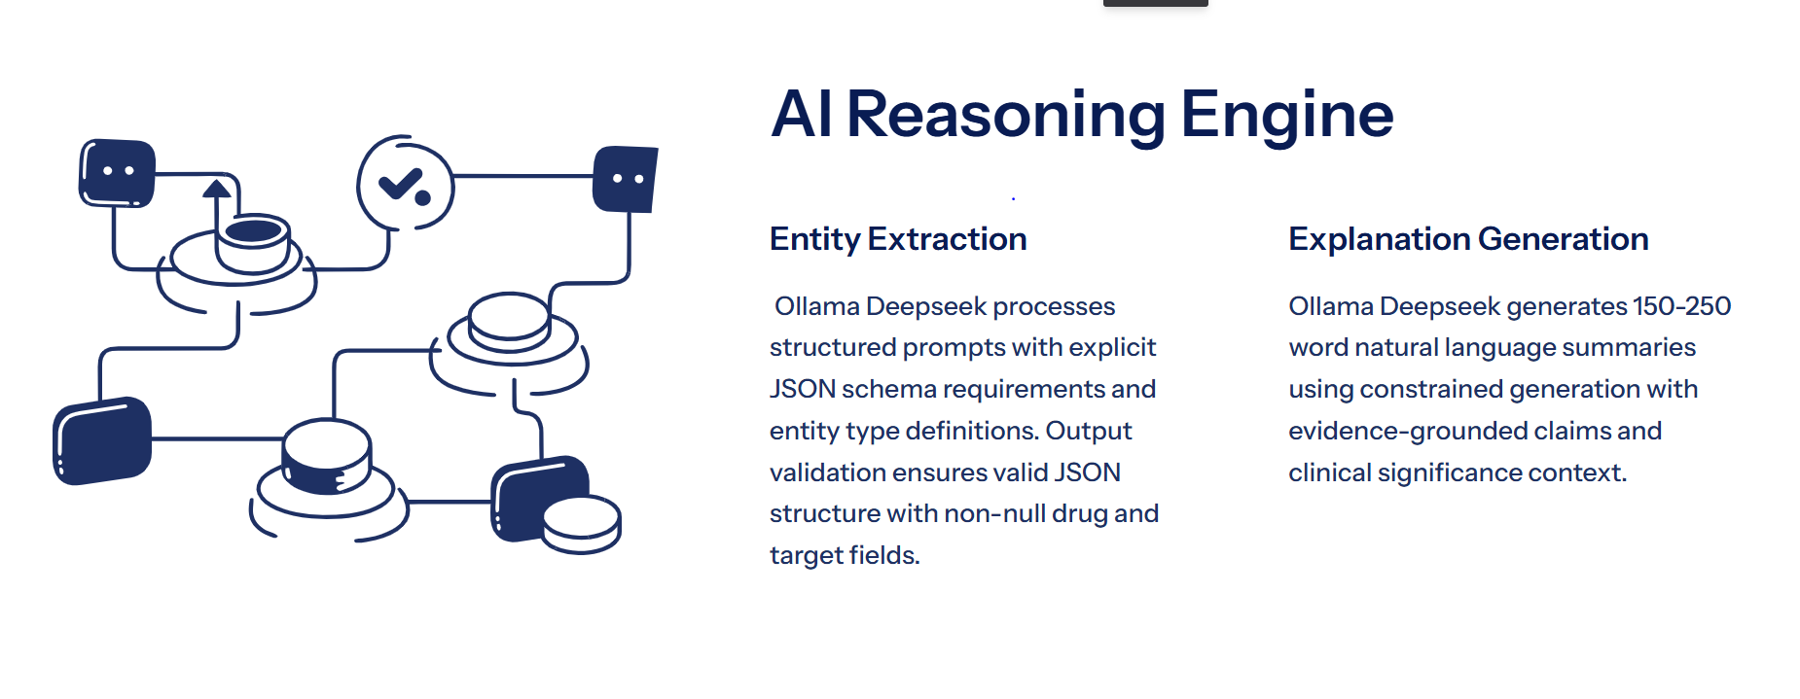

Slide 12
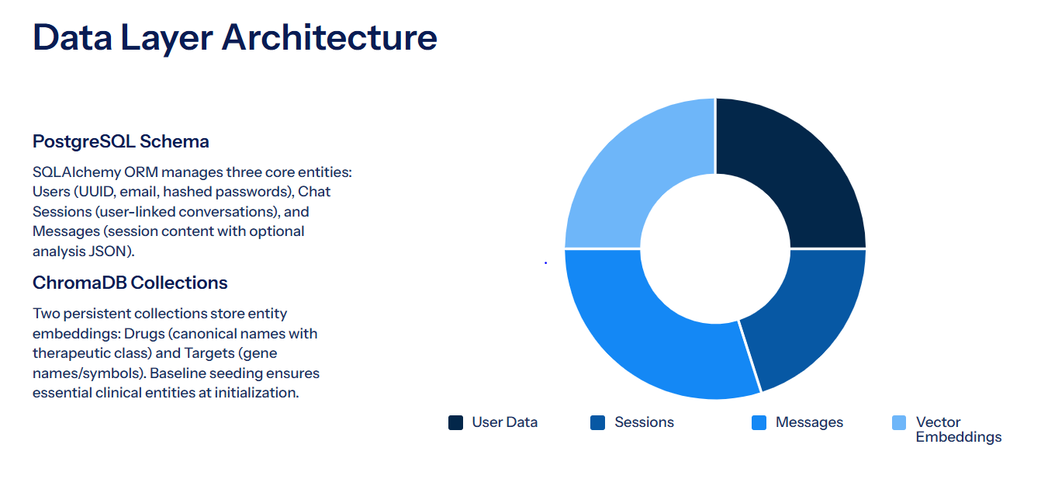

Slide 13
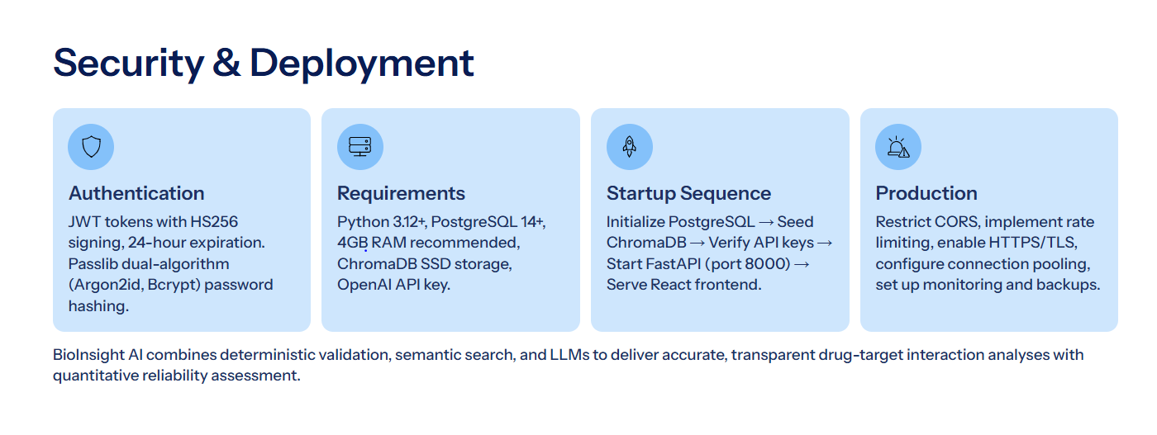

Slide 14
API Endpoints
Authentication Endpoints
Session Management Endpoints
Method | Endpoint | Description
POST | /auth/signup | Create new user account (email, password, full_name)
POST | /auth/login | Authenticate user and return JWT access token
GET | /auth/me | Get current authenticated user details
Method | Endpoint | Description
GET | /api/sessions | Retrieve all chat sessions for authenticated user
GET | /api/sessions/{id} | Retrieve all messages for specific session
Chat Endpoint
Method | Endpoint | Description
POST | /api/chat | Process user query and return analysis with confidence score

Slide 15
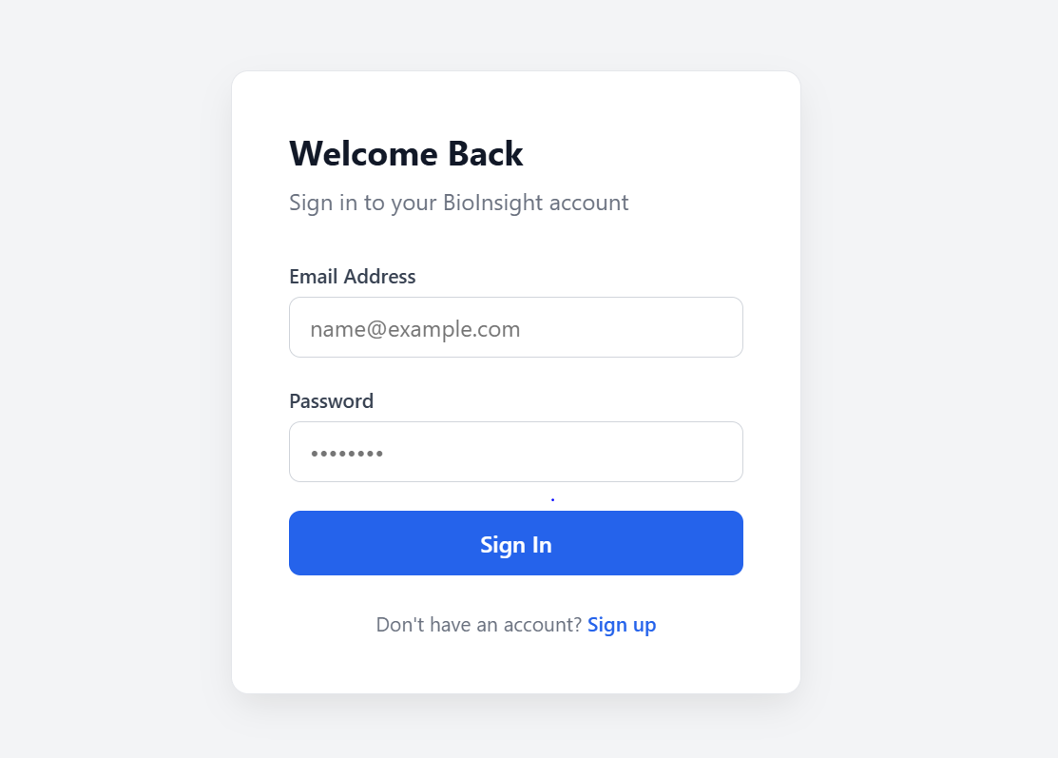
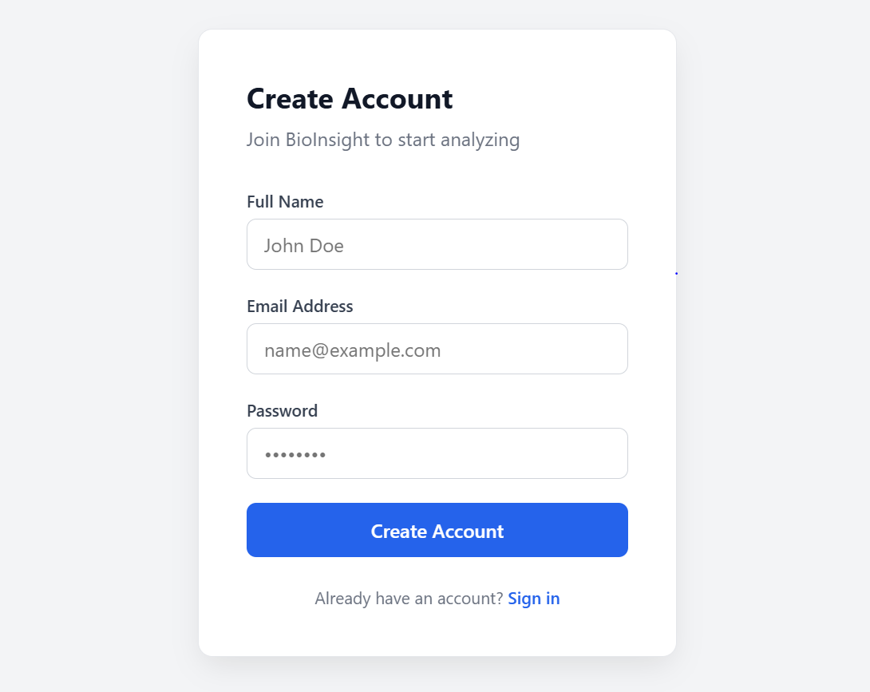
Login & Signup page :

Slide 16
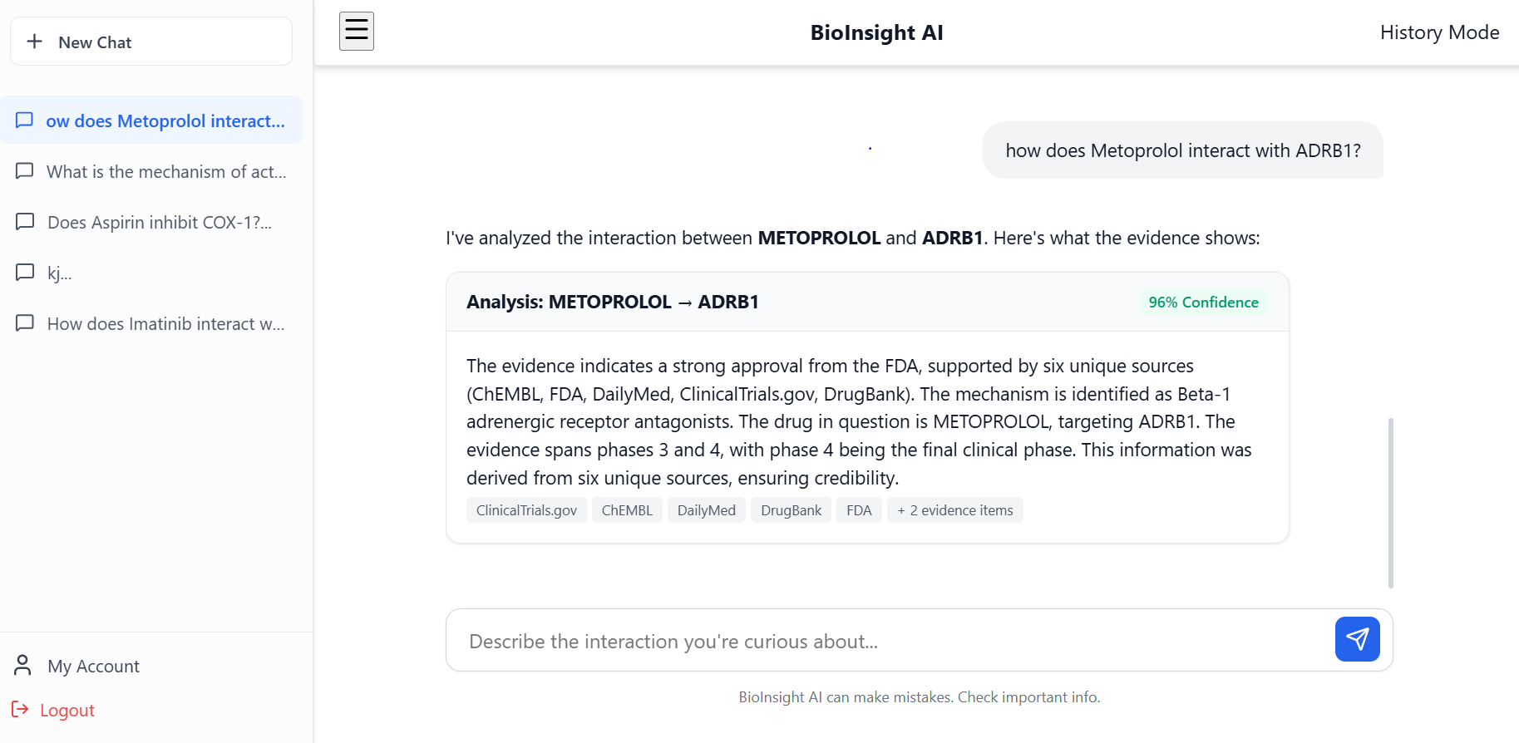
Chatbot Page

Slide 17
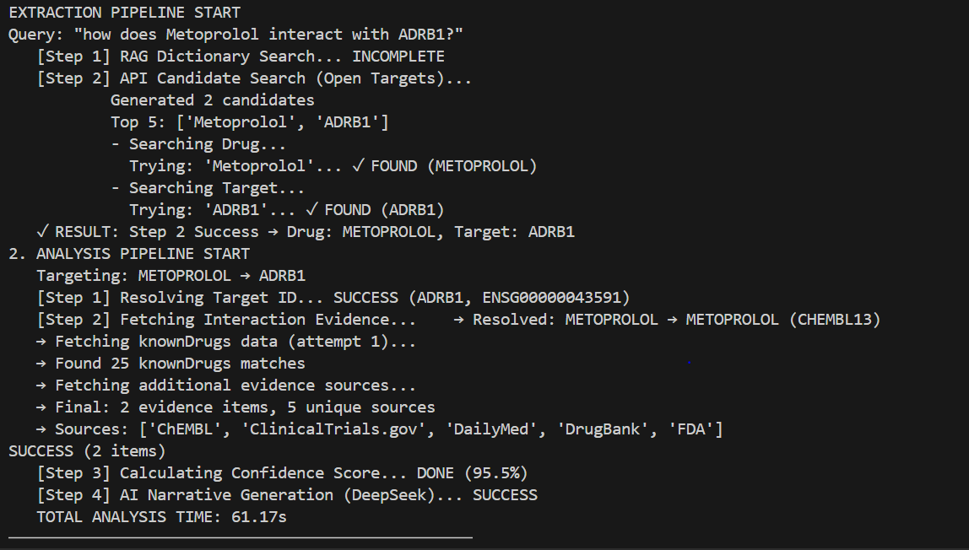
Backend Output

Slide 18

Thank You

