Slide 1

Gaussian Elimination and back substitution using dataflow
Naveenkumar Ramaraju

Slide 2
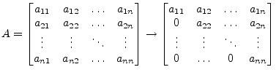
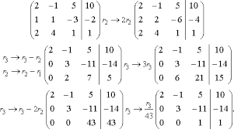
Gaussian elimination
The goal of forward elimination is to transform a given co-efficient matrix into an upper triangular matrix.
This can be achieved by below illustration in a system of 3 unknowns. It is easily scalable to ‘n’ unknowns.

Slide 3
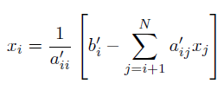
BACK substitution
Back substitution involves obtaining values from reduced equation from bottom up.
This step is represented by the formula in the figure.

Slide 4
Proposed solution
In order to leverage the advantages of data flow computing, we will pass pair of equation to data flow engine.
Data flow engine(max code) will reduce the given two equations with ‘n’ dimensions into one equation with ‘n-1’ dimensions.
CPU code will recursively call max(DFE) code until system is reduced to one equation.
Now these values will be substituted backwards to get the final solution.

Slide 5
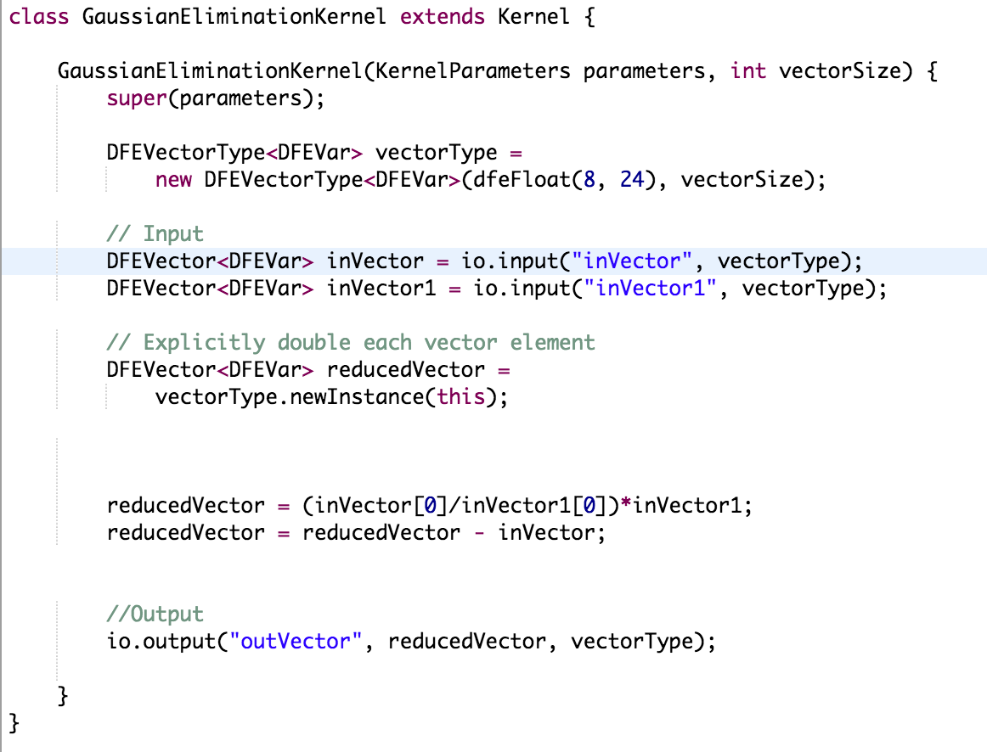
Code snippet of dataflow kernel

Slide 6
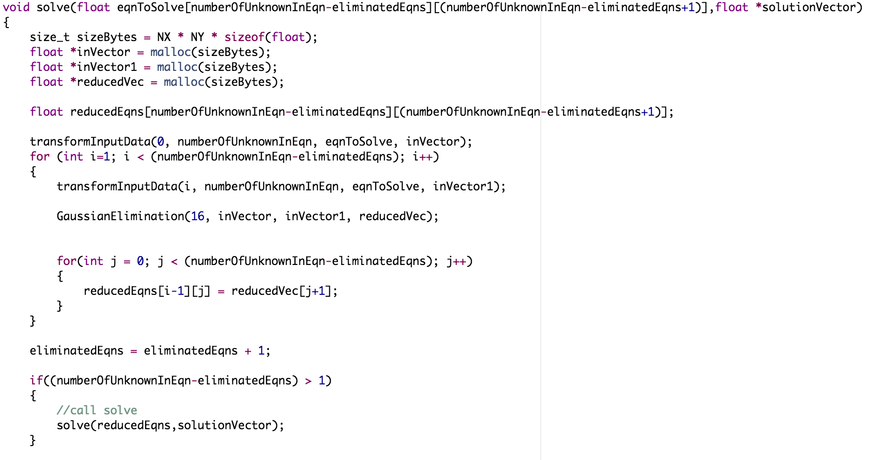
Code snippet of host

Slide 7
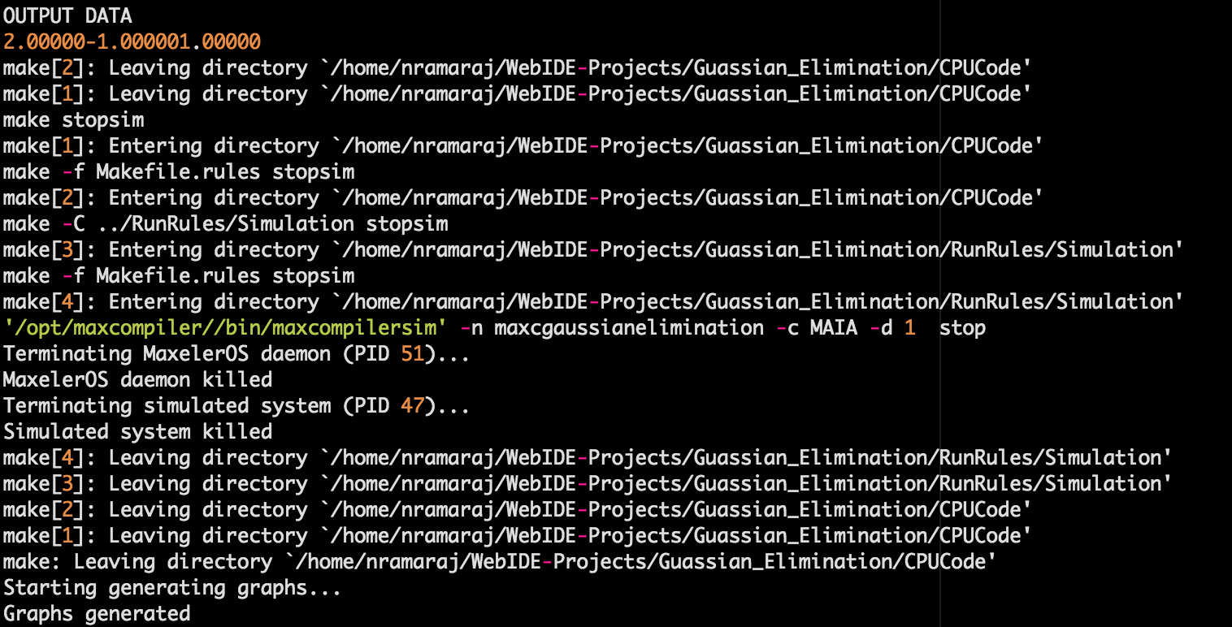
RESULTS
The code was compiled successfully and solved the equations to print the solution.
Console output of run of 3 unknowns is shown here.

Slide 8
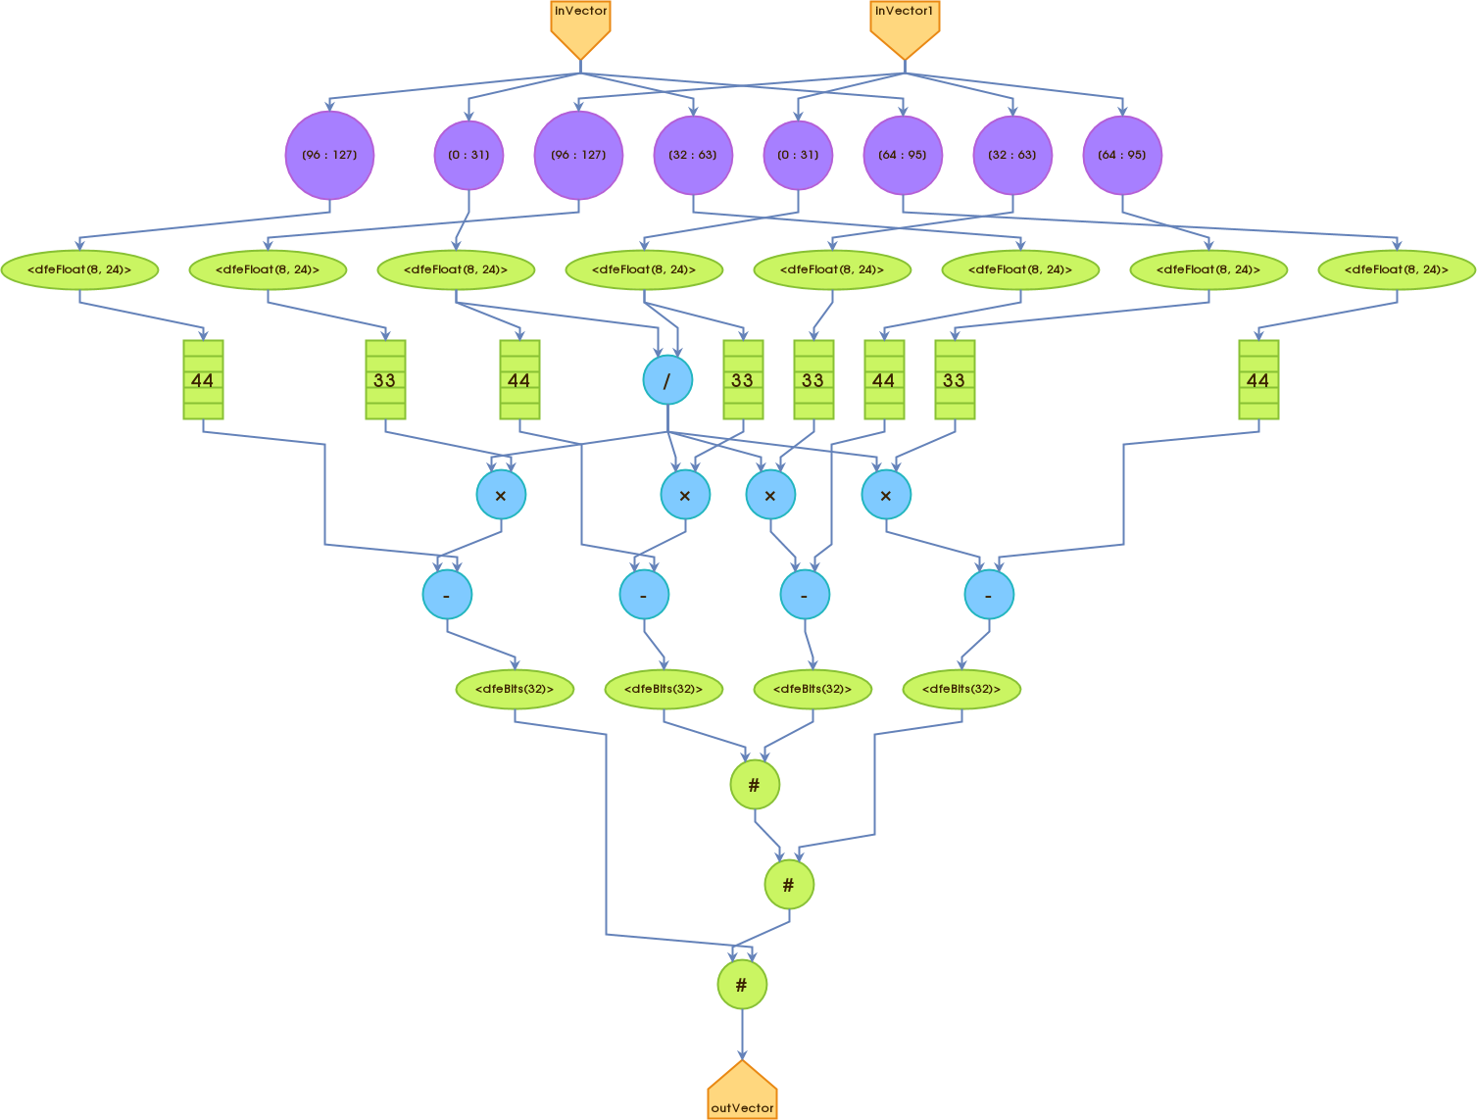
RESULTS
The graphs generated in the elimination process is shown here
The eliminated equations were used in back substitution in host code to get the solution.

