Slide 1

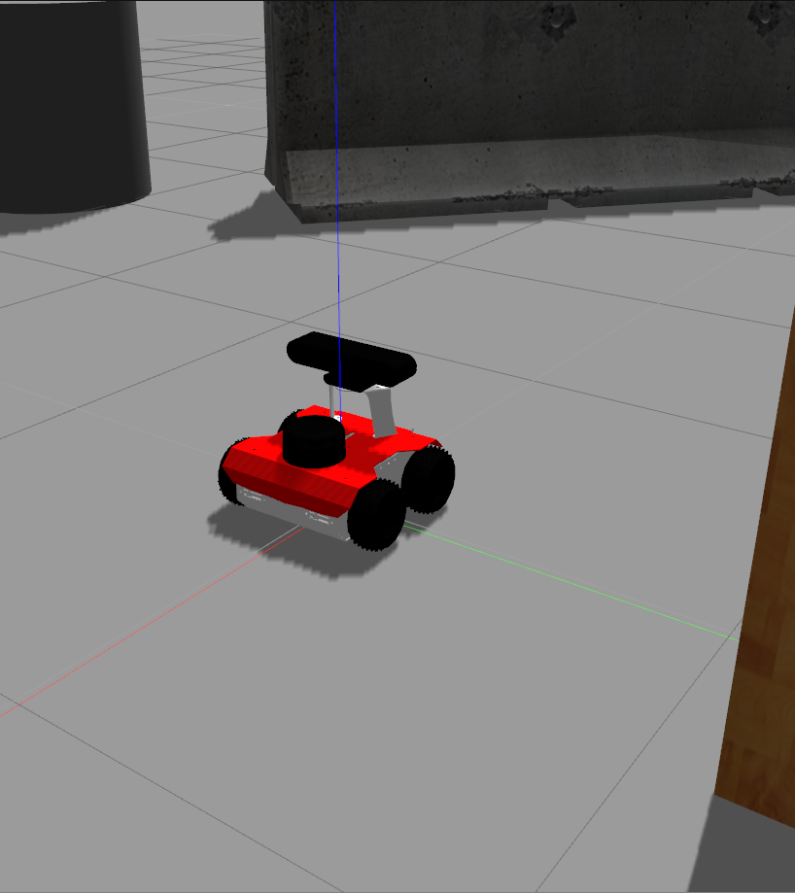
CE801
Chandra Naveen Kumar
2003246

Slide 2
PID Controller
Using two separate PID controllers. One controlling the linear or forward speed and the other controls the steering angle.
INPUTS:
1) Min Right distance to right edge(b/w ranges 379 to 699)
2) the position where min distance was found
→The linear speed control PID works on distance error alone but the PID controller which controls the Steering takes both min distance from position for error calculation.
Parameters:
Distance PID
kp_d = 0.05
ki_d = 0.00000001
kd_d = 0.05
Steering PID
kp_a = 0.3
ki_a = 0.000001
kd_a = 0.25

Slide 3
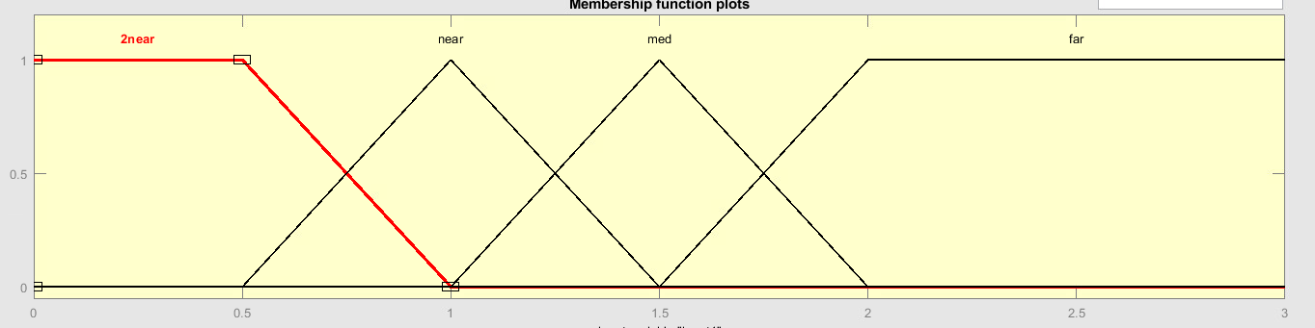

Right Edge fuzzy Controller
Using two sensor values Right front distance and Right back distance
Instead of using a single value a range of values are used for finding the min distance
Ranges:
Right Front Range : 390 to 540
Right Back Range : 541 to 719
Using 4 labels
2near : 0.0 to 1.0
Near : 0.5 to 1.5
Med : 1.0 to 2.0
Far : 1.5 & beyond

Slide 4
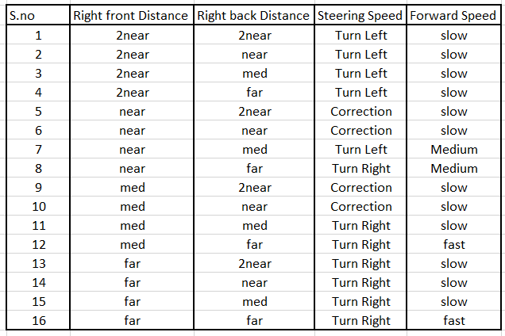
Rule BASE

Slide 5
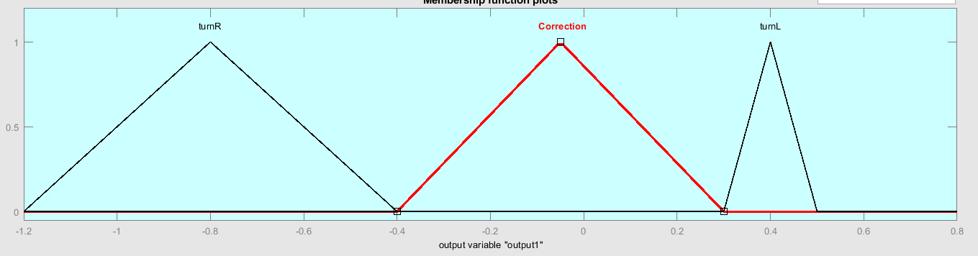
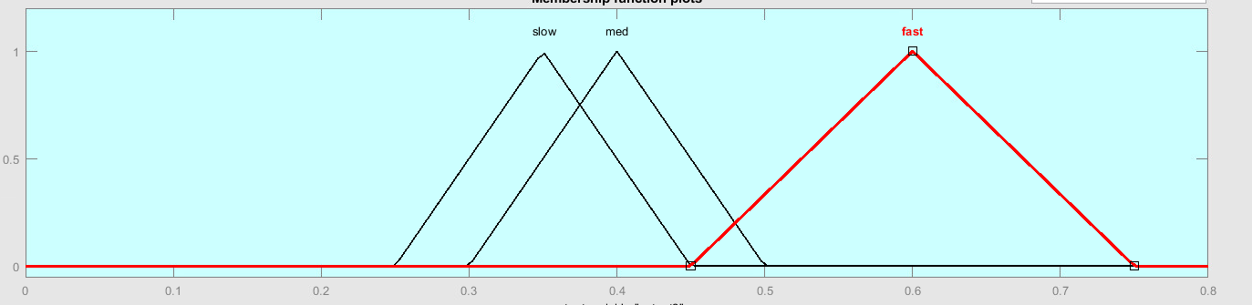
Output membership functions
3 Labels
Turn Right : -1.2 to -0.4
Correction : -0.4 to 0.35
Turn Left : 0.35 to 0.45
3 Labels
Slow : 0.25 to 0.5
Med : 0.3 to 0.5
Fast : 0.45 to 0.75

Slide 6
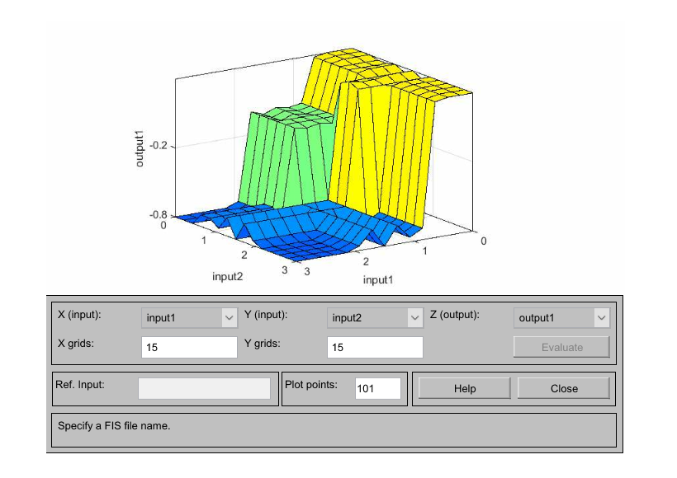
Steering control Surface

Slide 7
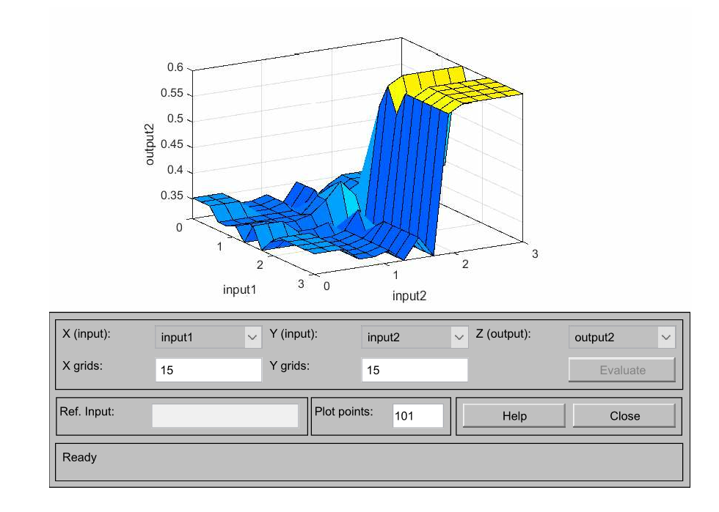
Forward Speed Surface

Slide 8
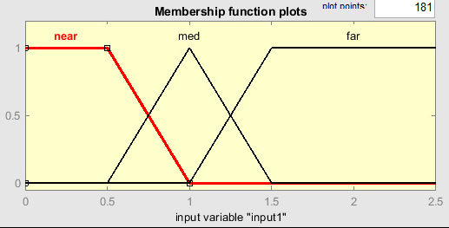
Obstacle avoidance fuzzy controller
Using three sensor values Front Right distance, Front center distance and Front left distance
Instead of using a single value a range of values are used for finding the min distance
Ranges:
Front Right Range : 670 to 700
Front Center Range : 701 to 19
Front Left Range : 20 to 50
Using 3 labels
Near : 0 to 1
Med : 0.5 to 1.5
Far : 1 & beyond

Slide 9
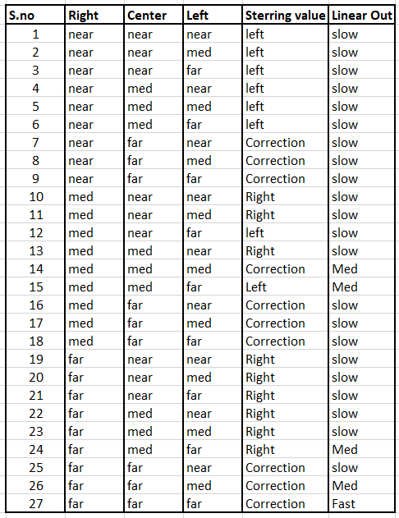
Rule base

Slide 10
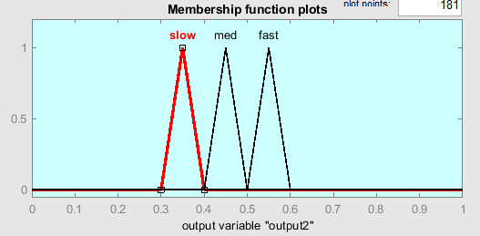
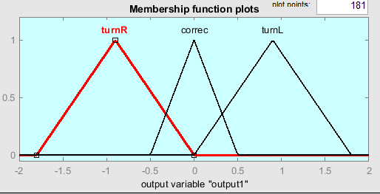
Output Variables
3 Labels
Slow : 0.3 to 0.4
Med : 0.4 to 0.5
Fast : 0.5 to 0.6
3 Labels
Turn Right : -1.8 to 0.0
Correction : -0.5 to 0.5
Turn Left : 0.0 to 1.8

Slide 11
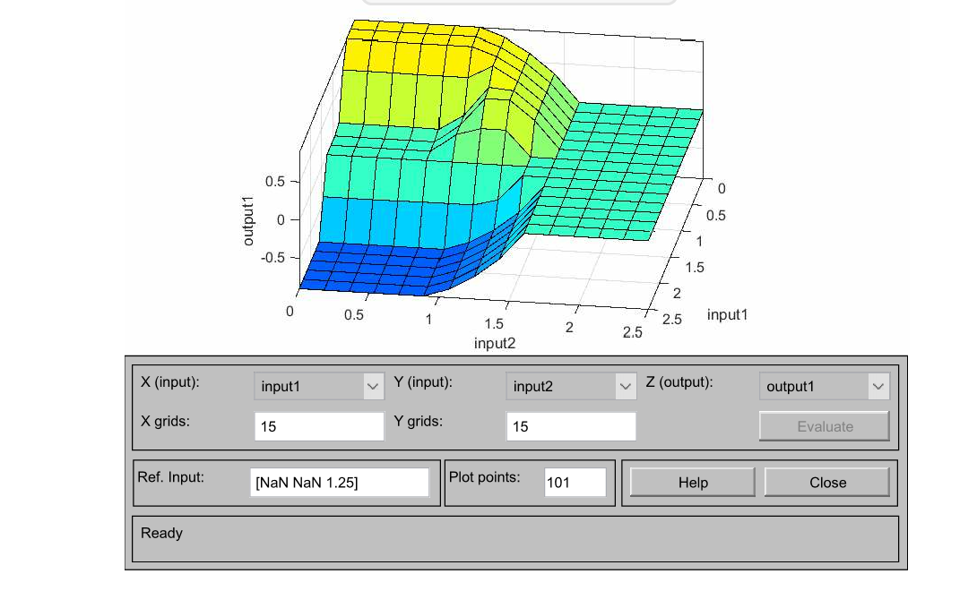
Steering control surface

Slide 12
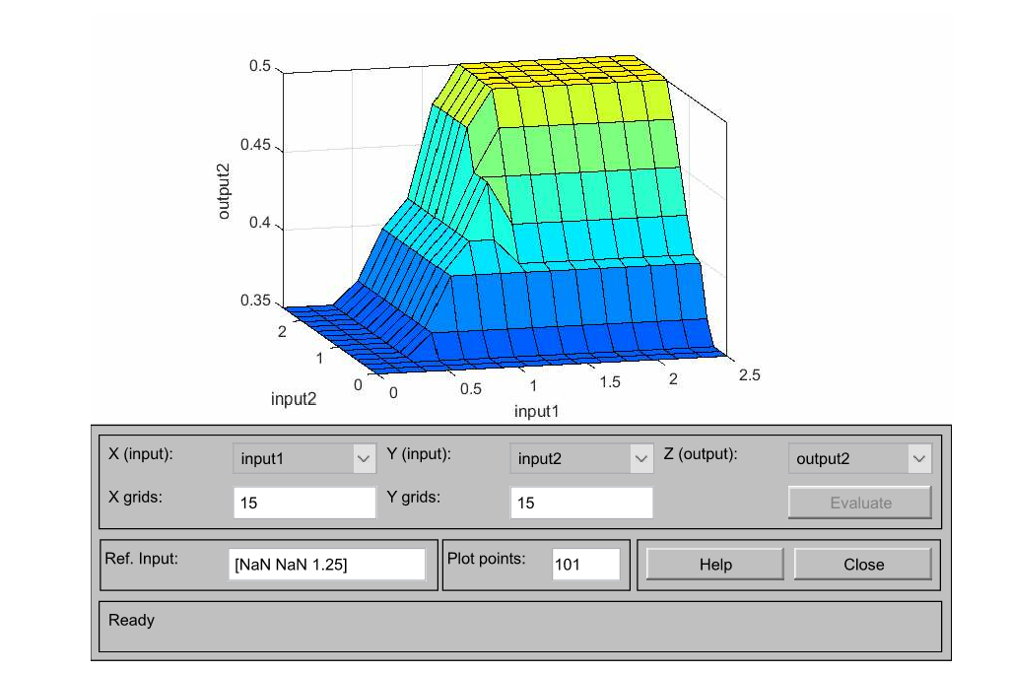
Forward Speed Control Surface

Slide 13
Fuzzy Coordination
Used front obstacle distance for determining the firing strength of each behavior
When there is no obstacle present and the path is clear robot tries to find a right edge and follow it.
Firing Strength
1.0
0.5
1.0
Front Obstacle Distance

Slide 14
Thank you

