Slide 1

INTERNSHIP
PROJECT REPORT
AI-Based Language Translation, Music Generation
and Object Detection & Tracking
CodeAlpha Virtual Internship Program • Artificial Intelligence
NAVEEN KUMAR
Student ID: CA/DF1/206810
B.Tech CSE • Batch 2026-27
20 JUL 2026 — 20 AUG 2026
Certificate issued: 21 AUG 2026

Slide 2
Internship Overview
Three practical AI tasks spanning NLP, generative AI and computer vision
01 Language Translation
02 AI Music Generation
03 Object Detection + Tracking
User enters text → selects source/target languages → translation API returns the result. Optional copy and text-to-speech improve usability.
MIDI files are parsed with music21 → note sequences feed an RNN/LSTM → generated sequences are reconstructed into MIDI.
OpenCV captures frames → YOLO/Faster R-CNN detects objects → SORT/Deep SORT maintains IDs in real time.
CodeAlpha AI Internship • NAVEEN KUMAR
2

Slide 3
Problem Statement & Objectives
Convert three AI task briefs into demonstrable software modules
Problem Statement
Core Objectives
The project must transform different input types into useful AI outputs while handling preprocessing, API/model execution, validation and user-facing presentation. The three tasks require different techniques but can share a modular application architecture.
• Build a simple translation interface
• Generate new symbolic music from learned sequences
• Detect multiple objects in video frames
• Track object identities over time
• Provide clear outputs and basic error handling
CodeAlpha AI Internship • NAVEEN KUMAR
3

Slide 4
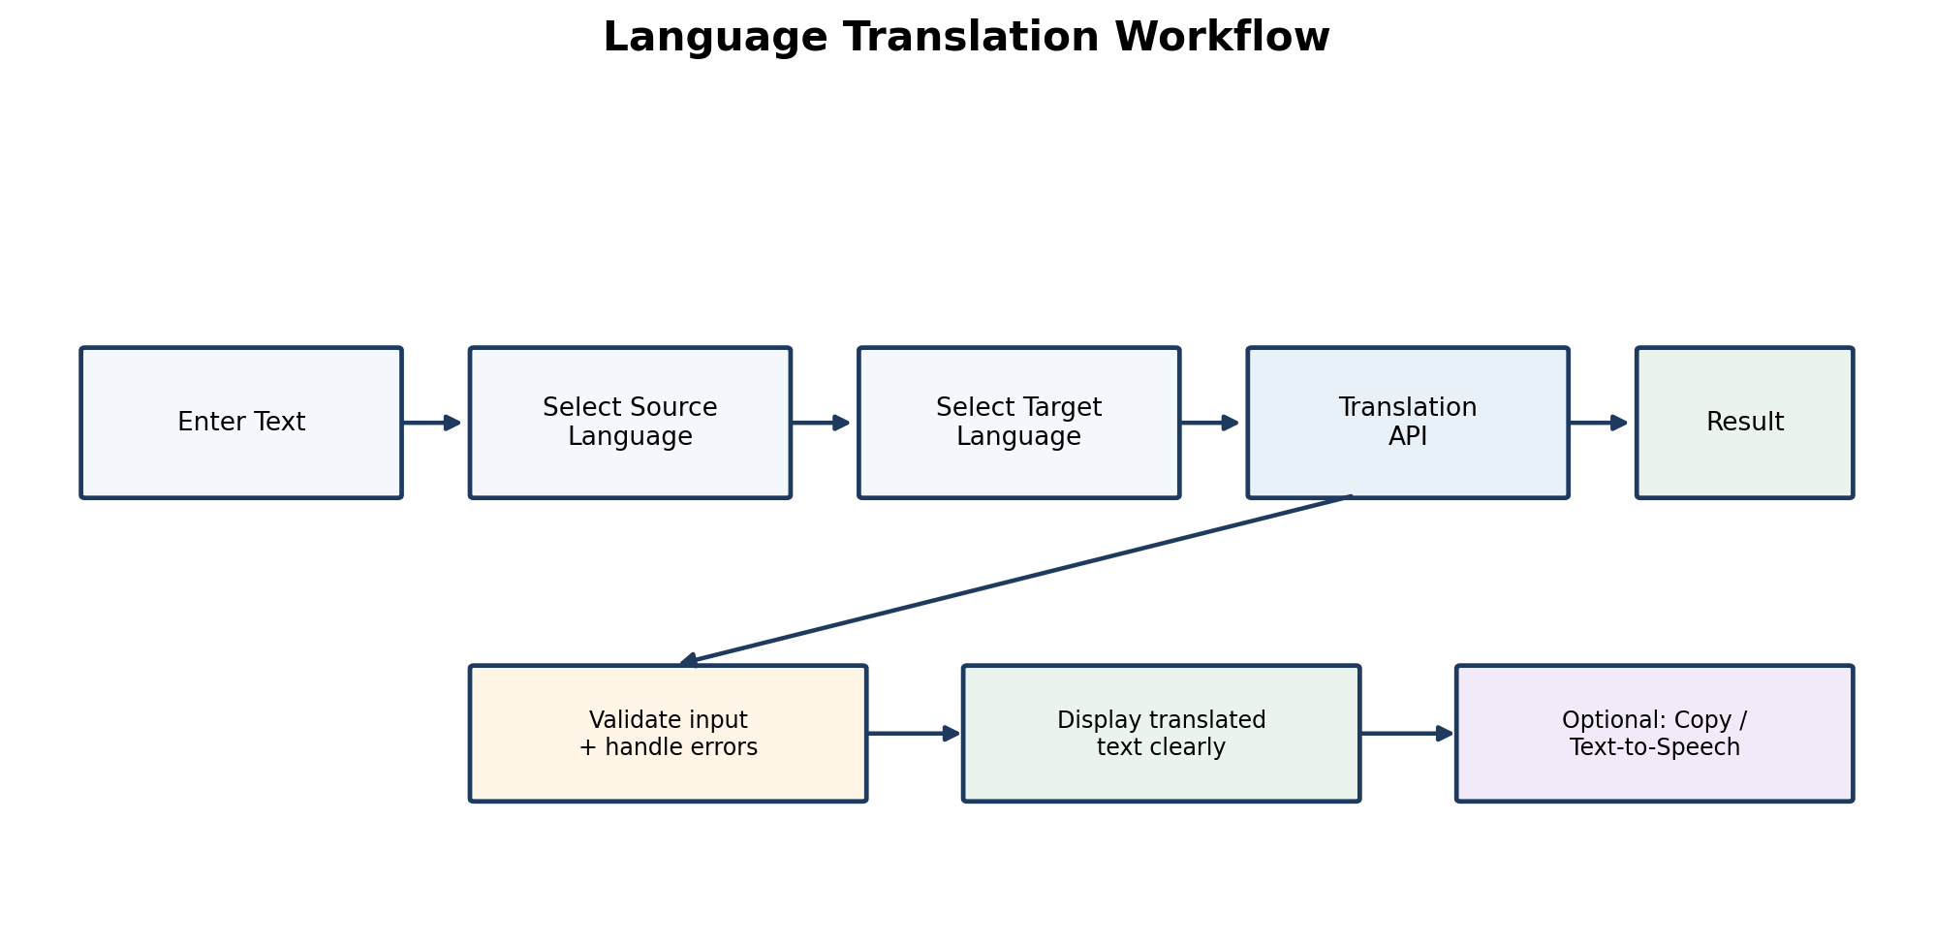
Task 1 — Language Translation Tool
NLP + API integration
Implementation Flow
1. Enter and validate text
2. Choose source and target languages
3. Build authenticated API request
4. Parse translated response
5. Display result clearly
6. Optional: Copy / Text-to-Speech
CodeAlpha AI Internship • NAVEEN KUMAR
4

Slide 5
Task 1 — Usability & Validation
The application should fail clearly, not silently
Input Validation
API Reliability
User Experience
Reject empty text; validate language selection; handle long requests and unsupported parameters.
Keep credentials outside source code; handle network errors, authentication errors and rate limits.
Readable translated output, copy-to-clipboard, optional speech playback and clear status messages.
CodeAlpha AI Internship • NAVEEN KUMAR
5

Slide 6
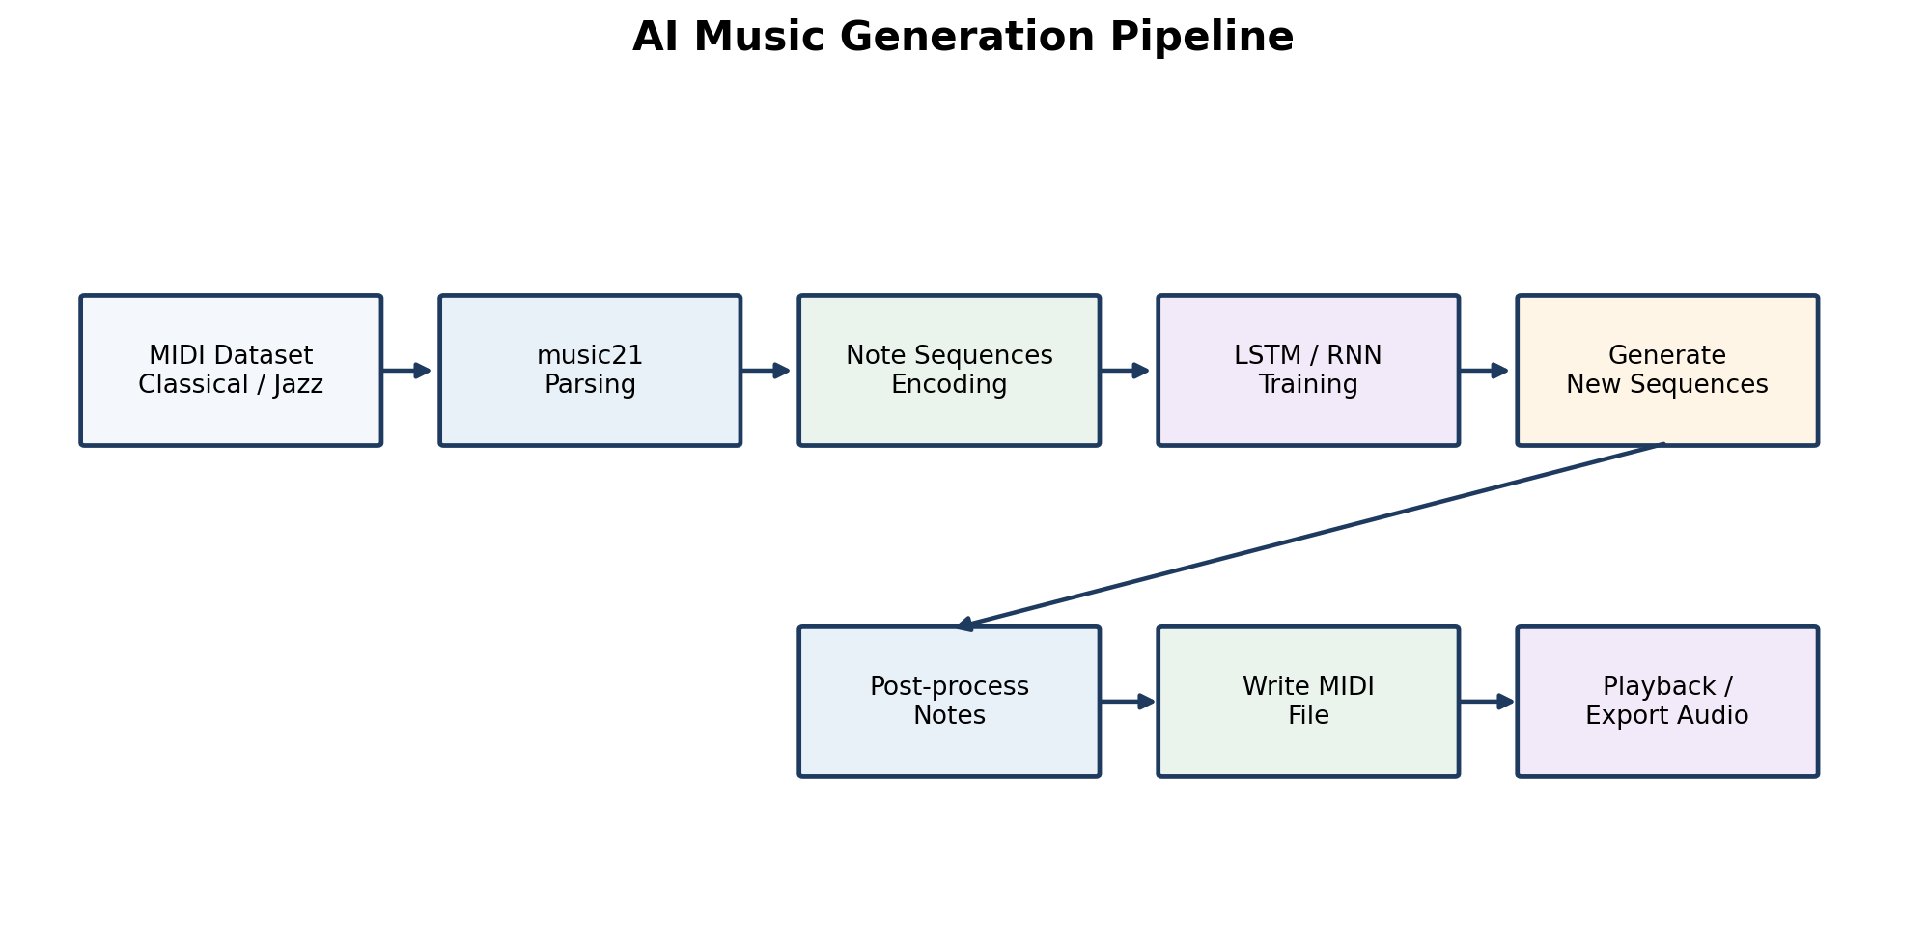
Task 2 — Music Generation with AI
Symbolic music as a sequence-learning problem
Key Steps
Dataset → music21 parsing → token/number encoding → input windows → RNN/LSTM training → sequence sampling → MIDI reconstruction → playback.
CodeAlpha AI Internship • NAVEEN KUMAR
6

Slide 7
Task 2 — RNN / LSTM Generation
Learning local transitions and longer musical context
Data Preparation
Model Training
Generation
Extract notes/chords, standardize events, create a vocabulary and build fixed-length sequences with next-event targets.
Use recurrent layers such as LSTM to model sequential dependencies. Train on prepared sequences and watch for overfitting or unstable training.
Seed the model, sample predicted events repeatedly, rebuild the sequence as a music21 stream, write MIDI and listen to the result.
CodeAlpha AI Internship • NAVEEN KUMAR
7

Slide 8
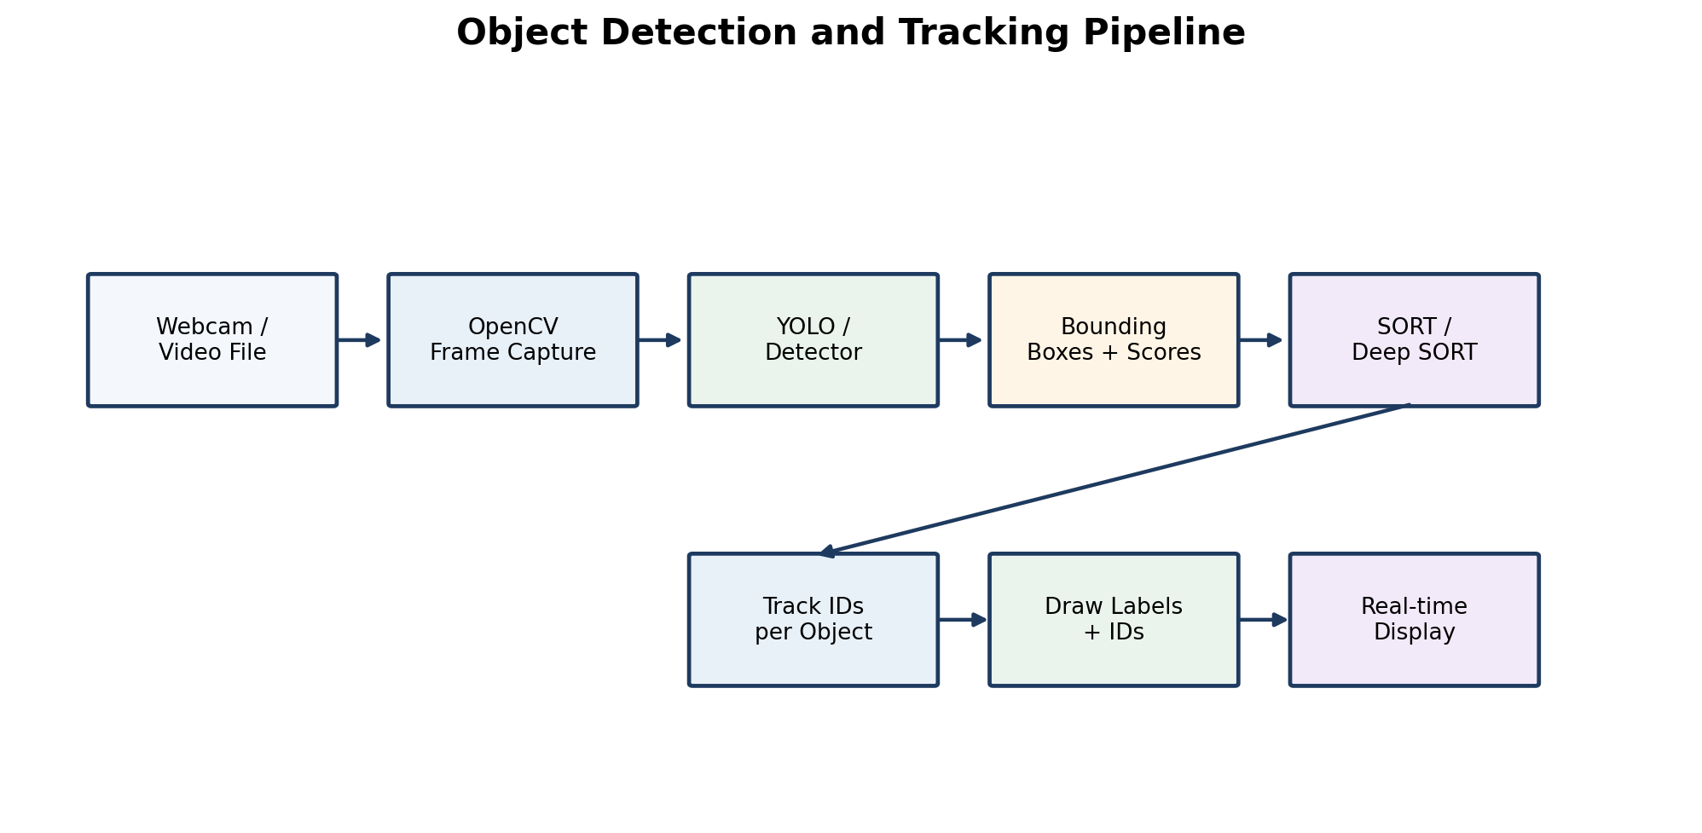
Task 3 — Object Detection & Tracking
Real-time computer vision with persistent object identity
Detection + Tracking
Webcam/video → OpenCV frames → YOLO/Faster R-CNN → boxes/classes/confidence → SORT/Deep SORT → labels + tracking IDs → display.
CodeAlpha AI Internship • NAVEEN KUMAR
8

Slide 9
Task 3 — What the Tracker Adds
Detection tells us what is visible; tracking helps preserve identity over time
Detection Stage
Tracking Stage
• Class label
• Confidence score
• Bounding box
• Per-frame localization
• Confidence thresholding
• Temporal association
• Persistent track IDs
• Object movement continuity
• Better interpretation across frames
• Sensitivity to occlusion / missed detections
CodeAlpha AI Internship • NAVEEN KUMAR
9

Slide 10
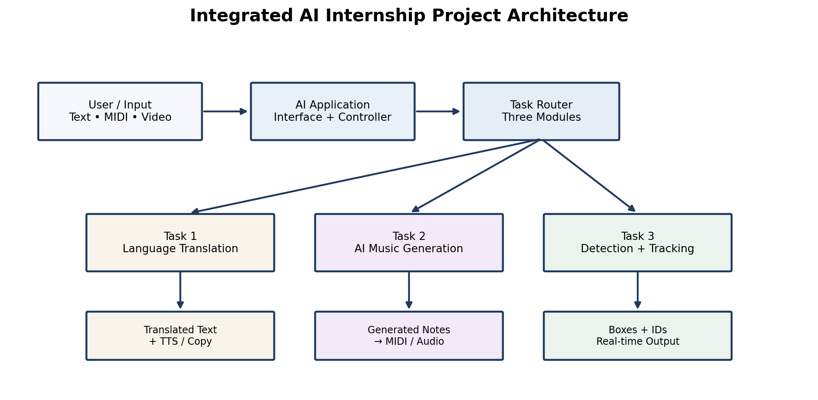
Integrated System Architecture
A common application pattern keeps the three tasks modular
Shared Engineering Pattern
Input validation
↓
Preprocessing
↓
AI inference / API
↓
Output formatting
↓
User-facing result
Each task can be tested independently.
CodeAlpha AI Internship • NAVEEN KUMAR
10

Slide 11
Technology Stack & Expected Outcomes
Tool choices map directly to the three task requirements
Python
Application logic, AI/ML orchestration
Google Translate / Microsoft Translator
Translation API
music21
MIDI parsing and symbolic music processing
PyTorch / TensorFlow
RNN / LSTM implementation
OpenCV
Video capture and annotation
YOLO / Faster R-CNN
Object detection
SORT / Deep SORT
Object tracking
Expected outcome: three demonstrable AI modules with observable inputs, AI processing stages and user-visible outputs. Numerical benchmark values should be added only when supported by experiment logs.
CodeAlpha AI Internship • NAVEEN KUMAR
11

Slide 12
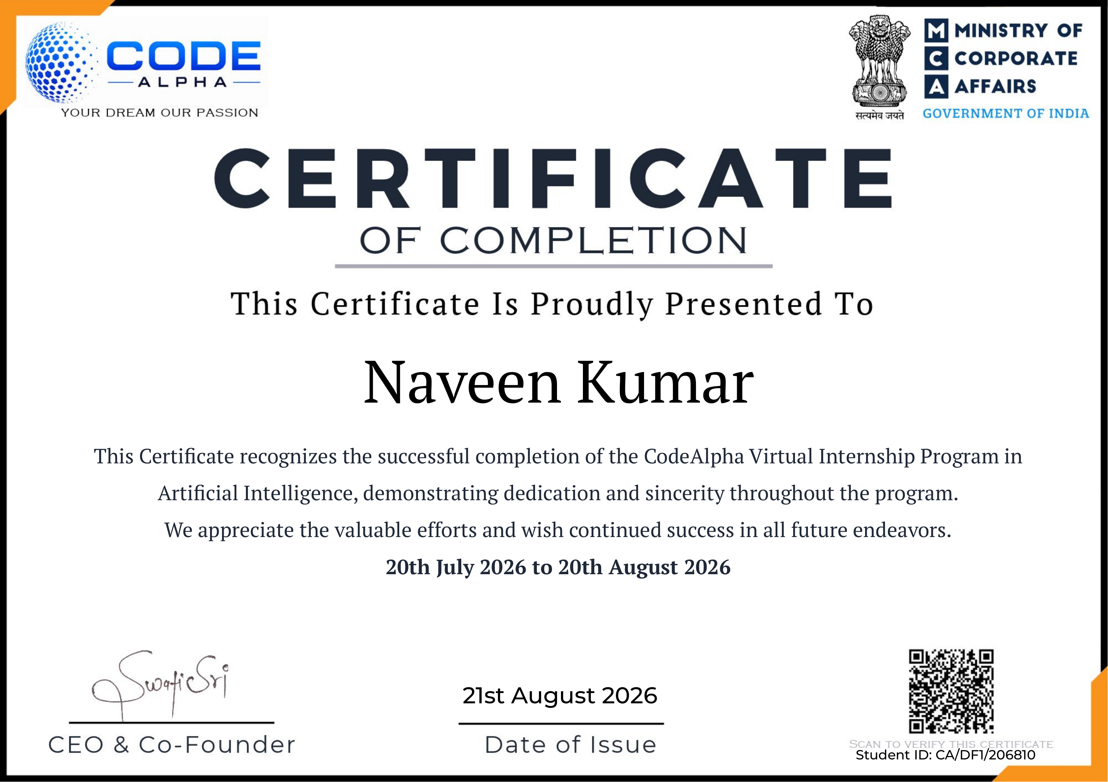
Internship Completion Certificate
Documentary evidence supplied with the internship report
CodeAlpha AI Internship • NAVEEN KUMAR
12

Slide 13
Conclusion
The project demonstrates three complementary AI workflows:
NLP
Generative AI
Computer Vision
API-driven language translation with practical UI and validation.
Sequence learning for symbolic music and MIDI generation.
Real-time detection plus temporal tracking of object identities.
Thank you
NAVEEN KUMAR • B.Tech CSE • Batch 2026-27
CodeAlpha AI Internship • NAVEEN KUMAR
13

