Slide 1


Food Bridge
SURPLUS SHARED, HUNGER BRIDGED
Mid of Mids
Krishna Koushik Padigala
Charan Derangula
Naveen Kumar Kalisetty
Sreedhar Babu Thappeta
Food Bridge

Slide 2
PROBLEM STATEMENT
Leftover Food: A Growing Crisis
India wastes approximately 67 million tonnes of food annually, valued at ₹92,000 crore – Times of India
In North Indian vegetarian messes, daily preparation ranges from 90–100 kg, with 40–50 kg left over – Hindustan Times
10–20 kg of food is wasted by students in North Indian messes daily – The Hindu
IIT Bombay wastes an estimated 1,000 kg of food daily across 16 hostels – Times of India
Overproduction without accurate demand forecasting leads to significant food waste – NDTV
Lack of real-time inventory and consumption tracking contributes to wastage – The Times of India
Food Bridge

Slide 3
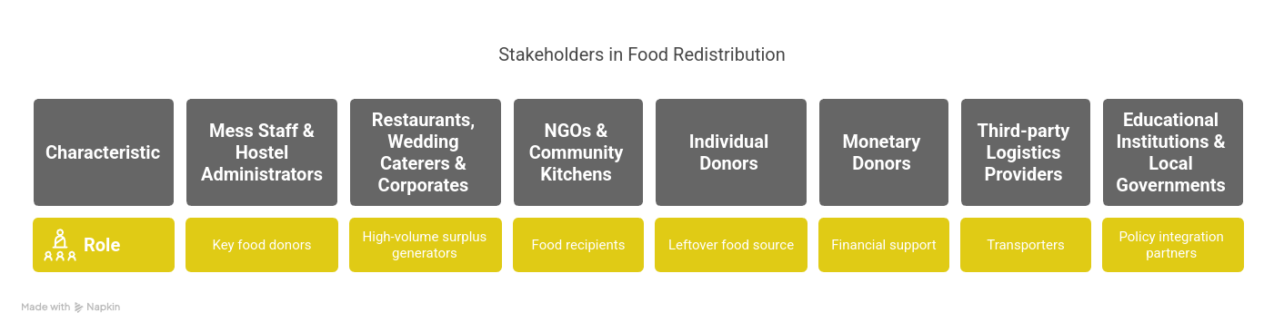
Target Audience
Food Bridge

Slide 4
Solving the Problem from Both Ends
Through Food Bridge, we don’t just address food waste — we attack it from both sides.
Our platform combines prevention and redistribution, creating a comprehensive and scalable solution.
Food Bridge

Slide 5
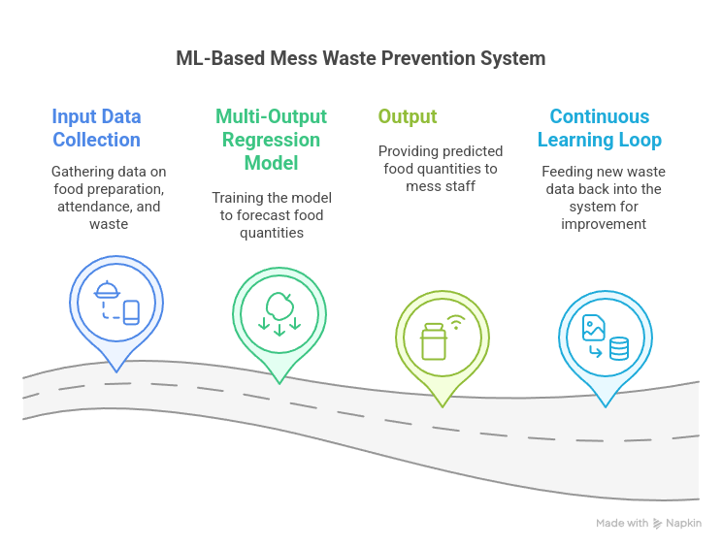
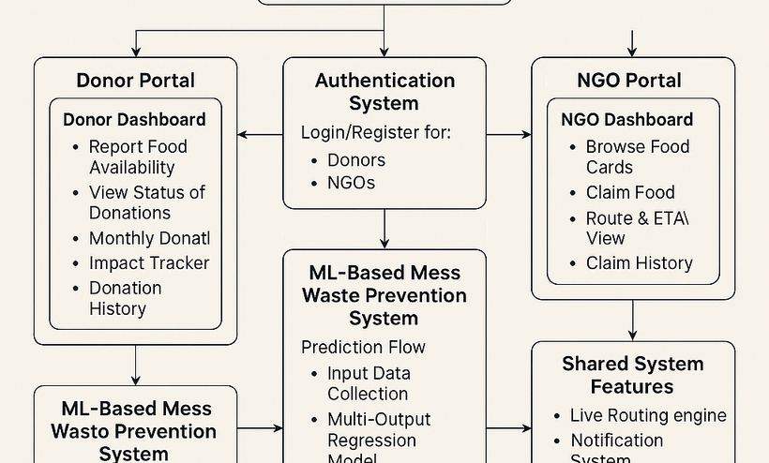
Solution Overview
Turning Leftovers into Lifelines
Donors report surplus food via our platform.
Nearby NGOs get instant alerts and can claim it easily.
Live location, route, and contact info ensure smooth handovers.
Smarter Cooking Starts with Smarter Forecasting
Our ML model predicts next-day food needs using past data,
helping mess halls cook just enough and cut down waste at the source.
Food Bridge

Slide 6
KEYBENEFITS
🔗 Connects Surplus to Need
📉 Reduces Food Waste
📊 Prevents Overcooking
📍 Live Routing
Efficiently links mess halls and donors with NGOs and food distribution centers.
Minimizes mess waste through predictive analytics and smart tracking of leftovers.
Our ML model forecasts food requirements, helping mess staff cook just enough.
Route optimization ensures food reaches NGOs quickly and safely, minimizing spoilage.
📬 Instant Notifications
💰 Supports Monthly Donors
.
🚚 3rd Party Delivery Integration
📈 Scalable Architecture
Donors and NGOs get real-time updates via email for every claim, delivery, and report.
Regular contributors get detailed impact reports showing meals served per month.
Donations can be picked up by delivery services like Zepto when NGOs can't reach the donor.
Built to scale across campuses, communities, and cities—no infrastructure overhaul required.
Food Bridge

Slide 7
UNIQUE SELLING POINTS
Dual-pronged impact: Prevention + Reduction
Focused on mess halls, where food waste is often overlooked
Data-driven insights + real-time action
Scalable, location-aware, and designed for sustainable social good
Food Bridge

Slide 8

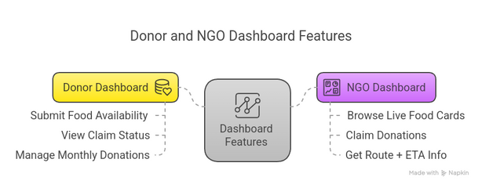


CORE FUNCTIONALITIES: OVERVIEW
Real-Time Alerts & Communication
ML-Based Forecasting Engine
Impact-Driven Monthly Donations
Dedicated Dashboards
Donor Dashboard – Submit food availability, view claim status, and manage monthly donations.
NGO Dashboard – Browse live food cards, claim donations, and get route + ETA info.
Location-Aware Routing – Uses OpenRouteService API for live distance and time estimation.
Notification System – Instant email/SMS alerts via Firebase or Flask-Mail on food claims and deliveries.
A multi-output regression model trained on historical mess data (including attendance, day of week, previous waste levels) predicts multiple food quantities for the next day. This helps mess staff prepare accurate portions, preventing overcooking and minimizing waste at the source.
Donors can opt for monthly contributions to support logistics like third-party transport. In return, they receive a personalized impact report showing how many people were fed through their support—building trust and encouraging recurring generosity.
Food Bridge

Slide 9
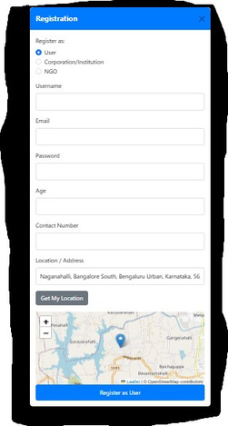
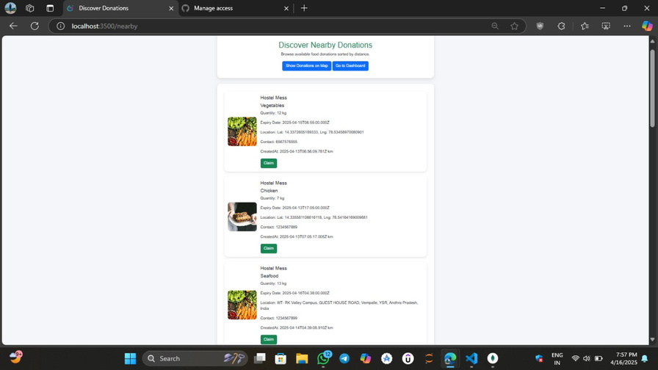
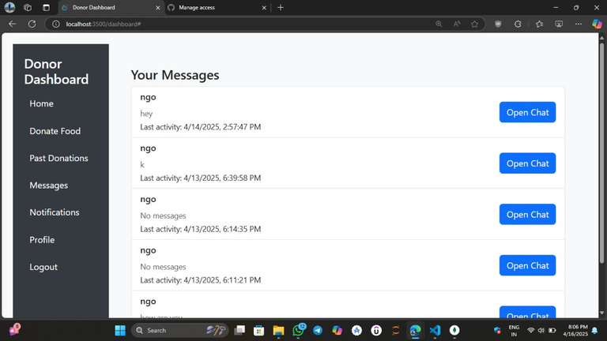
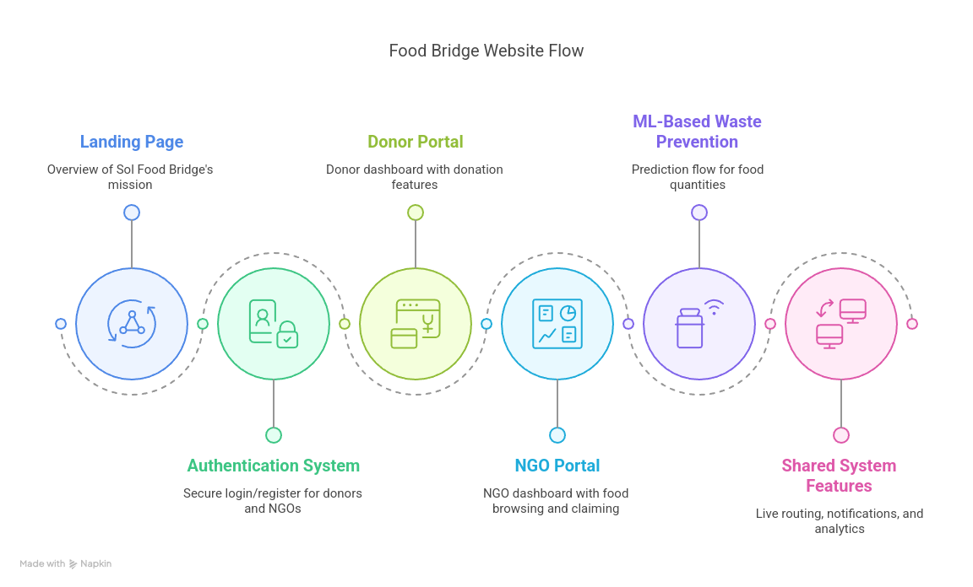
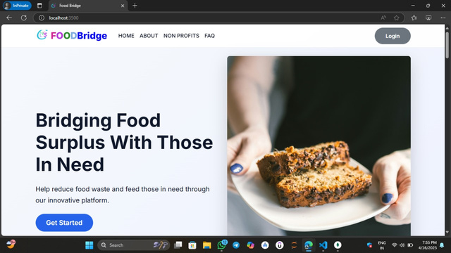
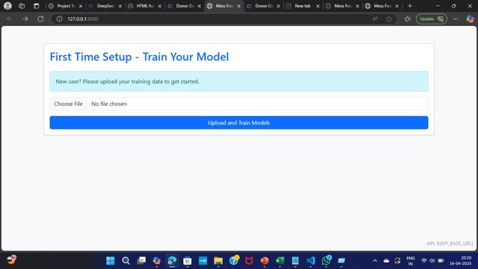
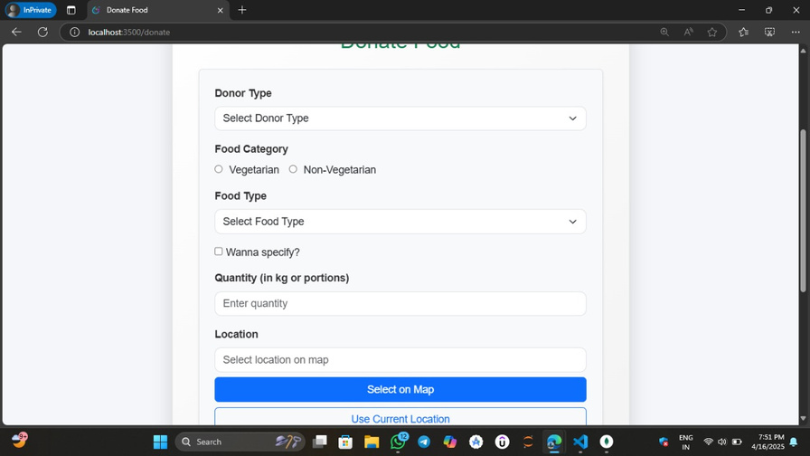
FLOW OF THE SOLUTION
Food Bridge

Slide 10
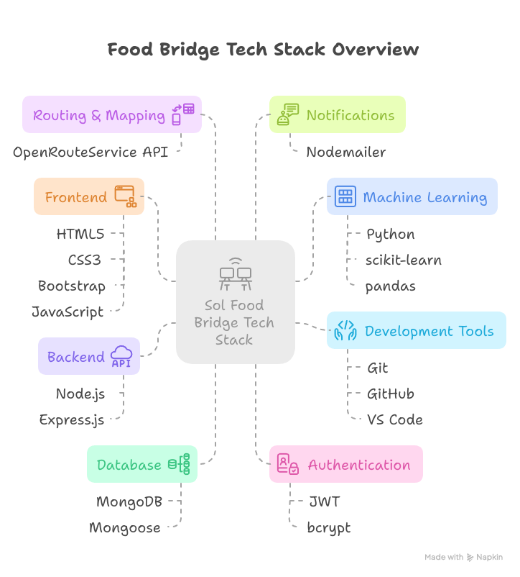
Food Bridge

Slide 11
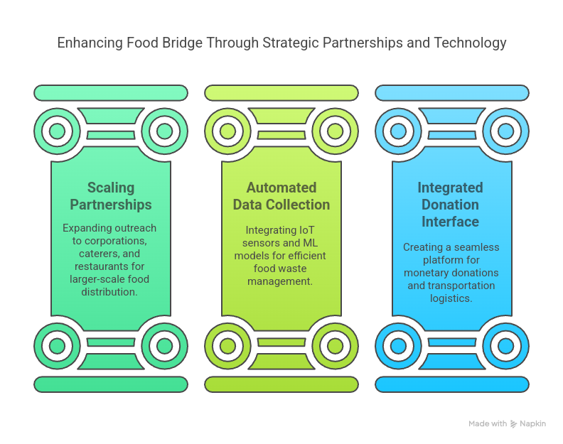
FUTURE UPDATES AND PLANNED IMPROVEMENTS FOR FOOD BRIDGE
Food Bridge

Slide 12
MILE STONES FOR PROTOTYPE DEVELOPMENT
Location-Based Features & Routing Integration
IoT Integration for Leftover Food Data Collection
Monetary Donation Interface Development
Transportation Service Integration
Deployment & Final Launch
Research and integrate third-party logistics APIs.
Automate transportation scheduling for food delivery.
Deploy the final prototype to a cloud platform (AWS/Heroku).
Collect feedback from users and resolve any critical issues.
Integrate OpenRouteService/OpenStreetMap APIs.
Implement routing and display of distance and estimated travel time.
Select and deploy IoT sensors (e.g., weight sensors).
Integrate sensor data for automated food surplus tracking into the platform.
Integrate payment gateway for monetary donations.
Develop the donation tracking dashboard.
Food Bridge

