Slide 1

University Admit Eligibility Predictor using Machine Learning

Slide 2
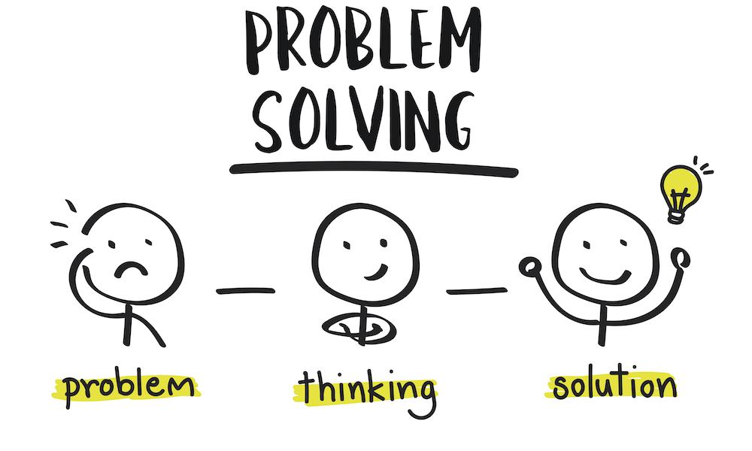
Content:
Problem
Solution
Technology used
Block diagram & Flow Chart
Result with Conclusion

Slide 3
Problem:
Students don’t have much idea whether they are eligible by the scores obtained, that is GRE score, TOEFL score, SOP, LOR, CGPA.
Most of the students don’t take risk of evaluating the colleges by themselves.
They invest large sum in consultancies even though they are unreliable.

Slide 4
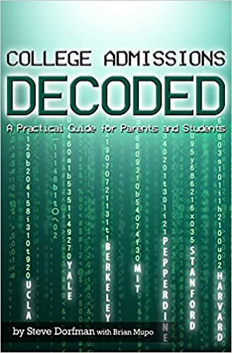
Solution:
The aim of this application is to help students in shortlisting universities with their profiles
The predicted output gives them a fair idea about their admission chances in a particular university.

Slide 5
Technology Used:
Hardware
Processor – Dual Core or higher
Hard Disk – 50 GB
Memory – 1GB RAM
Software
Python
Anaconda
Jupyter Notebook
Windows 7 or higher
XAMP Server

Slide 6
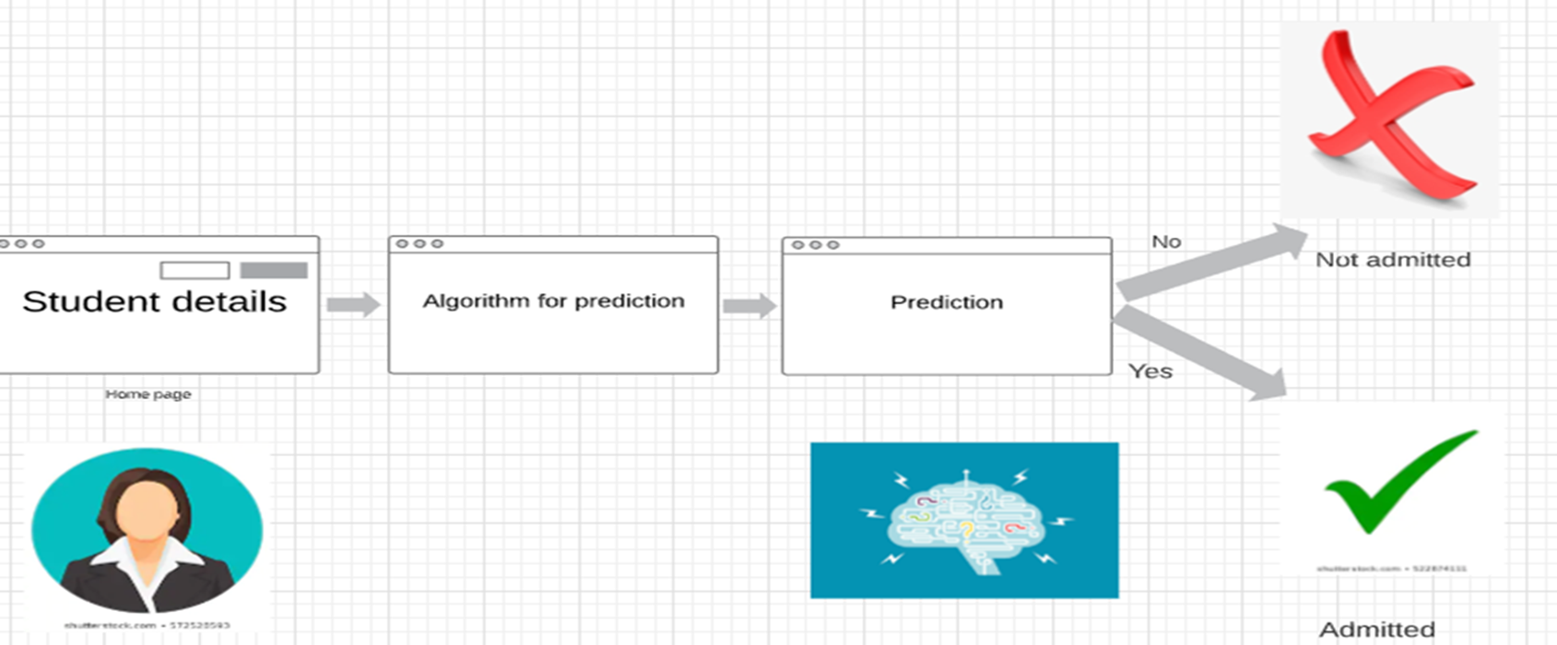
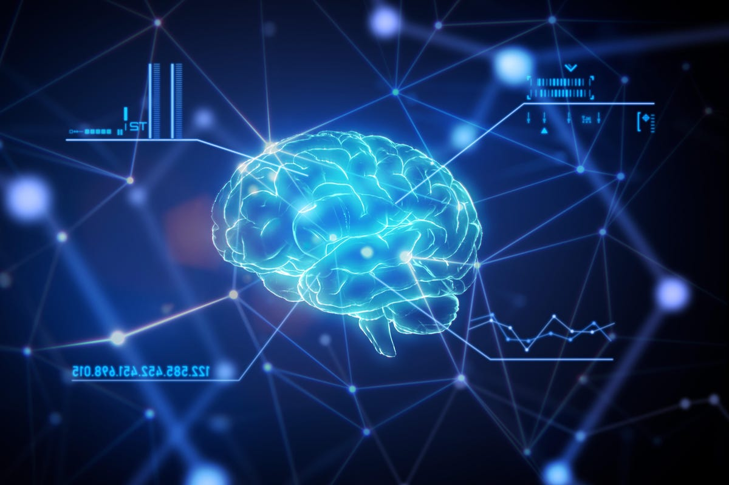
Block Diagram:

Slide 7
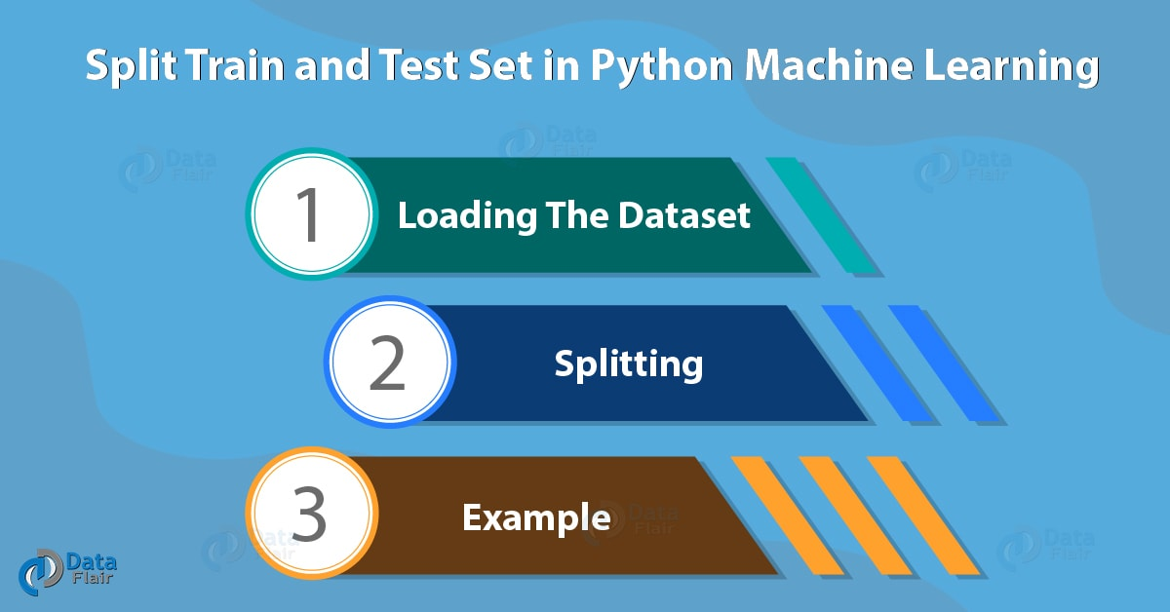
Flow Chart:

Slide 8
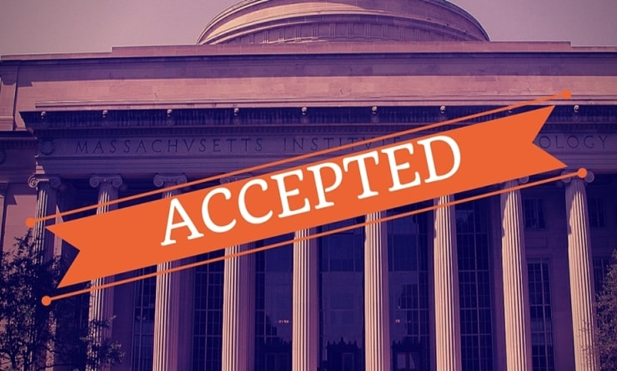
Result and Conclusion:
In this proposed machine learning model with an emphasis on the score obtained by the students it will decide whether the student can get admission or not.
If the chances of admission are more than 50% then it will declare as admitted else not admitted
We have achieved 91.25% accuracy in the regression model.

Slide 9
Thank you…!

