Slide 1


Department of Computer Science and Engineering
CS19621 – PRIEE
SMART CITY: GOVERNMENT SCHEME CHATBOT
Madhulika G 210701139
Mahalakshmi K 210701143
NaveenKumar S
210701175
Dr . K.Ananthajothi
Professor

Slide 2
Abstract
The Government sector provides services to citizens to provide welfare to the people. The services are provided in various forms. One of the services include schemes which are available online through websites. People face difficulties while accessing information about government schemes. The volume of available schemes makes it difficult for individuals to navigate through them effectively and it becomes a time consuming process. Menu based Chat bots integrated with deep learning models provides accurate data in timely manner. They can find the schemes which suits their need by interacting with the menu. The Chat bot saves the time of the user and distractions are avoided while searching the schemes through which the citizens can be benefitted. The Chat bot also provide eligibility and benefit of the particular scheme needed by the citizen in a single click.

Slide 3
Existing System
The existing system provides government schemes through websites. There are many websites which provides information about the scheme which leads to confusion and it becomes a time consuming process for citizens to search for the scheme which suits their needs. Moreover, the traditional methods of searching for schemes often lack user engagement, making it challenging for citizens to interact with the information effectively. As a result, individuals may miss out on valuable opportunities provided by government initiatives simply due to the inefficiency of accessing relevant information in a timely manner. The traditional method of searching is not a streamlined process this leads the user to get distracted while gaining information of a particular scheme.

Slide 4
Proposed System
The proposed system improves the Government scheme website by increasing user engagement and faster access of information through Menu based Chat bot with deep learning model. The proposed solution saves user time and they get to know the eligibility and benefits of the scheme. The system provides knowledge about the schemes so that the citizens can be benefitted by availing the schemes. The user guide in the website helps the user to get familiar with the chat bot. The deep learning model predicts the response that should be provided to the user accurately. The Menu based chat bot is a streamlined process which allows the user to access the information easily. This system does not lead to confusion. To know about other schemes the user can start a new chat.

Slide 5
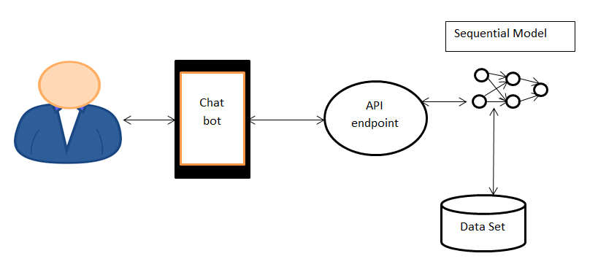
System Architecture

Slide 6
List of Modules
Data Set
Deep Learning Module
User Interface Module
Chat Module

Slide 7
Functional Description of Module
Data Set: The data set plays a vital role in the performance of the system. It is in JSON format. The intent behind every user question is stored in the data set. The intent is here describes about which scheme the user is asking queries. For each scheme there are tag, pattern and responses. Tag uniquely identifies a scheme. Pattern corresponds to the user question. Responses are the information relevant to the particular scheme. The data set contains accurate information of schemes and its eligibility and benefits . This data determines the system efficiency and accuracy. The information from this data set is displayed to the user interface .

Slide 8
Functional Description of Module
Deep Learning Module: Upon collecting the data and organizing it in JSON format. The deep learning model is trained using the data. The patterns are considered as input. The probability of tag is the output of the model. The data was separated and encoded for training the model. The sequential model is defined with dense layer. The model architecture is defined to achieve high accuracy. Once the model is trained, it is saved in an API endpoint where the user query is passed and the response which is the output of the model is returned to the user interface.

Slide 9
Functional Description of Module
User Interface Module: Responsible for managing user interactions. The user clicks the menu and the request is sent to the API endpoint. The user guide helps the user to know how the chat bot works. The user interface is responsible for user engagement.

Slide 10
Functional Description of Module
Chat Module: The Menu based chat bot module is responsible for fetching the scheme detail from the deep learning model by sending request to the endpoint. It displays the information in the interface. The eligibility and benefit of the scheme is also provided by it. Start a new conversation to know about other scheme.

Slide 11
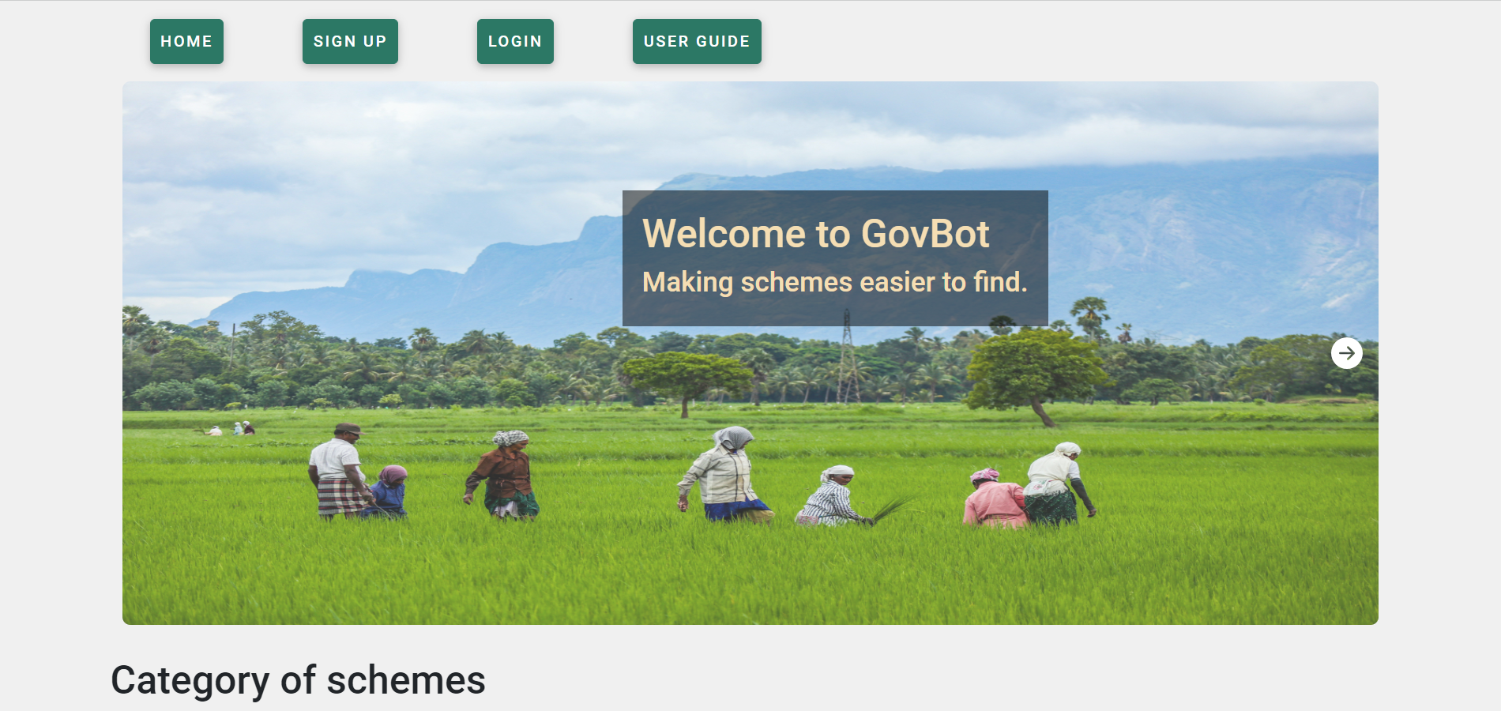
Implementation

Slide 12
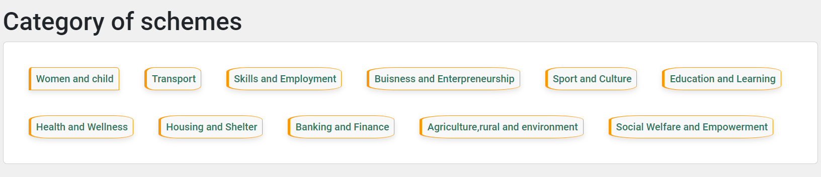
Implementation

Slide 13
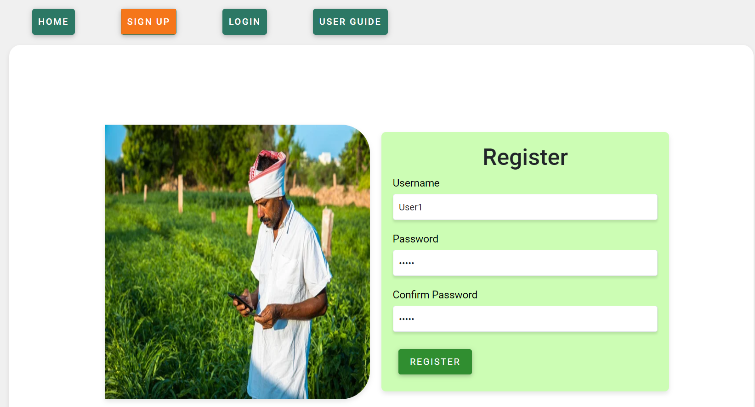
Implementation

Slide 14
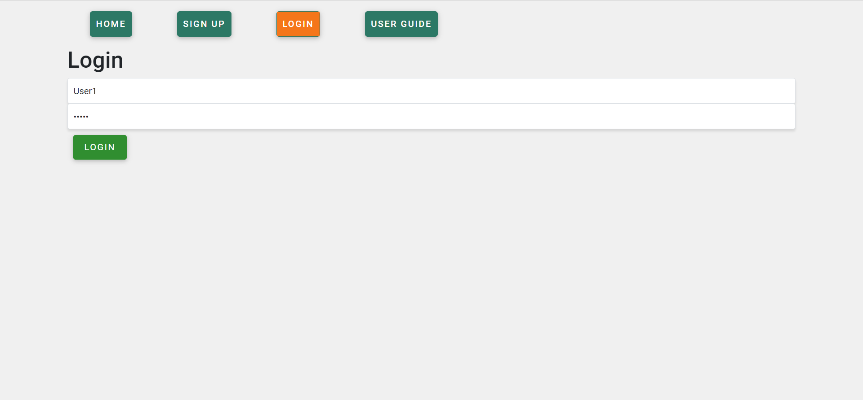
Implementation

Slide 15
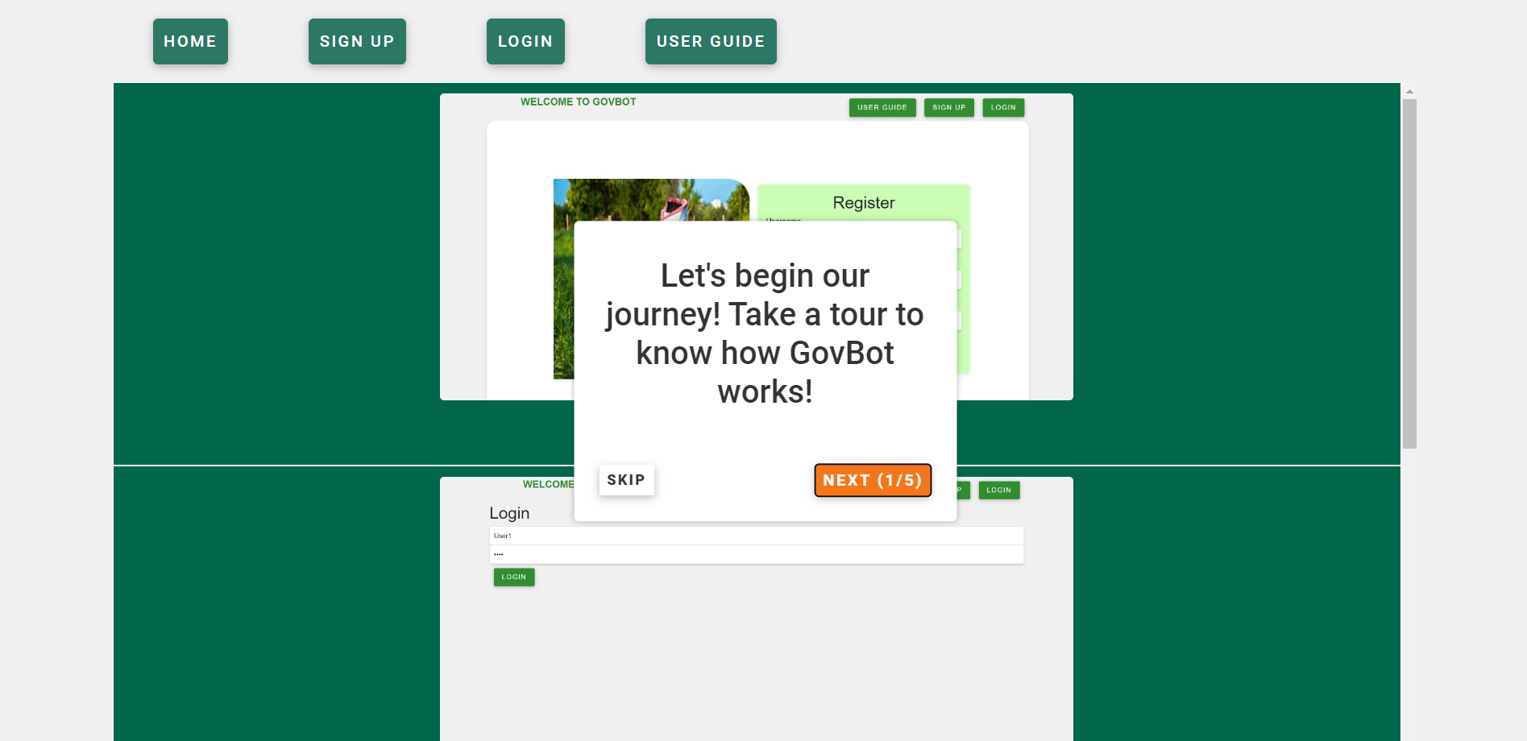
Implementation

Slide 16
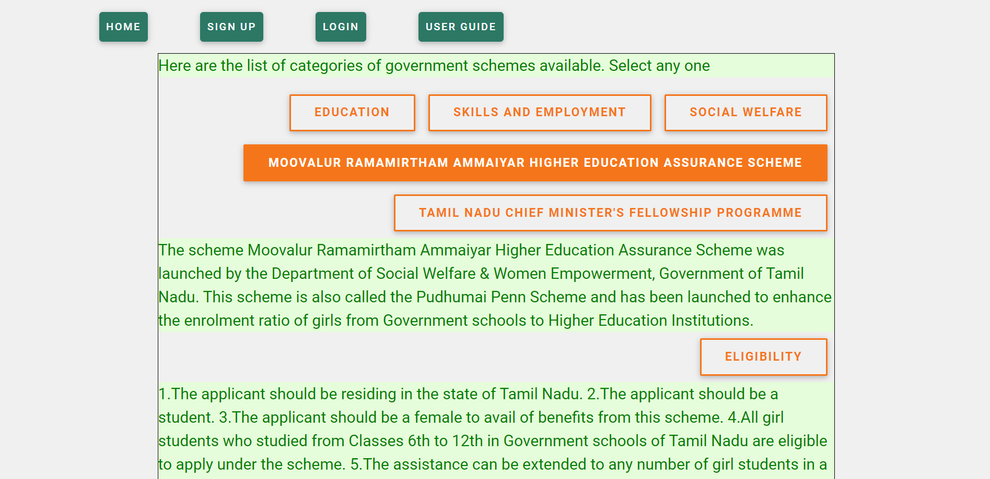
Implementation

Slide 17
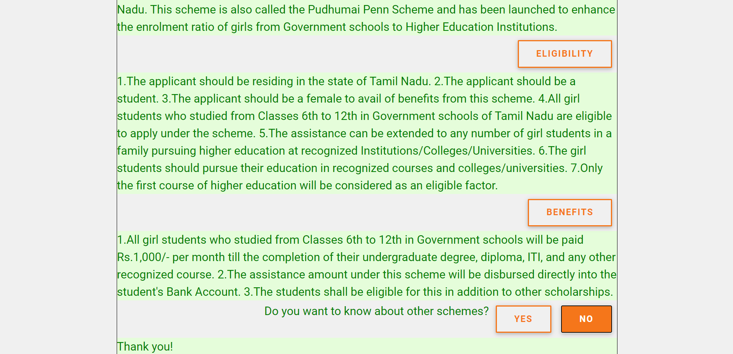
Implementation

Slide 18
Conclusion
In summary, government scheme information chat bot empowers citizens with easy access to relevant programs. This user-friendly web application allows users to explore various government schemes, understand eligibility criteria, and access application procedures. It delivers instant responses to users' queries by eliminating search time. It provides relevant information about the scheme, reducing complexity. It increases user engagement by providing an intuitive interface and engaging conversation. Additionally the chat bot provides dynamic interactions and overcomes the disadvantages of static websites.

Slide 19
References
1) Pardo, T. A., & Dawes, S. S. (2005). Digital Government: Building a Platfom for Transformation. "The Information Society", 21(3), 223-235.
2) Gomez, R., & Galperin, H. (2007). Digital Inclusion: Towards a More Inclusive Information Society. "The Journal of Community Informatics", 3(4).
3) Dann, S. (2013). Towards Inclusive E-Governance: A Literature Review and Framework. "Government Information Quarterly", 30(4), 359-366.
4) Georgiadis, P., & Askounis, D. (2017). Transforming Government Through E-Democracy: The Role of ICTs in Citizen Engagement. "International Journal of Electronic Governance", 9(1), 1-21.

Slide 20
References
5) Wimmer, M. A., & Janssen, M. (2008). Empowering Citizens Through E- Services: A Review of Success Factors. "Government Information Quarterly", 25(2), 487-502.
6) Tunio, M. Z., Pan, Q., & Zhang, X. (2020). Improving Digital Government Services: A Literature Review and Research Agenda. "Government Information Quarterly", 37(4), 101457.
7) Ferro, E., Tavanti, M., & Androniceanu, A. (2018). User-Centered Design for Government Systems: A User Study on Project Management Information Systems. "Government Information Quarterly", 35(1), 39-48.
8) Weerakkody, V., & Mahmood, S. (2012). E-Government Adoption in Developing Countries: A Case Study of E-Government Adoption.

Slide 21
References
9) Zhang, J., Wang, Y., & Feng, Z. (2017). Citizen-Centric E-Government Services: A Case Study of Singapore. "International Journal of Electronic Government Research", 13(3), 1-17.
10) Ankobil, C., Prakash, M., & Vikram, S. (2019). Blockchain Technology in Government: Benefits and Implications of Distributed Ledger Technology for e- Government. "International Journal of Electronic Government Research", 15(1).

Slide 22
Thank You

