Slide 1
Jira Software
Jira Software is a leading project management and issue tracking tool developed by Atlassian.

Slide 2
What is Jira Software?
Bullet Points:
Designed for Agile teams, software development, and project management.
Used to plan, track, and manage work efficiently.
Supports various methodologies, including Scrum and Kanban.

Slide 3
Key Features
List key features with brief explanations:
Task and Issue Tracking: Easily create, assign, and track tasks and issues.
Customizable Workflows: Tailor workflows to match your team's processes.
Dashboards and Reporting: Gain insights with customizable dashboards and reporting tools.
Integration: Seamlessly integrate with other Atlassian products and third-party apps.
Real-time Collaboration: Foster collaboration with real-time updates and notifications.

Slide 4
Benefits of Using Jira Software
Highlight the advantages:
Efficiency: Streamlines project management and work tracking.
Visibility: Provides a real-time view of project progress.
Scalability: Suitable for teams of all sizes and industries.
Customization: Adapt to your team's unique needs.
Data-Driven Decisions: Make informed decisions with data and reporting.

Slide 5
Jira Workflows
Explain the concept of workflows:
Define stages in your process (e.g., To Do, In Progress, In Review, Done).
Visualize and manage work as it progresses through these stages.
Customize workflows to match your team's specific processes.

Slide 6
Use Cases
Provide examples of how Jira Software can be used:
Software Development: Agile project management for software teams.
IT Operations: Incident management, change management, and support ticket tracking.
Marketing: Campaign planning and execution.
HR: Onboarding, employee management, and performance reviews.

Slide 7
Conclusion
Summarize key points:
Jira Software is a powerful project management and issue tracking tool.
It offers customization, real-time collaboration, and integration capabilities.
Suited for various industries and use cases.

Slide 8
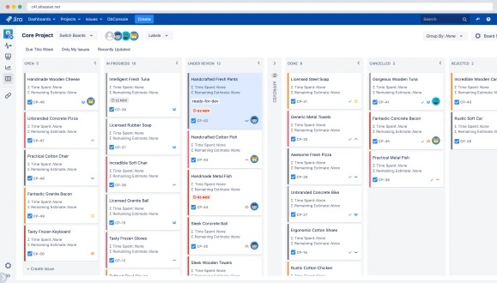

Slide 9
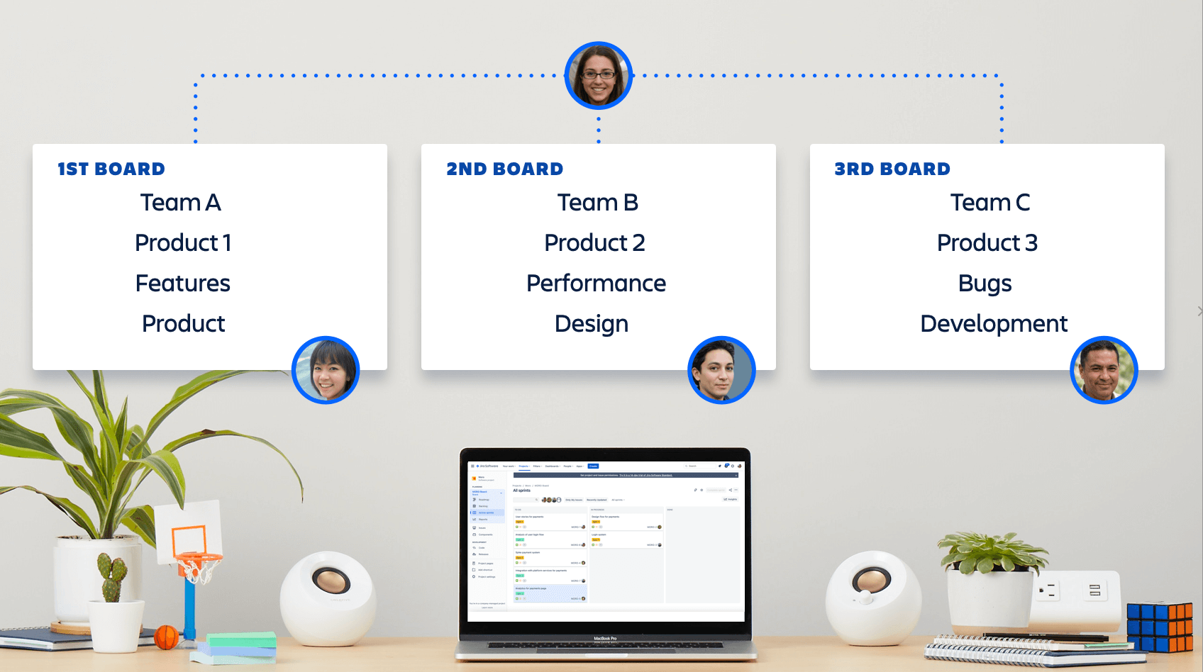

Slide 10
Thank you...

