Slide 1

Python is a rapid application development and prototyping language. So, design patterns can be a very powerful tool in the hands of a Python programmer

Slide 2
Design pattern ?
Design patterns are typical solutions to common problems in software design. Each pattern is like a blueprint that you can customize to solve a particular design problem in your code
A design pattern systematically names, motivates, and explains a general design that addresses a recurring design problem in object-oriented systems.
It describes the problem, the solution, when to apply the solution, and its consequences.
In software engineering, a software design pattern is a general, reusable solution to a commonly occurring problem within a given context in software design.

Slide 3
Benefits of using design pattern
Patterns provide developer a selection of tried and tested solutions for the specified problems.
All design patterns are language neutral.
Patterns help to achieve communication and maintain well documentation.
It includes a record of accomplishment to reduce technical risk to the project.
Design patterns are highly flexible & customize to use and easy to understand.

Slide 4
Common misunderstandings about design patterns
1. Design patterns should be used right from the start when writing code.
[Design patterns are discovered as better solutions over existing solutions. If you have no existing solution, it doesn't make sense to look for a better one]
2. Design patterns should be used everywhere.
[This results in creating complex solutions with unnecessary interfaces and hierarchies, where a simpler and straightforward solution would be sufficient & efficient]
The point is do not limit your creativity in favor of forcing yourself to use existing design patterns.
Do not treat design patterns as a panacea because they are not. They must be used only if there is proof that your existing code "smells", and is hard to extend and maintain.
Try thinking in terms of
You Aren’t Gonna Need It (YAGNI) &
Keep It Simple Stupid (KISS).
- Using design patterns everywhere is as evil process and premature optimization.

Slide 5
Classification of patterns
The most basic and low-level patterns are often called idioms. They usually apply only to a single programming language.
The most universal and high-level patterns are architectural patterns. Developers can implement these patterns in virtually any language.
All patterns can be categorized by their intent, or purpose.
Three main groups of patterns:
Creational patterns
They describe how best an object can be created.
This increase flexibility and reuse of existing code.
Structural patterns
They describe how best objects and classes can work together to achieve larger results.
This keeping the structures flexible and efficient.
Behavioral patterns
They describe how best interaction between objects.

Slide 6
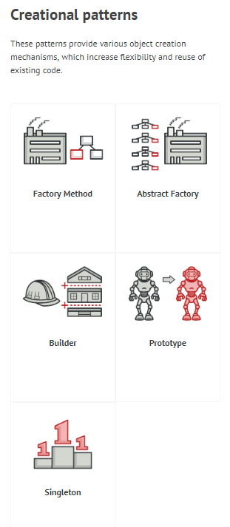

Slide 7
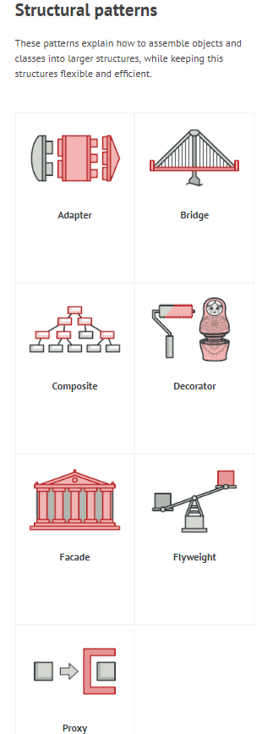

Slide 8
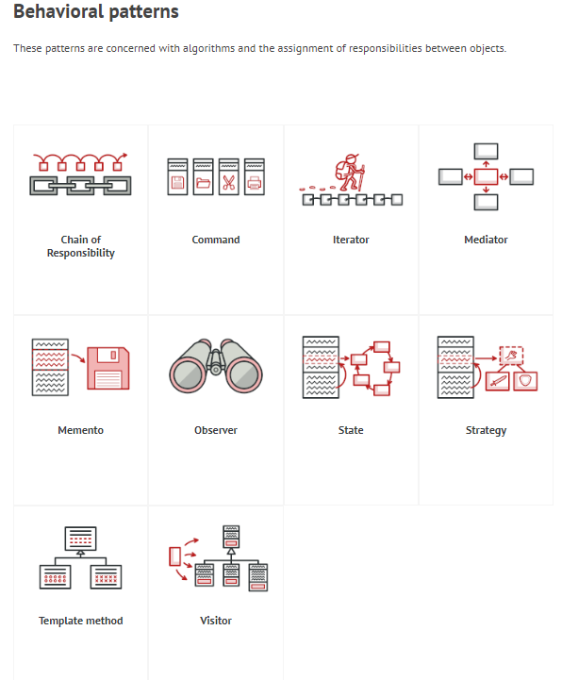

Slide 9
We will try to cover following 7 design patterns
DP#1 – Model-View-Controller Pattern
DP#2 – Command Pattern
DP#3 – Observer Pattern
DP#4 – Facade Pattern
DP#5 – Mediator Pattern
DP#6 - Factory Pattern
DP#7 - Proxy Pattern

Slide 10
DP#1: The Model-View-Controller Pattern
Model–View–Controller (MVC), considered an architectural pattern.
In MVC Design Pattern, the application is divided into three interacting categories known as the Model, the View and the Controller.
The pattern aims at separating out the inputs to the application (the Controller part), the business processing logic (the Model part) and the output format logic (the View part).
The pattern isolates “domain logic” (the application logic for the user) from input and presentation (GUI), permitting independent development, testing and maintenance of each.”

Slide 11
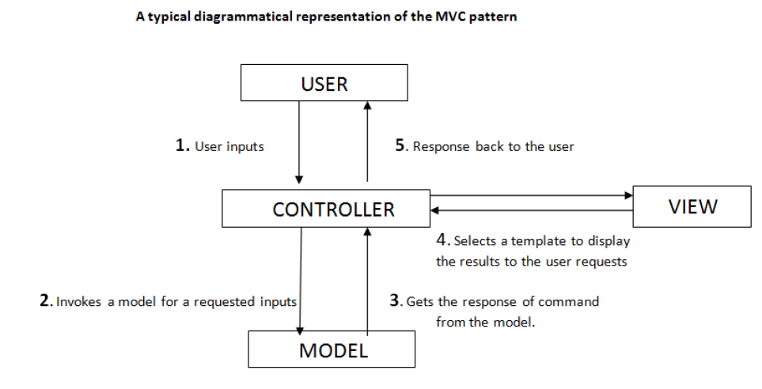

Slide 12
Controller can be considered as a entry point & middle man between user and processing (Model) & formatting (View) logic.
Model represents the business processing logic of the application.
is responsible for displaying the results obtained by the controller from the model component in a way that user wants them to see or a pre-determined format.

Slide 13
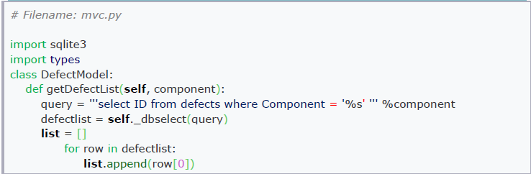
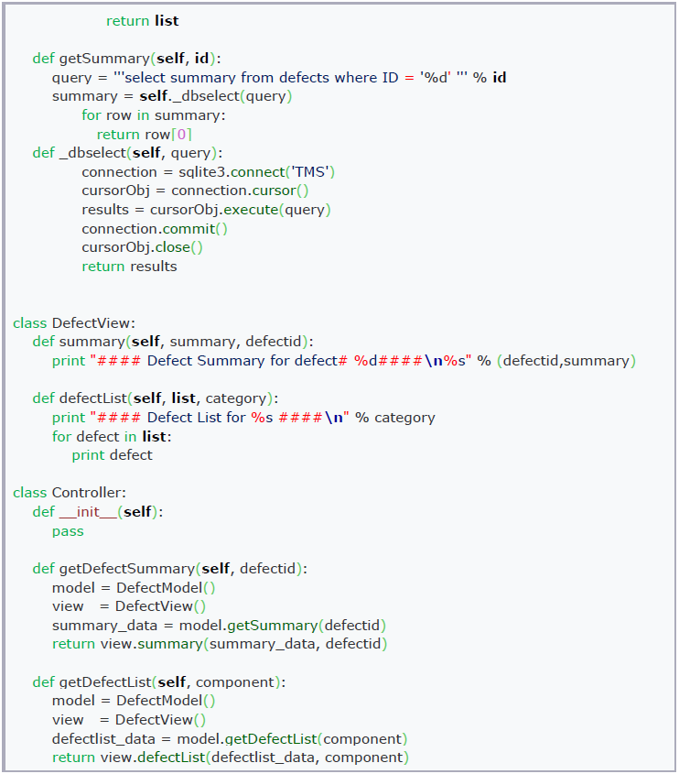
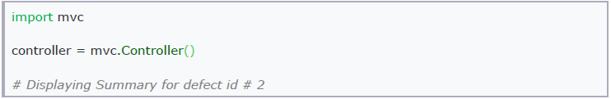
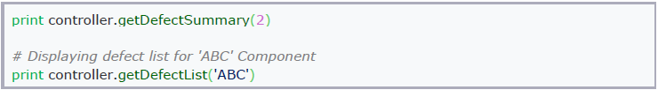

Slide 14
DP#2: The Command Pattern
Command pattern is categorized under ‘Observer‘ design pattern.
The command pattern is a design pattern in which an object is used to represent and encapsulate all the information needed to call a method at a later time or at the point of time.
In command pattern the object is encapsulated in the form of a command, i.e., the object contains all the information that is useful to invoke a method anytime user needs.
Thus command pattern gives the client (or the user) to use the interface without the information of the actual actions being performed, without affecting the client program.

Slide 15
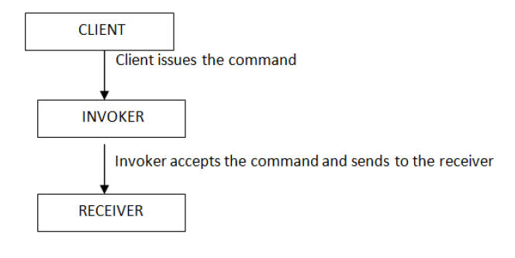
The key to implementing this pattern is that
Invoker object should be kept away from specifics of what exactly happens when its methods are executed.
Invoker object can be used to send commands to objects with similar interfaces.
Command Pattern is associated with three components, the client, the invoker, and the receiver. Let‘s take a look at all the three components.
Client: the Client represents the one that instantiates the encapsulated object.
Invoker: the invoker is responsible for deciding when the method is to be invoked or called.
Receiver: the receiver is that part of the code that contains the instructions to execute when a corresponding command is given.

Slide 16
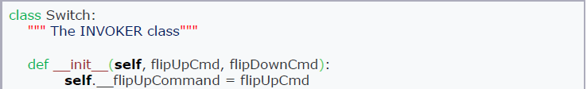
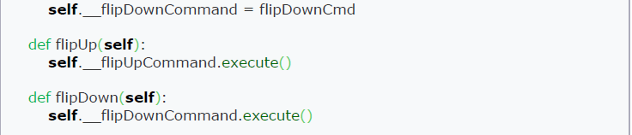
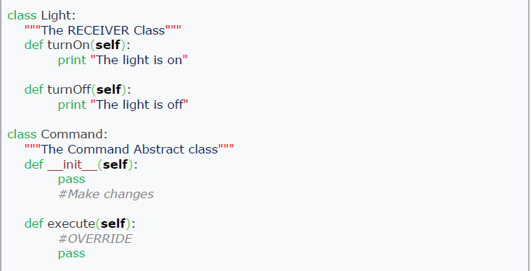
- It's the implementation of a switch - It could be used to switch on/off - It should't be hard-coded to switch on/off a particular thing (a lamp or an engine)

Slide 17
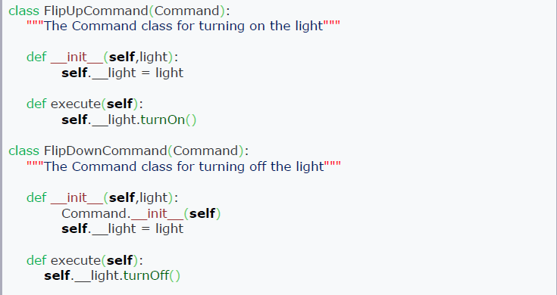

Slide 18
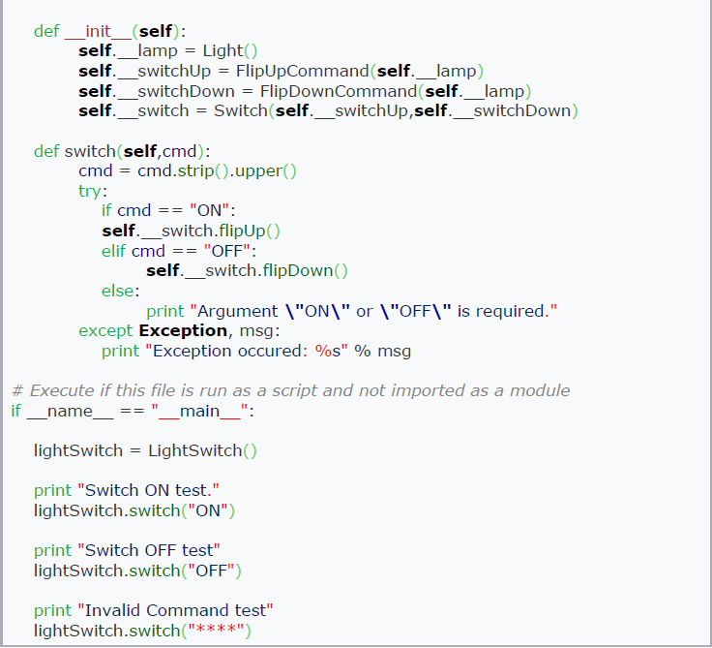

Slide 19
DP#3: Observer Pattern
The observer pattern (a subset of the publish/subscribe pattern) is a software design pattern in which an object, called the subject, maintains a list of its dependants, called observers, and notifies them automatically of any state changes, usually by calling one of their methods.
It is mainly used to implement distributed event handling systems.

Slide 20
Typically in the Observer Pattern, we would have:
1. Publisher class that would contain methods for:
▪ Registering other objects which would like to receive notifications
▪ Notifying any changes that occur in the main object to the registered objects (via registered object's method)
▪ Unregistering objects that do not want to receive any further notifications
2. Subscriber Class that would contain:
▪ A method that is used by the Publisher Class, to notify the objects registered with it, of any change that occurs.
3. An event that triggers a state change that leads the Publisher to call its notification method
To summarize, Subscriber objects can register and unregister with the Publisher object. So whenever an event, that drives the Publisher's notification method, occurs, the Publisher notifies the Subscriber objects. The notifications would only be passed to the objects that are registered with the Subject at the time of occurrence of the event.

Slide 21
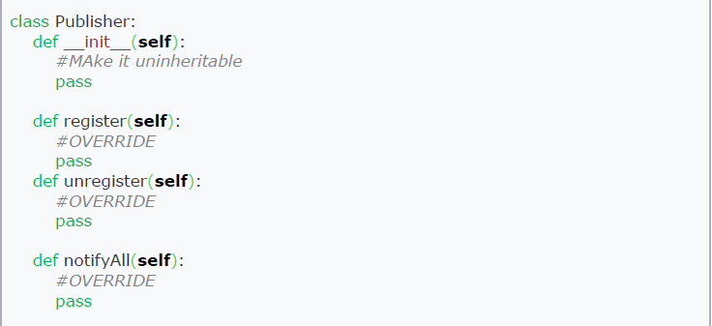

Slide 22
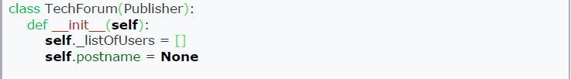
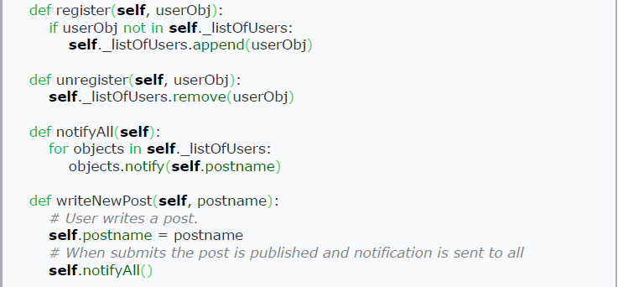

Slide 23
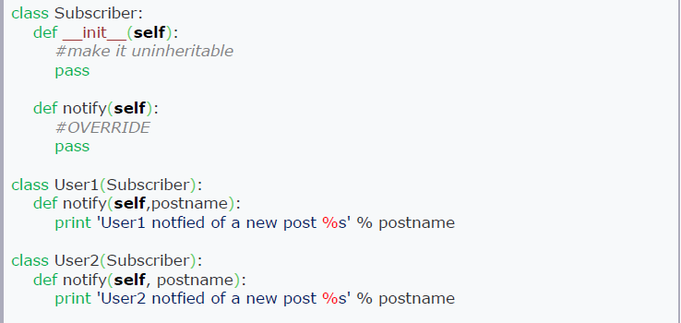

Slide 24
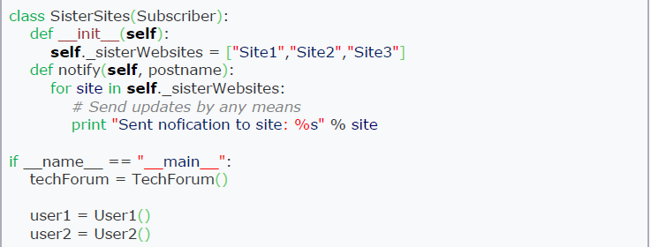
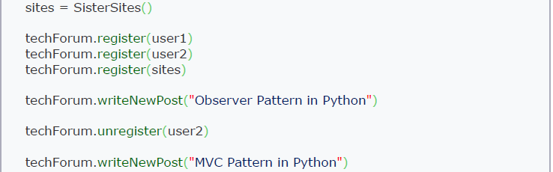

Slide 25
DP#4: Facade design pattern
A facade is an object that provides a simplified interface to a larger body of code, such as a class library.
Façade pattern falls under the hood of Structural Design Patterns.
Façade hides the inside details and complexities of a system and provides a simplified ― interface to the client.
Facade pattern provides a simplified interface to a part of the system, thereby providing ease-of-use for a sub-set of the functionality rather than complete functionality.
Facade pattern is not about ―encapsulating the sub-system, rather about providing a simplified interface for a chosen functionality.

Slide 26
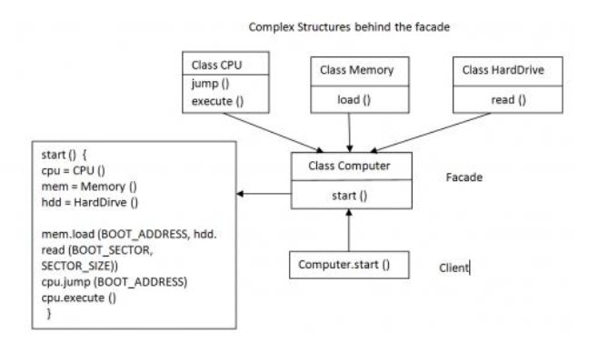

Slide 27
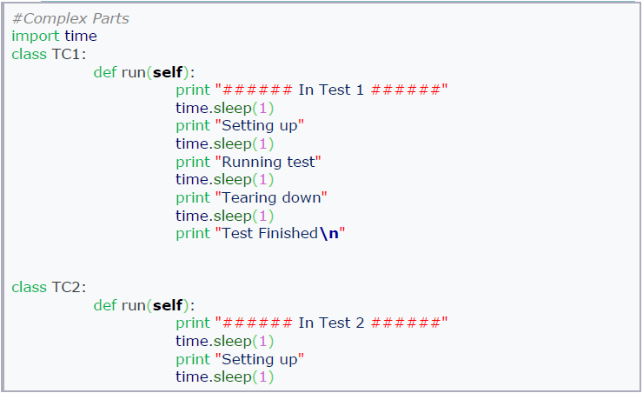
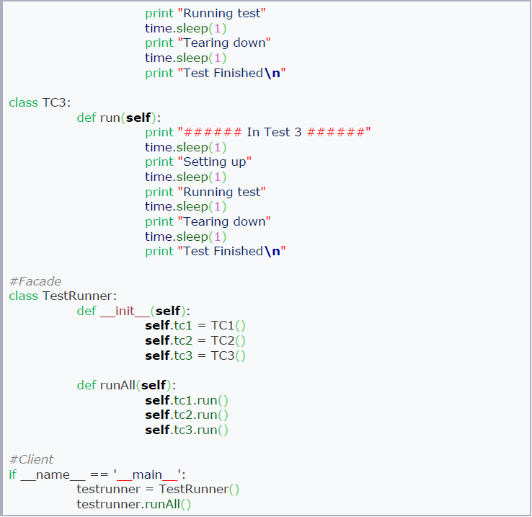

Slide 28
DP#5: Mediator design pattern
The mediator pattern provides a unified interface to a set of interfaces in a subsystem.
This pattern is considered to be a behavioral pattern due to the way it can alter the program's running behavior.
Mediator pattern is used in cases where many classes start communicating amongst each other to produce result.[Problem statement]
Mediator pattern comes in as a solution to this problem by allowing loose-coupling between the classes, also called as Colleagues in the Mediator Design Pattern.
The idea is that there would be one Mediator class that is aware of the functionality of all the classes in the system. The classes are aware of their functionality and interact with the Mediator class. Whenever there is a need of interaction between the classes, a class sends information to the Mediator and it is the responsibility of the Mediator to pass this information to the required class. Thus the complexity occurring because of interaction between the classes gets reduced.

Slide 29
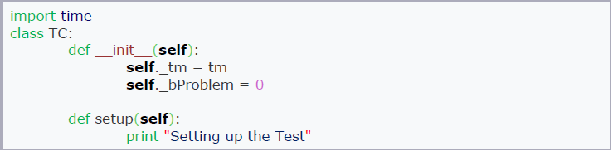
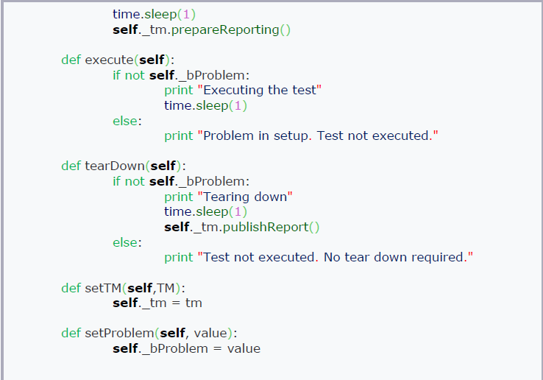
Building the analogy with the Mediator pattern, the TestManager class is a Mediator between Class TC, Class Reporter and Class DB, the Colleagues in the system.

Slide 30
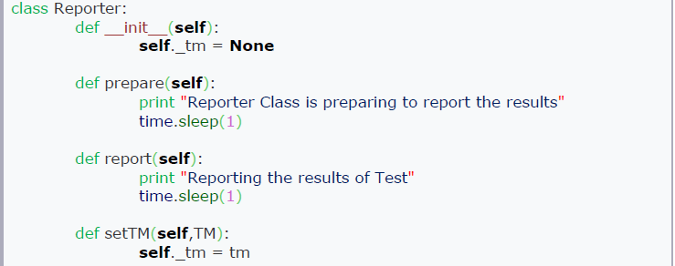
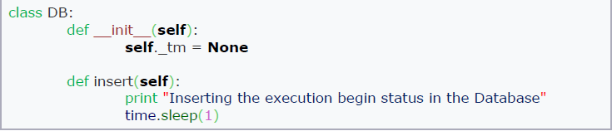
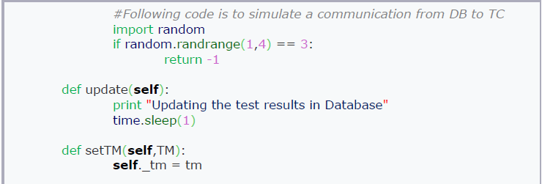

Slide 31
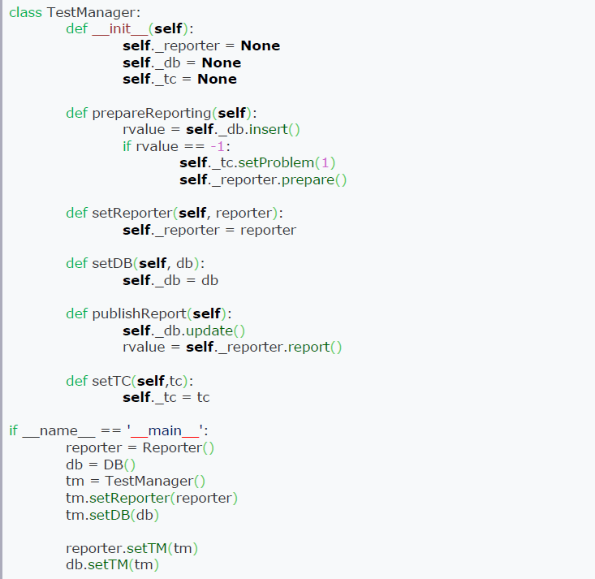
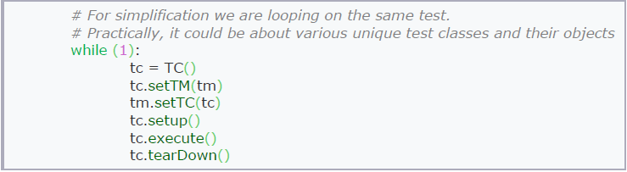

Slide 32
DP#6: Factory design pattern
The factory pattern is used in to encapsulate the processes involved in the creation of objects.
The factory pattern is a creational design pattern.
Factory pattern involves creating a super class which provides an abstract interface to create objects of a particular type, but instead of taking a decision on which objects get created it defers this creation decision to its subclasses.
Factory pattern is used in cases, when, based on a ―type‖ got as an input at run-time, the corresponding object has to be created.
Implementing code based on Factory pattern can result in scalable and maintainable code i.e. to add a new type, one need not modify existing classes; it involves just addition of new subclasses that correspond to this new type.

Slide 33
In short, use Factory pattern when:
A class does not know what kind of object it must create on a user‘s request.
You want to build an extensible association between this creator class and classes corresponding to objects that it is supposed to create.

Slide 34
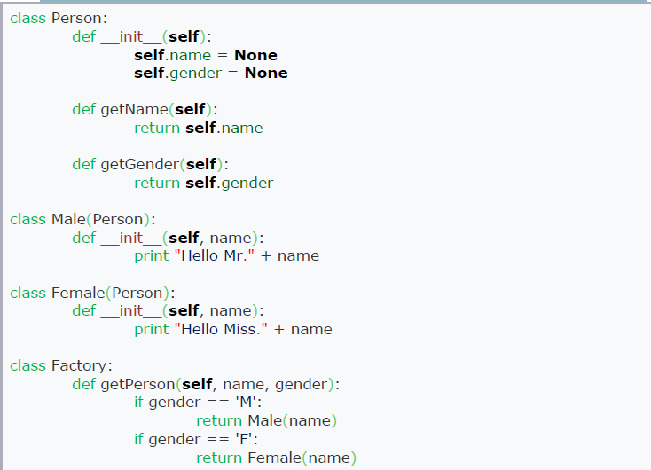


Slide 35
https://refactoring.guru/design-patterns https://sourcemaking.com/design_patterns
Design Patterns – Elements of Resuable Object-Oriented Software – the GoF book (Pearson Publication) Erich Gamma, Richard Helm, Ralph Johnson and John Vlissides
Head First Design Patterns – Oreilly Publication Eric Freeman and Elisabeth Freeman with Kathey Sierra and Bert Bates
Automated Software Testing – Addison-Wesley Elfriede Dustin, Jeff Rashka and John Paul

