Slide 1
Analysis on Cereals
Presented by-
Naveen Mechu

Slide 2
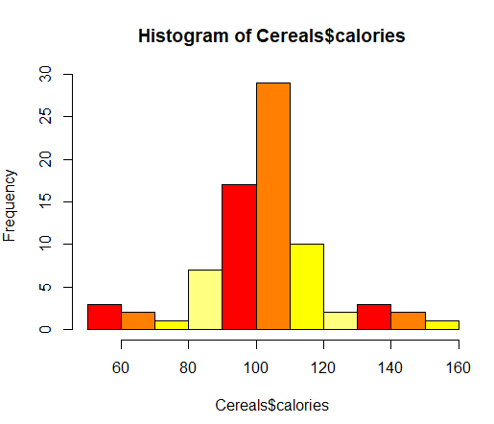
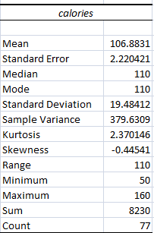
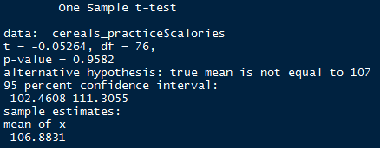
Analysis of Calories
1.As per Evidence thrown by sample we are 95% confident that Avg.calorie produced by
these cereals lie between 102.47 (102)and 111.29(112) per serving.
2.Graph indicates symmetric(No skewness) and Mesokurtic distribution of data.
3.Hypothesis testing indicates Average calories produced by cereals is 107 per serving

Slide 3
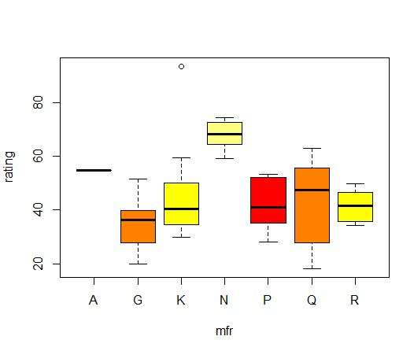
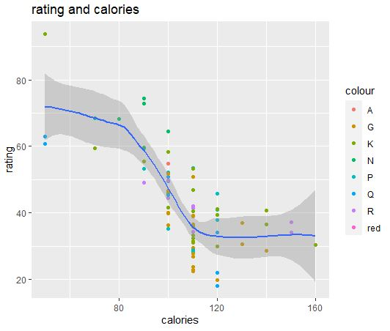
(B)
Plot Analysis of Cereals
(A)
(A) represents manufacturer wise rating, its clear from boxplot i.e rating of manufacturer “N” is above average.
(B) shows there is –ve correlation between Calories and rating.

Slide 4
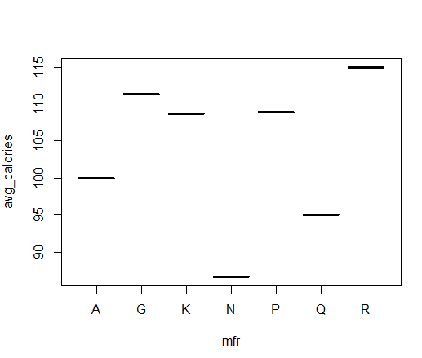
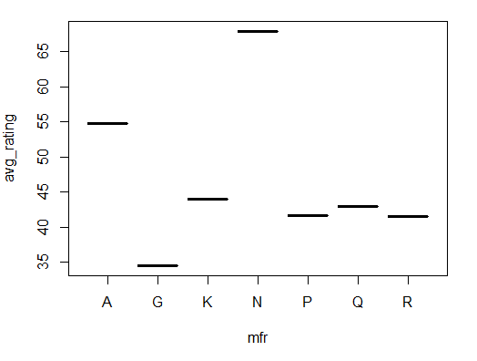
Variation of calories and rating
Above plots represents manufacturer wise average rating and average calories, And conclusions with these plots are-
Manufacturer “N” has highest average ratings whereas averages calories is lowest.
Manufacturer “G” has lowest average ratings whereas averages calories is above average.
It can be concluded that product of manufacturer “A” has good average ratings as well as good amount of average calories.

Slide 5
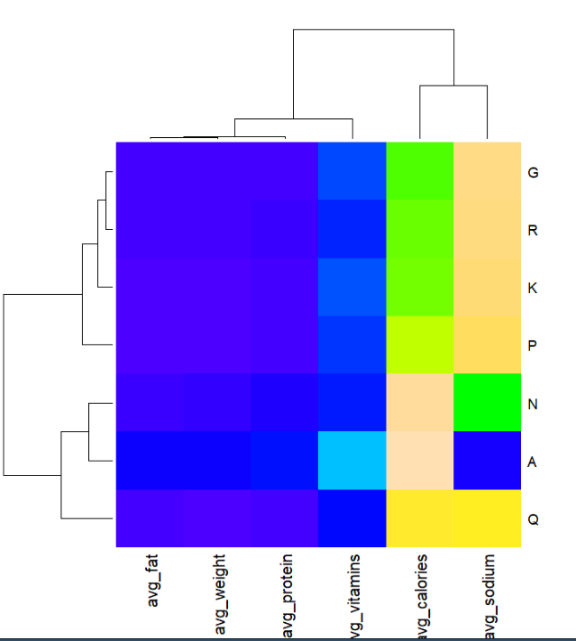
Heatmap (Manufacturer-wise)

Slide 6
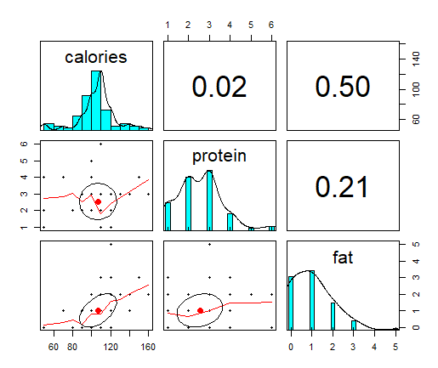
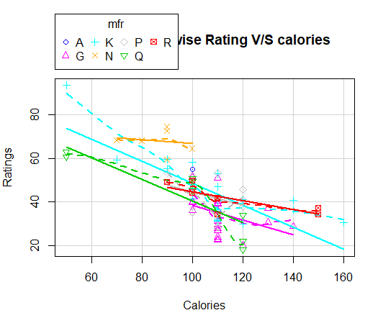
Correlation
Panel plot shows correlation among calories, protein and fat.
Manufacturer wise Scatterplot of Rating and Calories shows ratings of manufacturer “N” is consistent and above 60

Slide 7
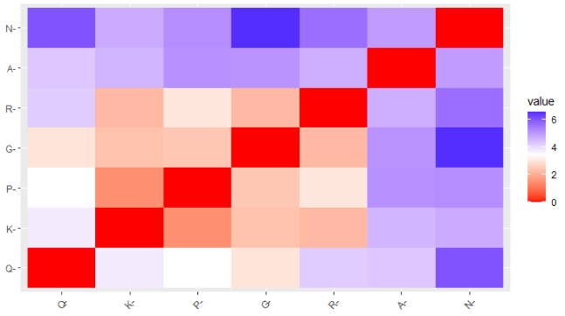
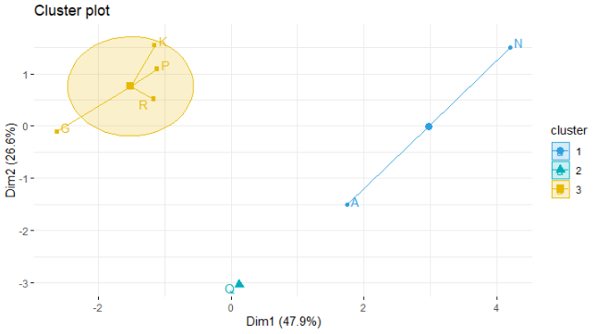
Clustering
Cluster plot represent how
Manufacturer are distinct/similar
Manufacturer wise Cluster plot shows
Similarities between Manufacturer

Slide 8
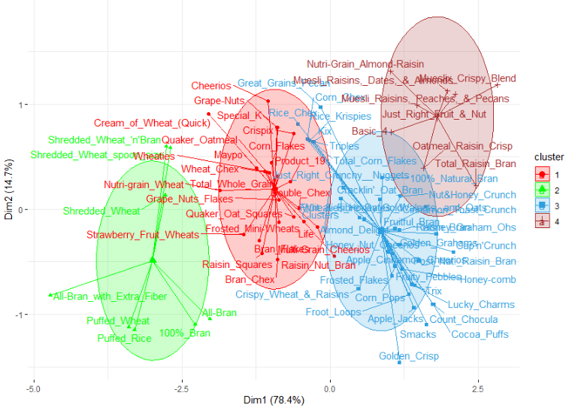
Cluster Analysis of Cereals

Slide 9

Word Cloud Calories

Slide 10
Thank You
Enjoyed Learning

