Slide 1
Recommender system based on Psychographics similarity
Arokia Naveen.S (911716104003)
Chandra Manikandan.S (911716104007)
Logeshwaran.A (911716104026)
Santhosh kumar.B (911716104050)
Guide: Rohini.P AP/CSE

Slide 2
Agenda
INTRODUCTION
EXISTING SYSTEM
PROPOSED SYSTEM
LITERATURE SURVEY
ARCHITECTURE DIAGRAM
MODULES DESCRIPTION
EXPERIMENTAL RESULTS
CONCLUSION
REFERENCE

Slide 3
Abstract:
A recommender system has a job to predict the user preference by analyzing the past and current knowledge about the user.
The existing data-driven methodologies are highly dependent on a huge amount of past data.
Here we used Psychographics market segmentation Approach to build recommendation engine by finding the similarity score between the products

Slide 4
Introduction
Recommender system is used for estimating users’ preferences and group the similar items they have not seen
It predicts the rating and rank of the product to the users
Types: 1) Content Based Recommendation (focused in Items Objects)
2) Collaborative filtering Recommendation (focused in relations)

Slide 5
Problems of Existing system
It works well, when it have a enough data to predict
Lack of information produce Cold start situation
Cold start happens when new users or new items arrive in to the system

Slide 6
Proposed system
Psychographics Market segmentation techniques along with ,Demographics Cognitive Attributes Collection, and Item to Item based collaborative filtering, makes the efficient recommendation system

Slide 7
Literature Survey
Title | Advantages | Disadvantages
Content-based filtering for recommendation systems using multi attribute networks -JieunSon, Seoung BumKim -2017 | Reliable results when fewer number of users and product | 1.Requires a lot of domain knowledge 2.Model has limited ability to expand
Collaborative Filtering Recommendation Algorithm Based on Knowledge Graph - Ruihui Mu , Xiaoqin Zeng1 (2018) | Obtain the similarity model by using filtering the similar items, and grouping in together | 1.Fully depends on user ratings and available data 2.Cold start

Slide 8
Literature Survey
Title | Advantages | Disadvantages
A Collaborative Recommendation System for Online Courses Recommendations-Raghad Obeidat ; Rehab Duwairi ; Ahmad Al-Aiad | recommends courses based on similarities of students' course history. The system employs data mining techniques to discover patterns | 1.user’s past history and engagement score has been required 2.hard to scale
Recommendation System Using Semi-Supervised Learning-Sushmita Roy ; Mahendra Sharma ; Santosh Kumar Singh | Recommendation by using machine learning algorithms such as a content-based filtering approach, a collaborative-based filtering approach. | 1 High computation required 2.Cold start problem,

Slide 9
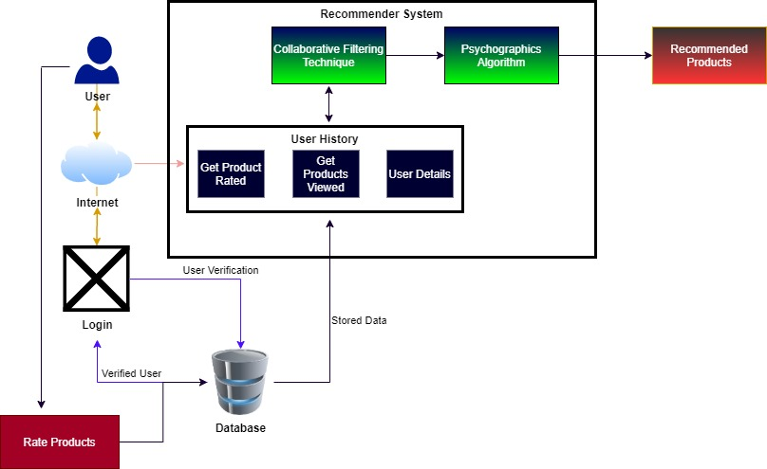
Architecture diagram

Slide 10
Modules
Obtain and Optimize the dataset
Find the similarity matrix
Stored in reliable database
Recommend that item to user
Feedback

Slide 12
Calculate similarity
Psychographics market segmentation
Mainly focused on divides consumers into subgroups based on shared psychological characteristics
Item to item based collaborative filtering
similarity between items calculated using the rating users have given to items

Slide 13
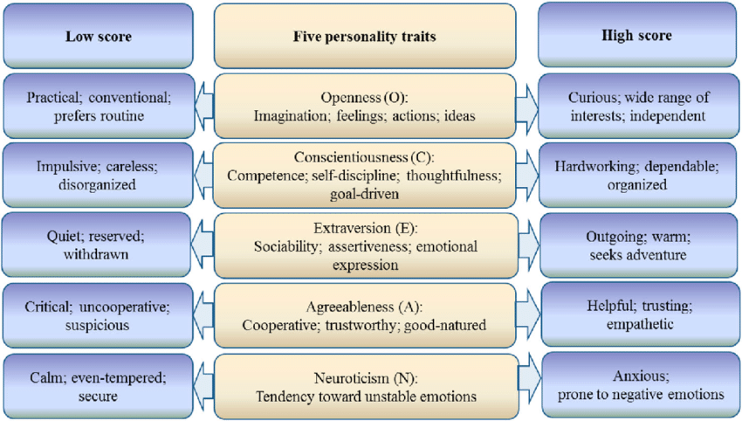
Big Five personality traits -Psychographics
Openness
Consciousness
Extraversion
Agreeableness
Neuroticism

Slide 14
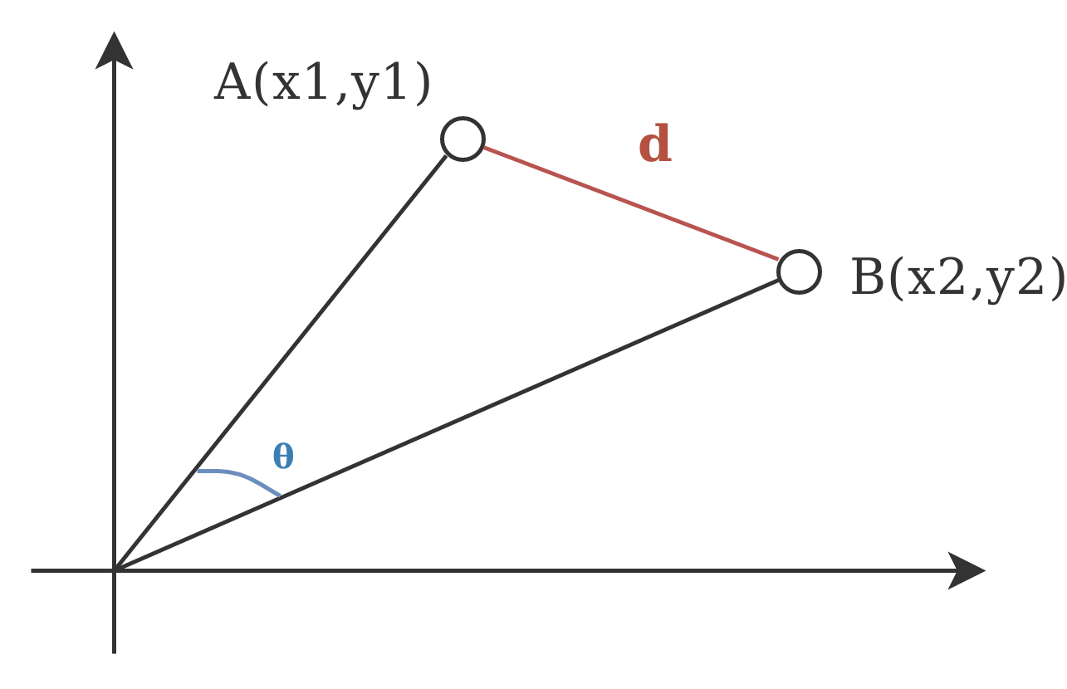
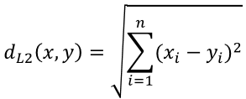
Psychographics Score Calculation
Compare the similarity, against to another product by using euclidean distance and take a mean value
x = Product A vector
Y = Product B vector
D = Distance

Slide 15
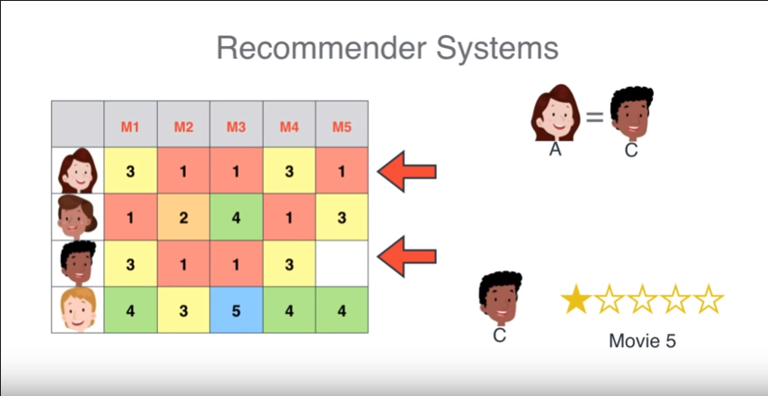
Collaborative filtering Recommendation
The key idea behind CF is that similar users share the same interest and that similar items are liked by a user

Slide 16
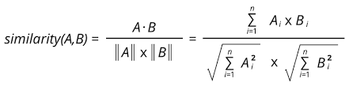
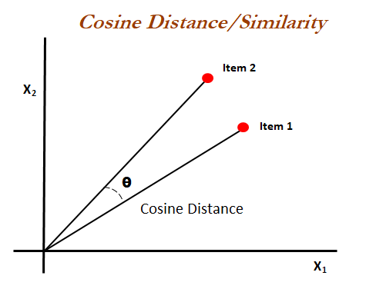
Score calculation in Collaborative filtering
Find the similarity between the items by using method like cosine similarity in two vectors
A = Product A vector
B = Product B vector

Slide 17
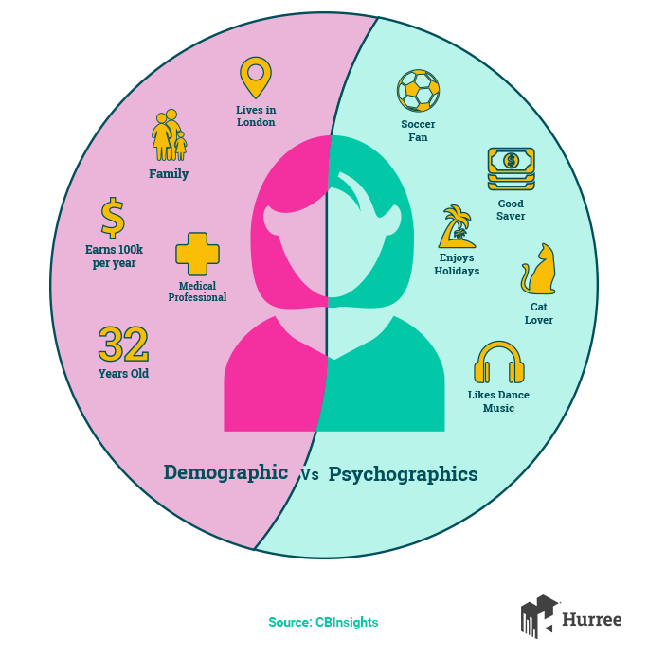
Combining with demographics
It includes: Age, race, ethnicity, gender, marital status, income, education, and employment.

Slide 18
Implementation
Psychographic dataset for the product was obtained from the series of Brainstorming session in each Cognitive attribute
Collaborative filtering was achieved by collection ratings
Application follows Microservice Architecture

Slide 19
Feedback
The feedback of recommendation has been collected and analyse the accuracy rate
It is responsible to tell performance of recommendation system
Its gives a opportunity to upgrade or recalculate the scores

Slide 20
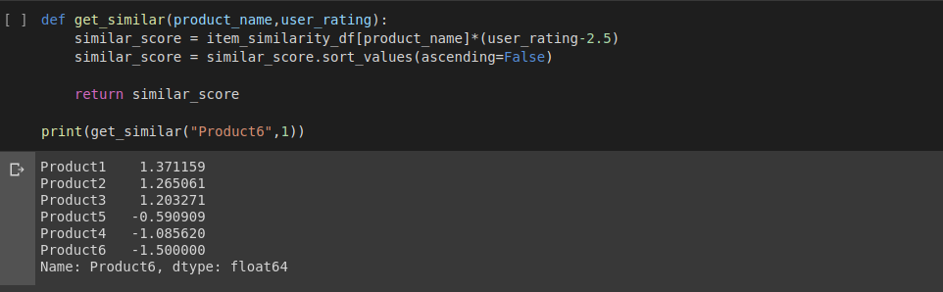
Output
Collaborative approach

Slide 21
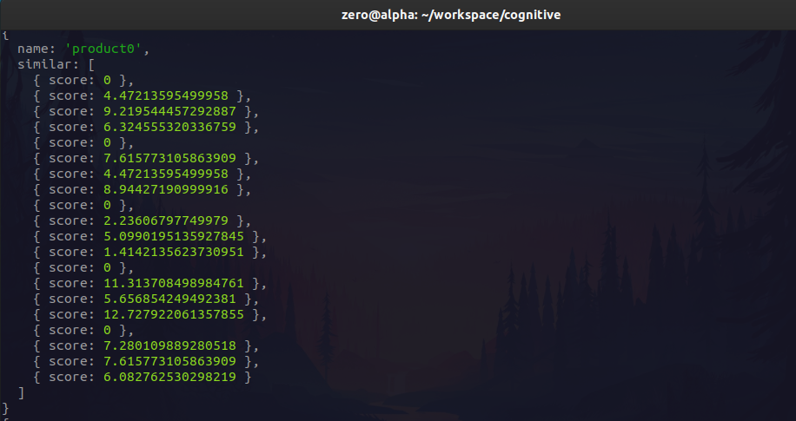
Psychographics score calculation

Slide 22
Conclusion
This System can provide a efficient recommendation with minimal computation requirement
Ability to scale and compatible to emerging application needs

Slide 23
Applications
Well suitable for efficient product matching and filtering
Deliver the results in the form of REST
Profound Decision making strategies by answering the question what? Why?

Slide 24
Further Enhancement
We are looking forward to implement that approach in neural networks to build a psychographic models on live
Implement the OSINT (Open source Intelligence) capabilities

Slide 25
References
Collaborative Filtering Recommendation Algorithm Based on Knowledge Graph - Xiaoqin Zeng , Ruihui Mu -College of computer information hohai university nanjing -April 2018
A Comparative Study of Psychographic Segmentation Hui Liu 1,† , Yinghui Huang 1,2,† , Zichao Wang 3 , Kai Liu, Xiangen Hu , and Weijun Wang -Key Laboratory of Adolescent Cyberpsychology and Behavior, Ministry of Education,Central China Normal University, Wuhan - March 2019
Augmenting E-Commerce Product Recommendations by Analyzing Customer Personality - Anwesh Marwade, Nakul Kumar, Shubham Mundada, and Jagannath Aghav 2019
Recommendation systems: Principles, methods and evaluation (https://www.sciencedirect.com/science/article/pii/S1110866515000341)

Slide 26
Attribute-Aware Recommender System Based on Collaborative Filtering: Survey and Classification Front. Big Data, 15 January 2020https://www.frontiersin.org/articles/10.3389/fdata.2019.00049/full
A Hybrid Recommender System Based on User-Recommender Interaction Heng-Ru Zhang,1 Fan Min ,1 Xu He,1,2 and Yuan-Yuan Xu1 https://www.hindawi.com/journals/mpe/2015/145636/
Recommender systems in social networks https://www.scielo.br/scielo.php?pid=S1807-17752011000300009&script=sci_arttext&tlng=en

Slide 27
Thank You

